Slide 1
Climate Forecasting Using Physics Informed Neural Networks
Good Dynamics

Slide 2
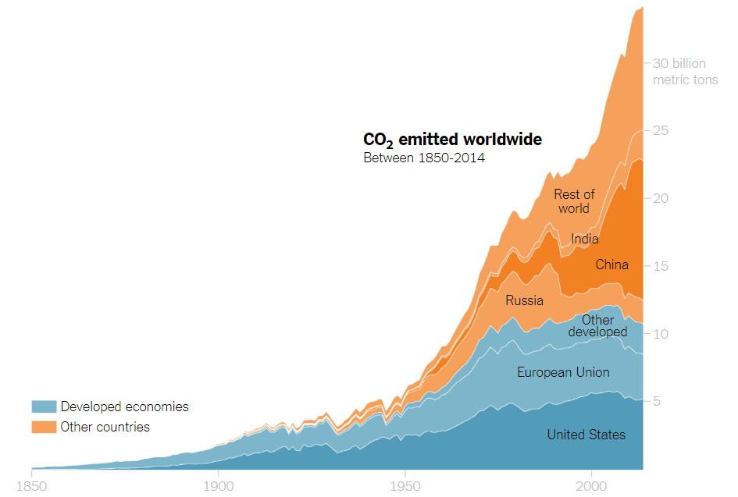
Project goal
Use Physics Informed Neural Networks to model the set of coupled differential equations that govern the patterns of Earth’s temperature, Ice coverage, and CO2 based on the data acquired during the last half-century
Using the the data recovered from our ML model make predictions about near future

Slide 3
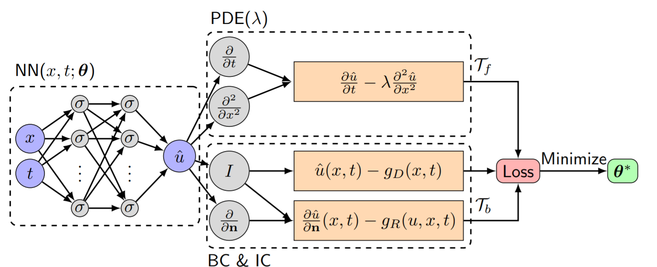
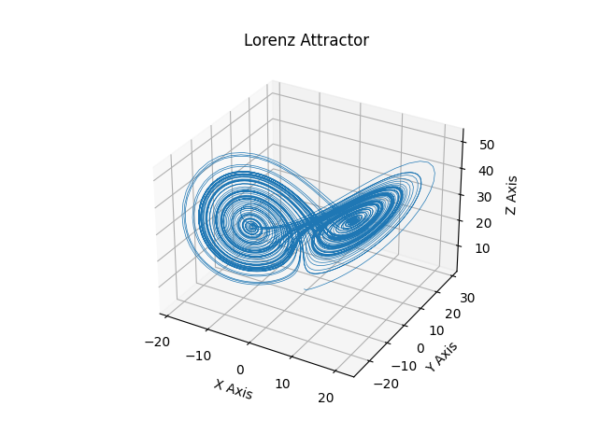

DeepXDE (2020)
New library for finding differential equations for dynamical systems using Physics Informed Neural Networks (PINNs)

Slide 4
Initial idea
We initially intended to create a set of coupled differential equations based on 6 different parameters. 3 of those were rejected. The rejected parameters were cloud coverage, ocean’s mean temperature, and annual average precipitation.

Slide 5
Why the 3 variables were rejected
Cloud coverage was almost constant with only a variability of 2.5%. Similarly average precipitation was almost constant with only 0.3% variability.
Ocean mean temperature measurements were found to be coupled with ambient temperature so to avoid redundancy we avoid including it.

Slide 6

Temperature Model
We chose the following model for the change in Earth’s temperature:
C is the average heat capacity of the Earth.

Slide 7
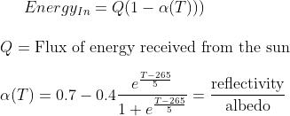
Temperature Model
We chose the following model for incoming energy:
Albedo 𝛼(T) was assumed to be constant since temperature only changed 1.2K throughout the past 50 years.

Slide 8
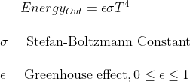
Temperature Model
We chose the following model for outgoing energy:
𝜺 is a measure of how much energy is captured by the atmosphere, causing energy to remain.
For our initial simulation, we used 𝜺=0.61.

Slide 9
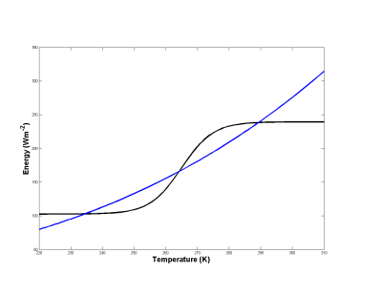

Initial Findings
There are 2 stable equilibria in this system at 233 K and 288 K.
There is 1 unstable equilibrium in this system at 265 K.
At 233 K, 𝛂(T) ≅ 0.7, suggesting that a large amount of light is reflected. This makes sense, as in these cold temperatures, there is a lot of sea ice.
At 288 K, 𝛂(T) ≅ 0.3, suggesting that less light is reflected. This makes sense, as there is less sea ice at this temperature.

Slide 10
Assumptions
This model assumes a sustainable system, where there are no other factors driving albedo or the greenhouse effect.
Both albedo and the greenhouse effect have been heavily influenced by human industrial activity, forcing the Earth’s global temperature out of equilibrium.
We wanted to develop a new model, where albedo and the greenhouse effect were dependent on human activity.

Slide 11

Human Impact On Albedo and Greenhouse Effect
We reconsidered α to be linearly correlated to sea ice coverage:
We reconsidered ε to be linearly correlated to CO2 levels:

Slide 12
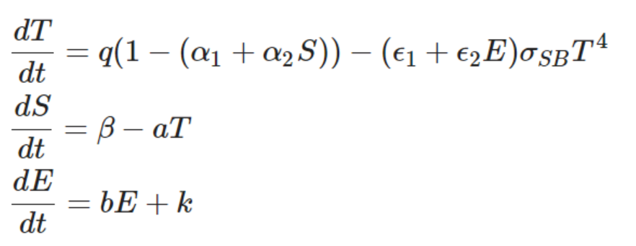
Using ML To Solve the constants of the Dynamics
Based on our changes, we created a new model that considered the temperature (T), dynamics of sea ice (S) and carbon concentration in the atmosphere (E).

Slide 13
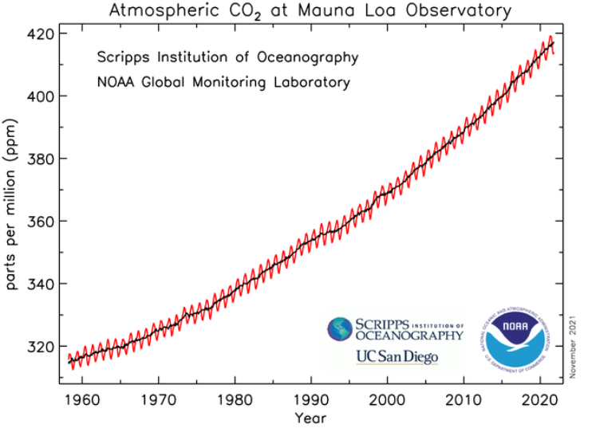
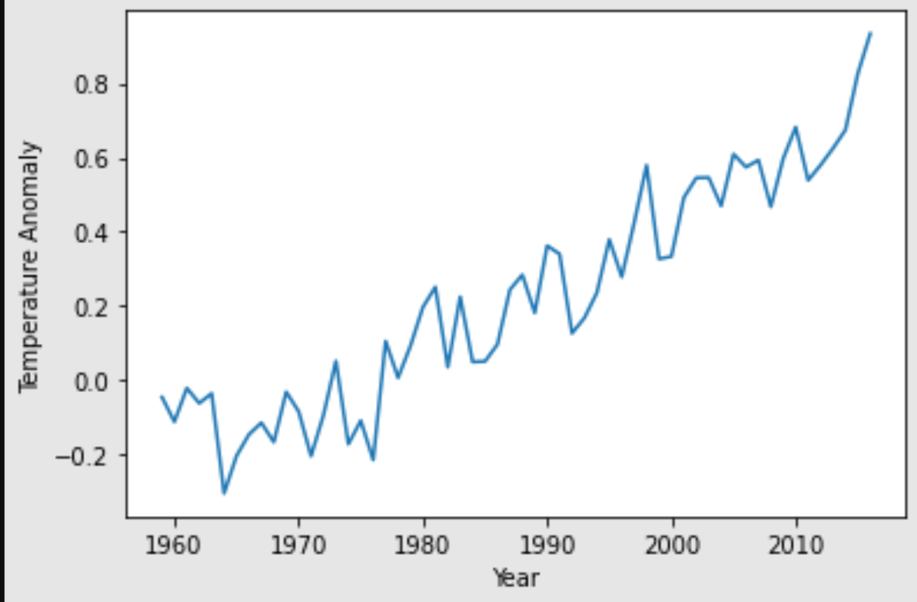
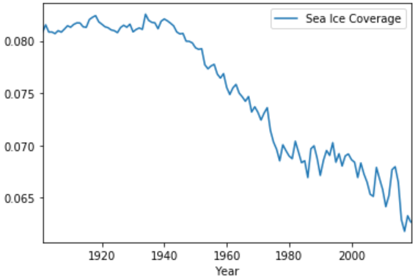
Sea Ice coverage and CO2 emission model
We decided to use historical data of temperature, sea ice coverage, and CO2 concentrations to predict the dynamics of albedo and the greenhouse effect. This way, our model would capture human impact global temperature.

Slide 14
Using ML To Solve the constants of the Dynamics
We used a new open-source ML library called DeepXDE to find the constants in our ODE system using historical data of global average temperature, sea ice coverage, and carbon concentration. DeepXDE leverages Physics Informed Neural Networks (PINNs).
(Lu et al. 2020)

Slide 15
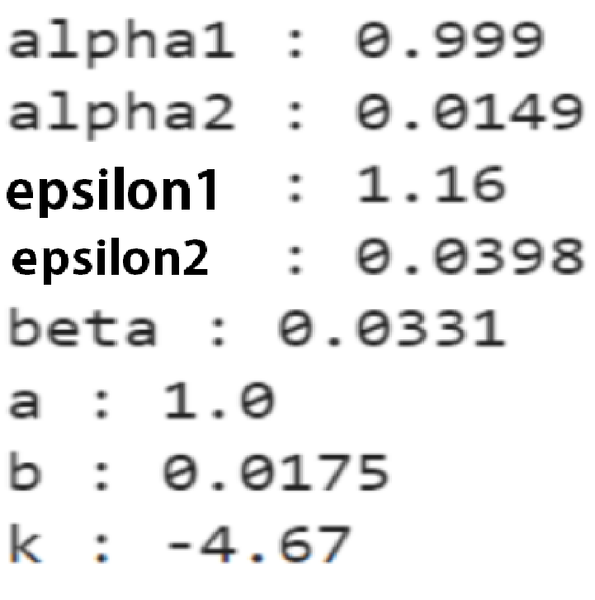
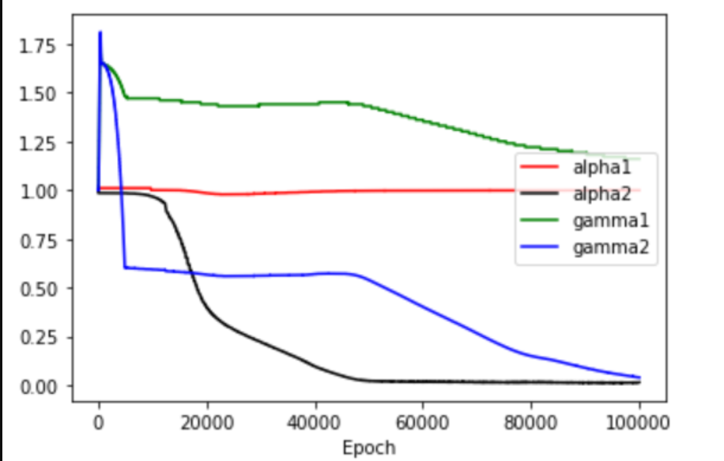
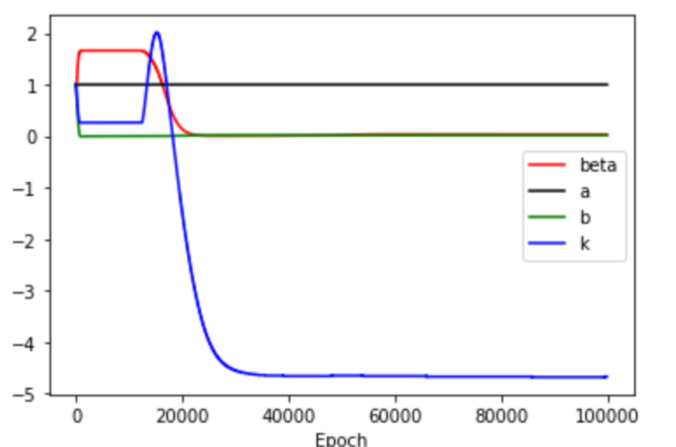
Finding the constants

Slide 16
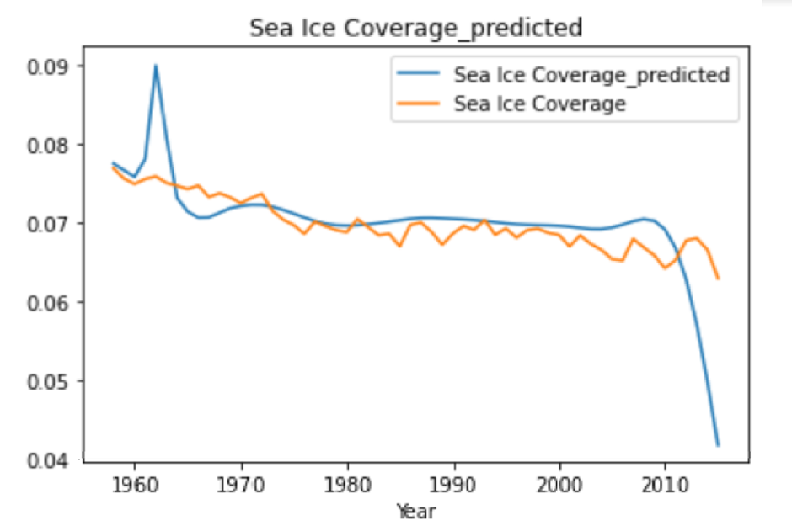
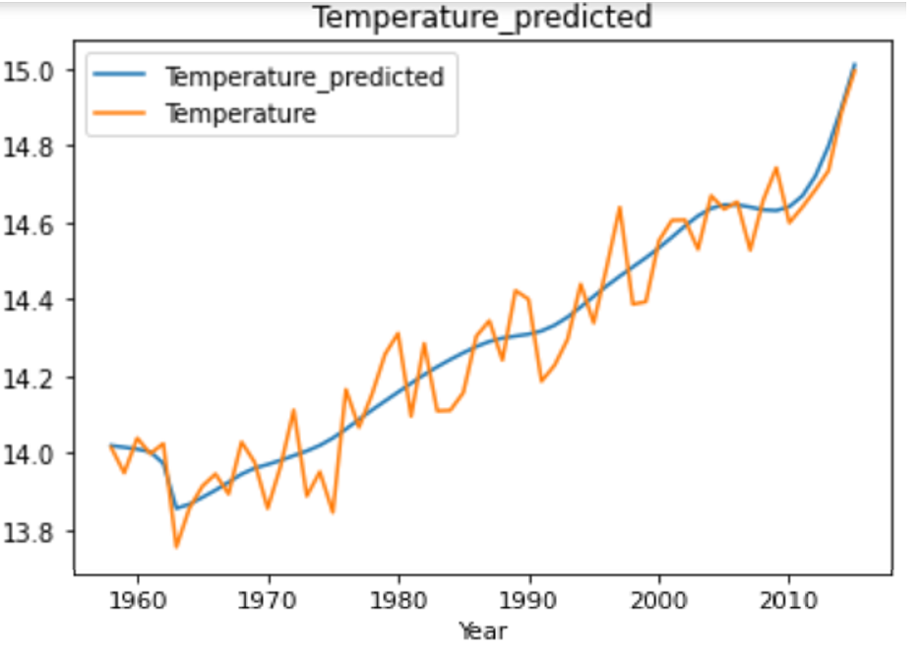
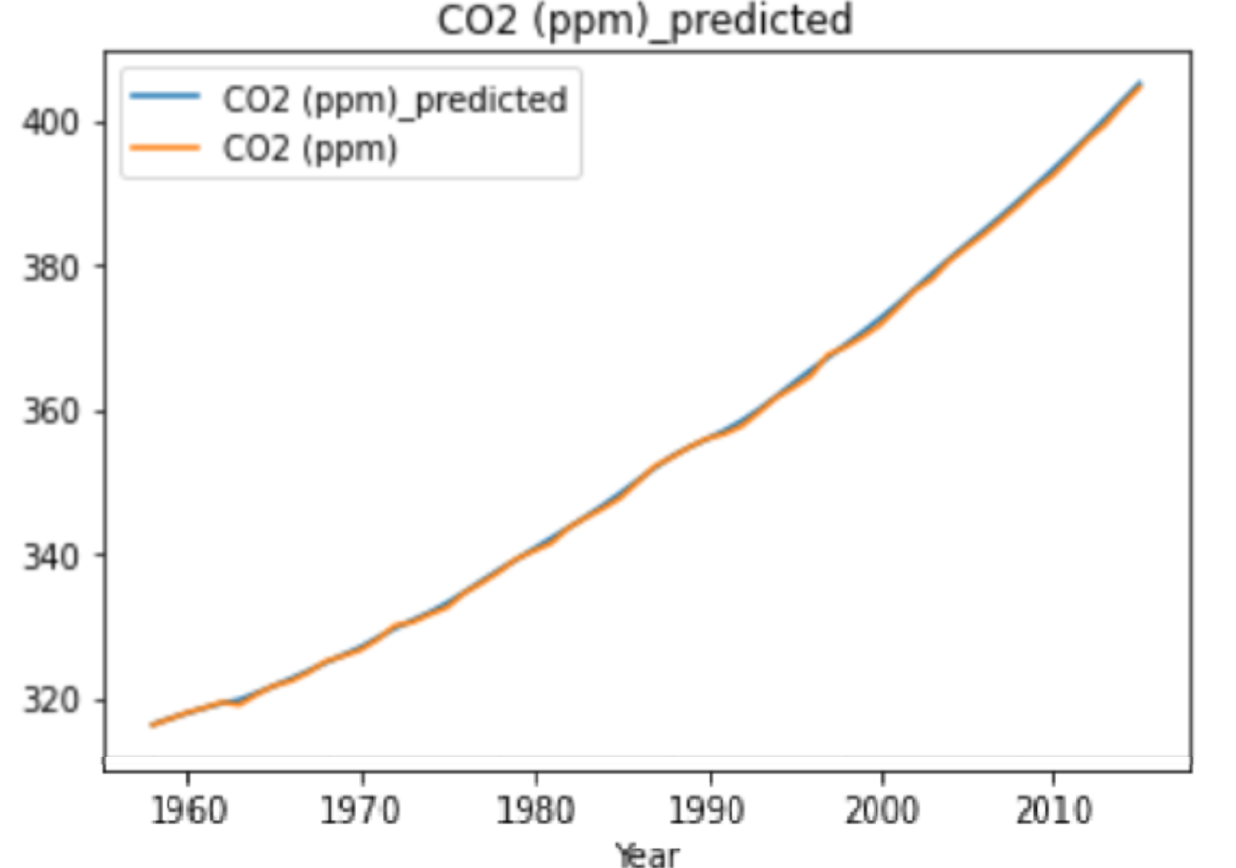
Results
% of Earth covered in Sea Ice
Temperature (C)
CO2 Concentration (ppm)

Slide 17
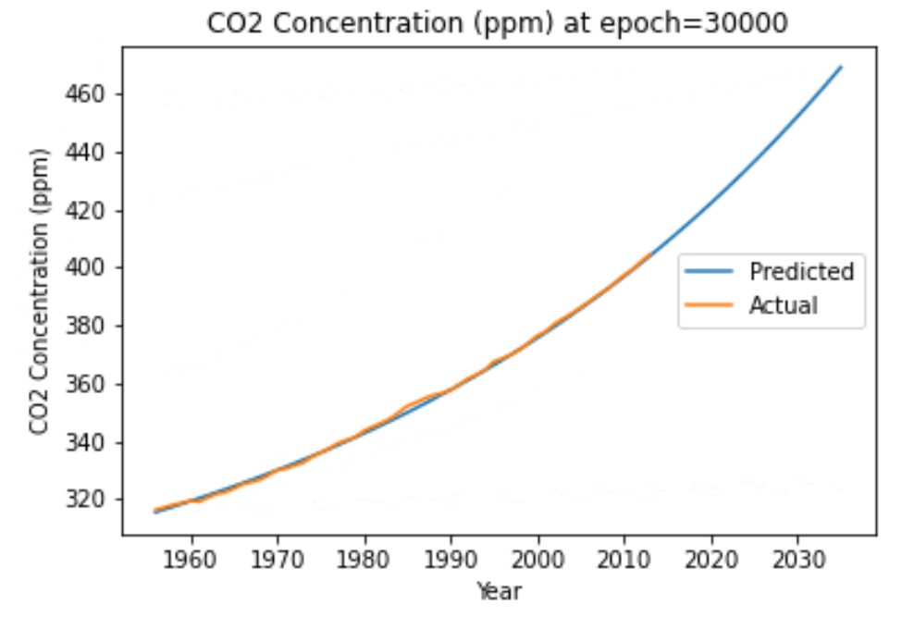
Evolution of the prediction

Slide 18
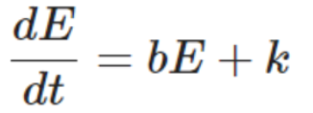

CO2 exponential growth
Although CO2 decays exponentially in long time frames, in the short time frame of 50 years, human contributions take over. Hence CO2 grows exponentially and decays linearly in a half-century time frame.

Slide 19
Human impacts on temperature
Although the system naturally self-restores at around 288K(14.8 C), we have evidently witnessed that human impacts have stopped this self-restoration and have raised the temperature against the natural tendency of the system.

Slide 20
Bibliography
Flath D., Kaper H., Wattenberg F., Widiasih E. Energy Balance Models (2012) (http://archive.dimacs.rutgers.edu/MPE/Energy/DIMACS-EBM.pdf)
Lu, L., Meng, Mao, Z., Karniadakis, G., DeepXDE: A Deep Learning Library For Solving Differential Equations (2020) (https://arxiv.org/pdf/1907.04502.pdf)
All datasets from the World Meteorological Organization

