Slide 1
HACKATHON PITCH
CrowdPulse: Quantifying Emotion Beyond Text
CrowdPulse: Quantifying Emotion Beyond Text
CrowdPulse: Quantifying Emotion Beyond Text
LLMs excel in text and code. We add a sensory layer that measures crowd emotion from video over time.
From text intelligence to emotion intelligence
VIDEO -> SIGNAL -> EMOTION
Editable PowerPoint deck: copy, cards, metrics, signal marks, and demo frame.
Notes:
Open with your thesis: if AI should understand humans, it must model emotional experience beyond text.
[Sources]
- Local run outputs from Boiler Room Crowd Reaction Analyzer.
- data/processed/set_summary.csv (top-10 set analysis).

Slide 2
PROBLEM
02 / 06
Text-native intelligence misses sensory emotional context
Text-native intelligence misses sensory emotional context
Text-native intelligence misses sensory emotional context
Human emotional experience is not only text; it is movement, sound, light, and collective behavior.
LLMs are text-first
Emotion is sensory
Opportunity
Most digital workflows are
language and code, where
LLMs are excellent.
Crowd emotion appears in
movement, rhythm, lighting
shifts, and group reaction.
Quantify these signals and
you unlock measurable
emotional intelligence.
Editable PowerPoint deck: copy, cards, metrics, signal marks, and demo frame.
Notes:
Bridge from philosophy to product: we operationalize emotional signal in a repeatable pipeline.
[Sources]
- Local run outputs from Boiler Room Crowd Reaction Analyzer.

Slide 3
RESULTS
03 / 06
Top-10 benchmark run produced clear DJ performance spread
Top-10 benchmark run produced clear DJ performance spread
Top-10 benchmark run produced clear DJ performance spread
Same pipeline, same cadence, and normalized signals make cross-set ranking possible.
0.498
0.286
10
Top avg_energy (Kaytranada set)
Lowest avg_energy (Acid Pauli set)
Sets fully analyzed in local run
From leaderboard_top10
From leaderboard_top10
From set_summary.csv
Editable PowerPoint deck: copy, cards, metrics, signal marks, and demo frame.
Notes:
Call out that relative spread is the value: we can now compare crowd reaction quantitatively.
[Sources]
- data/processed/set_summary.csv (top-10 set analysis).
- data/processed/leaderboard_top10.csv (ranking by avg_energy).

Slide 4
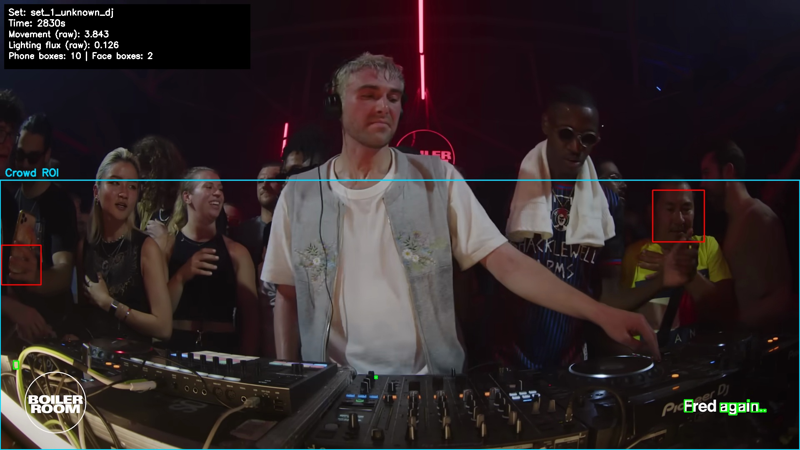
HOW IT WORKS
04 / 06
Automated pipeline from discovery to time-coded insights
Automated pipeline from discovery to time-coded insights
Automated pipeline from discovery to time-coded insights
The workflow is modular, repeatable, and designed for regular refresh runs.
Discover + ingest
Score crowd energy
Map songs to moments
Rank trending DJs, then
ingest top YouTube sets with
metadata.
Every 10 seconds we score
movement, phones, lighting,
and crowd motion.
Map high/low moments to
tracks using metadata and
fingerprinting.
Editable PowerPoint deck: copy, cards, metrics, signal marks, and demo frame.
Notes:
Explain that each module can be upgraded independently (better detection models, stronger fingerprint APIs).
[Sources]
- Local run outputs from Boiler Room Crowd Reaction Analyzer.
- data/processed/tracks/*_tracks.csv (audio-fingerprint track mapping).
- data/processed/peaks/*_moments.csv (high/low crowd moments).

Slide 5
CODEX FEATURES
05 / 06
Natural-language Ops in Codex
Natural-language Ops in Codex
Natural-language Ops in Codex
Codex operates the project as a repeatable system: skill, Q&A, automation, diagnostics, and artifacts.
CrowdPulse skill
Ask the data
Cron + artifacts
Skill packages refresh, Q&A,
checks, frames, and deck
tasks.
run_pipeline.py ask answers
DJ, song, track, and peak
questions.
Automation refreshes top
sets; Codex creates this
deck and demo frames.
Editable PowerPoint deck: copy, cards, metrics, signal marks, and demo frame.
Notes:
Show NL-to-ops mapping: 'scrape more sets' maps to run_pipeline.py refresh-top10 --top-n 20; 'ask top songs' maps to run_pipeline.py ask; 'check if demo-ready' maps to run_pipeline.py doctor. Mention the installed CrowdPulse skill, PowerPoint skill deck generation, the daily automation named CrowdPulse top-10 DJ refresh, and human review through data/input/manual_track_overrides.csv.
[Sources]
- Local run outputs from Boiler Room Crowd Reaction Analyzer.

Slide 6
NEXT PHASE
06 / 06
Roadmap: crowd analytics to emotional intelligence
Roadmap: crowd analytics to emotional intelligence
Roadmap: crowd analytics to emotional intelligence
This MVP is the first step toward quantifying real-world emotional experience at scale.
1
2
3
Add track-ID providers + confidence calibration
Add person/phone detection + camera-motion compensation
Generalize to sports, concerts, and brand activations
Higher song precision
More stable engagement signal
Broader emotional-intelligence platform
Editable PowerPoint deck: copy, cards, metrics, signal marks, and demo frame.
Notes:
Close with ask: pilot with one promoter/label and benchmark 50+ sets in the next cycle.
[Sources]
- Local run outputs from Boiler Room Crowd Reaction Analyzer.

