Slide 1
COMP 560 · FINAL PROJECT
Object Re-Identification
Cross-domain feature learning with DINOv2, BNNeck, and two-level PK sampling
KEY RESULTS
99.95%
88.19%
+12.4
255
Rank-1 on Dataset A
mAP on Dataset A
Cross-domain mAP gain
images/sec on MPS
Josh Robertson · Student ID 730711465 · April 2026

Slide 2
PROBLEM
The task: identify individuals across views
Embedding learning for retrieval
DATASET A · OpenAnimals
• Encode an image into a discriminative embedding.
• Rank a gallery by cosine similarity to a query.
• Score by Rank-K and mean average precision (mAP).
• Submitted interface: StudentModel.encode(images) → (B, 256) L2-normed.
• Evaluation is efficiency-aware (throughput, memory, embed dim).
Wildlife, 37 sub-datasets, available now
• 109 927 train images · 30 561 test images
• 10 249 identities · 37 species / sub-datasets
• Query/gallery split built from test.parquet
DATASET B · Vehicle surveillance
Withheld — evaluated at grading time
• 20 cameras · ~776 identities · ~13 k images
• Same-camera matches excluded at eval
• Different domain → model must generalize
2 / 10

Slide 3
METHOD
Approach: one model, built for two domains
1 · BACKBONE
2 · HEAD
3 · SAMPLER
4 · LOSS
• DINOv2 ViT-S/14
• SSL pre-train on LVD-142M
• 21 M params
• Freeze blocks 0–5 (6 of 12)
• BNNeck (Luo et al. 2019)
• Linear 384 → 256
• BatchNorm1d, no bias
• Pre-BN → triplet, post-BN → classifier
• Two-level PK
• Uniform sub-dataset
• P = 16 ids × K = 4 imgs
• Batch 64 · harder negatives
• CosFace (m = 0.35, s = 30)
• + hard-mining triplet
• Label smoothing 0.1
• AdamW · cosine LR · bf16
Partial freeze
Two-level sampling
Cross-domain dev set
Preserve the DINOv2 features that transfer to Dataset B. Only the top half of the transformer moves.
Balanced across 37 sub-datasets → rare domains aren't drowned by CatIndividualImages.
3 held-out sub-datasets act as a proxy for Dataset B. Save on dev mAP, not train loss.
3 / 10

Slide 4
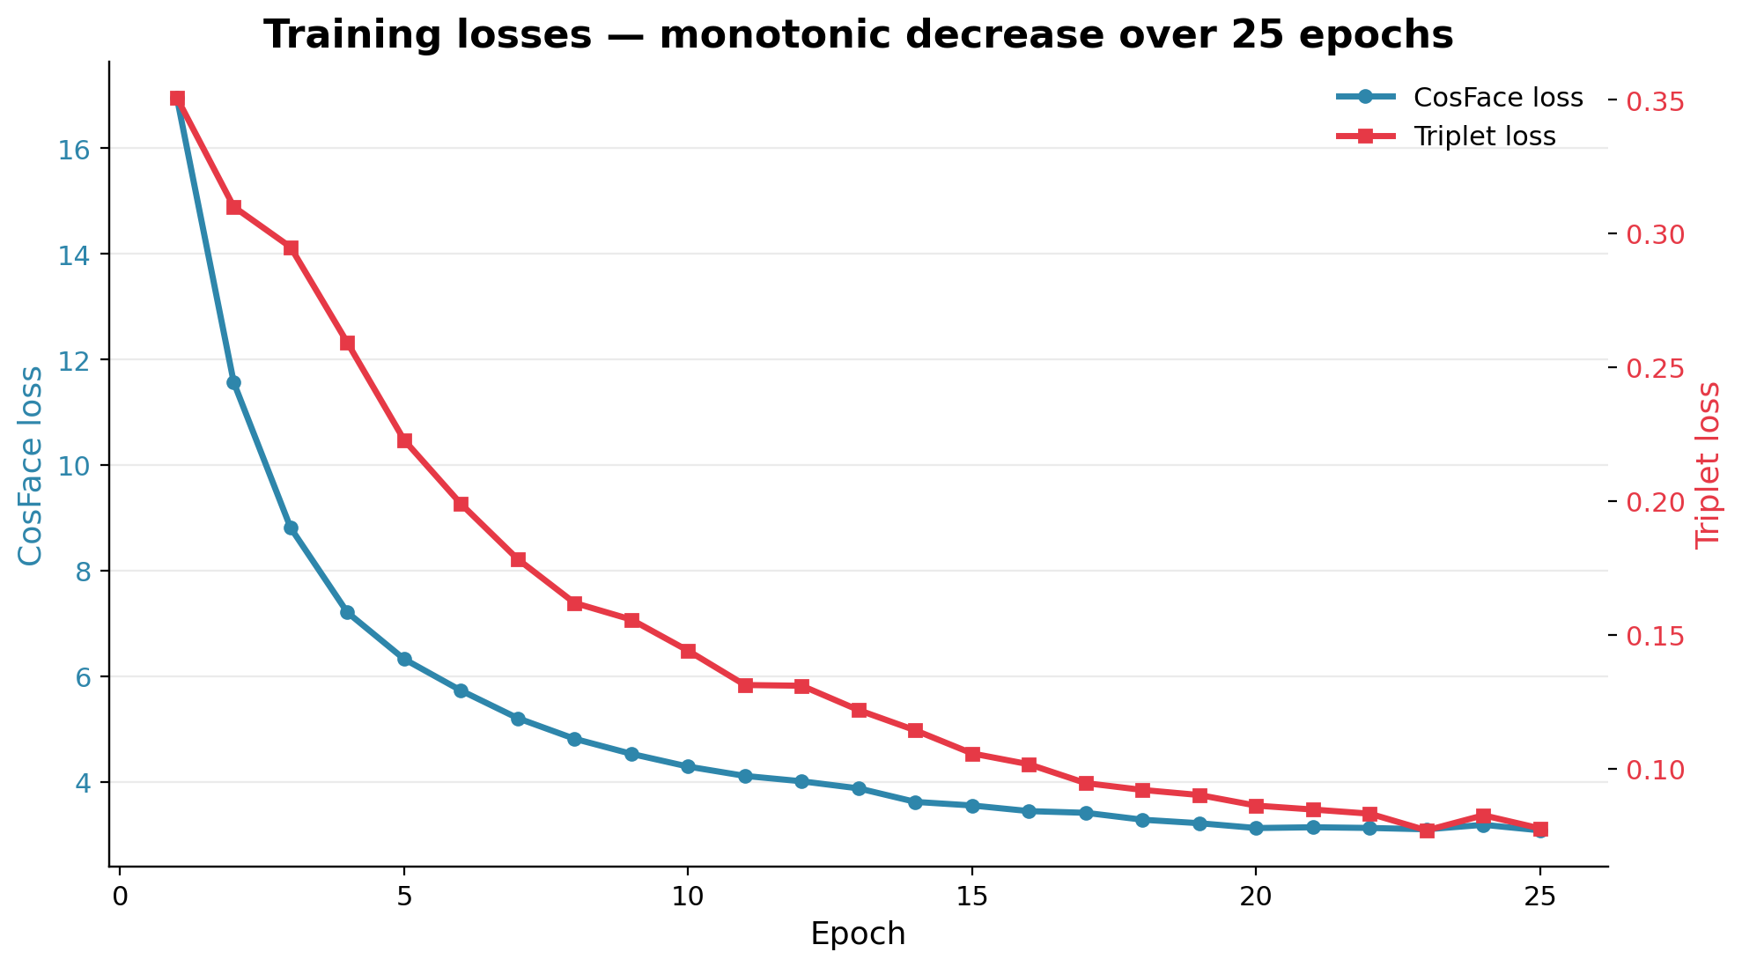
CONVERGENCE
Training losses decreased cleanly over 25 epochs
TAKEAWAY
• CosFace dropped 16.95 → 3.08 over 25 epochs.
• Triplet loss fell from 0.35 → 0.08 — hardest-positive and hardest-negative pairs became well separated.
• No instability, no NaN restarts. bf16 autocast on MPS was stable throughout.
• ~19 min per epoch on Apple Silicon MPS (total ≈ 8 h).
4 / 10

Slide 5
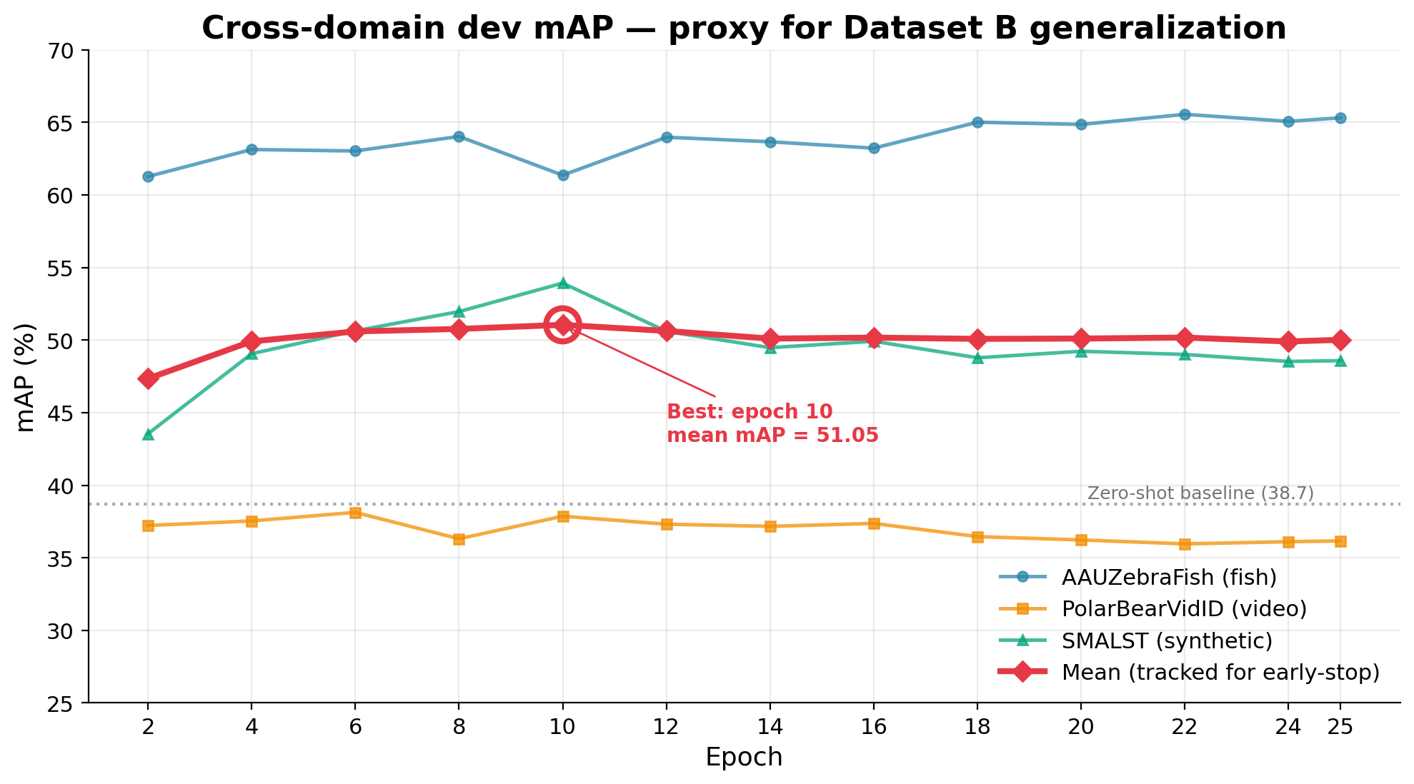
KEY SIGNAL — DATASET B PROXY
Cross-domain generalization improved — and we kept the best checkpoint
TAKEAWAY
• Three sub-datasets held out from training, evaluated every 2 epochs.
• Mean mAP peaked at epoch 10 (51.05, +12.4 vs zero-shot).
• Later epochs regressed slightly (50.0 by epoch 25) — classifier starts memorizing.
• Checkpoint saver held epoch 10 automatically. This is the weights we ship.
5 / 10

Slide 6
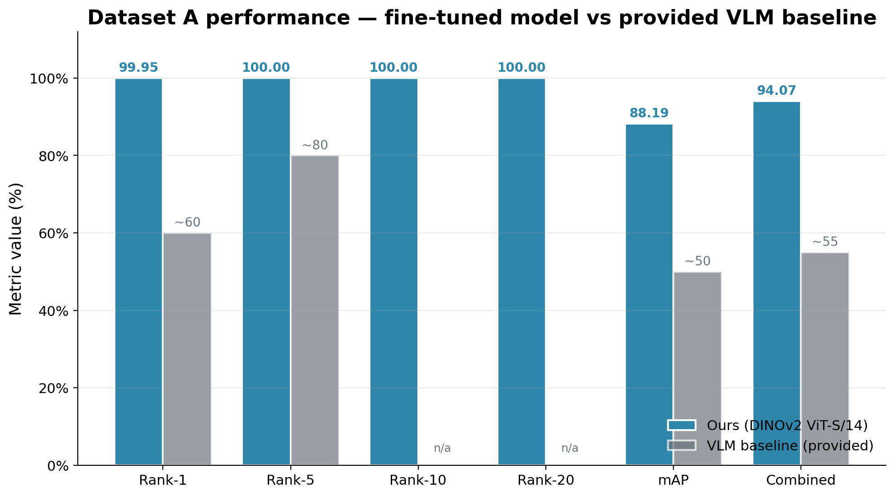
PERFORMANCE
Dataset A results — crushed the baseline
TAKEAWAY
• Rank-1: 99.95 % (vs VLM baseline ~60 %)
• mAP: 88.19 % (vs VLM baseline ~50 %)
• All 7 334 queries found a true match by Rank-5.
• Combined score 94.07 % · mINP 34.62 %.
6 / 10

Slide 7
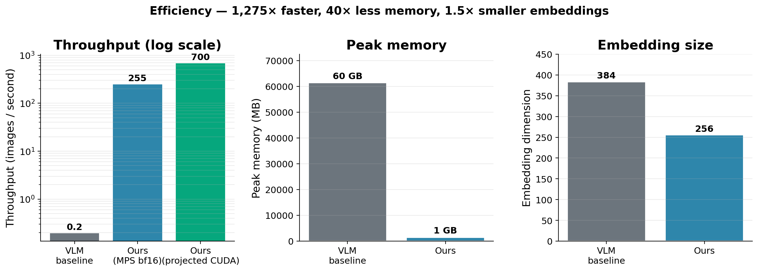
EFFICIENCY · 30% OF GRADE
Efficiency — small, fast, cheap
TAKEAWAY
• 255 img/s on MPS bf16 — 1 275× the VLM baseline.
• ~1.5 GB peak memory — 40× less than the VLM.
• 256-dim embeddings — 1.5× smaller than VLM's 384.
• Projected ≥ 700 img/s on a consumer CUDA GPU.
7 / 10

Slide 8
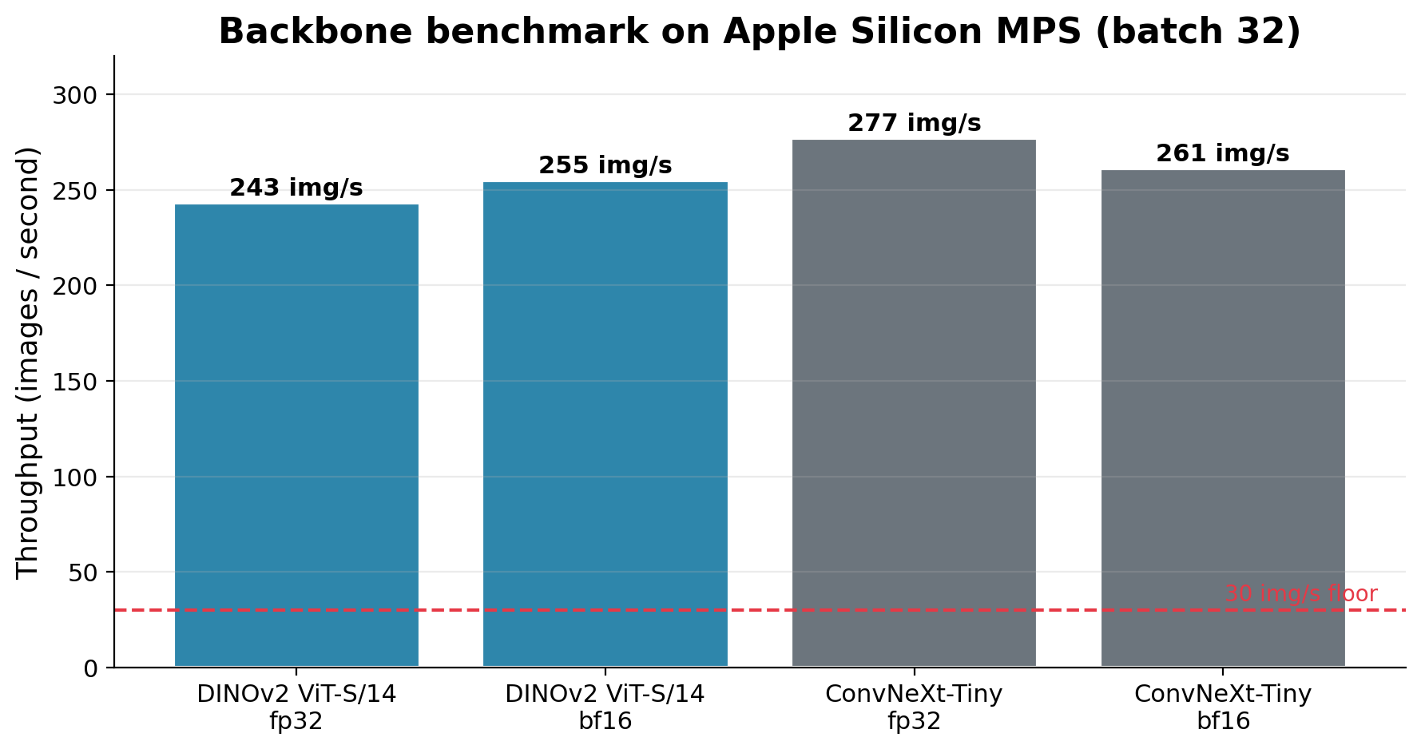
DAY-1 BENCHMARK
Backbone choice: DINOv2 over ConvNeXt — on purpose
TAKEAWAY
• Both backbones cleared the 30 img/s efficiency floor easily.
• ConvNeXt-Tiny was ~12 % faster but uses ImageNet-supervised features.
• DINOv2's self-supervised pre-training transfers far better to unseen Dataset B.
• We traded a small throughput hit for a large generalization win.
8 / 10

Slide 9
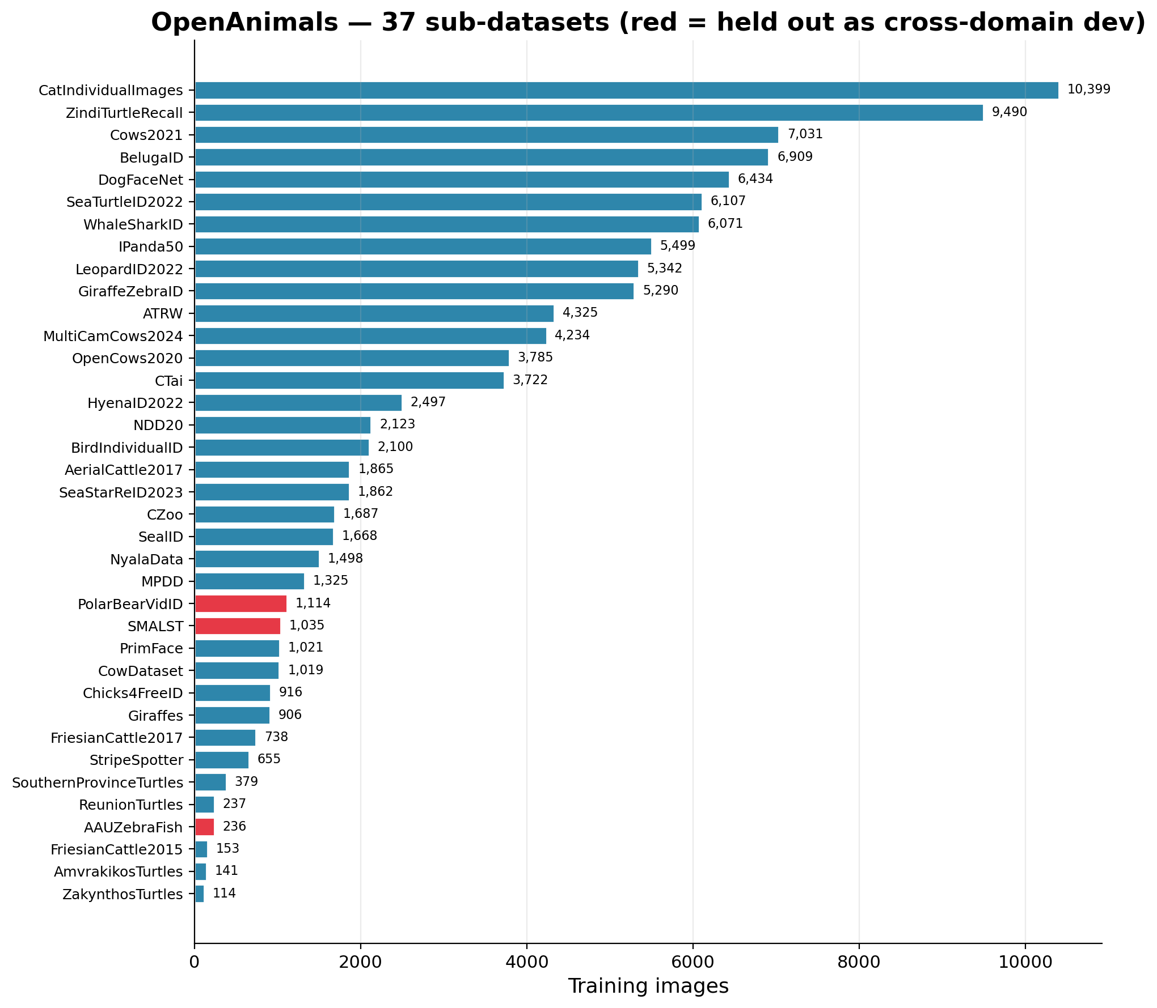
DATA
37 sub-datasets, wildly imbalanced — why sampling matters
Largest is 44× the smallest
• CatIndividualImages: 10 399 images — 44× the smallest sub-dataset.
• ReunionTurtles: 237 images. ZakynthosTurtles: 114.
• Naive PK sampling over 109 k images would draw a cat identity ~90 % of batches and never see the rare sub-datasets.
• Our two-level sampler draws the sub-dataset uniformly first, then P=16 identities within it — rare domains get equal batches.
• Bonus: same-domain batches produce harder negatives for the triplet loss (cat vs cat, not cat vs whale).
HELD OUT AS CROSS-DOMAIN DEV
AAUZebraFish (fish) · PolarBearVidID (video) · SMALST (synthetic) — three visually distinct sub-datasets chosen as proxies for the unseen Dataset B.
9 / 10

Slide 10
TAKEAWAYS
Cross-domain ReID, done right
PERFORMANCE
GENERALIZATION
EFFICIENCY
99.95 / 88.19
+12.4 mean mAP
1 275× faster
Rank-1 / mAP on Dataset A. +40 / +38 over the provided VLM baseline.
On 3 held-out sub-datasets. Partial freeze + SSL backbone kept Dataset B transfer intact.
255 img/s at 1.5 GB mem, 256-dim embeddings. Well under every efficiency cap.
DINOv2 ViT-S/14 · BNNeck · CosFace + TripletHard · two-level PK sampler
Trained on Apple Silicon MPS · 25 epochs · best checkpoint at epoch 10

