Slide 1
Radio Altimeter Tolerance of Wireless Avionics Intra-Communication (WAIC) Systems
Joshua Ruff
Advisor: Dr. Gregory H. Huff
Electromagnetics and Microwave Laboratory
Department of Electrical and Computer Engineering, TAMU
College Station, Texas, 77843-3128
3-8-2019

Slide 2
Radio Altimeter Tolerance of WAIC Systems
Acknowledgements
Project Funding
This work was sponsored by the Aerospace Vehicles Systems Institute (AVSI) through Authorization for Expenditure 76s1 (AFE 76s1)
Project members include Honeywell, Rockwell Collins, Thales, Airbus, Boeing, Garmin
Members contributed funding, equipment, and expertise without which the project would not have been completed
Members contributed widely used commercial radio altimeter models for testing

Slide 3
Introduction

Slide 4

Radio Altimeter Tolerance of WAIC Systems
Introduction
Motivation – Wireless Avionics
Critical instruments have redundant wiring
Moving to wireless reduces need for redundant paths
Interest in wireless spans the aerospace industry:
Regulators: dissimilar redundancy
Airframers: fuel efficiency
Manufacturers: new products
Source: https://www.bbc.com/news/business-23076586

Slide 5
Radio Altimeter Tolerance of WAIC Systems
Introduction
History – Acquiring Spectrum
Feasibility study found no insurmountable barriers
AVSI began effort to acquire spectrum in 2008
Effort to find suitable band spanned World Radio Conferences in 2012 and 2015 (WRC-12 and WRC-15)
WAIC placed on agenda at WRC-12, studied candidate bands
An allocation in the Radio Altimeter (4.2-4.4GHz) band was secured at WRC-15
As a condition of allocation, WAIC had to develop international standards which ensured compatibility with radio altimeters

Slide 6
Radio Altimeter Tolerance of WAIC Systems
Introduction
Project Goals
AVSI wanted to determine WAIC operating characteristics which ensured compatibility with radio altimeters
Altimeter manufacturers could have done this themselves, but a neutral party provided objectivity
Approached Huff Research Group at Texas A&M to develop an automated test bench for radio altimeters
My contribution was the development of this test bench throughout the project, the execution of these compatibility tests, and support the analysis of the data

Slide 7
Background

Slide 8
Radio Altimeter Tolerance of WAIC Systems
Background
Radar Altimeter Applications
Radio altimeters (RAs) measure height with radar signal
Function on the 4200 – 4400 MHz band
Used in autopilot, navigation systems
Safety critical function
Heavily regulated
Image showing altimeter on plane

Slide 9
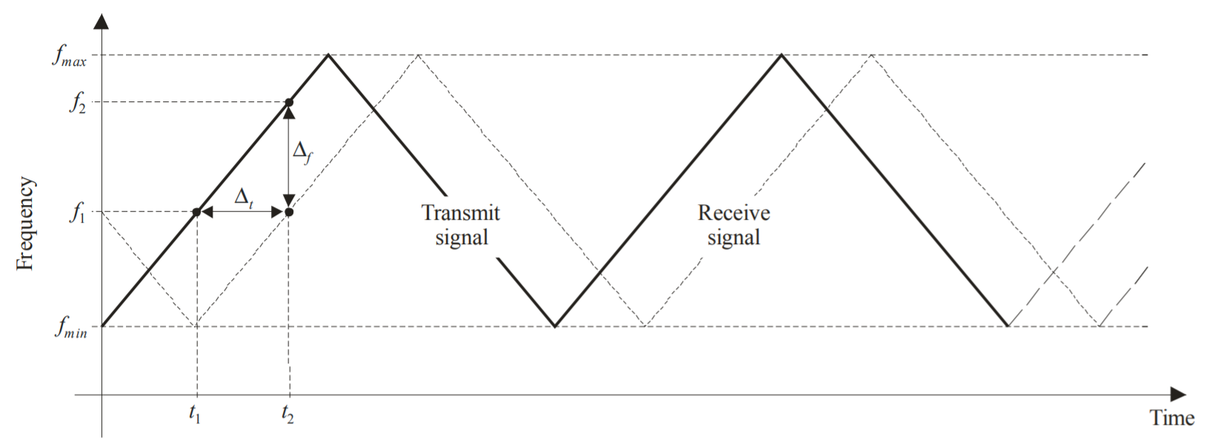
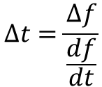
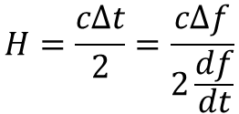
Radio Altimeter Tolerance of WAIC Systems
Background
Radar Altimeter Functionality
Frequency Modulated Carrier (FMCW) waveform
Return time of signal proportional to frequency
$$Δt=\frac{Δf}{\frac{df}{dt}}$$
$$H=\frac{cΔt}{2}=\frac{cΔf}{2\frac{df}{dt}}$$
FMCW diagram from DO-155

Slide 10
Radio Altimeter Tolerance of WAIC Systems
Background
Altimeter Signal Processing
Homodyne detection extracts altitude data
Actively transmitted waveform fed into receiver mixer
Down converted to baseband
FFT allows post processing in frequency domain
Proprietary algorithms then estimate altitude
Block diagram here

Slide 11
Radio Altimeter Tolerance of WAIC Systems
Backgound
Loop Loss
RA signal affected by:
TX/RX Cable losses
Free Space Path Loss
Scattering by Ground
Antenna gains
Standard loop losses defined in RTCA DO-155
encapsulates these effects for standard configurations
Height [ft] | Loop Loss [dB]
40 | 76
95 | 84
500 | 100
1500 | 109
3000 | 116
5000 | 120
8000 | 124
Loop loss for 60° antennas and worse case scattering

Slide 12
Test Bed Development

Slide 13
Radio Altimeter Tolerance of WAIC Systems
Test Bed Development
Project Overview
Three test regimens
First developed testbed and investigated basic altimeter response
Second tested filled entire band with representative interference
Third tested out of band signals
Results from the first test informed both the second and third studies
Results from next two studies inform regulatory action
Out of band testing still active
Preliminary results shown here

Slide 14
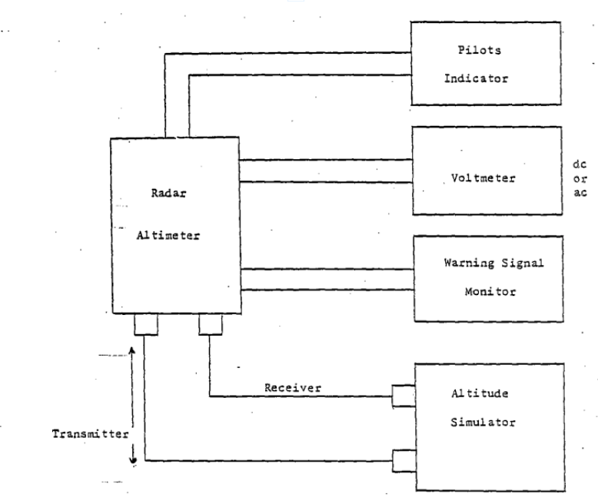
Radio Altimeter Tolerance of WAIC Systems
WAIC Only Interference
Basic Altimeter Test Bed
Test bed developed from DO-155 specs
Basic test bed required
Altitude Simulator
Data Acquisition
Altitude simulator most critical
Device which delays and attenuates RF energy
Basic altimeter test bed from DO-155

Slide 15
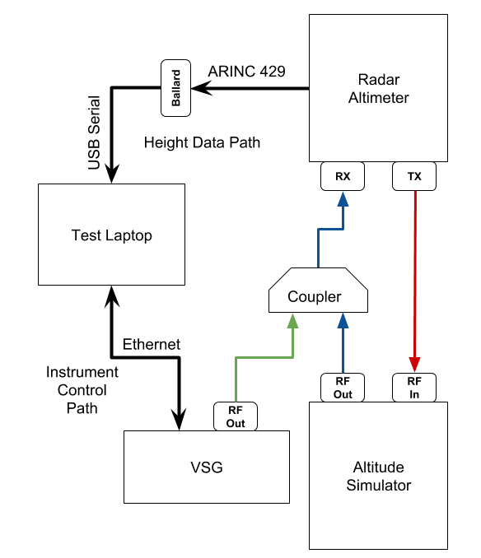
Radio Altimeter Tolerance of WAIC Systems
WAIC Only Interference
Modified Altimeter Test Bed
AVSI developed testbed based on DO-155
VSG coupled to altitude simulator output
Altimeter operates normally
computed altitude output on digitial avionics bus (ARINC-429)
Copilot software reads data from ARINC bus

Slide 16
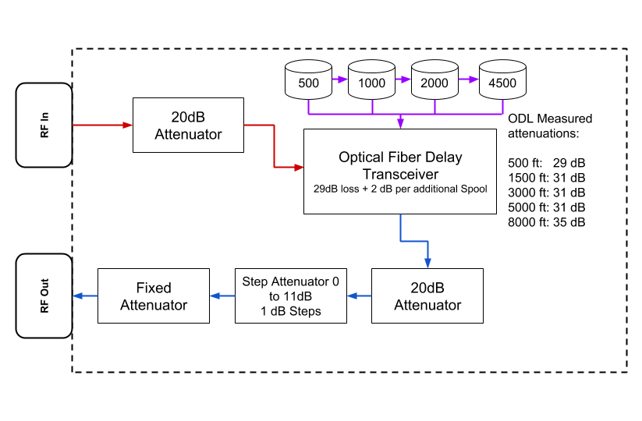
Radio Altimeter Tolerance of WAIC Systems
WAIC Only Interference
Altitude Simulator
ODL implements altitude simulator
Switchable “Fixed” and “Step attenuator” achieve desired loop loss
Cascade different spools of fiber optic line for different altitude

Slide 17
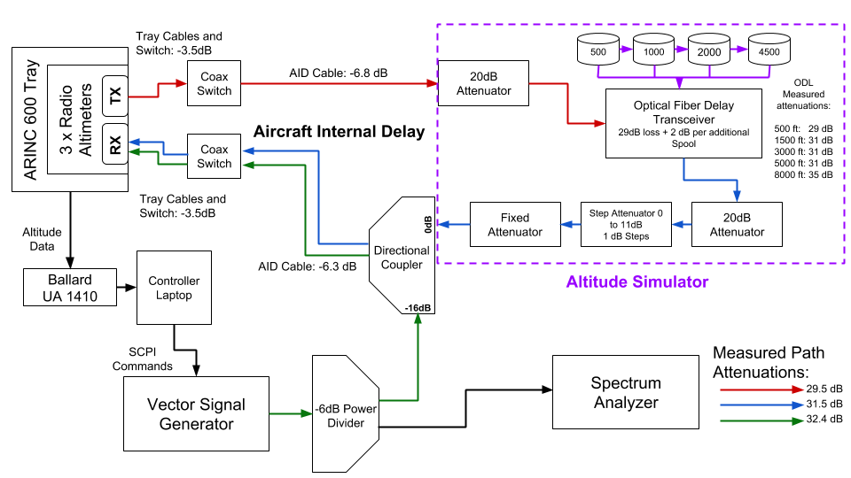
Radio Altimeter Tolerance of WAIC Systems
WAIC Only Interference
Full Setup Diagram

Slide 18
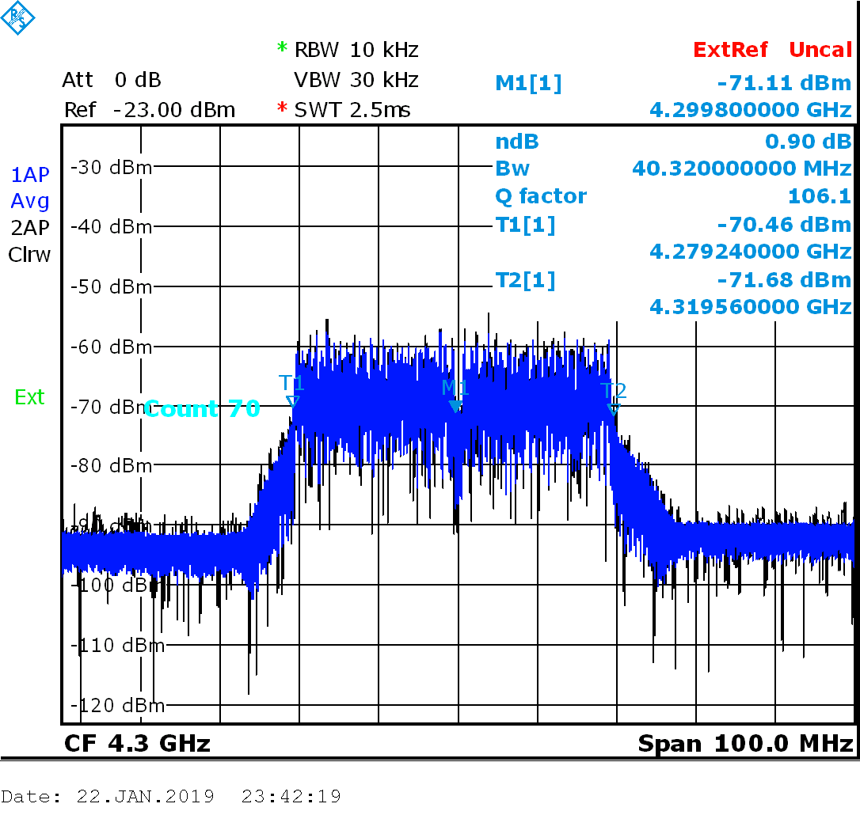
Radio Altimeter Tolerance of WAIC Systems
WAIC Only Interference
Waveform Generation
MSK and OFDM used for interference
OFDM used for LTE
MSK variant used for GSM networks
Chipset widely available for other bands
OFDM bandwidths varying from 5 to 80 MHz used for testing
40 MHz OFDM on Spectrum Analyzer

Slide 19
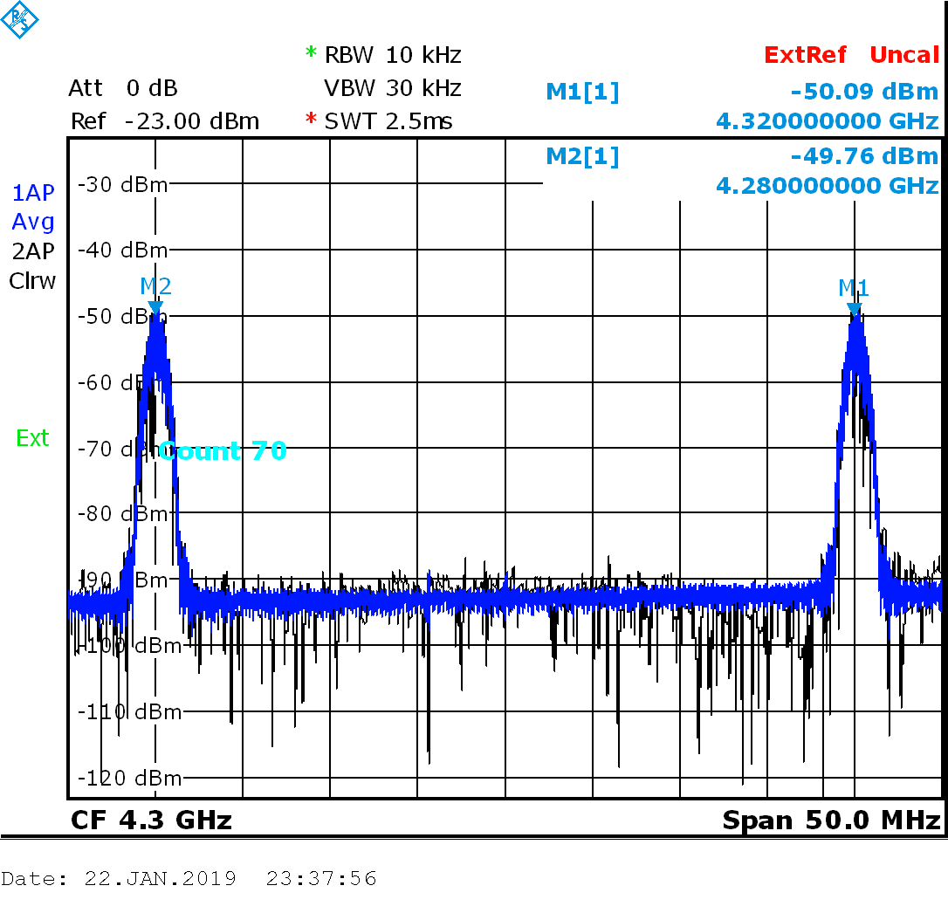
Radio Altimeter Tolerance of WAIC Systems
WAIC Only Interference
Waveform Generation
Dual and single versions of both waveforms used
Dual waveforms had 20 MHz offset
MSK can be interpreted as minimum bandwidth version of OFDM
Wide bandwidth simulates multiple radios
Dual MSK on Spectrum Analyzer

Slide 20
Radio Altimeter Tolerance of WAIC Systems
WAIC Only Interference
Interference Generation
VSG baseband generator set modulation
RF Generator set carrier frequency and power
RF toggled ON and OFF
Increasing power over time
RF OFF allows altimeter to recover
Dual MSK on Spectrum Analyzer

Slide 21
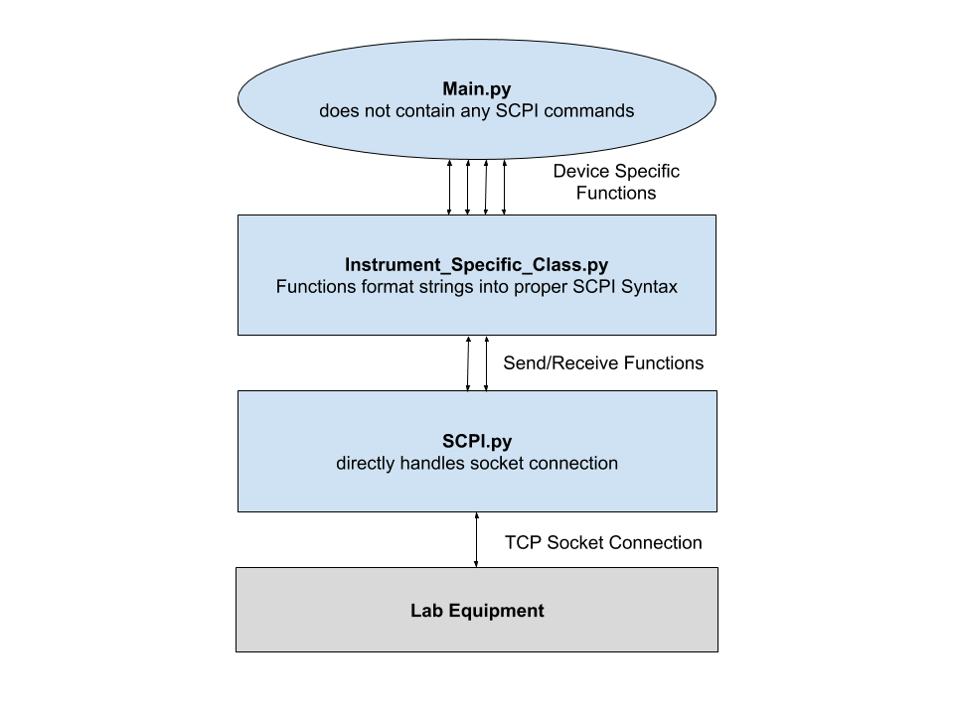
Radio Altimeter Tolerance of WAIC Systems
WAIC Only Interference
Software Architecture
Main loop controls power/modulation stepping
Functions in VSG class construct strings for each command
SCPI.py handles TCP connection
Main loop never touches strings or TCP
SCPI Class Hierarchy

Slide 22
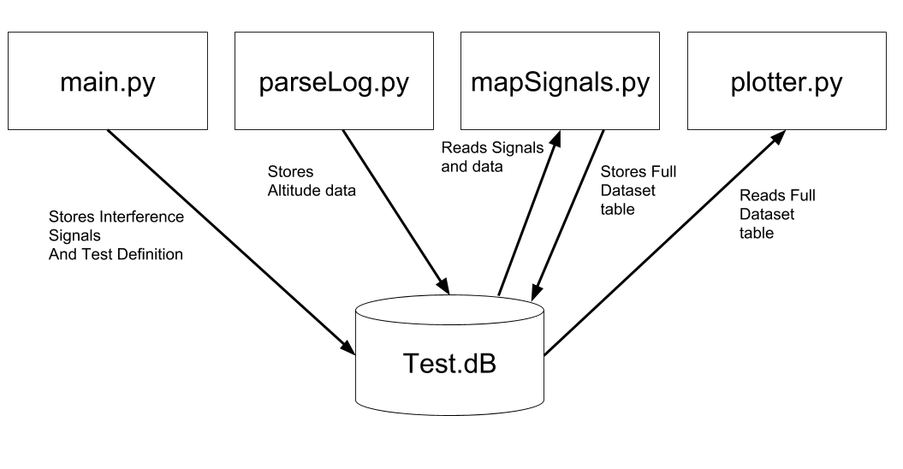
Radio Altimeter Tolerance of WAIC Systems
WAIC Only Interference
Data Storage and Post Processing
SQLite database for data storage
Table of measured heights and interference signals
Both time stamped
Measurements mapped to VSG state
Full Dataset table allows easy plotting
Functionality of each Python script as it interacts with SQLite database

Slide 23
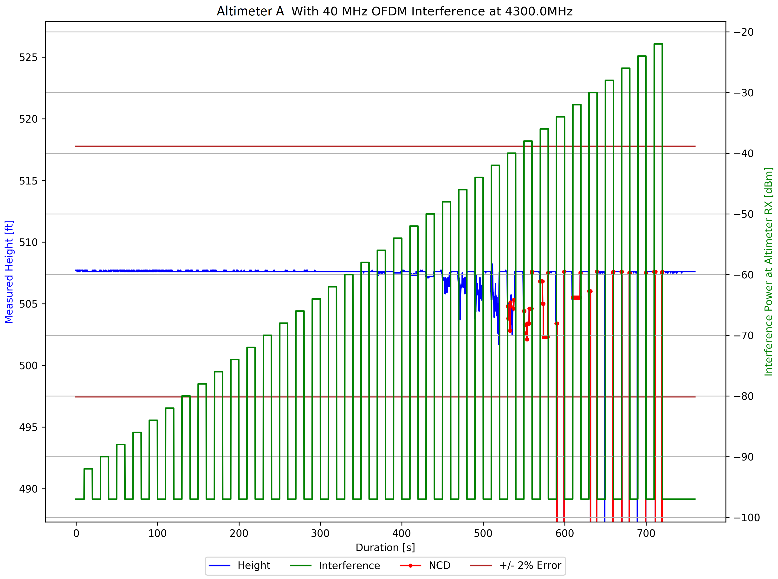
Radio Altimeter Tolerance of WAIC Systems
WAIC Only Interference
Data Display – Height Plots
Example ‘Height Plot’ shown
Altitude signal distorted with increasing power
Eventually altimeter throws NCD
Breaking point defined as 2% error or any NCD

Slide 24
Radio Altimeter Tolerance of WAIC Systems
WAIC Only Interference
Nominal Height vs Correct Height
Tests run at a ‘nominal height’ based on delay device
500ft, 1500ft, 40ft, ect.
Altimeter may output from ~490 to ~510 for 500ft test
Real installations calibrate out AID and airfame height
We’re only interested in the error
absolute height not important, so we don’t calibrate
Correct Height defined as median with no interference
All errors measured from this value

Slide 25
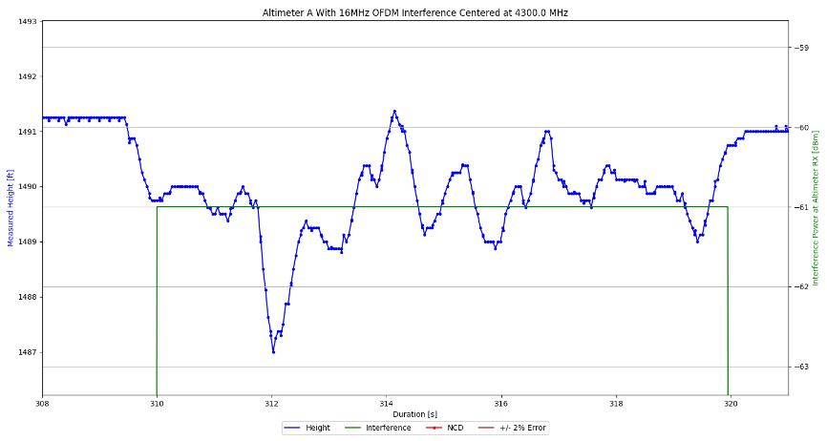
Radio Altimeter Tolerance of WAIC Systems
WAIC Only Interference
Timing and Synchronization
Several Synchronization issues appeared
Significant improvement from leaving TAMU network
‘wait until’ delay function yielded precise interference durations
Ballard internal clock lagged behind slightly
Height Plot zoomed in on one power level

Slide 26
Radio Altimeter Tolerance of WAIC Systems
WAIC Only Interference
Data Display – Height Plot Again
Height plots were effective but cluttered
Needed more compact way to display same information

Slide 27
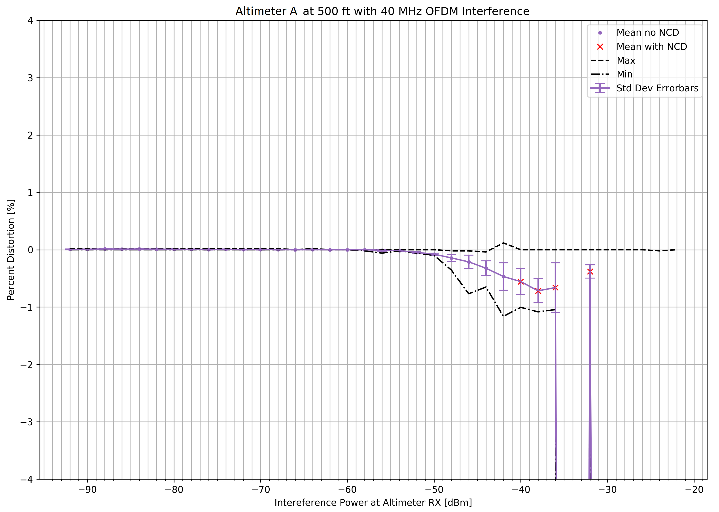
Radio Altimeter Tolerance of WAIC Systems
WAIC Only Interference
Data Display – Stat Plots
Example ‘Stat Plot’ shown
Easier to read than height plot
Shows all the same information except time
Less useful for debugging

Slide 28
Initial Test Regimen – WAIC Only Interference

Slide 29
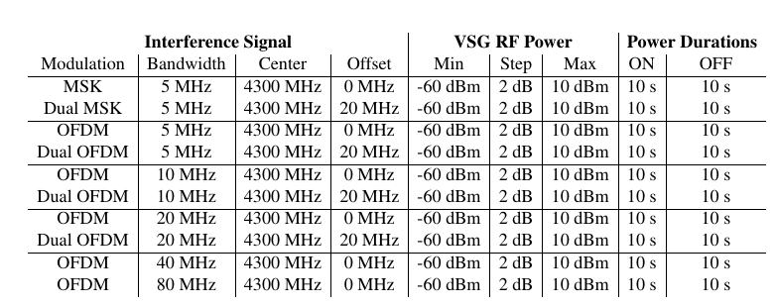
Radio Altimeter Tolerance of WAIC Systems
WAIC Only Interference
Goals and Test Definition
Find breaking point for different waveforms
Find sensitivity to
interference bandwidth
position in spectrum
Separation of signal into dual waveforms
Bring results to regulators or develop further tests
Test definition for last round of initial tests

Slide 30
Radio Altimeter Tolerance of WAIC Systems
WAIC Only Interference
Breaking Point Definitions
ARINC 707 standards specify minimum accuracy of +/-2%
AVSI determined early on that WAIC would need to cause an error significantly below this margin
0.5% settled on as a quarter of the allowable error
Tolerance from all WAIC radios combined on an aircraft

Slide 31
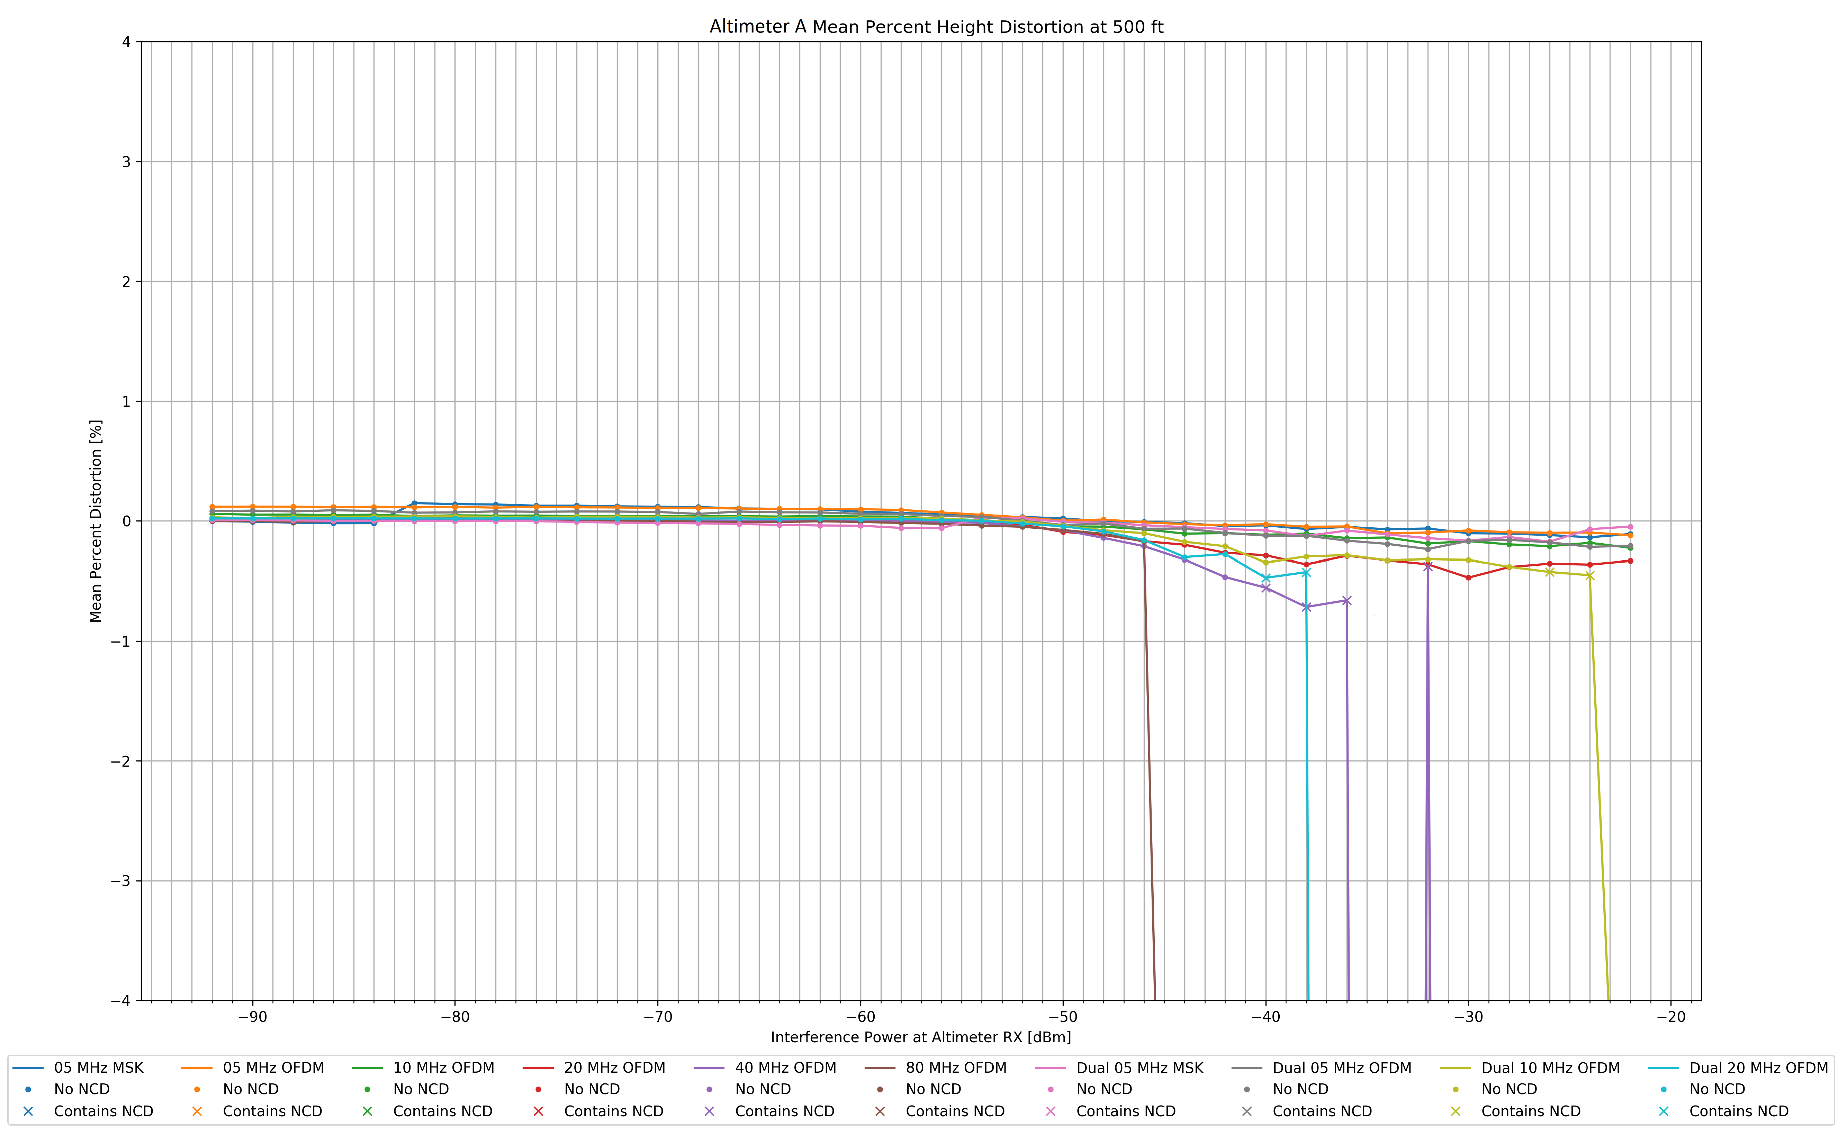
Radio Altimeter Tolerance of WAIC Systems
WAIC Only Interference
Results

Slide 32
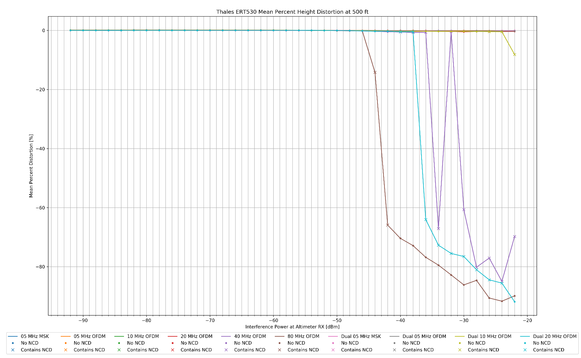
Radio Altimeter Tolerance of WAIC Systems
WAIC Only Interference
Results

Slide 33
Radio Altimeter Tolerance of WAIC Systems
WAIC Only Interference
Results
Summary of results submitted to FSMP. Each data point represents the power level at which an altimeter exceeded 0.5% error

Slide 34
Radio Altimeter Tolerance of WAIC Systems
WAIC Only Interference
Results
Altimeters were most sensitive to wider bandwidth signals
Signals at the band edges had fewer effects
Band center was the most sensitive to interference
Separation of dual waveforms helped but not consistently
Needed to test altimeters under worst case scenario
Interference from other altimeters during approach
Full 200MHz band filled WAIC Interferers
Breaking point under these conditions could be brought to regulators

Slide 35
Expanding the Test bed

Slide 36
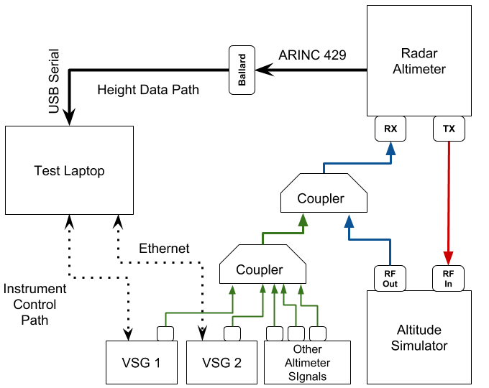
Radio Altimeter Tolerance of WAIC Systems
Expanding the Test Bed
Overview
Second VSG enables wider band signals
Simulated altimeter signals also injected
VSG controlled over ethernet
Altitude Simulator modified for lower altitudes and higher interference power

Slide 37
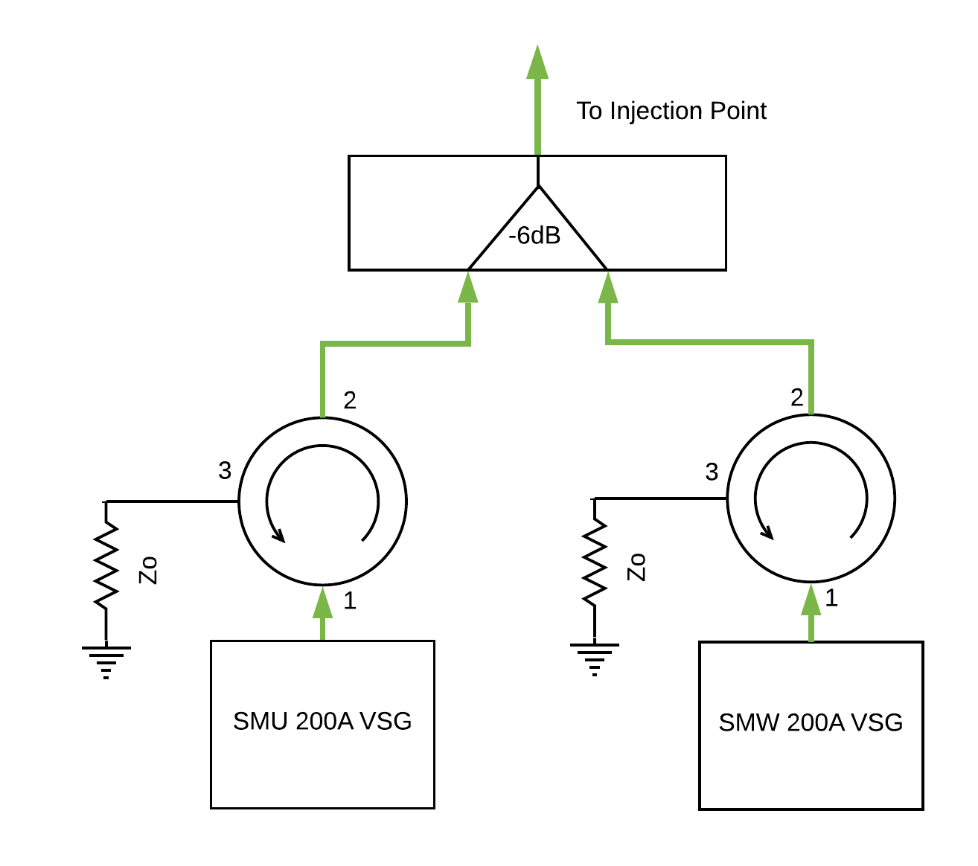
Radio Altimeter Tolerance of WAIC Systems
Expanding the Test Bed
Adding the Second VSG
Resistive 6dB coupler did not provide enough isolation
Looked into new couplers
Garmin provided circulators for free
Function as isolators when one port has a matched load

Slide 38
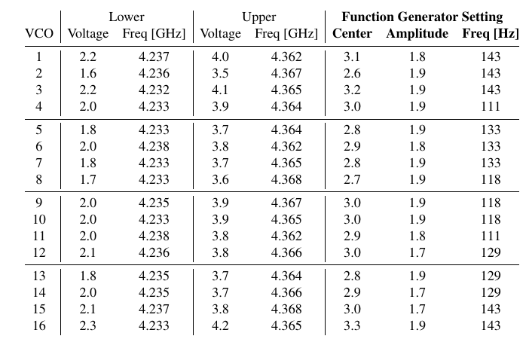
Radio Altimeter Tolerance of WAIC Systems
Expanding the Test Bed
Simulating Altimeter Interference
Simulated other altimeter signals using VCOs
Control voltage changes oscillation frequency
Function generators output triangle voltage waveform
Triangle waveform simulates FMCW
Table of control voltages for all 16 VCOs

Slide 39
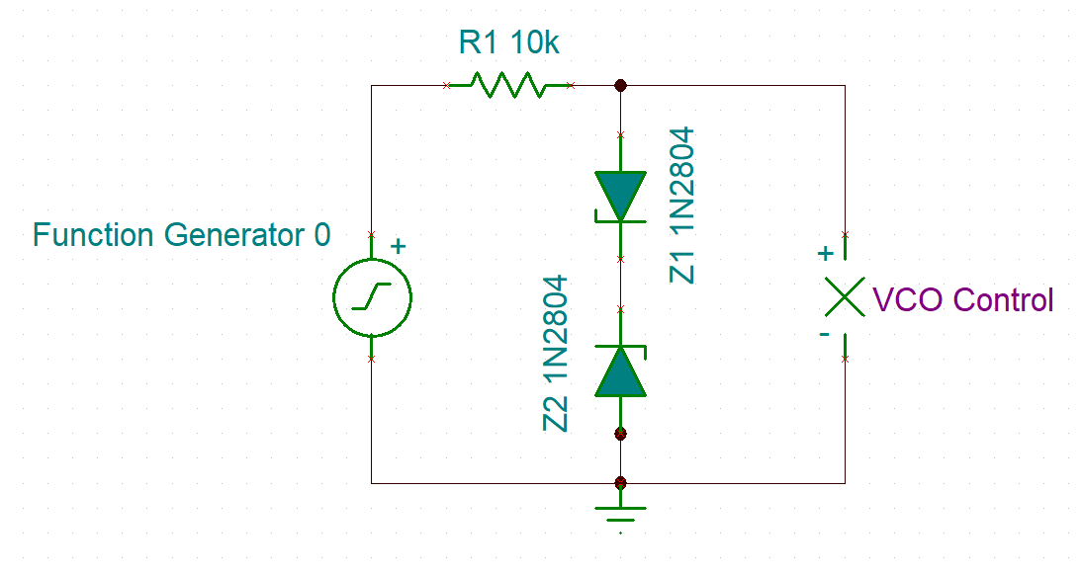
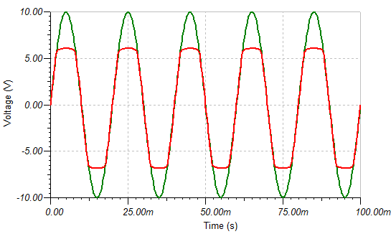
Radio Altimeter Tolerance of WAIC Systems
Expanding the Test Bed
VCO Protection Circuit
Function generators capable of destroying the VCO with wrong setting
Designed and simulated a double ‘clipper’ circuit to protect VCOs
Soldered diodes and resistor into function generator leads

Slide 40
Radio Altimeter Tolerance of WAIC Systems
Expanding the Test Bed
Landing Scenario Geometry
Airbus provided landing scenario analysis
Approach at a 3° slope
16 nearest interferers on aircraft modeled
Capable of WAIC and RA emissions
External devices placed at wing tip
Minimize slant range
Landing scenario geometry for 16 Nearest Interferers

Slide 41
Radio Altimeter Tolerance of WAIC Systems
Expanding the Test Bed
Landing Scenario Geometry
Airbus provided a landing scenario analysis
Internal WAIC devices placed at center of airframe
External devices placed at wing tip
Minimize slant range
Landing scenario geometry
Both Images of landing scenario used in ICAO Frequency Spectrum Management Panel Information Paper FSMP-WG08-IP04_WAIC_r1

Slide 42
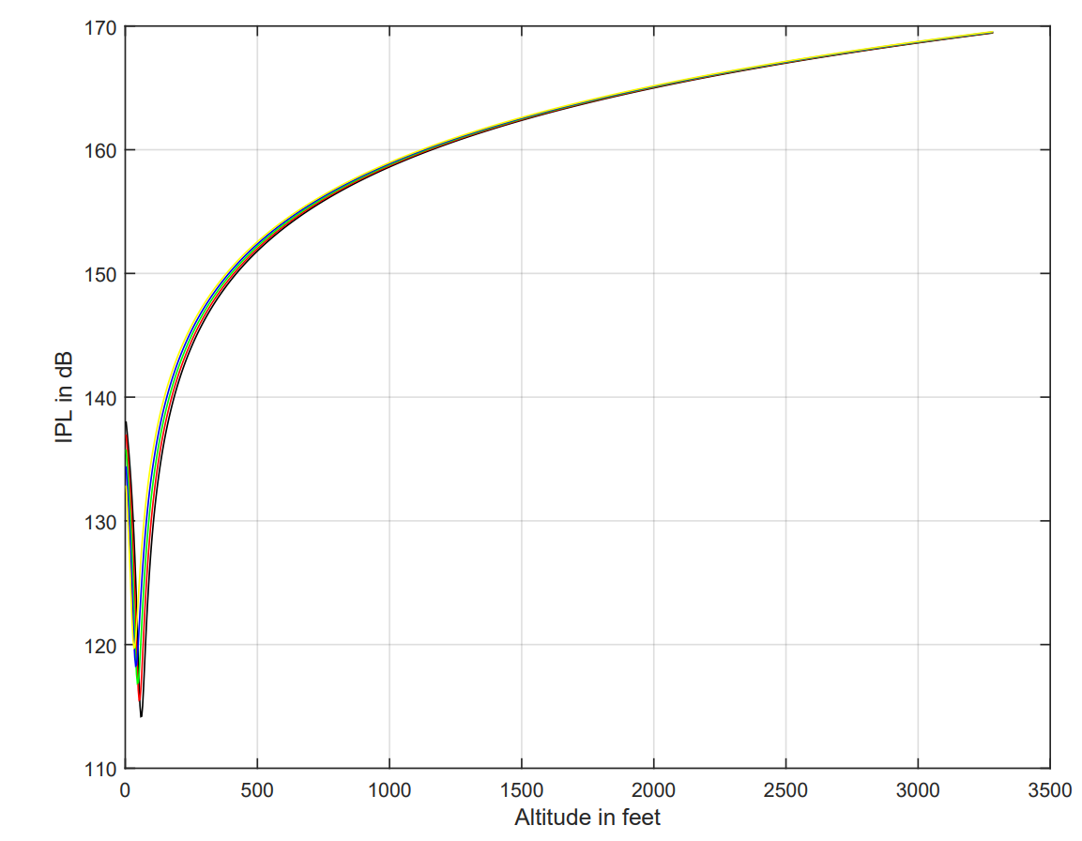
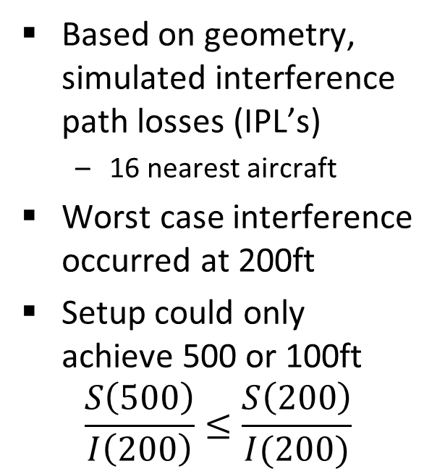
Radio Altimeter Tolerance of WAIC Systems
Expanding the Test Bed
Worst Case Landing Scenario
Based on geometry, simulated interference path losses (IPL’s)
16 nearest aircraft
Worst case interference occurred at 200ft
Setup could only achieve 500 or 100ft
$$\frac{S\left(500\right)}{I\left(200\right)}≤\frac{S\left(200\right)}{I(200)}$$
Plot of IPL vs altitude in landing scenario

Slide 43
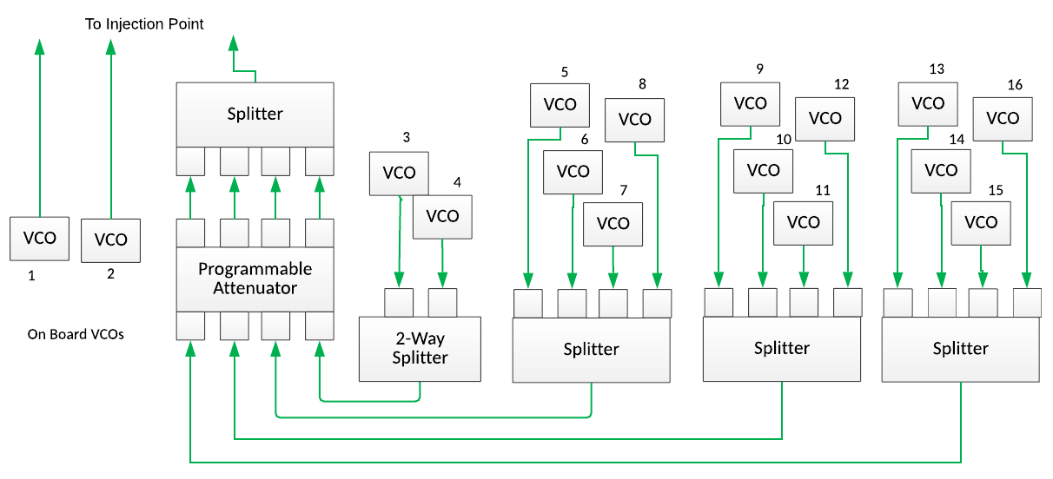
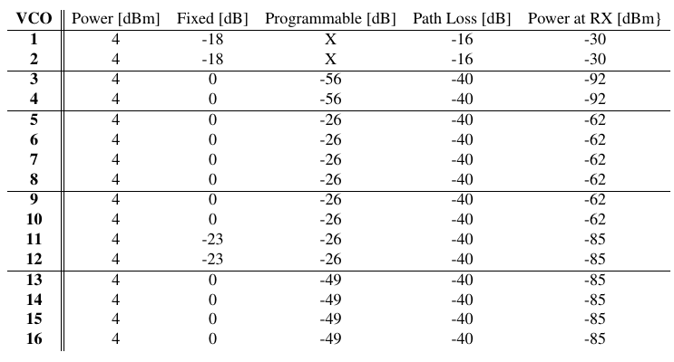
Radio Altimeter Tolerance of WAIC Systems
Expanding the Test Bed
Connecting VCO Signals
VCOs connected using splitters, programmable attenuator
First two VCOs simulate “Own Ship” altimeters
Combination of fixed and programmable attenuators achieve IPL’s

Slide 44
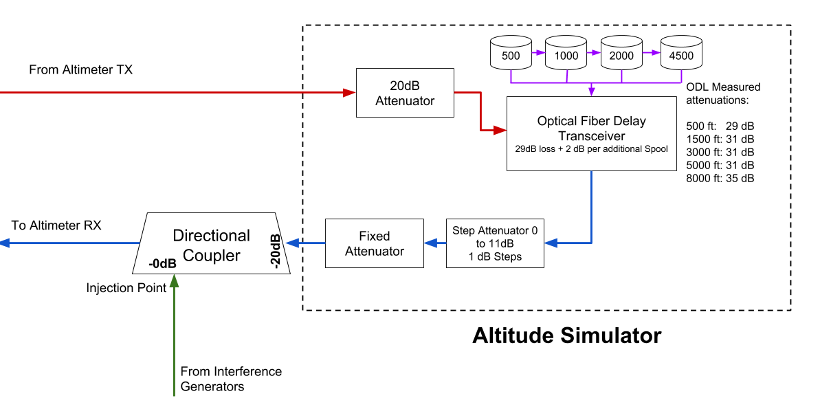
Radio Altimeter Tolerance of WAIC Systems
Expanding the Test Bed
Achieving Higher Power Interference
Simple modification to altitude simulator enabled higher power interference without changing fixed/step attenuators

Slide 45
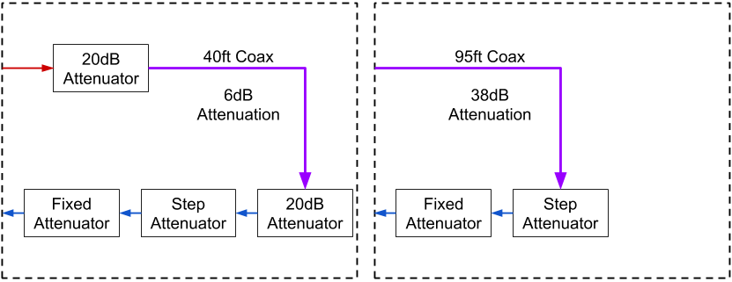
Radio Altimeter Tolerance of WAIC Systems
Expanding the Test Bed
Adding Lower Altitude Capability
40ft coax altitude simulator used some during initial testing regimen.
95ft coax added later on

Slide 46
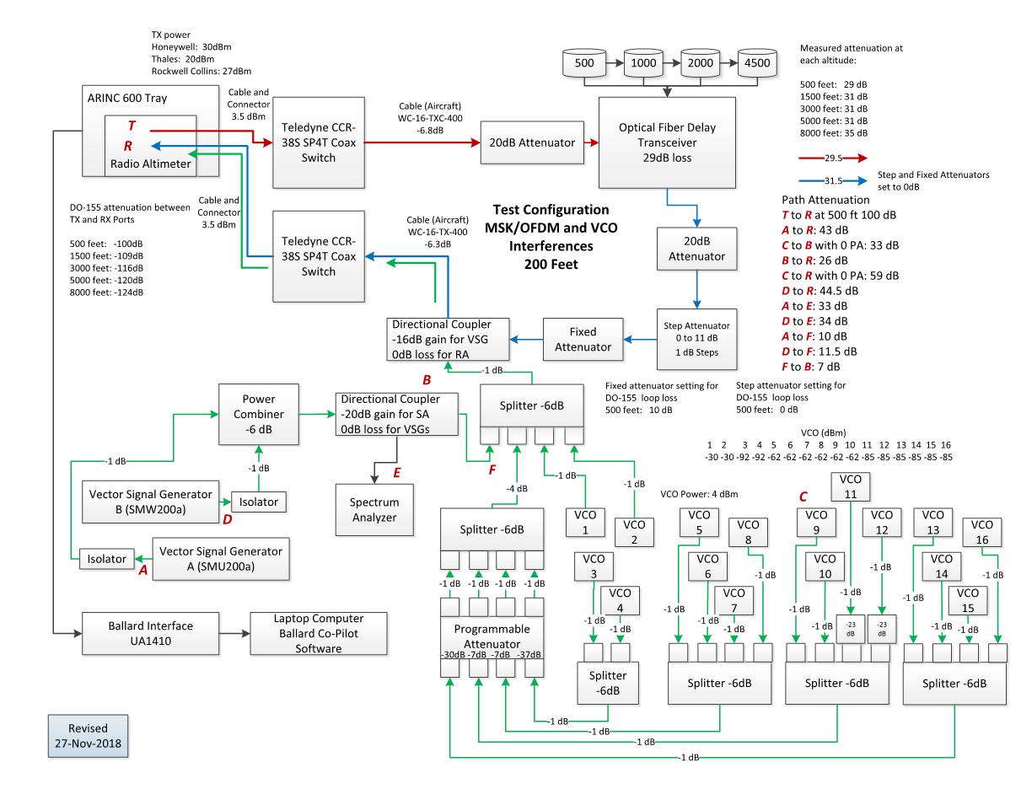
Radio Altimeter Tolerance of WAIC Systems
Expanding the Test Bed
Full Test Diagram

Slide 47
‘In Band’ WAIC Test Results

Slide 48
Radio Altimeter Tolerance of WAIC Systems
‘In Band’ WAIC Tests
Results Overview
Combined test setup described above used to simulate 200 MHz OFDM signals for all five altimeters
Breaking point defined as:
Any altitude labeled NCD
Any altitude with an absolute error greater than 2%
Any power causing a mean altitude error greater than 0.5%
Results brought to FSMP to propose Aggregate WAIC Interference thresholds

Slide 49
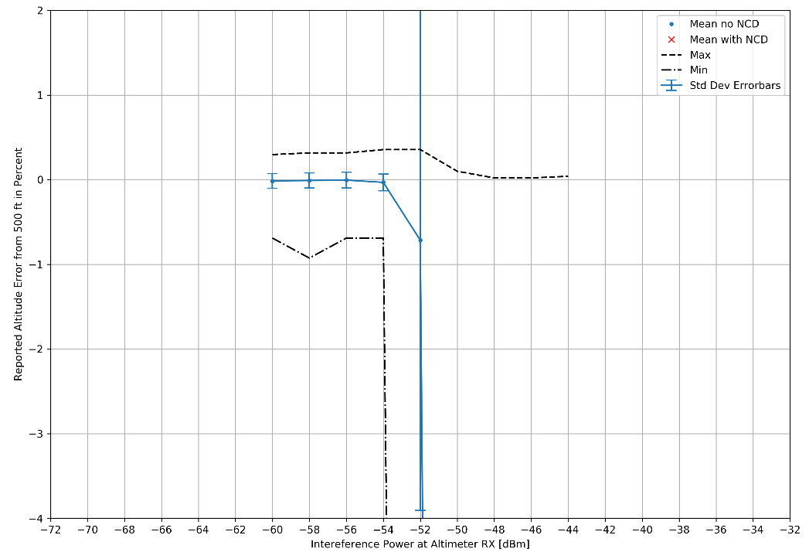
Radio Altimeter Tolerance of WAIC Systems
‘In Band’ WAIC Tests
Results – RA Type 1

Slide 50
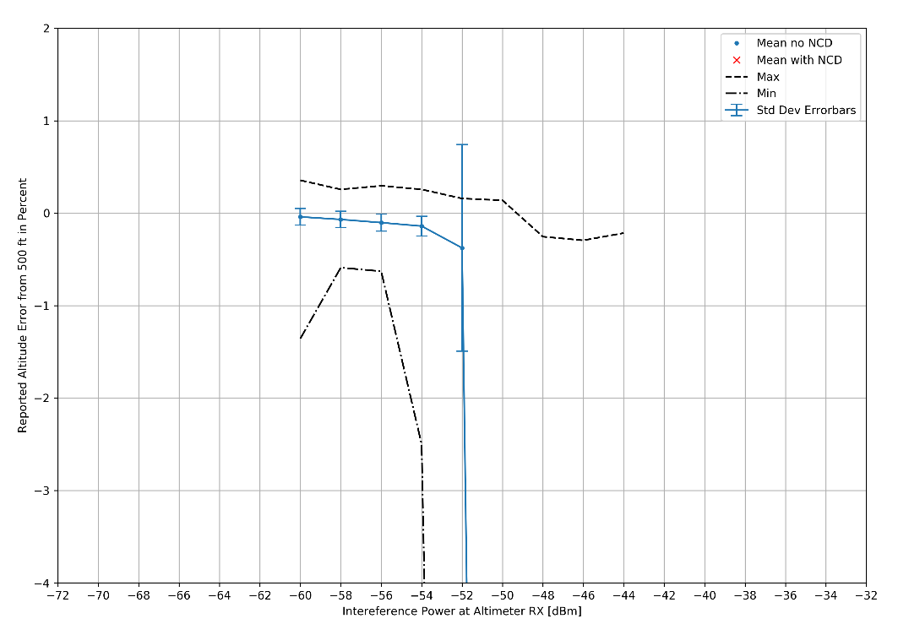
Radio Altimeter Tolerance of WAIC Systems
‘In Band’ WAIC Tests
Results – RA Type 2

Slide 51
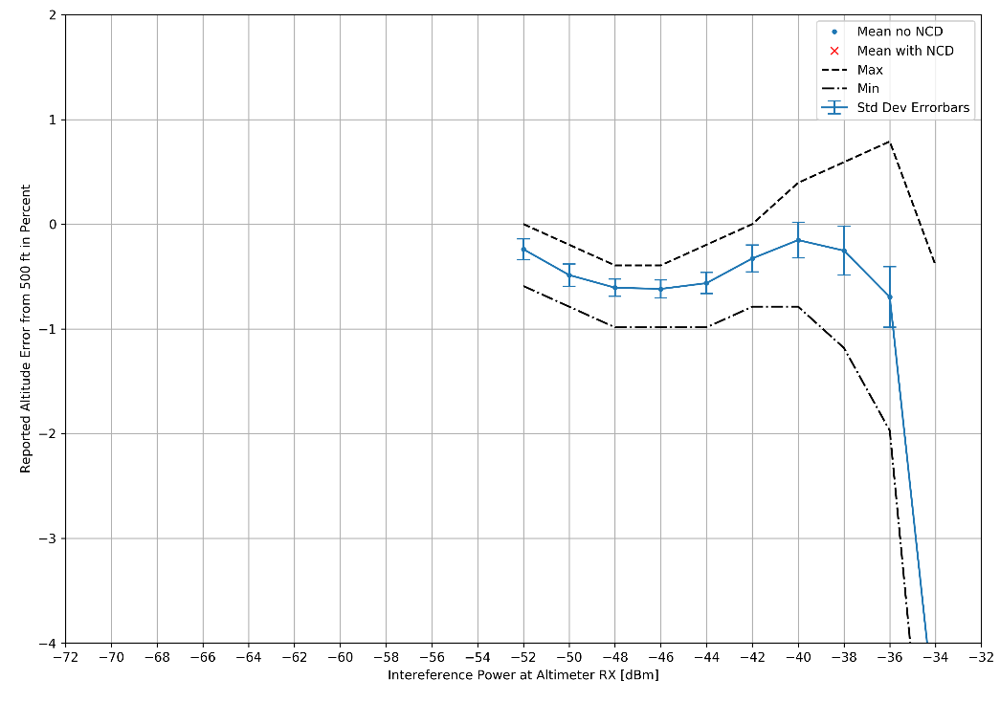
Radio Altimeter Tolerance of WAIC Systems
‘In Band’ WAIC Tests
Results – RA Type 3

Slide 52
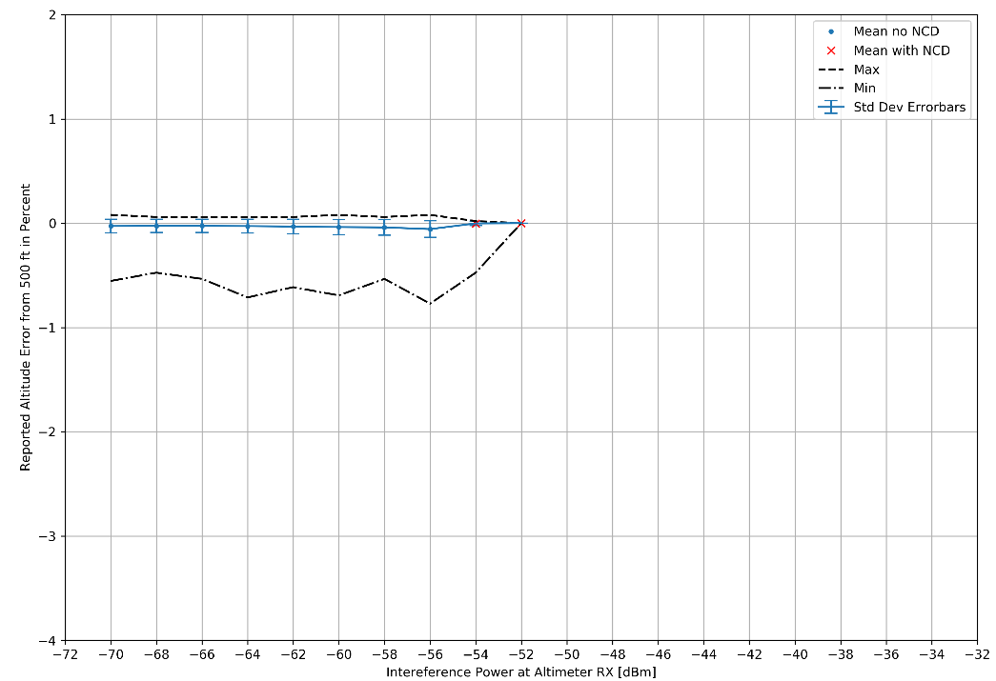
Radio Altimeter Tolerance of WAIC Systems
‘In Band’ WAIC Tests
Results – RA Type 4

Slide 53
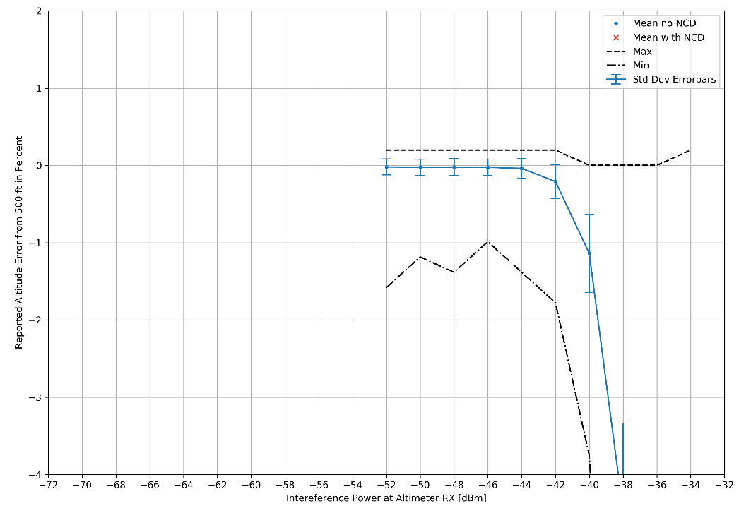
Radio Altimeter Tolerance of WAIC Systems
‘In Band’ WAIC Tests
Results – RA Type 5

Slide 54
Radio Altimeter Tolerance of WAIC Systems
‘In Band’ WAIC Tests
Results – Summary
 | RA Type 1 | RA Type 2 | RA Type 3 | RA Type 4 | RA Type 5
WAIC Interference Threshold | -54 dBm | -56 dBm | -44 dBm | -56 dBm* | -44 dBm

Slide 55
‘Out of Band’ WAIC Test Results

Slide 56
Radio Altimeter Tolerance of WAIC Systems
‘Out of Band’ WAIC Tests
Preliminary results here

Slide 57
Conclusions

Slide 58
Radio Altimeter Tolerance of WAIC Systems
Conclusions
Results of Test Bed Automation
Successfully developed a reference test bed validated by RA manufacturers and aircraft manufacturers.
Developed automation which enabled testing under a wide range of test conditions
Developed reporting formats which supported the development of international standards
International Civil Aviation Organization Standard and Recommended Practices
RTCA Inc. Minimum Aviation System Performance Standards
RTCA Inc. Minimum Operational Performance Standards

Slide 59
References
“Minimum Performance Standards Airborne Low-Range Radar Altimeters,” Industry Standard DO-155, Radio Technical Commission for Aeronautics, Washington, D.C., Nov. 1974.
“Compatibility Analysis Between Wireless Avionics Intra-Communication Systems and Systems in the Existing Services in the Frequency Band 4 200-4 400 MHz,” ITU Reccomendation ITU-R M.2319-0, International Telecommunication Union, Geneva, Switzerland, Nov. 2014.

