Slide 1
Radio Altimeter Tolerance of Wireless Avionics Intra-Communication (WAIC) Systems
Joshua Ruff
Advisor: Dr. Gregory H. Huff
Electromagnetics and Microwave Laboratory
Department of Electrical and Computer Engineering, TAMU
College Station, Texas, 77843-3128
3-8-2019

Slide 2
Radio Altimeter Tolerance of WAIC Systems
Acknowledgements
Project Funding
This work was sponsored by the Aerospace Vehicles Systems Institute (AVSI) through Authorization for Expenditure 76s1 (AFE 76s1)
Project members include Honeywell*, Rockwell Collins*, Thales*, Garmin*, Airbus, Boeing, Embraer, Lufthansa, UTC, Zodiac, NASA, FAA, IATA
Members contributed funding, equipment, and expertise without which the project would not have been completed
* contributed widely used commercial radio altimeter models for testing

Slide 3
Introduction

Slide 4

Radio Altimeter Tolerance of WAIC Systems
Introduction
Motivation – Wireless Avionics
Critical instruments have redundant wiring
Moving to wireless reduces need for redundant paths
Interest in wireless spans the aerospace industry:
Regulators: dissimilar redundancy
Airframers: fuel efficiency
Manufacturers: new products
Source: https://www.bbc.com/news/business-23076586

Slide 5
Radio Altimeter Tolerance of WAIC Systems
Introduction
History – Acquiring Spectrum
Feasibility study found no insurmountable barriers
AVSI began effort to acquire spectrum in 2008
Effort to find suitable band spanned World Radio Conferences in 2012 and 2015 (WRC-12 and WRC-15)
WAIC placed on agenda at WRC-12, studied candidate bands
An allocation in the Radio Altimeter (4.2-4.4GHz) band was secured at WRC-15
As a condition of allocation, WAIC had to develop international standards which ensured compatibility with radio altimeters

Slide 6
Radio Altimeter Tolerance of WAIC Systems
Introduction
Project Goals
AVSI wanted to determine WAIC operating characteristics which ensured compatibility with radio altimeters
Altimeter manufacturers could have done this themselves, but a neutral party provided objectivity
Approached Huff Research Group at Texas A&M to develop an automated test bench for radio altimeters
My contribution was the development of this test bench throughout the project, the execution of these compatibility tests, and support the analysis of the data

Slide 7
Radio Altimeter Tolerance of WAIC Systems
Introduction
Project Goals
Results support generation of regulatory documentation
International Civil Aviation Organization (ICAO)
Standard and Recommended Practices (SARPs)
Radio Telecommunication Technology Association (RTCA, inc)
Minimum Aviation System Performance Standards (MASPS)
Minimum Operational Performance Standards (MOPS)
This type of characterization of Radio Altimeters has never been performed before
Historically always a protected band

Slide 8
Background

Slide 9
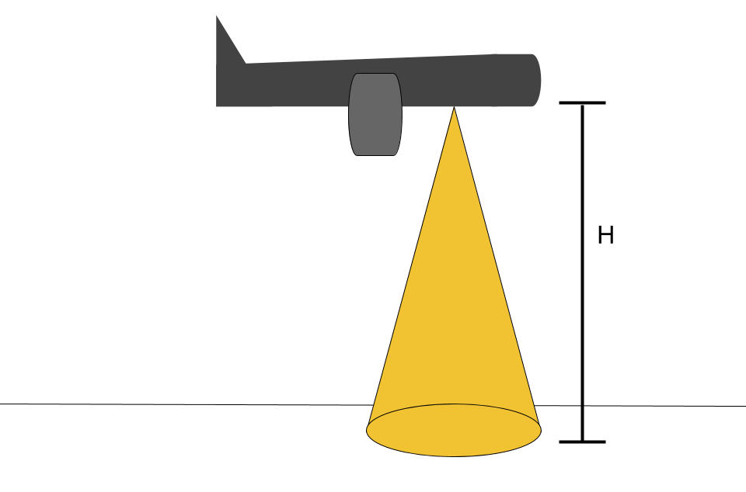
Radio Altimeter Tolerance of WAIC Systems
Background
Radar Altimeter Applications
Radio altimeters (RAs) measure height with radar signal
Function on the 4200 – 4400 MHz band
Used in autopilot, navigation systems
Safety critical function
Heavily regulated

Slide 10
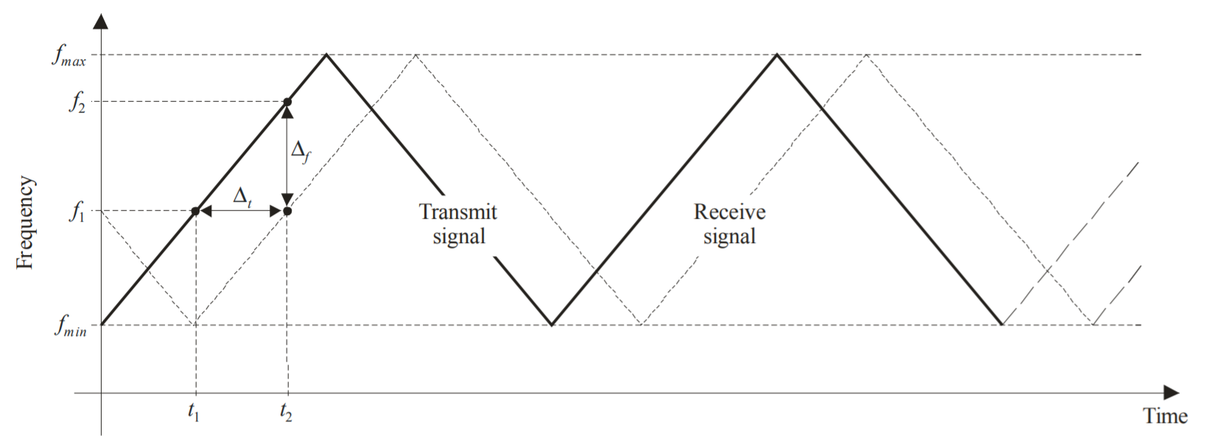
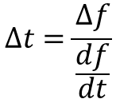
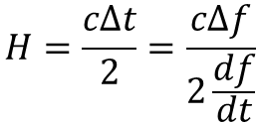
Radio Altimeter Tolerance of WAIC Systems
Background
Radar Altimeter Functionality
Frequency Modulated Continuous Wave (FMCW) signal
Return time of computed from frequency shift
$$Δt=\frac{Δf}{\frac{df}{dt}}$$
$$H=\frac{cΔt}{2}=\frac{cΔf}{2\frac{df}{dt}}$$
FMCW diagram from DO-155

Slide 11
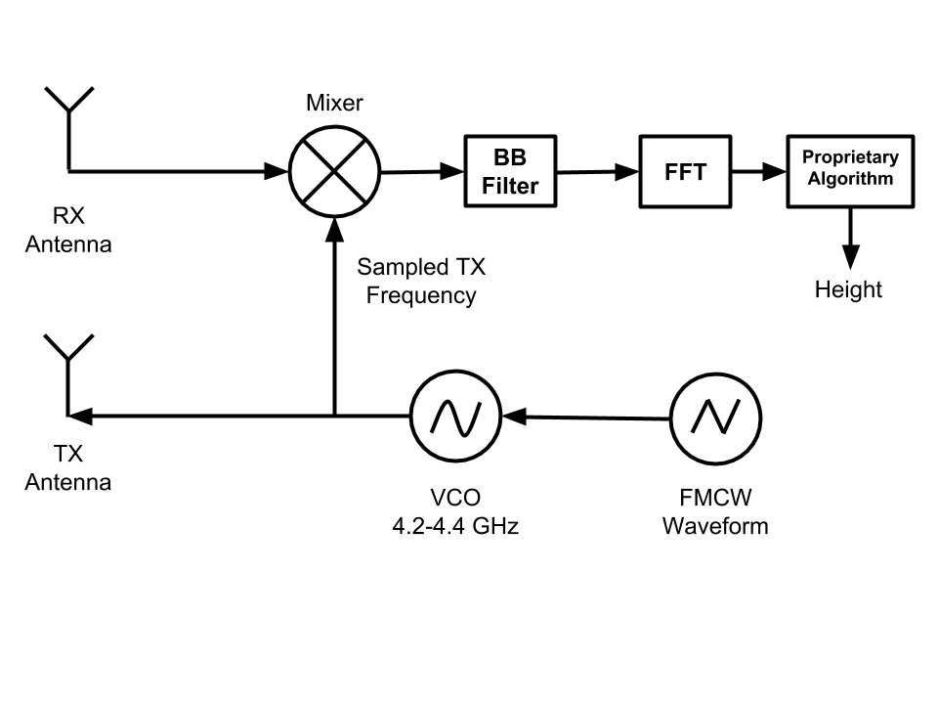
Radio Altimeter Tolerance of WAIC Systems
Background
Altimeter Signal Processing
Homodyne detection extracts altitude data
Actively transmitted waveform fed into receiver mixer
FFT allows post processing in frequency domain
Proprietary algorithms then estimate altitude

Slide 12
Radio Altimeter Tolerance of WAIC Systems
Background
Loop Loss
RA signal affected by:
TX/RX Cable losses
Free Space Path Loss
Scattering by Ground
Antenna gains
Standard loop losses defined in RTCA DO-155
encapsulates these effects for standard configurations
Height [ft] | Loop Loss [dB]
40 | 76
95 | 84
500 | 100
1500 | 109
3000 | 116
5000 | 120
8000 | 124
Loop loss for 60° antennas and worse case scattering

Slide 13
Test Bed Development

Slide 14
Radio Altimeter Tolerance of WAIC Systems
Test Bed Development
Project Overview
Test setup evolved over three testing regimens
First developed testbed and investigated basic altimeter response
Second tested filled entire band with representative interference
Third tested out of band signals
Results from the first test informed both the second and third studies
Results from next two studies inform deployment of regulatory documents
Out of band testing still active
Preliminary results shown here

Slide 15
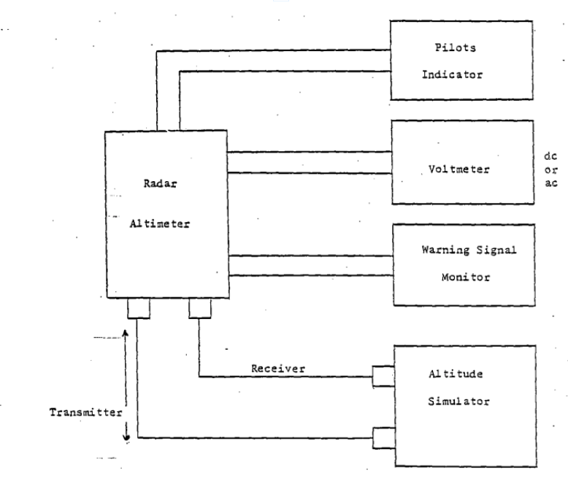
Radio Altimeter Tolerance of WAIC Systems
Test Bed Development
Basic Altimeter Test Bed
Test bed developed from DO-155 specs
Basic test bed required
Altitude Simulator
Data Acquisition
Altitude simulator most critical
Device which delays and attenuates RF energy
Basic altimeter test bed
Source: DO-155

Slide 16
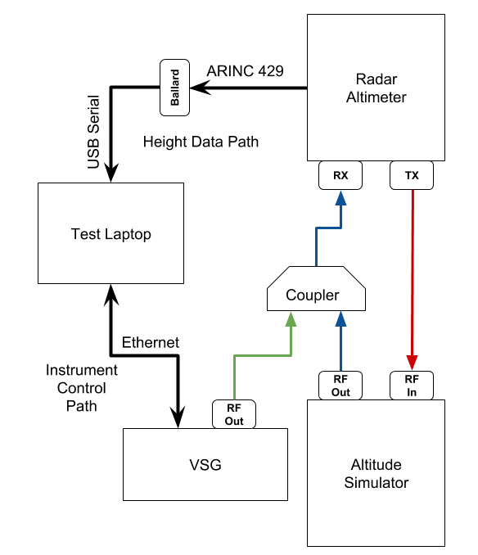
Radio Altimeter Tolerance of WAIC Systems
Test Bed Development
Modified Altimeter Test Bed
AVSI developed testbed based on DO-155
VSG coupled to altitude simulator output
Altimeter operates normally
computed altitude output on digital avionics bus (ARINC-429)
Ballard Copilot software reads data from ARINC bus

Slide 17
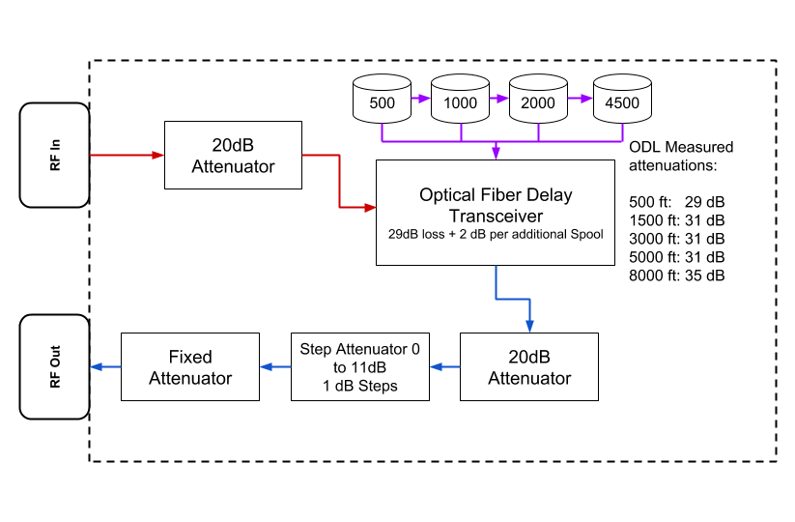
Radio Altimeter Tolerance of WAIC Systems
Test Bed Development
Altitude Simulator
Optical delay line implements altitude simulator
Switchable “Fixed” and “Step attenuator” achieve desired loop loss
Cascade different spools of fiber optic line for different altitude

Slide 18
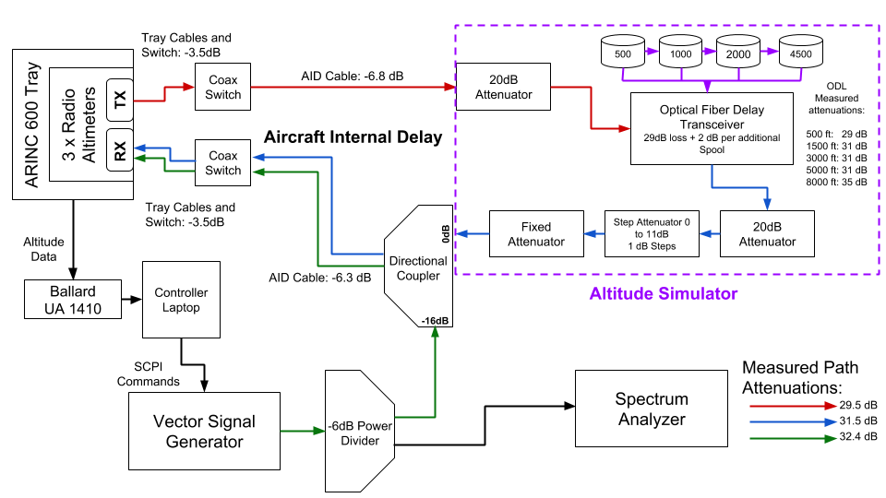
Radio Altimeter Tolerance of WAIC Systems
Test Bed Development
Full Setup Diagram

Slide 19
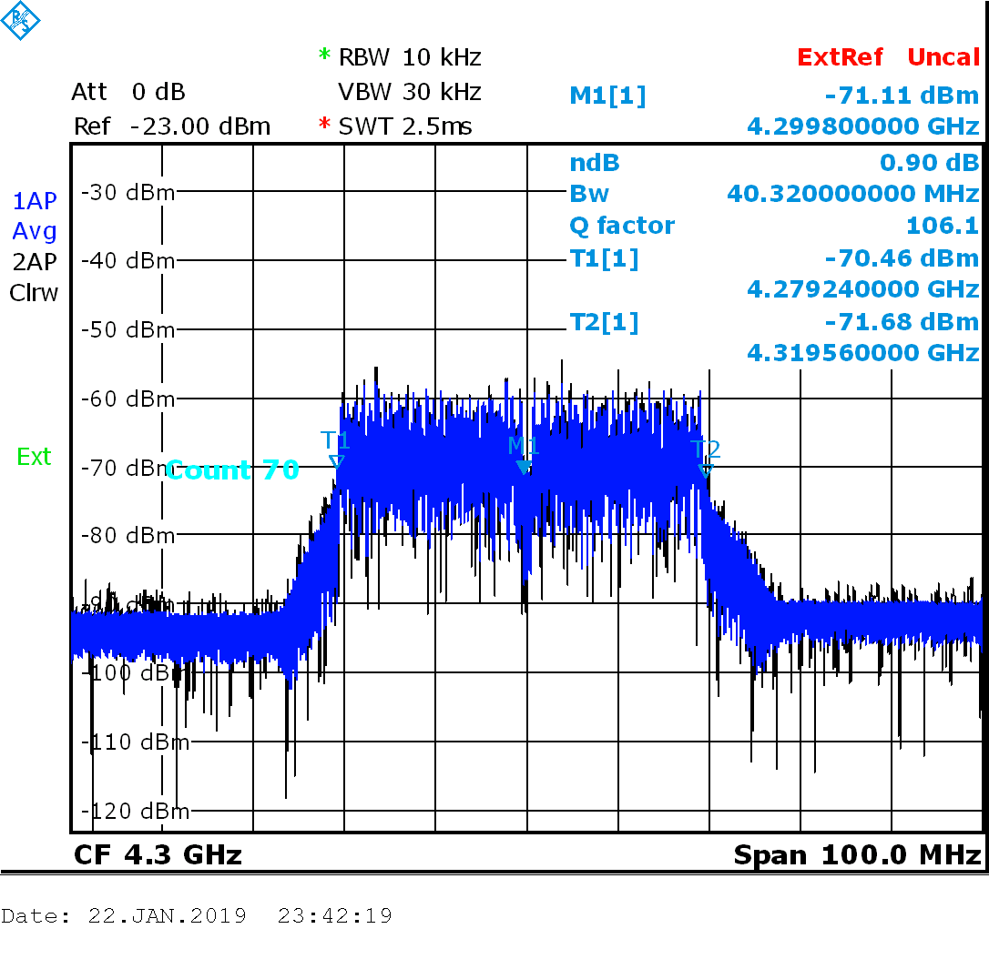
Radio Altimeter Tolerance of WAIC Systems
Test Bed Development
Waveform Generation
MSK and OFDM were candidate WAIC signals used as representative interference waveforms
OFDM used for LTE
MSK variant used for GSM networks
Reuse existing technology where possible
OFDM bandwidths varying from 5 to 80 MHz tested
40 MHz OFDM on Spectrum Analyzer

Slide 20
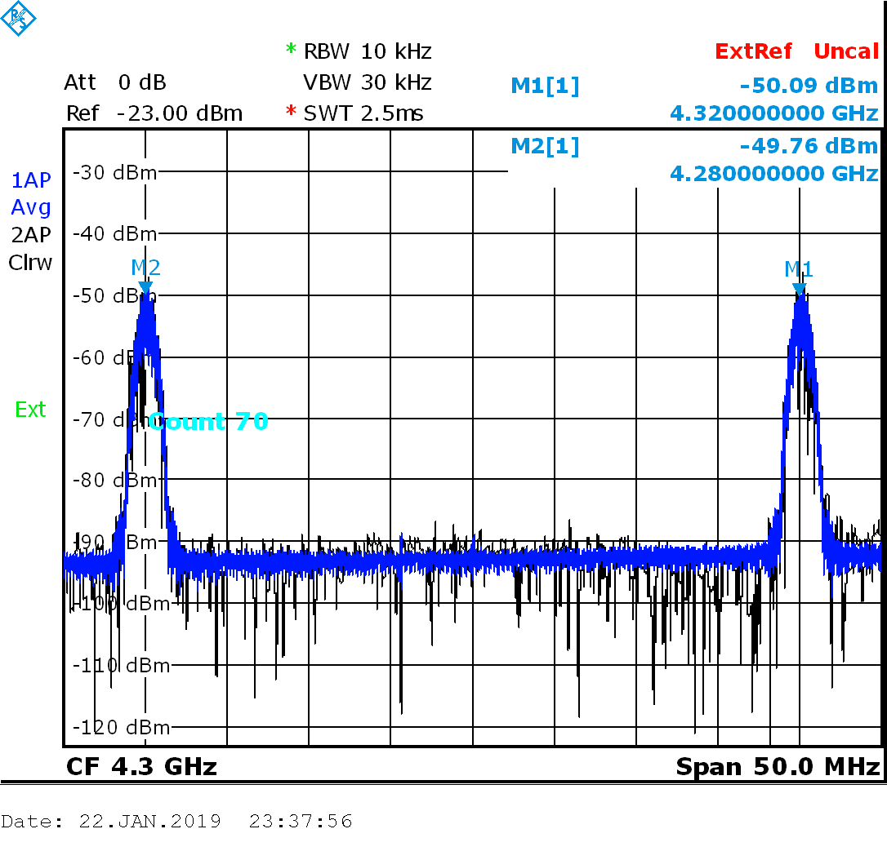
Radio Altimeter Tolerance of WAIC Systems
Test Bed Development
Waveform Generation
Dual and single versions of both waveforms used
Dual waveforms had 20 MHz offset
MSK can be interpreted as minimum bandwidth version of OFDM
Wide bandwidth simulates multiple radios
Dual MSK on Spectrum Analyzer

Slide 21
Radio Altimeter Tolerance of WAIC Systems
Test Bed Development
Interference Generation
VSG baseband generator set modulation
RF Generator set carrier frequency and power
RF toggled ON and OFF
Increasing power over time
RF OFF allows altimeter to recover
“Staircase” Power Profile

Slide 22
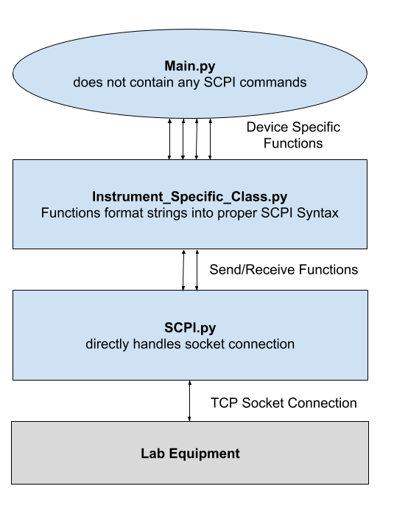
Radio Altimeter Tolerance of WAIC Systems
Test Bed Development
Software Architecture
Main loop controls power/modulation stepping
Functions in VSG class construct strings for each command
SCPI.py handles TCP connection
Main loop never touches strings or TCP
SCPI class hierarchy enables reconfigurability

Slide 23
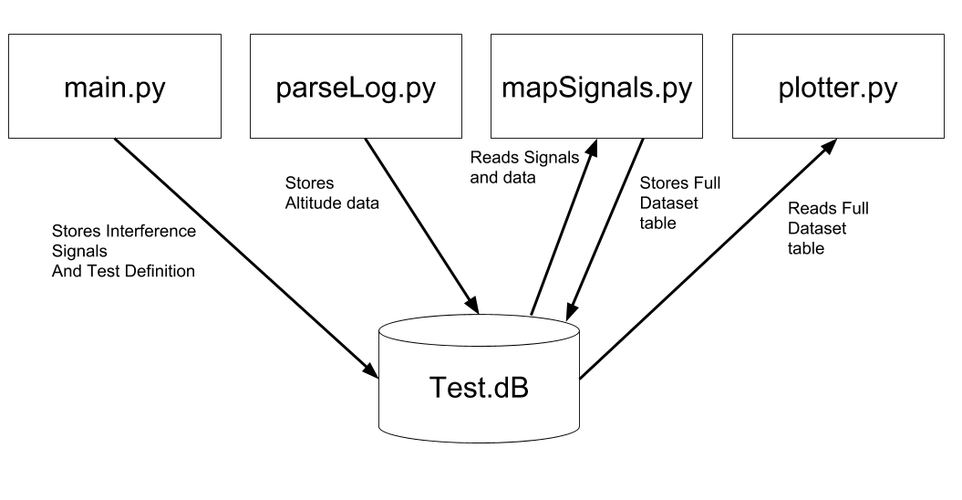
Radio Altimeter Tolerance of WAIC Systems
Test Bed Development
Data Storage and Post Processing
SQLite database for data storage
Table of measured heights and interference signals
Both time stamped
Measurements mapped to VSG state
Test metadata also stored
Functionality of each Python script as it interacts with SQLite database

Slide 24
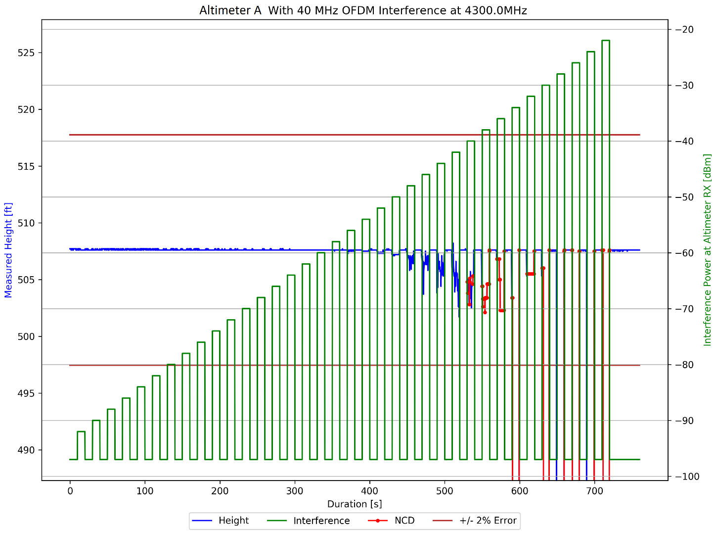
Radio Altimeter Tolerance of WAIC Systems
Test Bed Development
Data Display – Height Plots
Example ‘Height Plot’ shown
Altitude signal distorted with increasing power
Eventually altimeter throws NCD
Error Tolerance defined as 2% or any NCD

Slide 25
Radio Altimeter Tolerance of WAIC Systems
Test Bed Development
Nominal Height vs Correct Height
Tests run at a ‘nominal height’ based on delay device
500ft, 1500ft, 40ft, ect.
Altimeter may output from ~490 to ~510 for 500ft test
Real installations calibrate out AID and airfame height
We’re only interested in the error
absolute height not important, so we don’t calibrate
Correct Height defined as median with no interference
All errors measured from this value

Slide 26
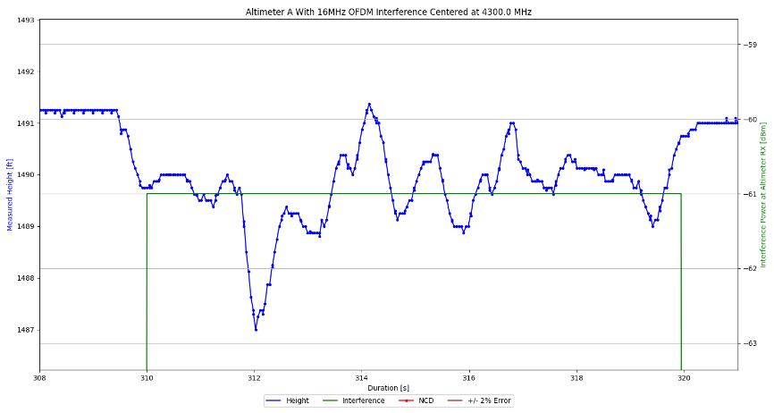
Radio Altimeter Tolerance of WAIC Systems
Test Bed Development
Timing and Synchronization
Several Synchronization issues appeared
Significant improvement from dedicated LAN
‘wait until’ delay function yielded precise interference durations
Ballard internal clock lagged behind slightly
Height Plot zoomed in on one power level

Slide 27
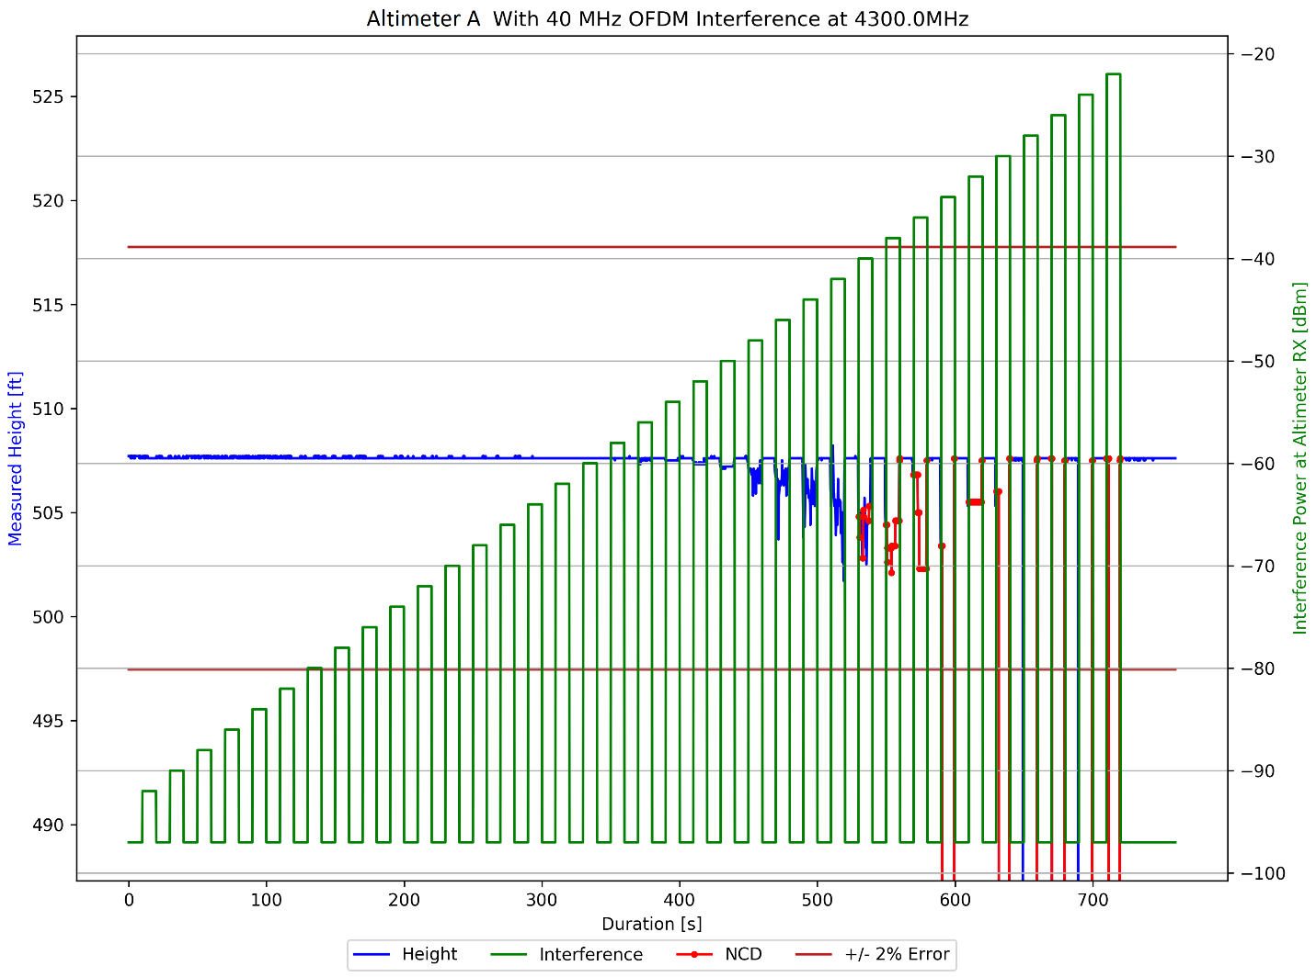
Radio Altimeter Tolerance of WAIC Systems
Test Bed Development
Data Display – Height Plot Again
Height plots were effective but cluttered
Needed more compact way to display same information

Slide 28
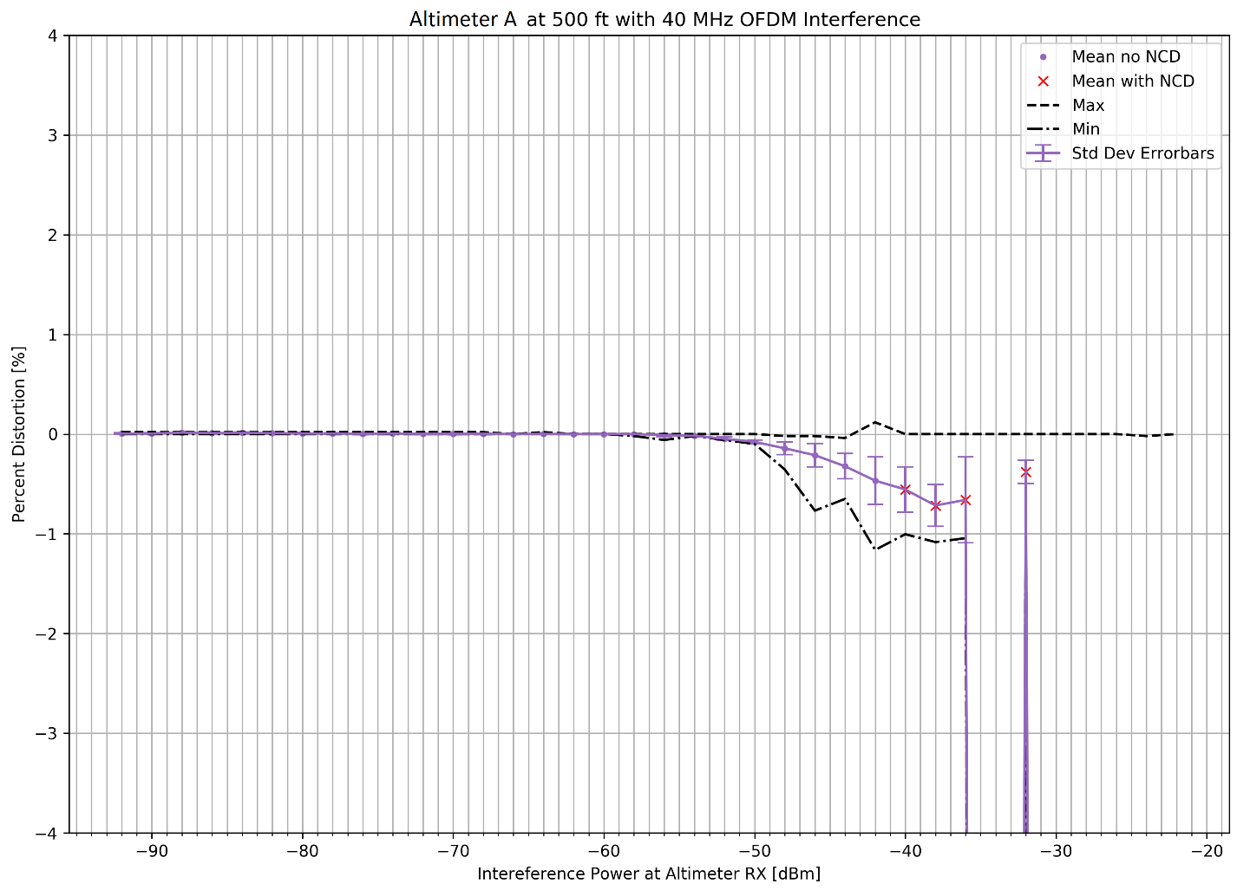
Radio Altimeter Tolerance of WAIC Systems
Test Bed Development
Data Display - Statistical Plots
Example ‘Stat Plot’ shown
Used to determine thresholds
Shows same information except time
Less useful for debugging
Percent Error [%]

Slide 29
Initial Test Regimen – WAIC Only Interference

Slide 30
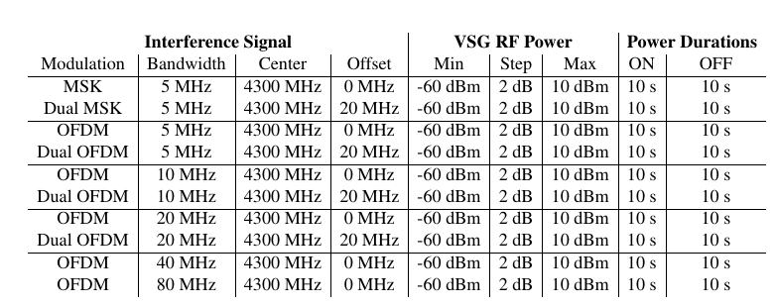
Radio Altimeter Tolerance of WAIC Systems
WAIC Only Interference
Goals and Test Definition
Find ‘breaking point’ for different waveforms
Find sensitivity to
interference bandwidth
position in spectrum
Separation of signal into dual waveforms
Bring results to regulators or develop further tests
Example test definition

Slide 31
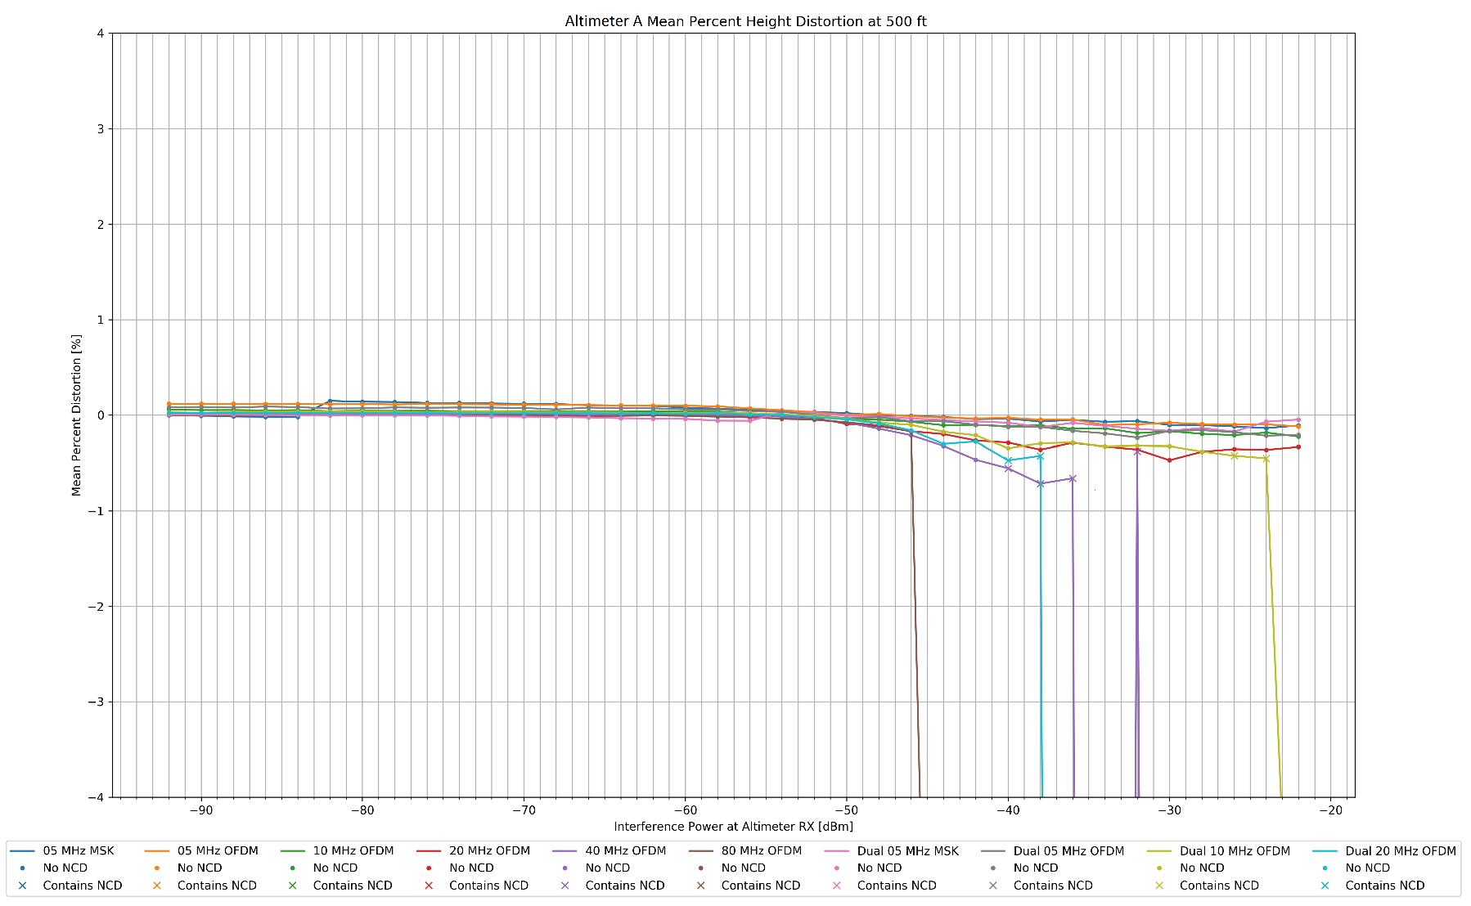
Radio Altimeter Tolerance of WAIC Systems
WAIC Only Interference
Results – Altitude Degradation vs Bandwidth/Power
Mean Percent Error [%]

Slide 32
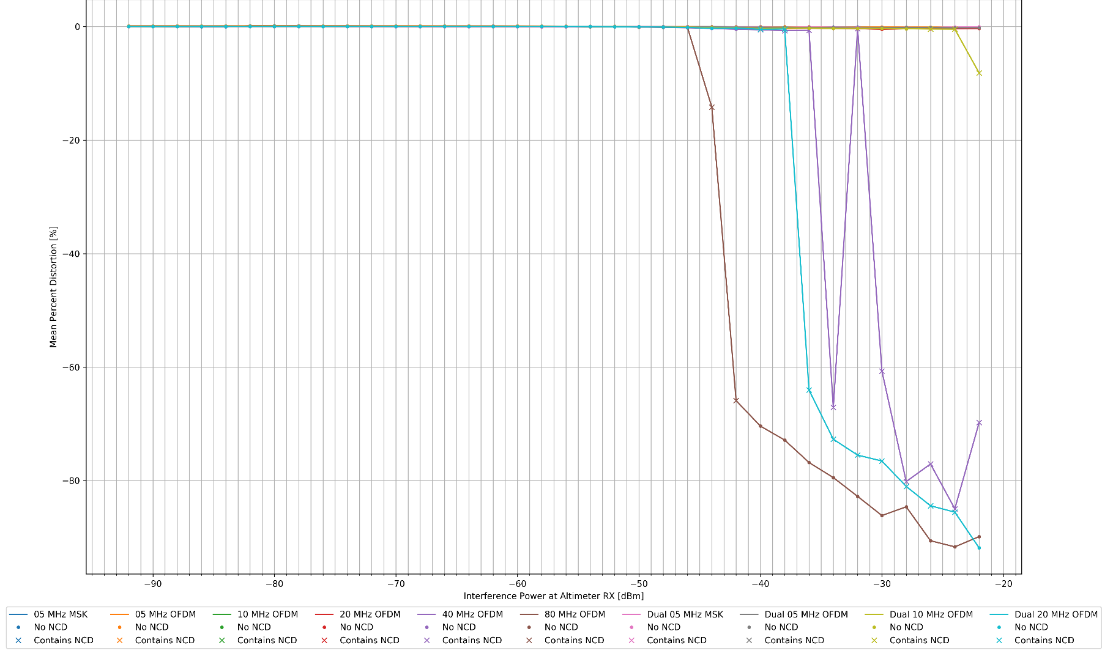
Radio Altimeter Tolerance of WAIC Systems
WAIC Only Interference
Results – Altitude Degradation vs Bandwidth/Power
Mean Percent Error [%]

Slide 33
Radio Altimeter Tolerance of WAIC Systems
WAIC Only Interference
Breaking Point Definitions
ARINC 707 standards specify minimum accuracy of +/-2%
AVSI determined early on that WAIC would need to cause an error significantly below this margin
Mean of 0.5% settled on
a quarter of the allowable error
Tolerance from all WAIC radios combined on an aircraft
2% err or NCD would still cause ‘breaking point’
Interference power corresponding to breaking point can be used to determine allowable WAIC transmissions compatible with RA’s

Slide 34
Radio Altimeter Tolerance of WAIC Systems
WAIC Only Interference
Results
Summary of results submitted to FSMP. Each data point represents the power level at which an altimeter exceeded 0.5% error

Slide 35
Radio Altimeter Tolerance of WAIC Systems
WAIC Only Interference
Results
Sensitivity to bandwidth
most sensitive to wider bandwidth signals
Sensitivity to position in band
Signals at the band edges had fewer effects
Band center was the most sensitive to interference
Separation of dual waveforms helped but not consistently
Needed to test altimeters under worst case scenario
Interference from other altimeters during approach
Full 200MHz band filled WAIC Interferers
Thresholds under worst case used to create standards

Slide 36
Expanding the Test bed

Slide 37
Radio Altimeter Tolerance of WAIC Systems
Expanding the Test Bed
Motivation - Landing Scenario Geometry
Airbus provided landing scenario analysis
WAIC system modeled as isotropic radiator at geometric center of aircraft
Landing scenario geometry for 16 Nearest Interferers
Images of landing scenario used in ICAO Frequency Spectrum Management Panel Information Paper FSMP-WG08-IP04_WAIC_r1

Slide 38
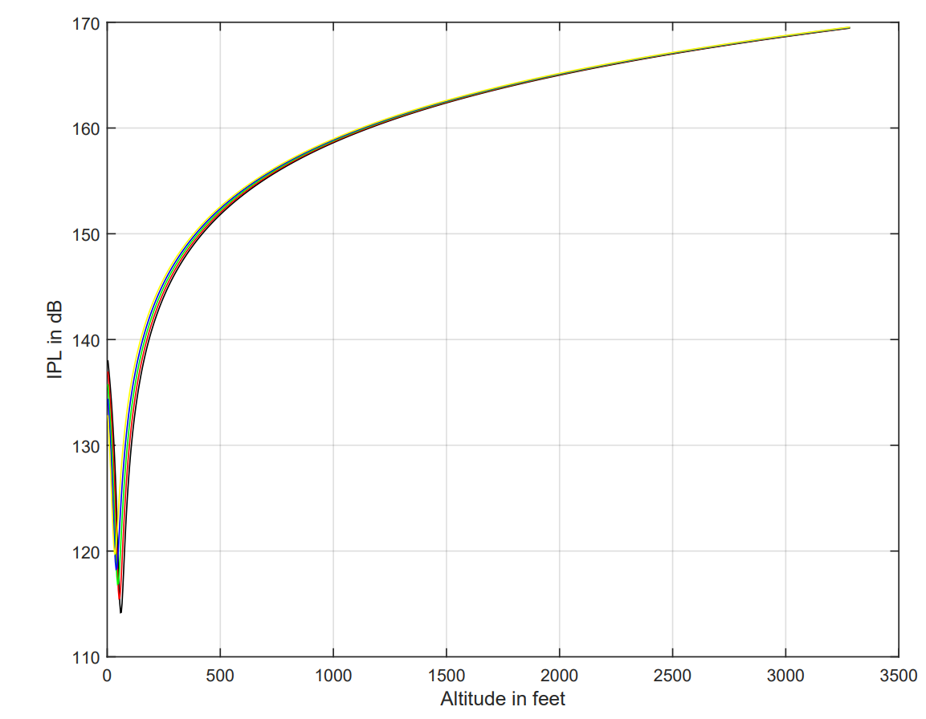
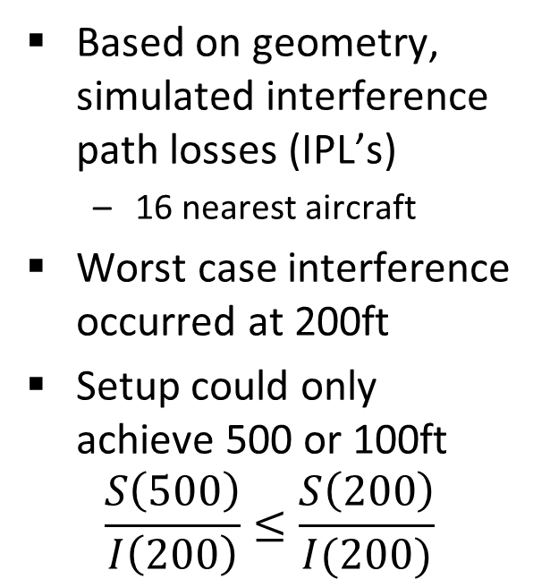
Radio Altimeter Tolerance of WAIC Systems
Expanding the Test Bed
Worst Case Landing Scenario
Based on geometry, simulated interference path losses (IPL’s)
16 nearest aircraft
Worst case interference occurred at 200ft
Setup could only achieve 500 or 100ft
$$\frac{S\left(500\right)}{I\left(200\right)}≤\frac{S\left(200\right)}{I(200)}$$
Plot of IPL vs altitude in landing scenario

Slide 39
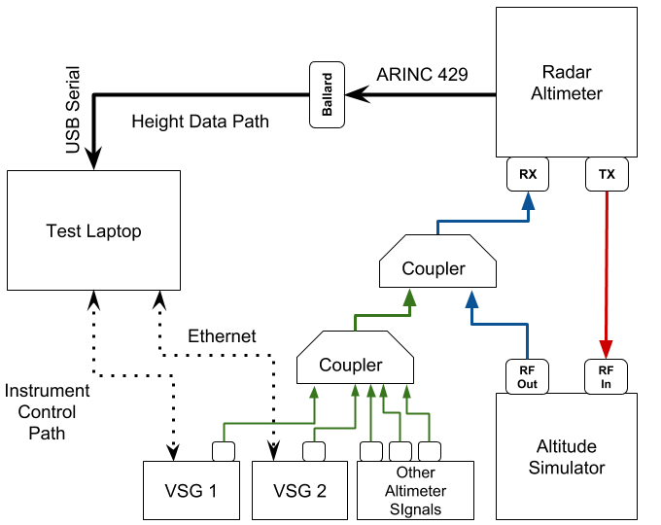
Radio Altimeter Tolerance of WAIC Systems
Expanding the Test Bed
Overview
Second VSG enables wider band signals
Simulated altimeter signals also injected
Altitude Simulator modified for lower altitudes and higher interference power
Realistic worst case to support ICAO SARPs

Slide 40
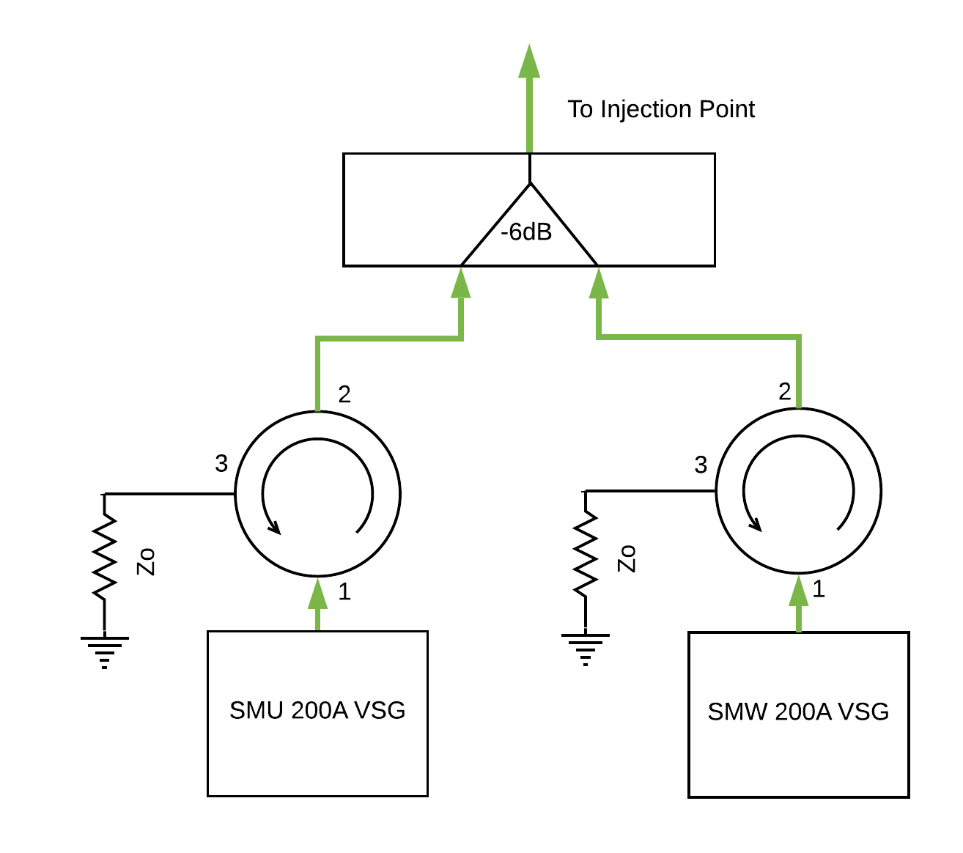
Radio Altimeter Tolerance of WAIC Systems
Expanding the Test Bed
Adding the Second VSG
Resistive 6dB coupler did not provide enough isolation
Looked into new couplers
Garmin provided circulators for free
Function as isolators when one port has a matched load

Slide 41
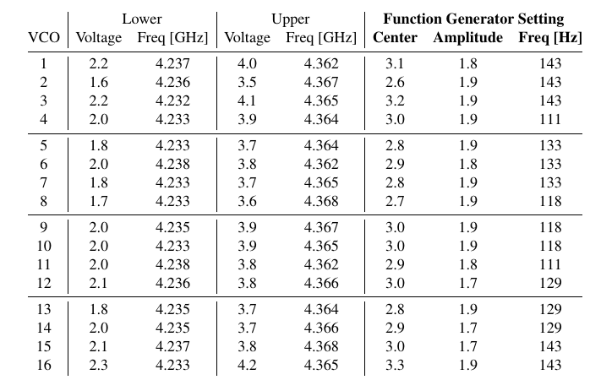
Radio Altimeter Tolerance of WAIC Systems
Expanding the Test Bed
Simulating Altimeter Interference – Sweep Characteristics
Simulated other altimeter signals using VCOs
Control voltage changes oscillation frequency
Function generators output triangle voltage waveform
Triangle waveform simulates FMCW
Table of control voltages for all 16 VCOs

Slide 42
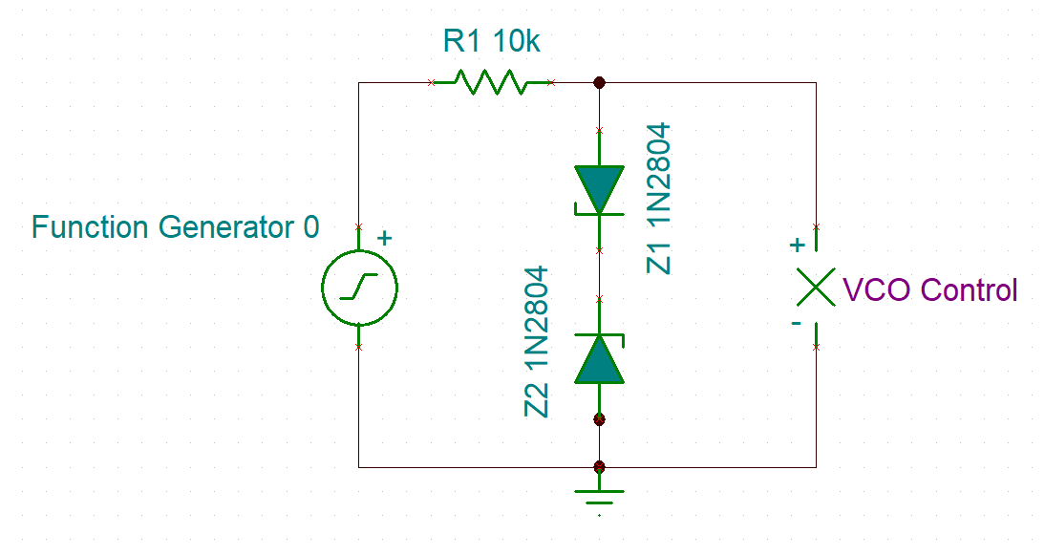
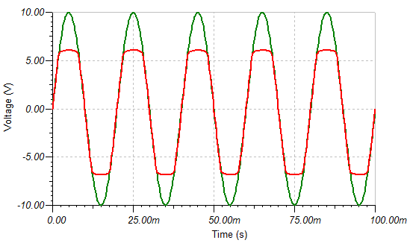
Radio Altimeter Tolerance of WAIC Systems
Expanding the Test Bed
Simulating Altimeter Interference – VCO Protection Circuit
Function generators capable of destroying the VCO with wrong setting
Designed and simulated a double ‘clipper’ circuit to protect VCOs
Soldered diodes and resistor into function generator leads

Slide 43
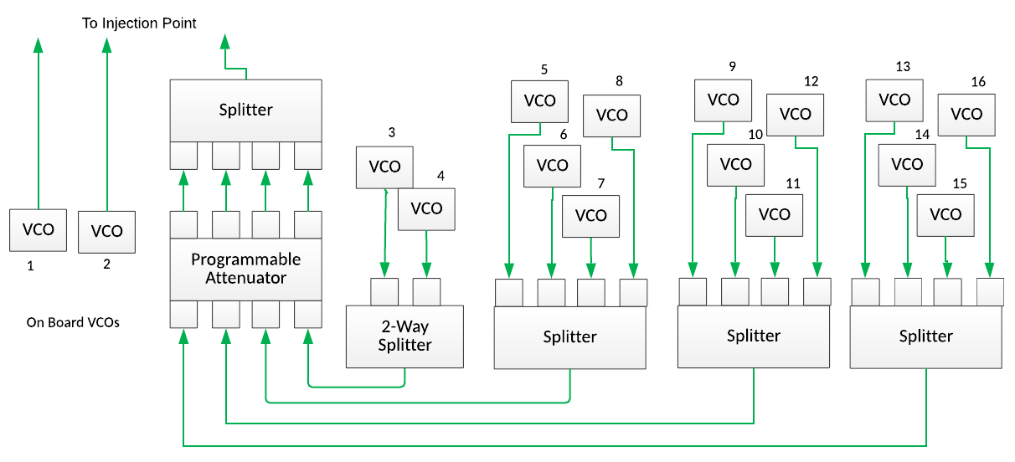
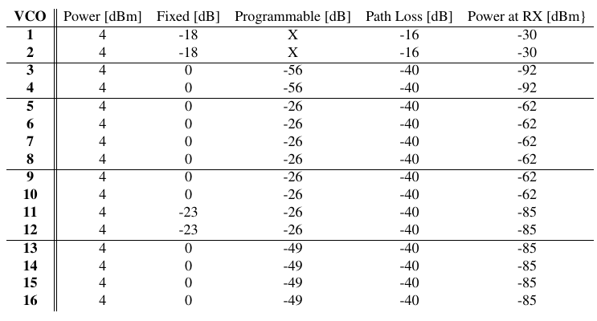
Radio Altimeter Tolerance of WAIC Systems
Expanding the Test Bed
Simulating Altimeter Interference – Attenuation Characteristics
VCOs connected using splitters/combiners, programmable attenuator
First two VCOs simulate “Own Ship” altimeters
Combination of fixed and programmable attenuators achieve IPL’s representative of landing Scenario

Slide 44
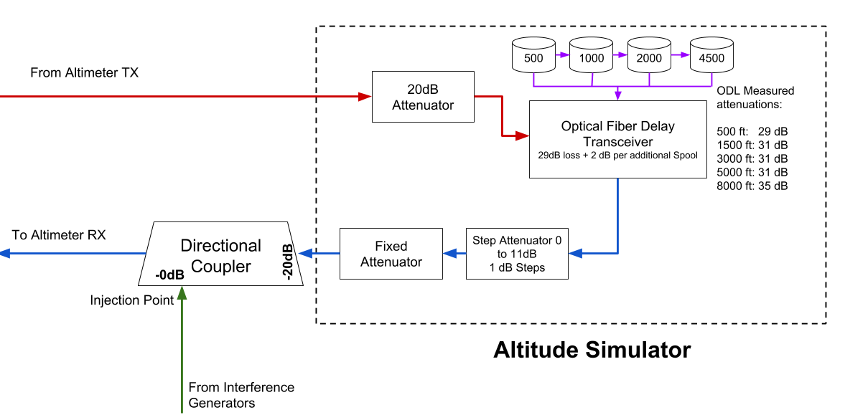
Radio Altimeter Tolerance of WAIC Systems
Expanding the Test Bed
Achieving Higher Power Interference
Simple modification to altitude simulator enabled higher power interference without changing fixed/step attenuators

Slide 45
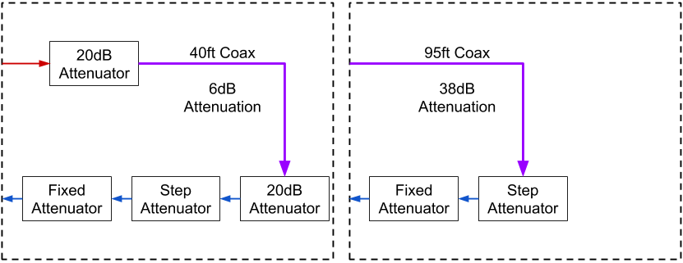
Radio Altimeter Tolerance of WAIC Systems
Expanding the Test Bed
Adding Lower Altitude Capability
40ft coax altitude simulator used some during initial testing regimen.
95ft coax added later on

Slide 46
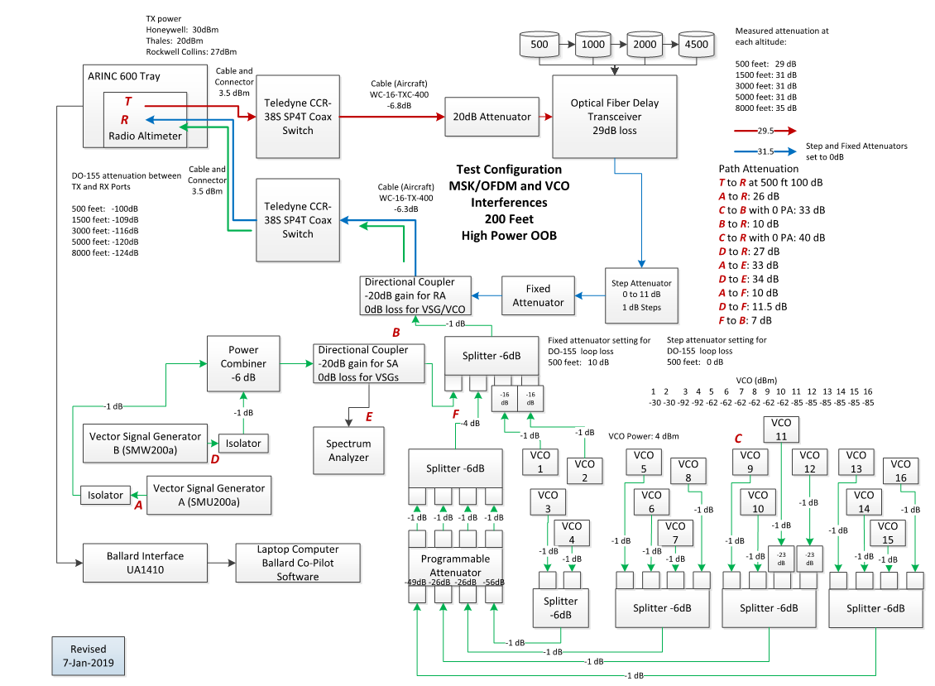
Radio Altimeter Tolerance of WAIC Systems
Expanding the Test Bed
Full Test Diagram

Slide 47
‘In Band’ WAIC Test Results

Slide 48
Radio Altimeter Tolerance of WAIC Systems
‘In Band’ WAIC Tests
Results Overview
Combined test setup described above used to simulate 200 MHz OFDM signals for all five altimeters
Realistic interference environment simulated for worst case path loss coupling to victim RA
Breaking point defined as:
Any altitude labeled NCD
Any altitude with an absolute error greater than 2%
Any power causing a mean altitude error greater than 0.5%

Slide 49
Radio Altimeter Tolerance of WAIC Systems
‘In Band’ WAIC Tests
Results – Summary
 | RA Type 1 | RA Type 2 | RA Type 3 | RA Type 4 | RA Type 5
WAIC Interference Threshold | -54 dBm | -56 dBm | -44 dBm | -56 dBm* | -44 dBm
Interference power levels above which reported altitude is impacted
-56 dBm limit set for safe coexistence of WAIC and RAs based on these results
Results brought to Frequency Spectrum Management Panel (FSMP) to propose Aggregate WAIC Interference thresholds

Slide 50
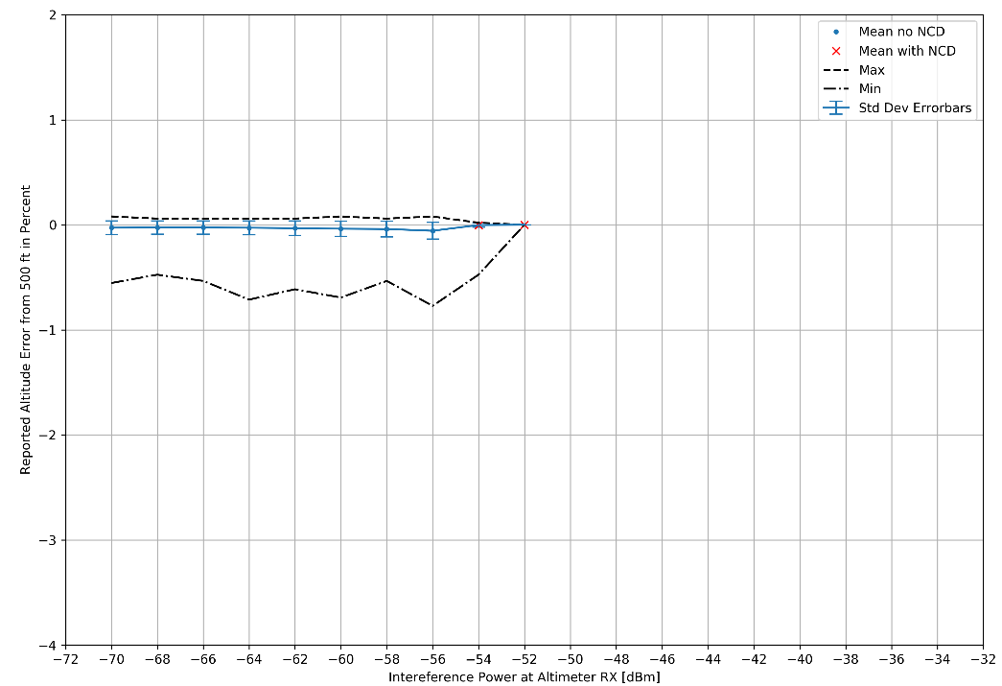
Radio Altimeter Tolerance of WAIC Systems
‘In Band’ WAIC Tests
Results – RA Type 4

Slide 51
‘Out of Band’ Ra Test Results

Slide 52
Radio Altimeter Tolerance of WAIC Systems
‘Out of Band’ RA Test Results
Overview
Setup repurposed for out of band signals with worst case in band interference scenario
Only required modifying software
Characterized altimeter response to potential signals in adjacent bands
Cell companies want access to adjacent bands

Slide 53
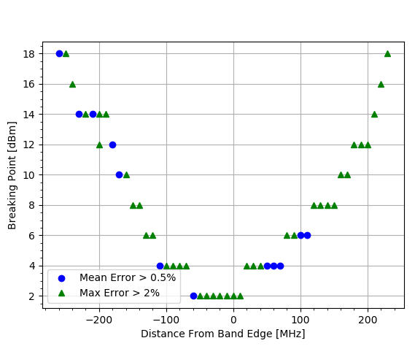
Radio Altimeter Tolerance of WAIC Systems
‘Out of Band’ WAIC Tests
Preliminary results
Preliminary interference mask being developed by AVSI for SARPs for RAs
Once finalized will be utilized by parties interested in adjacent bands for sharing studies
Prove/disprove compatibility of new services

Slide 54
Conclusions

Slide 55
Radio Altimeter Tolerance of WAIC Systems
Conclusions
Results of Test Bed Automation
Successfully developed a reference test bed validated by RA manufacturers and aircraft manufacturers.
Automated to enable testing under a wide range of conditions
Test bed recognized worldwide as standard for RA testing
Achieved results and developed reporting formats which supported the development of international standards
International Civil Aviation Organization Standard and Recommended Practices (ICAO SARPs)
RTCA Inc. Minimum Aviation System Performance Standards (MASPS)
RTCA Inc. Minimum Operational Performance Standards (MOPS)
First time RAs characterized in presence of interference

Slide 56
References
“Minimum Performance Standards Airborne Low-Range Radar Altimeters,” Industry Standard DO-155, Radio Technical Commission for Aeronautics, Washington, D.C., Nov. 1974.

Slide 57
Full In Band Results

Slide 58
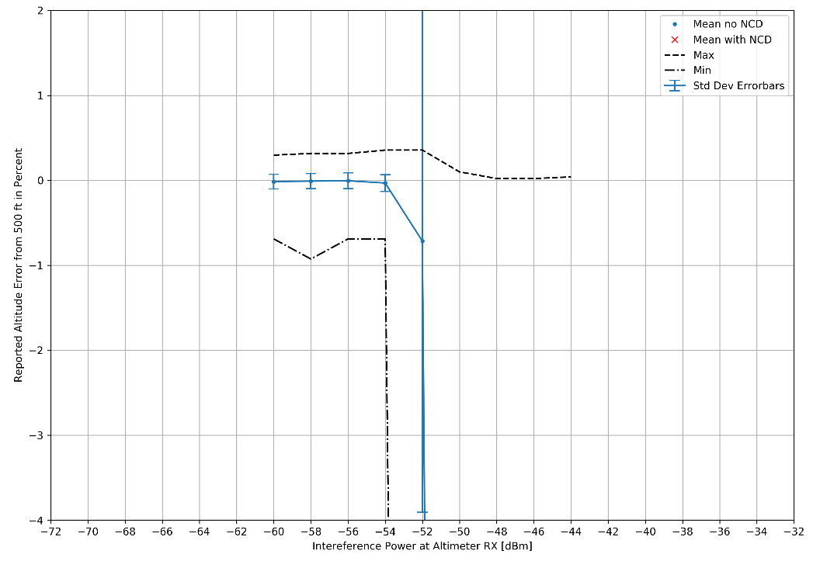
Radio Altimeter Tolerance of WAIC Systems
‘In Band’ WAIC Tests
Results – RA Type 1

Slide 59
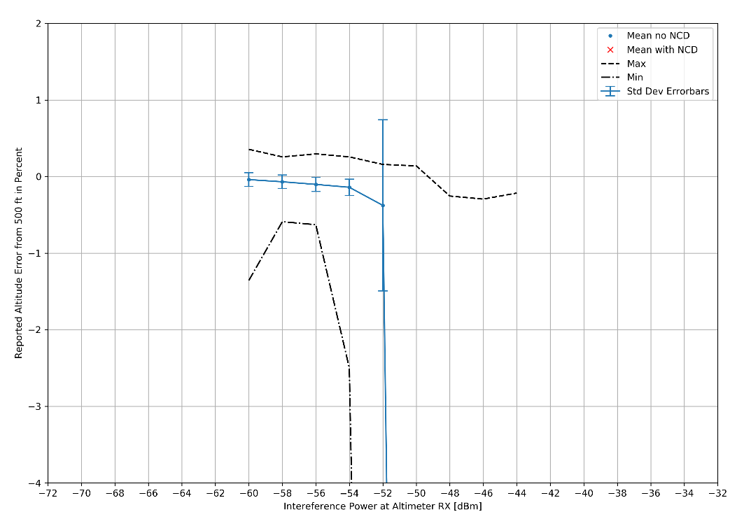
Radio Altimeter Tolerance of WAIC Systems
‘In Band’ WAIC Tests
Results – RA Type 2

Slide 60
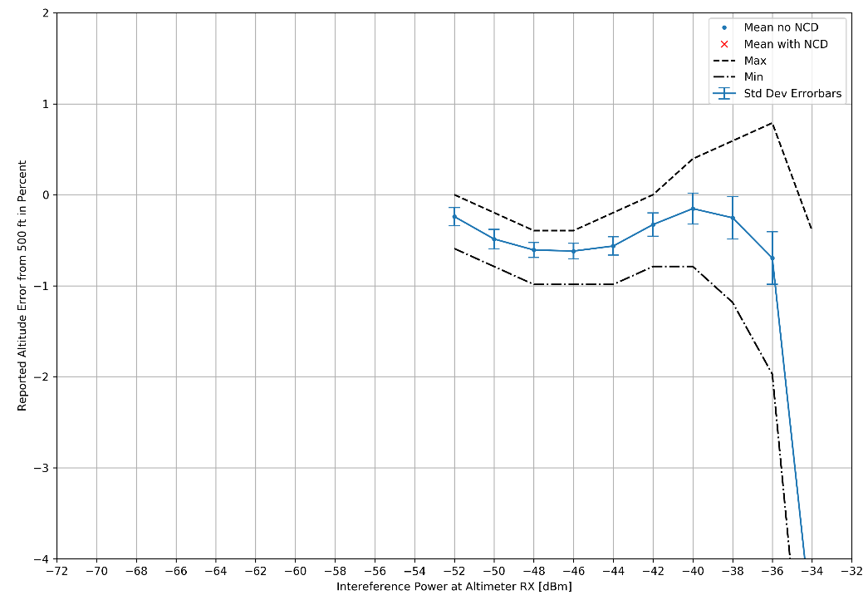
Radio Altimeter Tolerance of WAIC Systems
‘In Band’ WAIC Tests
Results – RA Type 3

Slide 61
Radio Altimeter Tolerance of WAIC Systems
‘In Band’ WAIC Tests
Results – RA Type 4

Slide 62
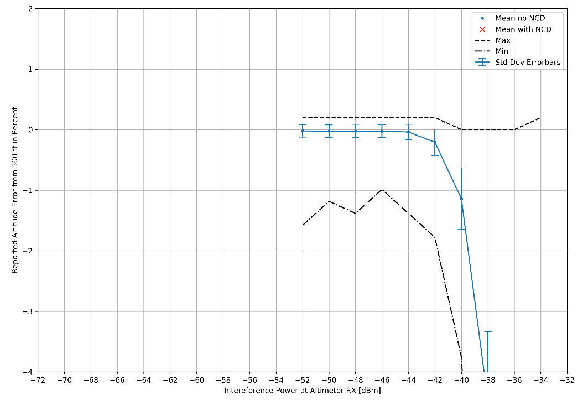
Radio Altimeter Tolerance of WAIC Systems
‘In Band’ WAIC Tests
Results – RA Type 5

