Slide 1
Instructions
This slide/poster size is 40.97” x 23.04” (16:9 aspect ratio)
Minimum font: 28pt (this may seem large, but at this poster size it’s not)
Recommended font types: Calibri, Arial, Times New Roman
When you are creating your e-poster, please make sure to save your formulas as an image and embed it into your presentation or they will change on our Surface Tablets.
Any video files need to be in .mov, .mpeg, .m4v or .mpg format
All files need to be saved in PPTX format
Bring the final version of your eposter and any video files to the event on a flash drive as a backup.

Slide 2
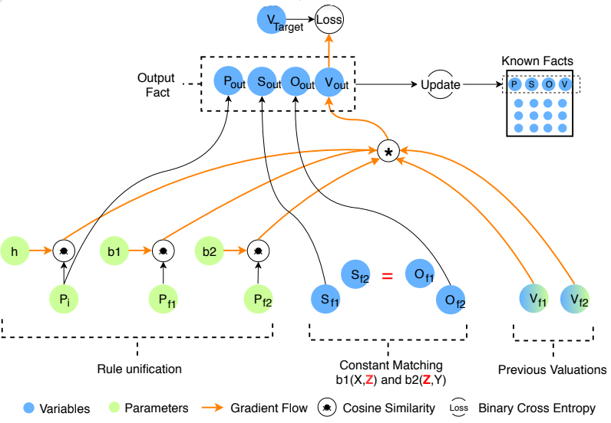
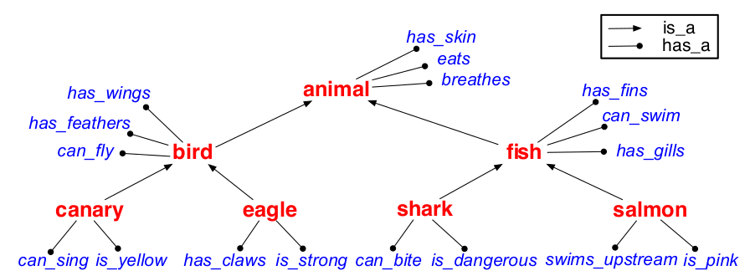
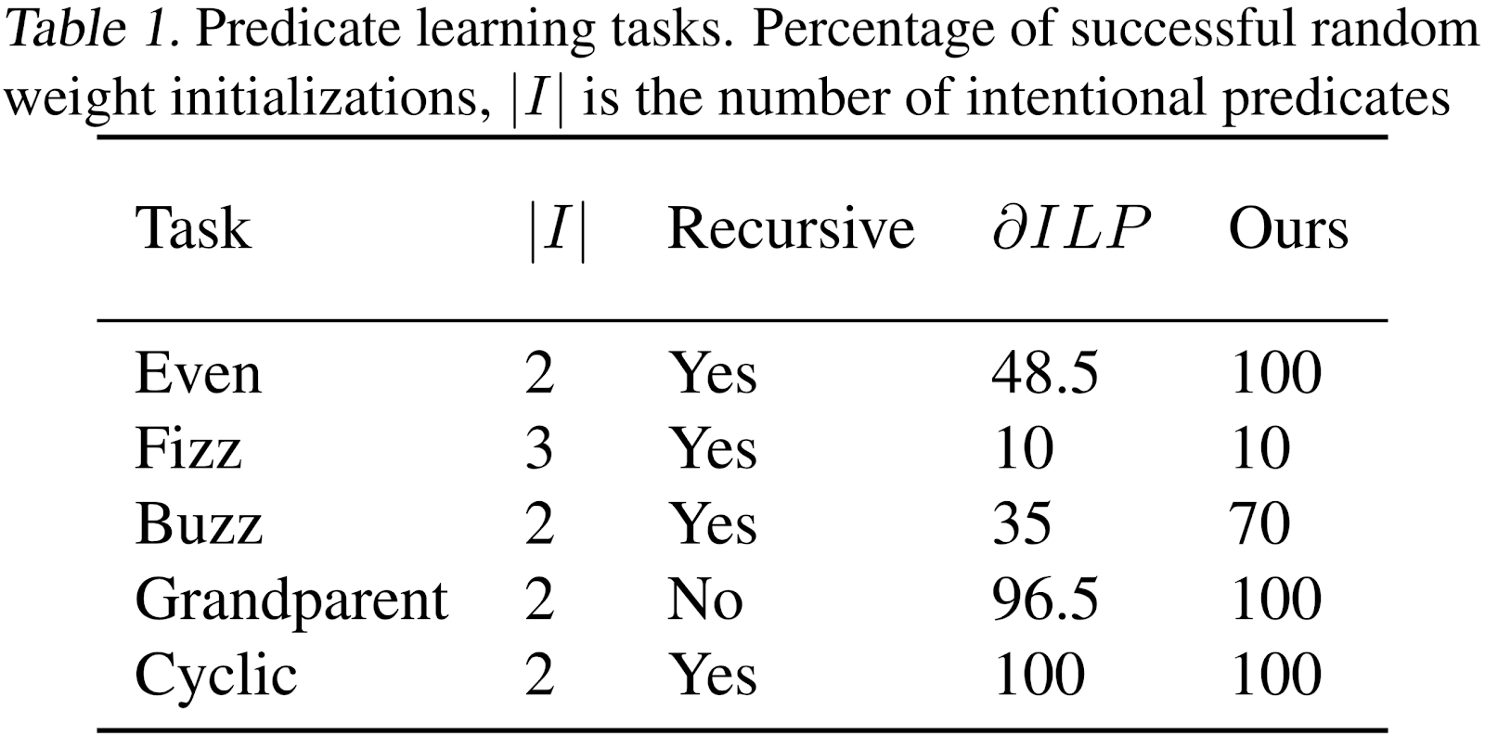
Department Name
Scholar Name
Poster Title
Student’s Name, PI Name,
Graduate Student Name if applicable
Logical Rule Induction and Theory Learning
We present a mechanism for logical theory acquisition. It takes a set of observed facts and compresses them into a theory composed of logical rules and a small set of core facts.
Our approach is neuro-symbolic and the learned rules and core facts representations are interpretable and can involve predicate invention.
Inductive Logic Programming
Theory Learning
We test the problems from (Evans and Grefenstette 2018), the task is to learn a target relation from a set of background knowledge facts.
We follow (Yarden et al., 2008) in proposing a form of Theory Learning by inducing a set of core facts and a set of logical rules. Our model can recover the following Taxonomy tree.

