Slide 1
Instructions
This slide/poster size is 40.97” x 23.04” (16:9 aspect ratio)
Minimum font: 28pt (this may seem large, but at this poster size it’s not)
Recommended font types: Calibri, Arial, Times New Roman
When you are creating your e-poster, please make sure to save your formulas as an image and embed it into your presentation or they will change on our Surface Tablets.
Any video files need to be in .mov, .mpeg, .m4v or .mpg format
All files need to be saved in PPTX format
Bring the final version of your eposter and any video files to the event on a flash drive as a backup.

Slide 2
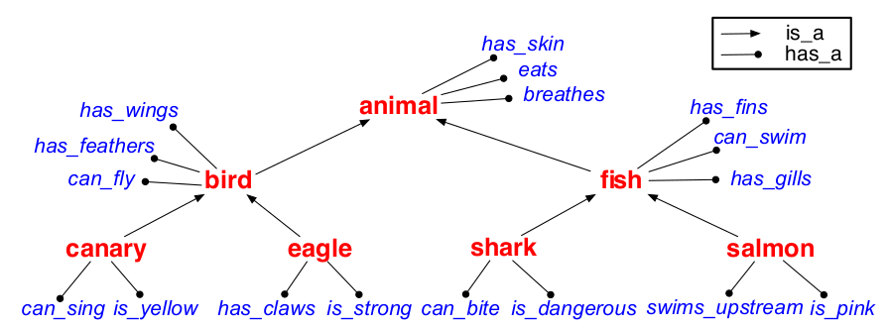
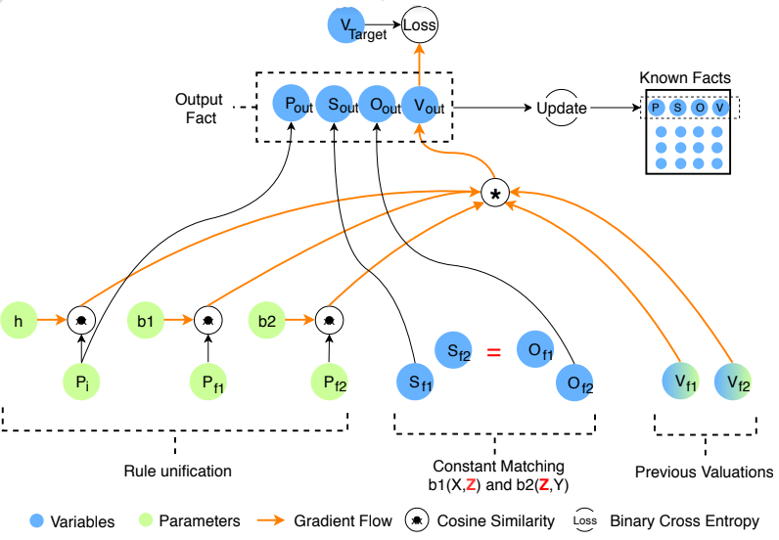
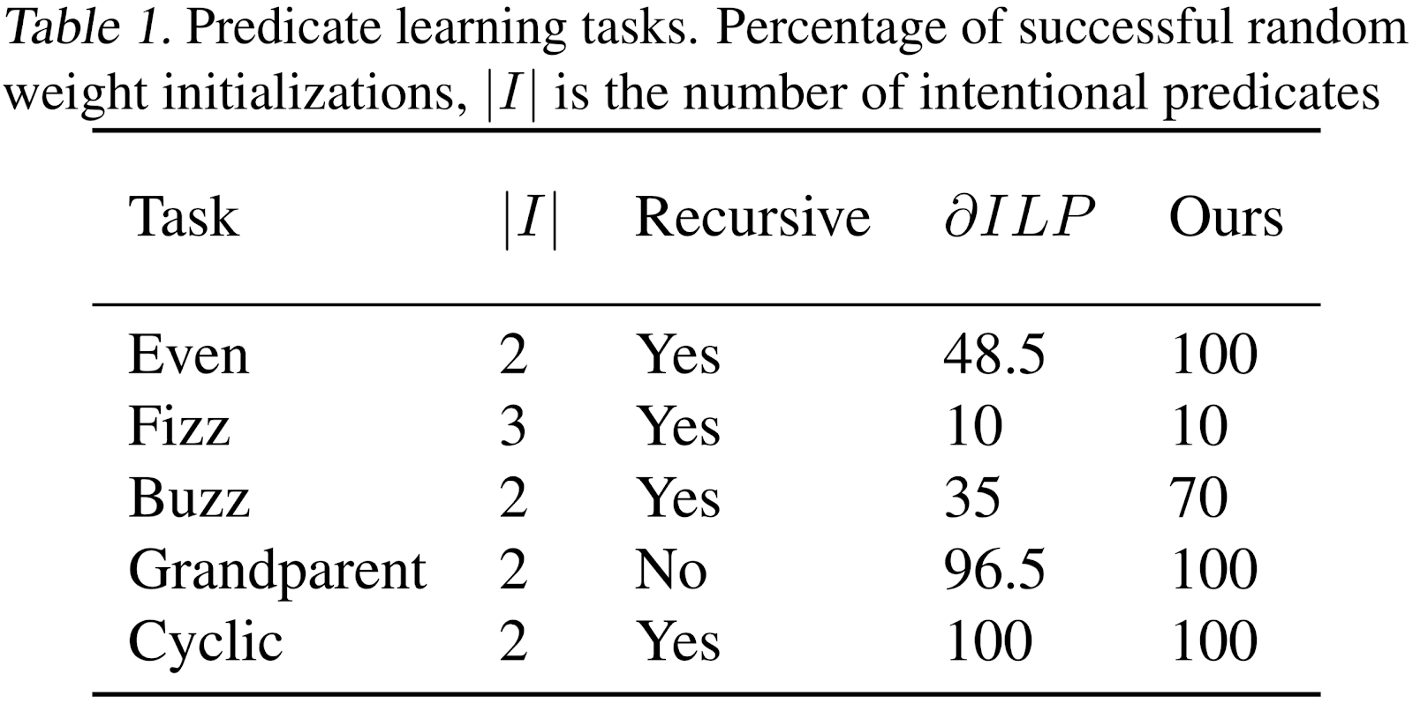
Computational Cognitive Science Group,
Dept. of Brain and Cognitive Sciences
Concept Learning as Program Learning
Joshua S. Rule, Andrés Campero,
Maxwell Nye, Joshua B. Tenenbaum
Logical Rule Induction and Theory Learning
Problem: logical theory acquisition
Approach: neuro-symbolic program induction
Results:

