Slide 1

Wired Control Car
Components
Electrical Circuit
Circuit Analysis
Example Build Procedure
Lafayette Jefferson High School – Digital Electronics – Mr. White

Slide 2

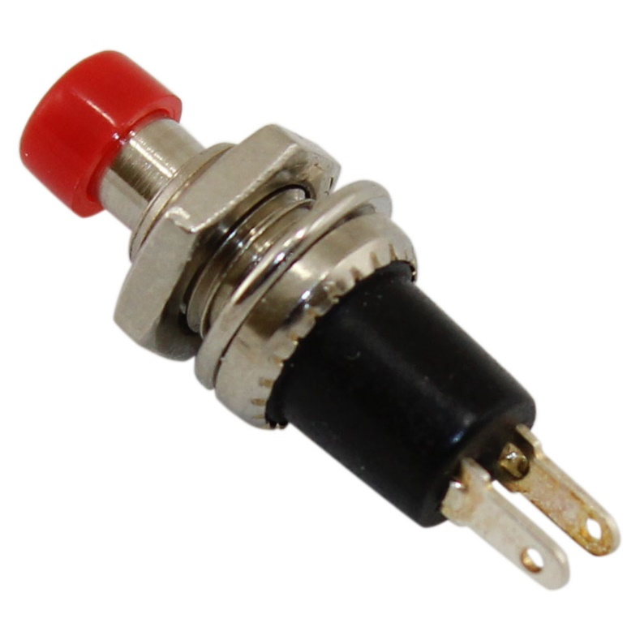
Components - Switches
Pushbutton
Opens/Closes Circuit
0 or Infinite (1.) Resistance
Lafayette Jefferson High School – Digital Electronics – Mr. White

Slide 3
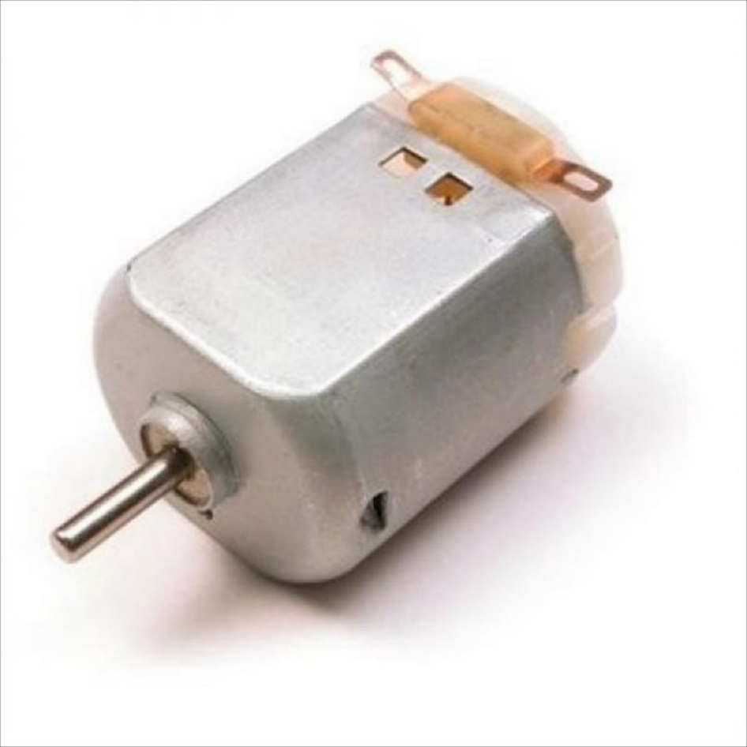
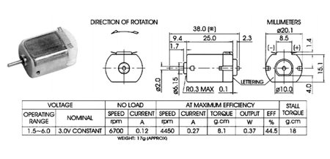
Components - Motors
3V DC Motor
11,000 rpm @ 3V
200mA Draw @ 3V
Lafayette Jefferson High School – Digital Electronics – Mr. White

Slide 4
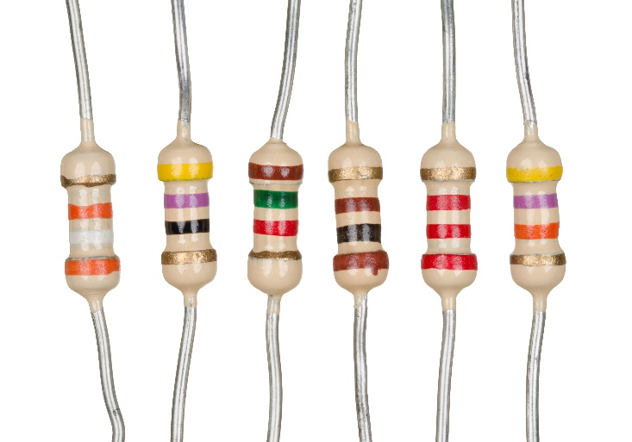
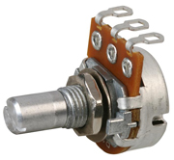
Components - Resistors
Fixed Resistors
Potentiometers
To set speed of vehicle
Lafayette Jefferson High School – Digital Electronics – Mr. White

Slide 5
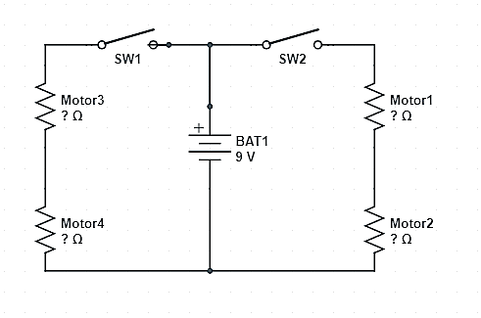
Electrical Schematic
Lafayette Jefferson High School – Digital Electronics – Mr. White

Slide 6





Circuit Analysis
$R_{Motor}$ =
When one side is closed
$V_{Motor1}$ =
$I_{Right}$ =
When both sides are closed
$V_{Motor1}$ =
$I_{Right}$ =
Lafayette Jefferson High School – Digital Electronics – Mr. White

Slide 7

Circuit Analysis - $R_{Motor}$
Lafayette Jefferson High School – Digital Electronics – Mr. White

Slide 8
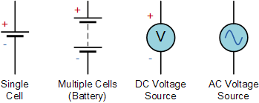
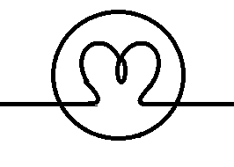




In-Class Activity
Determine the following using the power rule:
5 A
a
$I$ =
Lamp 1
60 W
E
20 V
$V_{Lamp 1}$ =
12 V
b
Lamp 2
40 W
$V_{Lamp 2}$ =
8 V
c
Lafayette Jefferson High School – Digital Electronics – Mr. White

