Slide 1
Theseus
Team NAVSEA

Slide 2
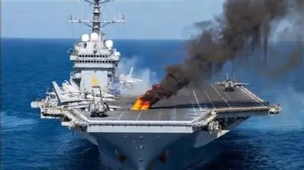
* Not actual picture of the event
Notes:
Lessons Learned Future Prevention Fleet Intelligence

Slide 3
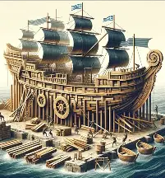
Theseus
Local Models, Fleet Intelligence
Notes:
Called theseus bc model updates itself but retains its identiy

Slide 4
Local UUV models
Learn underwater
Share when surfaced
THESEUS
Notes:
Our vision is that every UUV will run its own local AI model that learns while on mission and shares valuable lessons learned with the fleet upon resurfacing, improving the entire fleet with every mission. The model is constantly learning, it is constantly evolving, disproving assumptions, confirming hypotheses, and generating precious real-world data while retaining its roots, much like the mythical ship of Theseus.

Slide 5
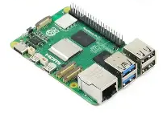

Hardware
Low-cost, credit card-sized computer
Notes:
Low-cost, credit card-sized computer
Report back to central computer when resurface
$100-200 depending on model and storage
Working on nist/stigs
Low cost and security means can cross valley of death many projects fall into

Slide 6
Learn from every mission
Share across fleet
Develop stronger warfighters

Slide 7
Thank you

