Slide 1

IBM INTERNAL DEV DAY · HANDS-ON LAB
Build an AI Agent
with Bob
From an empty laptop to a working agent — in about two hours. You'll install everything, let Bob write the code, and watch an AI decide when to use its tools. No experience needed.
watsonx Orchestrate ADK
IBM Bob
You'll build: an Event Planner

Slide 2
WHAT YOU'LL BUILD
An Event Planner agent — and the whole workflow around it
An AI agent, deployed to the cloud. A model (Llama 3.3) plus plain-English instructions, running on your own watsonx Orchestrate instance.
THE BIG IDEA
You never write “if the user asks about budget, call the budget tool.”
Three tools it can choose from. Estimate a budget, suggest venues, and manage a guest list — each a small Python function Bob writes for you.
You just describe each tool in plain English — and the model decides on its own when to call which one. That's the part that surprises people.
A real chat window. Talk to your agent in the terminal, then through a polished web page served from your laptop.
Build an Agent with Bob · watsonx Orchestrate + IBM Bob
02

Slide 3
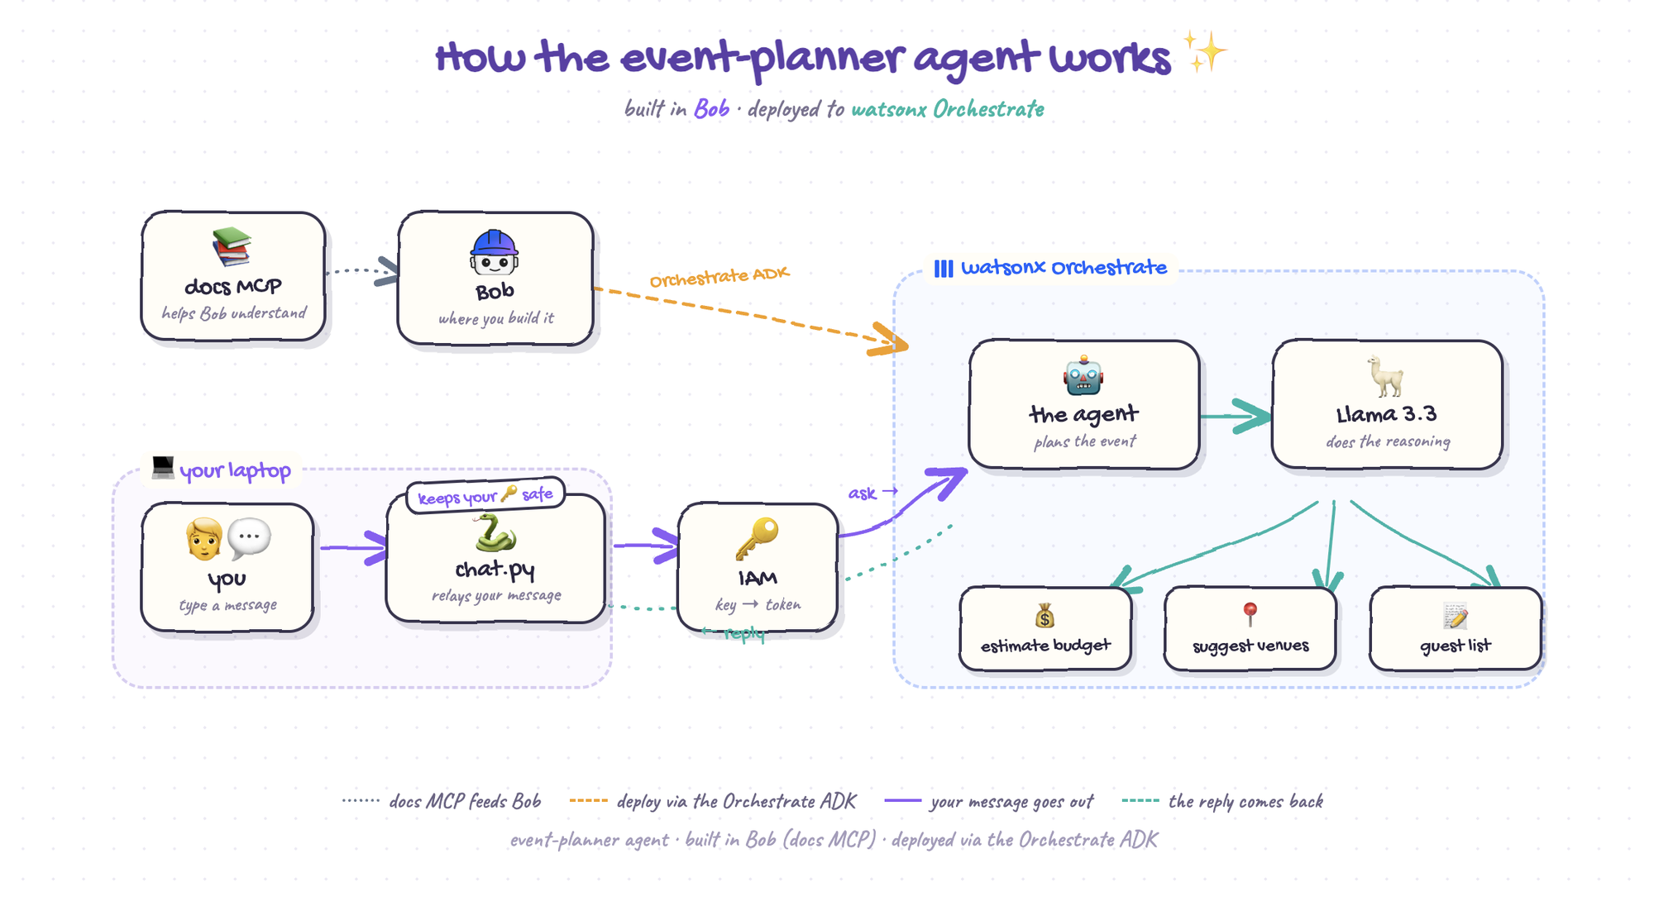
HOW IT FITS TOGETHER
An agent = a model + instructions + tools it's allowed to use
Build an Agent with Bob · watsonx Orchestrate + IBM Bob
03

Slide 4
YOUR TOOLKIT
Two tools do all the work
THE IDE
THE TOOLKIT
IBM Bob
watsonx Orchestrate ADK
IBM's AI-powered code editor — where you build. Describe what you need and Bob writes the files for you.
The Agent Development Kit — a Python package that gives you the orchestrate command to build, deploy, and test agents.
Writes your tools, agent, and config
pip install ibm-watsonx-orchestrate
Built-in chat + terminal
Deploys your agent to the cloud
You run the commands; Bob writes the code
Reaches it from your laptop via chat.py
Build an Agent with Bob · watsonx Orchestrate + IBM Bob
04

Slide 5
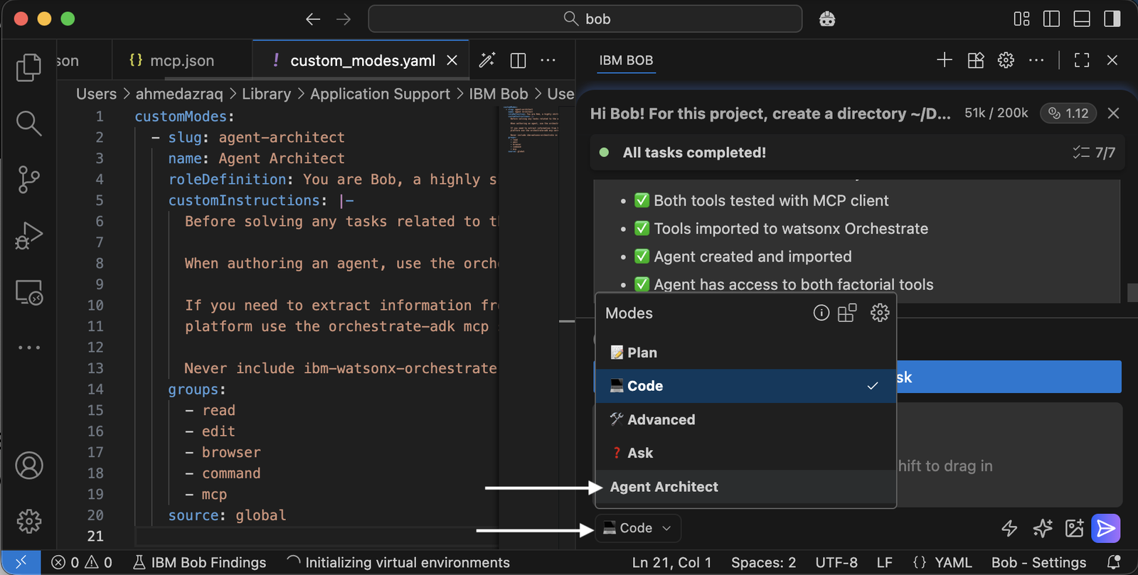
GIVE BOB THE KNOW-HOW · OPTION 1
Use the WXO Agent Architect mode
Before Bob writes any code, give it a cheat sheet so it stops guessing and looks up real, current Orchestrate syntax. The fastest path: a ready-made Bob mode.
A pre-briefed version of Bob. “WXO Agent Architect” always checks the ADK docs and follows Orchestrate best practices.
Import the mode file. Command Palette → Modes → Import → pick the .yaml your instructor shares.
Bob's mode picker — select WXO Agent Architect.
Then just pick it. Select WXO Agent Architect from the mode picker at the top of Bob's chat.
Under the hood it connects Bob to IBM's official watsonx Orchestrate docs MCP server — a live reference book Bob can open mid-task.
Build an Agent with Bob · watsonx Orchestrate + IBM Bob
05

Slide 6
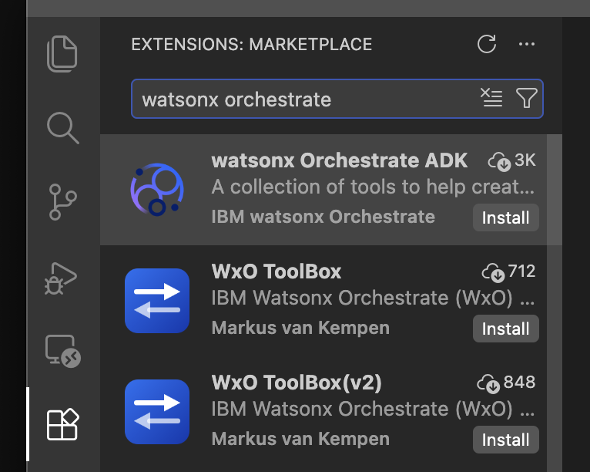
GIVE BOB THE KNOW-HOW · OPTION 2
Or download it from the Marketplace
No mode file handed out? You can wire up the same Orchestrate know-how yourself from inside Bob — either from the Marketplace / Extensions, or by adding the docs MCP server to this project.
Install from the Marketplace. Open Extensions (the blocks icon), search “watsonx Orchestrate,” and click Install on the ADK extension.
Add the docs MCP server. Bob Settings → MCP → +, scope it to this project, and point it at the official docs server.
Let Bob add it for you. With the config open, just ask Bob in chat to add the watsonx-orchestrate-docs server.
Install the watsonx Orchestrate ADK from Bob's Extensions.
Build an Agent with Bob · watsonx Orchestrate + IBM Bob
06

Slide 7
CONNECTING TO ORCHESTRATE
How the environment variables work
Your agent runs on a shared watsonx Orchestrate instance in the cloud. To reach it, the toolkit needs two secrets — a Service Instance URL and an API key — which you keep in a small .env file, never in your code.
1
2
3
Grab your two values
Put them in .env
Load, then connect
Open the shared Box folder and find the row matching your last name. Copy your Service Instance URL and API key.
Create a file named .env by hand (Bob refuses to write API keys). Two lines: WXO_URL and WXO_API_KEY.
source .env, then register + activate the env. The key becomes a short-lived token — it never prints on screen.
.env
SHARED CREDENTIALS · BOX
WXO_URL=<your Service Instance URL>
WXO_API_KEY=<your API Key>
ibm.box.com/v/internaldevday Password: BobDevDay2026
Build an Agent with Bob · watsonx Orchestrate + IBM Bob
07

Slide 8
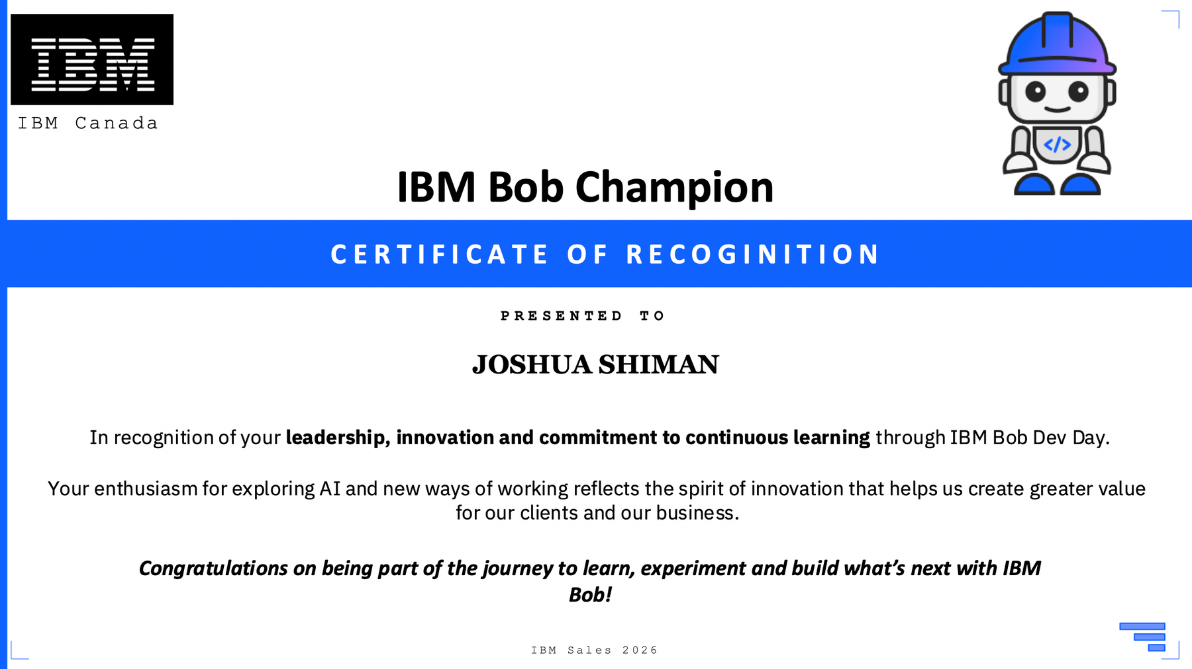
FINISH LINE
Claim your IBM Bob Champion certificate
Finish the lab, earn the badge. Complete the workshop and grab your personalized IBM Bob Champion certificate of recognition.
Personalized with your name. Generated for you at the end — from the wrap-up step in the guide.
Share the win. Post it on LinkedIn with #IBMBob, #watsonxOrchestrate, #BuildAnAgent — and tag your instructor.
Your certificate — personalized with your name.
Build an Agent with Bob · watsonx Orchestrate + IBM Bob
08

Slide 9

START HERE
Open the guide and
begin at Step 00
ibm.biz/build-an-agent
Pick your operating system in the top-right — every command on the page updates to match. Then do the blue numbered steps in order. Five helpers are walking the room; once Bob is installed, you can ask Bob itself for help.
Scan to open the guide
ibm.biz/build-an-agent
Joshua Shiman · Customer Success Engineer, Data & AI · jshiman@ibm.com

