Slide 1
Cryptography Overview
CS155
Spring 2010
John Mitchell

Slide 2
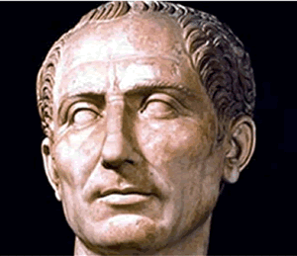
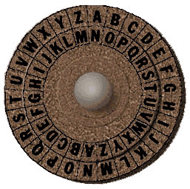
Caesar cipher

Slide 3
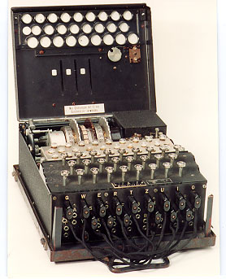
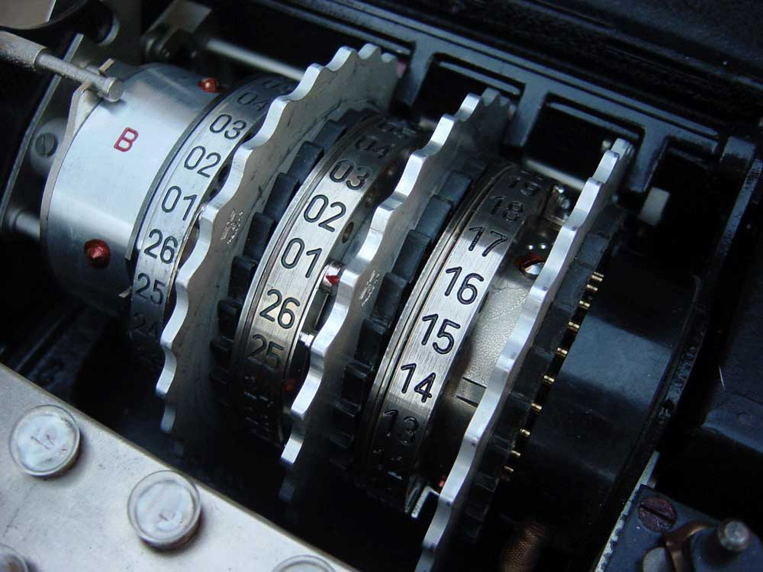
German Enigma

Slide 4

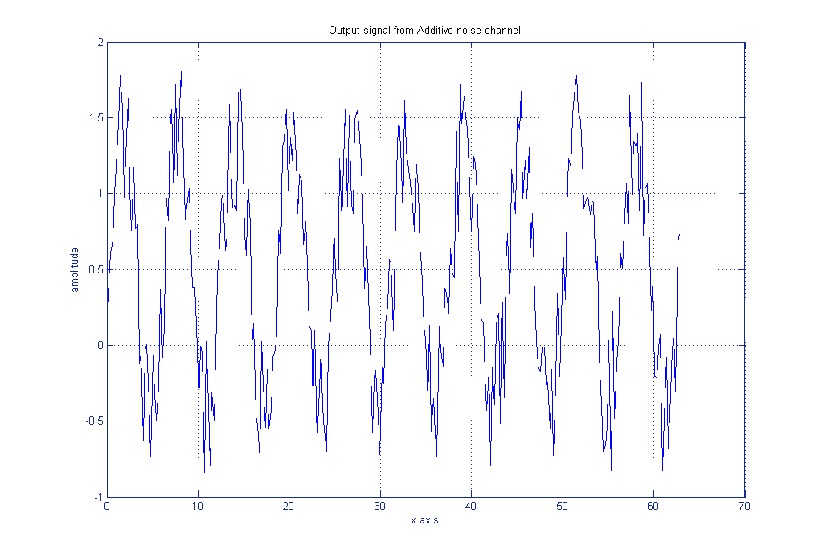
Information theory
Claude Shannon

Slide 5
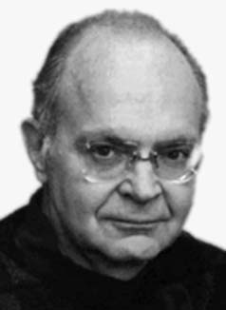

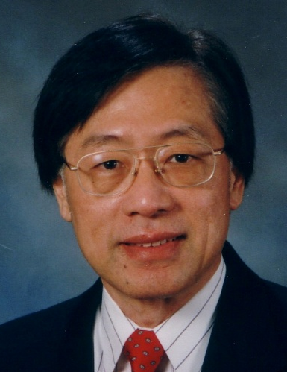
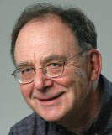
Complexity theory
hard
PSpace
NP
BPP
P
easy

Slide 6
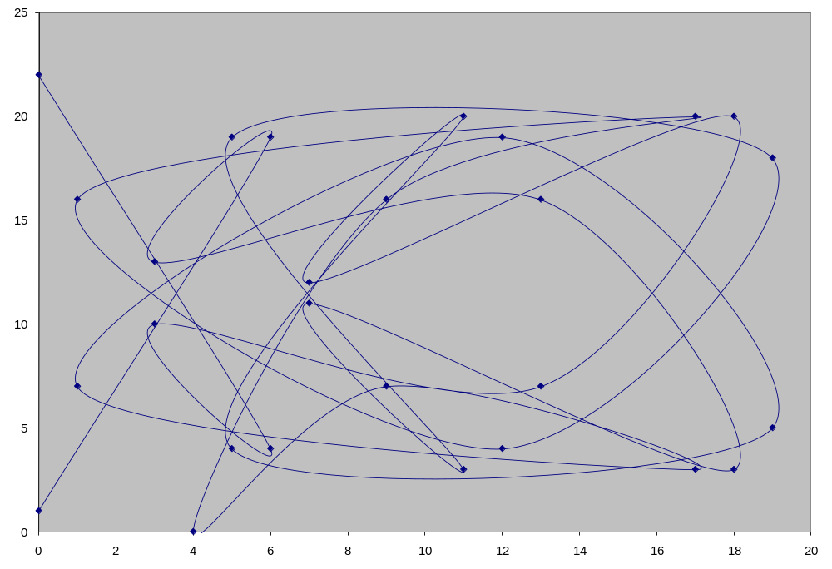
Elliptic curves

Slide 7
Cryptography
Is
  A tremendous tool
  The basis for many security mechanisms
Is not
  The solution to all security problems
  Reliable unless implemented properly
  Reliable unless used properly
  Something you should try to invent yourself unless
    you spend a lot of time becoming an expert
    you subject your design to outside review

Slide 8
Basic Cryptographic Concepts
Encryption scheme:
  functions to encrypt, decrypt data
Symmetric encryption
  Block, stream ciphers
Hash function, MAC
  Map any input to short hash; ideally, no collisions
  MAC (keyed hash) used for message integrity
Public-key cryptography
  PK encryption: public key does not reveal key⁻¹
  Signatures: sign data, verify signature

Slide 9



Example: network transactions
Assume attackers can control the network
  We will talk about how they do this in a few weeks
  Attackers can intercept packets, tamper with or suppress them, and inject arbitrary packets

Slide 10

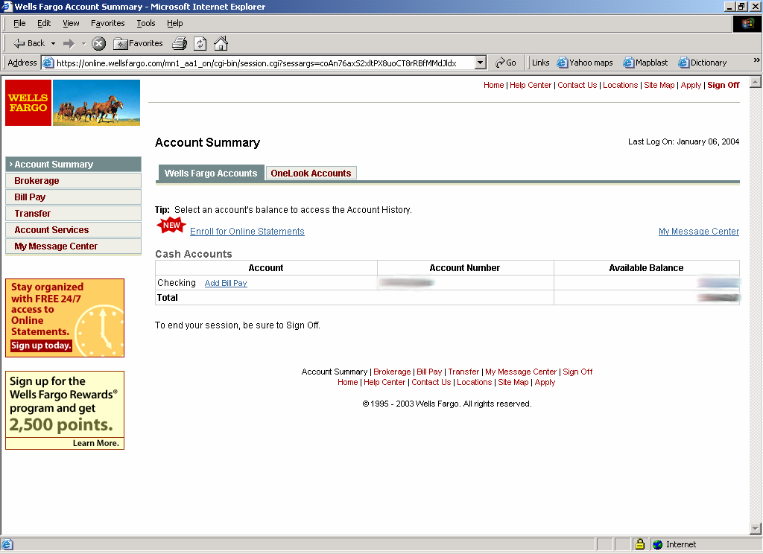
Secure communication
Based on
  Cryptography
  Key management protocols

Slide 11
Secure Sockets Layer / TLS
Standard for Internet security
  Originally designed by Netscape
  Goal: “... provide privacy and reliability between two communicating applications”
Two main parts
  Handshake Protocol
    Establish shared secret key using public-key cryptography
    Signed certificates for authentication
  Record Layer
    Transmit data using negotiated key, encryption function

Slide 12
SSL/TLS Cryptography
Public-key encryption
  Key chosen secretly (handshake protocol)
  Key material sent encrypted with public key
Symmetric encryption
  Shared (secret) key encryption of data packets
Signature-based authentication
  Client can check signed server certificate
  And vice-versa, if client certificates used
Hash for integrity
  Client, server check hash of sequence of messages
  MAC used in data packets (record protocol)

Slide 13
Goal 2: protected files
Disk
File 1
Alice
Alice
No eavesdropping
No tampering
File 2
Analogous to secure communication:
Alice today sends a message to Alice tomorrow

Slide 14
Symmetric Cryptography

Slide 15

Symmetric encryption
Alice
E, D: cipher k: secret key (e.g., 128 bits)
m, c: plaintext, ciphertext n: nonce (aka IV)
Encryption algorithm is publicly known
  Never use a proprietary cipher
Bob
m, n
E
E(k,m,n)=c
c, n
D
D(k,c,n)=m
k
k

Slide 16
First example: One Time Pad (single use key)
Vernam (1917)
Shannon ‘49:
  OTP is “secure” against ciphertext-only attacks
Key:
0
1
0
1
1
1
0
0
1
0
⊕
Plaintext:
1
1
0
0
0
1
1
0
0
0
Ciphertext:
1
0
0
1
1
0
1
0
1
0

Slide 17
Stream ciphers (single use key)
Problem: OTP key is as long the message
Solution: Pseudo random key -- stream ciphers
Stream ciphers: RC4 (113MB/sec) , SEAL (293MB/sec)
key
c ← PRBG(k) ⊕ m
PRBG
⊕
message
ciphertext
Notes:
Pentium 4, 2.1GhZ

Slide 18
Dangers in using stream ciphers
One time key !! “Two time pad” is insecure:
C₁ ← m₁ ⊕ PRBG(k)
  C₂ ← m₂ ⊕ PRBG(k)
  Eavesdropper does:
  C₁ ⊕ C₂ → m₁ ⊕ m₂
  Enough redundant information in English that:
  m₁ ⊕ m₂ → m₁ , m₂

Slide 19
Symmetric encryption: nonce (IV)
nonce
Alice
E, D: cipher k: secret key (e.g., 128 bits)
m, c: plaintext, ciphertext n: nonce (aka IV)
Bob
m, n
E
E(k,m,n)=c
c, n
D
D(k,c,n)=m
k
k

Slide 20
Use Cases
Single use key: (one time key)
  Key is only used to encrypt one message
    encrypted email: new key generated for every email
  No need for nonce (set to 0)
Multi use key:
  Key used to encrypt multiple messages
    SSL: same key used to encrypt many packets
  Need either unique nonce or random nonce
Multi use key, but all plaintexts are distinct:
  Can eliminate nonce (use 0) using special mode (SIV)

Slide 21
Block ciphers: crypto work horse
n Bits
E, D
n Bits
PT Block
CT Block
Key
k Bits
Canonical examples:
3DES: n= 64 bits, k = 168 bits
AES: n=128 bits, k = 128, 192, 256 bits
IV handled as part of PT block

Slide 22
Building a block cipher
Input: (m, k)
Repeat simple mixing operation several times
• DES: Repeat 16 times:
• AES-128: Mixing step repeated 10 times
Difficult to design: must resist subtle attacks
• differential attacks, linear attacks, brute-force, …
m_{L} ← m_{R}
m_{R} ← m_{L}⊕F(k,m_{R})

Slide 23
Block Ciphers Built by Iteration
key k
key expansion
k₁
k₂
k₃
k_{n}
m
R(k₁, ⋅)
R(k₂, ⋅)
R(k₃, ⋅)
R(k_{n}, ⋅)
c
R(k,m): round function
for DES (n=16), for AES (n=10)

Slide 24
Incorrect use of block ciphers
Electronic Code Book (ECB):
Problem:
  if m₁=m₂ then c₁=c₂
PT:
m₁
m₂
CT:
c₁
c₂

Slide 25
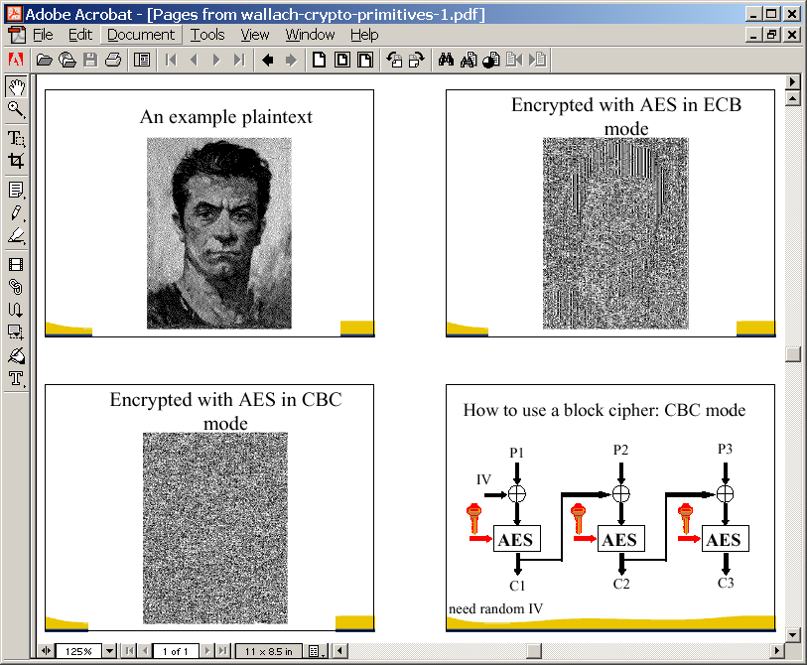
In pictures

Slide 26
Correct use of block ciphers I: CBC mode
E a secure PRP. Cipher Block Chaining with IV:
IV
m[0]
m[1]
m[2]
m[3]
⊕
⊕
⊕
⊕
E(k,⋅)
E(k,⋅)
E(k,⋅)
E(k,⋅)
IV
c[0]
c[1]
c[2]
c[3]
ciphertext
Q: how to do decryption?

Slide 27
Use cases: how to choose an IV
Single use key: no IV needed (IV=0)
Multi use key: (CPA Security)
  Best: use a fresh random IV for every message (IV ← X)
  Can use unique IV (e.g counter) [Bitlocker]
    but then first step in CBC must be IV’ ← E(k,IV)
    benefit: may save transmitting IV with ciphertext
  Multi-use key, but unique messages
  SIV: eliminate IV by setting IV ← F(k’, PT)
  F: secure PRF with key k’

Slide 28
CBC with Unique IVs
unique IV means: (k,IV) pair is used for only one message
may be predictable so use E(k,⋅) as PRF
IV
m[0]
m[1]
m[2]
m[3]
IV′
⊕
⊕
⊕
⊕
E(k,⋅)
E(k,⋅)
E(k,⋅)
E(k,⋅)
E(k,⋅)
IV
c[0]
c[1]
c[2]
c[3]
ciphertext

Slide 29
In pictures

Slide 30
Correct use of block ciphers II: CTR mode
Counter mode with a random IV: (parallel encryption)
IV
m[0]
m[1]
…
m[L]
⊕
E(k,IV)
E(k,IV+1)
…
E(k,IV+L)
IV
c[0]
c[1]
…
c[L]
ciphertext
Why are these modes secure? not today.

Slide 31
Performance: Crypto++ 5.2.1 [ Wei Dai ]
Pentium 4, 2.1 GHz ( on Windows XP SP1, Visual C++ 2003 )
Cipher Block/key size Speed (MB/sec)
RC4 113
SEAL 293
3DES 64/168 9
AES 128/128 61
IDEA 64/128 19
SHACAL-2 512/128 20

Slide 32
Hash functions and message integrity

Slide 33
Cryptographic hash functions
Length-reducing function h
  Map arbitrary strings to strings of fixed length
One way (“preimage resistance”)
  Given y, hard to find x with h(x)=y
Collision resistant
  Hard to find any distinct m, m’ with h(m)=h(m’)
Also useful: 2nd preimage resistance
  Given x, hard to find x’≠x with h(x’)=h(x)
  Collision resistance ⇒ 2nd preimage resistance

Slide 34
Applications of one-way hash
Password files (one way)
Digital signatures (collision resistant)
  Sign hash of message instead of entire message
Data integrity
  Compute and securely store hash of some data
  Check later by recomputing hash and comparing
Keyed hash for message authentication
  MAC – Message Authentication Code

Slide 35
Message Integrity: MACs
Goal: message integrity. No confidentiality.
  ex: Protecting public binaries on disk.
k
Message m
tag
k
Alice
Bob
Generate tag:
tag ← S(k, m)
Verify tag:
V(k, m, tag) = `yes’
?
note: non-keyed checksum (CRC) is an insecure MAC !!

Slide 36
Secure MACs
Attacker’s power: chosen message attack.
  for m₁,m₂,…,m_{q} attacker is given t_{i} ← S(k,mi)
Attacker’s goal: existential forgery.
  produce some new valid message/tag pair (m,t).
  (m,t) ∉ { (m₁,t₁) , … , (m_{q},t_{q}) }
A secure PRF gives a secure MAC:
  S(k,m) = F(k,m)
  V(k,m,t): `yes’ if t = F(k,m) and `no’ otherwise.

Slide 37
Construction 1: ECBC
m[0]
m[1]
m[2]
m[3]
⊕
⊕
⊕
E(k,⋅)
E(k,⋅)
E(k,⋅)
E(k,⋅)
Raw CBC
E(k₁,⋅)
tag
key = (k, k₁)

Slide 38
Construction 2: HMAC (Hash-MAC)
Most widely used MAC on the Internet.
H: hash function.
example: SHA-256 ; output is 256 bits
Building a MAC out of a hash function:
  Standardized method: HMAC
  S( k, m ) = H( k⊕opad || H( k⊕ipad || m ))

Slide 39
SHA-256: Merkle-Damgard
m[0]
m[1]
m[2]
m[3]
IV
h
h
h
h
H(m)
h(t, m[i]): compression function
Thm 1: if h is collision resistant then so is H
“Thm 2”: if h is a PRF then HMAC is a PRF

Slide 40
Construction 3: PMAC – parallel MAC
ECBC and HMAC are sequential. PMAC:
m[0]
m[1]
m[2]
m[3]
P(k,0)
⊕
P(k,1)
⊕
P(k,2)
⊕
P(k,3)
⊕
F(k,⋅)
F(k,⋅)
F(k,⋅)
F(k,⋅)
⊕
F(k₁,⋅)
tag

Slide 41
Why are these MAC constructions secure?
  … not today – take CS255
Why the last encryption step in ECBC?
  CBC (aka Raw-CBC) is not a secure MAC:
      Given tag on a message m, attacker can deduce
      tag for some other message m’
      How: good exercise.

Slide 42
Authenticated Encryption:
Encryption + MAC

Slide 43
Combining MAC and ENC (CCA)
Encryption key K_{E} MAC key = K_{I}
Option 1: MAC-then-Encrypt (SSL)
Option 2: Encrypt-then-MAC (IPsec)
Option 3: Encrypt-and-MAC (SSH)
MAC(M,K_{I})
Enc K_{E}
Msg M
Msg M
MAC
Enc K_{E}
MAC(C, K_{I})
Secure on general grounds
Msg M
MAC
Enc K_{E}
MAC(M, K_{I})
Msg M
MAC

Slide 44
Recent developments: OCB
offset codebook mode
More efficient authenticated encryption
m[0]
m[1]
m[2]
m[3]
checksum
P(N,k,0)
⊕
P(N,k,1)
⊕
P(N,k,2)
⊕
P(N,k,3)
⊕
P(N,k,0)
⊕
E(k,⋅)
E(k,⋅)
E(k,⋅)
E(k,⋅)
E(k,⋅)
P(N,k,0)
⊕
P(N,k,1)
⊕
P(N,k,2)
⊕
P(N,k,3)
⊕
auth
⊕
c[0]
c[1]
c[2]
c[3]
c[4]
Rogaway, …

Slide 45
Public-key Cryptography

Slide 46
Complexity Classes
hard
Answer in polynomial space may need exhaustive search
If yes, can guess and check in polynomial time
Answer in polynomial time, with high probability
Answer in polynomial time compute answer directly
PSpace
NP
BPP
P
easy

Slide 47
Example: RSA
Arithmetic modulo pq
  Generate secret primes p, q
  Generate secret numbers a, b with x^{ab} ≡ x mod pq
Public encryption key ⟨n, a⟩
  Encrypt(⟨n, a⟩, x) = xª mod n
Private decryption key ⟨n, b⟩
  Decrypt(⟨n, b⟩, y) = y^{b} mod n
Main properties
  This appears to be a “trapdoor permutation”
  Cannot compute b from n,a
    Apparently, need to factor n = pq
n

Slide 48
Why RSA works (quick sketch)
Let p, q be two distinct primes and let n=p*q
  Encryption, decryption based on group Z_{n}*
  For n=p*q, order φ(n) = (p-1)*(q-1)
    Proof: (p-1)*(q-1) = p*q - p - q + 1
Key pair: ⟨a, b⟩ with ab ≡ 1 mod φ(n)
  Encrypt(x) = xª mod n
  Decrypt(y) = y^{b} mod n
  Since ab ≡ 1 mod φ(n), have x^{ab} ≡ x mod n
    Proof: if gcd(x,n) = 1, then by general group theory, otherwise use “Chinese remainder theorem”.

Slide 49
Textbook RSA is insecure
What if message is from a small set (yes/no)?
  Can build table
What if I want to outbid you in secret auction?
  I take your encrypted bid c and submit
  c (101/100)e mod n
What if there’s some protocol in which I can learn other message decryptions?

Slide 50
OAEP [BR94, Shoup ’01]
Preprocess message for RSA
If RSA is trapdoor permutation, then this is chosen-ciphertext secure (if H,G “random oracles”)
In practice: use SHA-1 or MD5 for H and G
Message
01
00..0
rand.
+
H
Check pad
on decryption.
Reject CT if invalid.
G
+
∈{0,1}^{n-1}
Plaintext to encrypt with RSA

Slide 51
Digital Signatures
Public-key encryption
  Alice publishes encryption key
  Anyone can send encrypted message
  Only Alice can decrypt messages with this key
Digital signature scheme
  Alice publishes key for verifying signatures
  Anyone can check a message signed by Alice
  Only Alice can send signed messages

Slide 52
Properties of signatures
Functions to sign and verify
  Sign(Key⁻¹, message)
  Verify(Key, x, m) =
Resists forgery
  Cannot compute Sign(Key⁻¹, m) from m and Key
  Resists existential forgery:
  given Key, cannot produce Sign(Key⁻¹, m)
  for any random or arbitrary m
  true if x = Sign(Key⁻¹, m)
  false otherwise

Slide 53
RSA Signature Scheme
Publish decryption instead of encryption key
  Alice publishes decryption key
  Anyone can decrypt a message encrypted by Alice
  Only Alice can send encrypt messages
In more detail,
  Alice generates primes p, q and key pair ⟨a, b⟩
  Sign(x) = xª mod n
  Verify(y) = y^{b} mod n
  Since ab ≡ 1 mod φ(n), have x^{ab} ≡ x mod n
Generally, sign hash of message instead of full plaintext

Slide 54
Public-Key Infrastructure (PKI)
Anyone can send Bob a secret message
  Provided they know Bob’s public key
How do we know a key belongs to Bob?
  If imposter substitutes another key, can read Bob’s mail
One solution: PKI
  Trusted root authority (VeriSign, IBM, United Nations)
    Everyone must know the verification key of root authority
    Check your browser; there are hundreds!!
  Root authority can sign certificates
  Certificates identify others, including other authorities
  Leads to certificate chains

Slide 55
Public-Key Infrastructure
Known public signature verification key Ka
Certificate Authority
Certificate
Sign(Ka⁻¹, Ks)
Ka
Ks
Client
Sign(Ka⁻¹, Ks), Sign(Ks, msg)
Server
Server certificate can be verified by any client that has CA key Ka
Certificate authority is “off line”

Slide 56
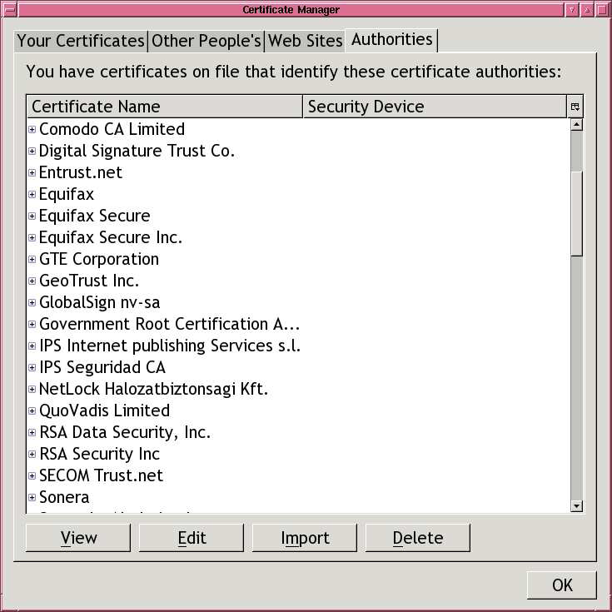

Slide 57
Back to SSL/TLS
Version, Crypto choice, nonce
S
C
Version, Choice, nonce,
Signed certificate
containing server’s
public key Ks
Secret key K
encrypted with
server’s key Ks
switch to negotiated cipher
Hash of sequence of messages
Hash of sequence of messages
data transmission

Slide 58
Crypto Summary
Encryption scheme:
  functions to encrypt, decrypt data
Symmetric encryption
  Block, stream ciphers
Hash function, MAC
  Map any input to short hash; ideally, no collisions
  MAC (keyed hash) used for message integrity
Public-key cryptography
  PK encryption: public key does not reveal key⁻¹
  Signatures: sign data, verify signature

Slide 59
Limitations of cryptography
Most security problems are not crypto problems
  This is good
    Cryptography works!
  This is bad
    People make other mistakes; crypto doesn’t solve them
Misuse of cryptography is fatal for security
  WEP – ineffective, highly embarrassing for industry
  Occasional unexpected attacks on systems subjected to serious review

Slide 60
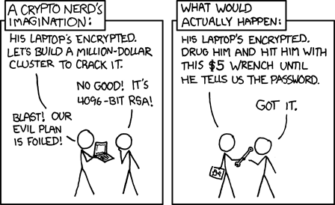

Slide 61


Slide 62
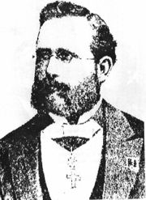
Auguste Kerckhoffs
A cryptosystem should be secure even if everything about the system, except the key, is public knowledge.
baptised as Jean-Guillaume-Hubert-Victor-François-
Alexandre-Auguste Kerckhoffs von Nieuwenhof

Slide 63
Example cryptosystems
One-time pad
  “Theoretical idea,” but leads to stream cipher
Feistel construction for symmetric key crypto
  Iterate a “scrambling function”
  Examples: DES, Lucifer, FREAL, Khufu, Khafre, LOKI, GOST, CAST, Blowfish, …
  AES (Rijndael) is also block cipher, but different …
Complexity-based public-key cryptography
  Modular exponentiation is a “one-way” function
  Examples: RSA, El Gamal, elliptic curve systems, ...

Slide 64
Symmetric Encryption
Encryption keeps communication secret
Encryption algorithm has two functions: E and D
  To communicate secretly, parties share secret key K
Given a message M, and a key K:
  M is known as the plaintext
  E(K,M) → C (C known as the ciphertext)
  D(K, C) → M
  Attacker cannot efficiently derive M from C without K
Note E and D use same key K
  Reason for the name “symmetric encryption”

Slide 65
One-time pad
Share a random key K
Encrypt plaintext by xor with sequence of bits
  encrypt(key, text) = key ⊕ text (bit-by-bit)
Decrypt ciphertext by xor with same bits
  decrypt(key, text) = key ⊕ text (bit-by-bit)
Advantages
  Easy to compute encrypt, decrypt from key, text
  This is an information-theoretically secure cipher
Disadvantage
  Key is as long as the plaintext
    How does sender get key to receiver securely?
  Idea for stream cipher: use pseudo-random generators for key …

Slide 66
Types of symmetric encryption
Stream ciphers – pseudo-random pad
  Generate pseudo-random stream of bits from short key
  Encrypt/decrypt by XORing as with one-time pad
  But NOT one-time PAD! (People who claim so are frauds!)
Block cipher
  Operates on fixed-size blocks (e.g., 64 or 128 bits)
  Maps plaintext blocks to same size ciphertext blocks
  Today use AES; other algorithms: DES, Blowfish, . . .

Slide 67
Feistel network: One Round
Divide n-bit input in half and repeat
Scheme requires
  Function f(R_{i-1} ,K_{i})
  Computation for K_{i}
    e.g., permutation of key K
Advantage
  Systematic calculation
    Easy if f is table, etc.
  Invertible if K_{i} known
    Get R_{i-1} from L_{i}
    Compute f(R _{i-1} ,K_{i})
    Compute L_{i-1} by ⊕
L _{i-1}
R _{i-1}
f
K _{i}
⊕
L _{i}
R _{i}

Slide 68
Data Encryption Standard
Developed at IBM, some input from NSA, widely used
Feistel structure
  Permute input bits
  Repeat application of a S-box function
  Apply inverse permutation to produce output
Worked well in practice (but brute-force attacks now)
  Efficient to encrypt, decrypt
  Not provably secure
Improvements
  Triple DES, AES (Rijndael)

Slide 69
Block cipher modes (for DES, AES, …)
ECB – Electronic Code Book mode
  Divide plaintext into blocks
  Encrypt each block independently, with same key
CBC – Cipher Block Chaining
  XOR each block with encryption of previous block
  Use initialization vector IV for first block
OFB – Output Feedback Mode
  Iterate encryption of IV to produce stream cipher
CFB – Cipher Feedback Mode
  Output block y_{i} = input x_{i} ⊕ encyrpt_{K}(y_{i-1})

Slide 70

Electronic Code Book (ECB)
Plain
Text
Plain
Text
Block Cipher
Block Cipher
Block Cipher
Block Cipher
Ciphe
r Tex
t Cip
her T
Problem: Identical blocks encrypted identically

Slide 71
Cipher Block Chaining (CBC)
Plain
Text
Plain
Text
IV
Block Cipher
Block Cipher
Block Cipher
Block Cipher
Ciphe
r Tex
t Cip
her T
Advantages: Identical blocks encrypted differently
Last ciphertext block depends on entire input

Slide 72
Comparison (for AES, by Bart Preneel)
Similar plaintext blocks produce similar ciphertext (see outline of head)
No apparent pattern

Slide 73
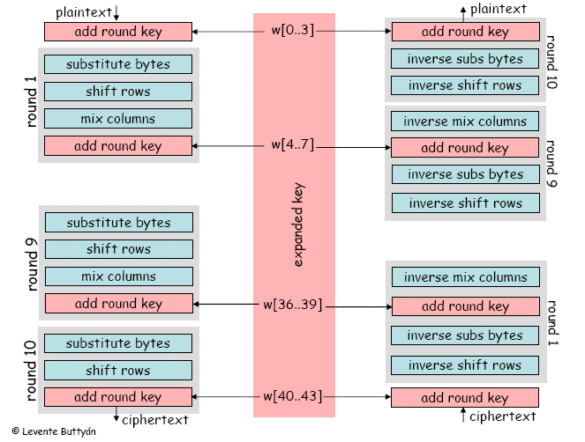
Structure of AES

Slide 74
RC4 stream cipher – “Ron’s Code”
Design goals (Ron Rivest, 1987):
  speed
  support of 8-bit architecture
  simplicity (circumvent export regulations)
Widely used
  SSL/TLS
  Windows, Lotus Notes, Oracle, etc.
  Cellular Digital Packet Data
  OpenBSD pseudo-random number generator

Slide 75
RSA Trade Secret
History
  1994 – leaked to cypherpunks mailing list
  1995 – first weakness (USENET post)
  1996 – appeared in Applied Crypto as “alleged RC4”
  1997 – first published analysis
  Weakness is predictability of first bits; best to discard them

Slide 76
Encryption/Decryption
key
state
000111101010110101
⊕
plain text plain text
=
cipher text cipher t
  Stream cipher: one-time pad based on pseudo-random generator

Slide 77
Security
Goal: indistinguishable from random sequence
  given part of the output stream, it is impossible to distinguish it from a random string
Problems
  Second byte [MS01]
    Second byte of RC4 is 0 with twice expected probability
  Related key attack [FMS01]
    Bad to use many related keys (see WEP 802.11b)
Recommendation
  Discard the first 256 bytes of RC4 output [RSA, MS]

Slide 78
Complete Algorithm
(all arithmetic mod 256)
Key scheduling
Random generator
for i := 0 to 255 S[i] := i
j := 0
for i := 0 to 255
j := j + S[i] + key[i]
swap (S[i], S[j])
i, j := 0
repeat
i := i + 1
j := j + S[i]
swap (S[i], S[j])
output (S[ S[i] + S[j] ])
0 | 1 | 2 | 3 | 4 | 5 | 6 | …
Permutation of 256 bytes, depending on key
2 | 123 | 134 | 24 | 1 | 218 | 53 | …
2 | 123 | 134 | 24 | 9 | 218 | 53 | …
i
j
+24

Slide 79
Example use of stream cipher?
Share secret s with web vendor
Exchange payment information as follows
  Send: E(s, “Visa card #3273. . . ”)
  Receive: E(s, “Order confirmed, have a nice day”)
Now eavesdropper can’t get out your Visa #

Slide 80
Wrong!
Suppose attacker overhears
  c1 = Encrypt(s, “Visa card #3273. . . ”)
  c2 = Encrypt(s, “Order confirmed, have a nice day”)
Now compute
  m ← c1 ⊕ c2 ⊕ “Order confirmed, have a nice day”
Lesson: Never re-use keys with a stream cipher
  Basic problem with one-time pads
  This is why they’re called one-time pads

Slide 81
Public-key Cryptosystem
Trapdoor function to encrypt and decrypt
  encrypt(key, message)
  decrypt(key ⁻¹, encrypt(key, message)) = message
Resists attack
  Cannot compute m from encrypt(key, m) and key, unless you have key⁻¹
key pair

Slide 83
Iterated hash functions
Repeat use of block cipher or custom function
  Pad input to some multiple of block length
  Iterate a length-reducing function f
    f : 2^{2k} -> 2^{k} reduces bits by 2
    Repeat h₀= some seed
    h_{i+1} = f(h_{i}, x_{i})
  Some final function g
  completes calculation
x
Pad to x=x₁x₂ …x_{k}
x_{i}
f(x_{i-1})
f
g

Slide 84
MAC: Message Authentication Code
General pattern of use
  Sender sends Message and M1 = MAC(Message)
  Receiver receives both parts
  Receiver computes M2 = MAC(Message)
    If M2 == M1, data is valid
    If M2 != M1, data has been corrupted
This requires a shared secret key
  Suppose an attacker can compute MAC(x)
  Intercept M and MAC(M), resend as M' and MAC(M')
  Receiver cannot detect that message has been altered

Slide 85
Basic CBC-MAC
Plain
Text
Plain
Text
IV=0
Block Cipher
Block Cipher
Block Cipher
Block Cipher
CBC block cipher, discarding all but last output block
Additional post-processing (e.g, encrypt with second key) can improve output

Slide 86
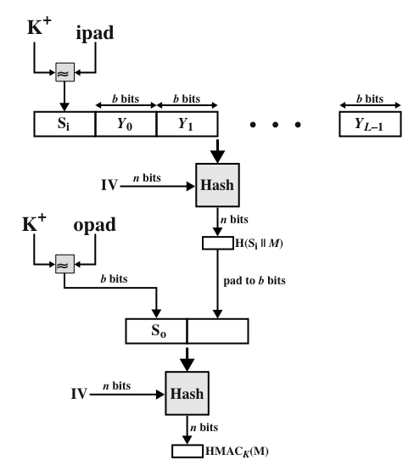
HMAC: Keyed Hash-Based MAC
Internet standard RFC2104
Uses hash of key, message:
  HMAC_{K}(M)
  = Hash[ (K⁺ XOR opad) ||
  Hash[(K⁺ XOR ipad)||M)] ]
Low overhead
  opad, ipad are constants
Any of MD5, SHA-1, … can be used
⊕
⊕
K+ is the key padded out to size

Slide 87
Order of Encryption and MACs
Should you Encrypt then MAC, or vice versa?
MACing encrypted data is always secure
Encrypting {Data+MAC} may not be secure!

