Slide 1
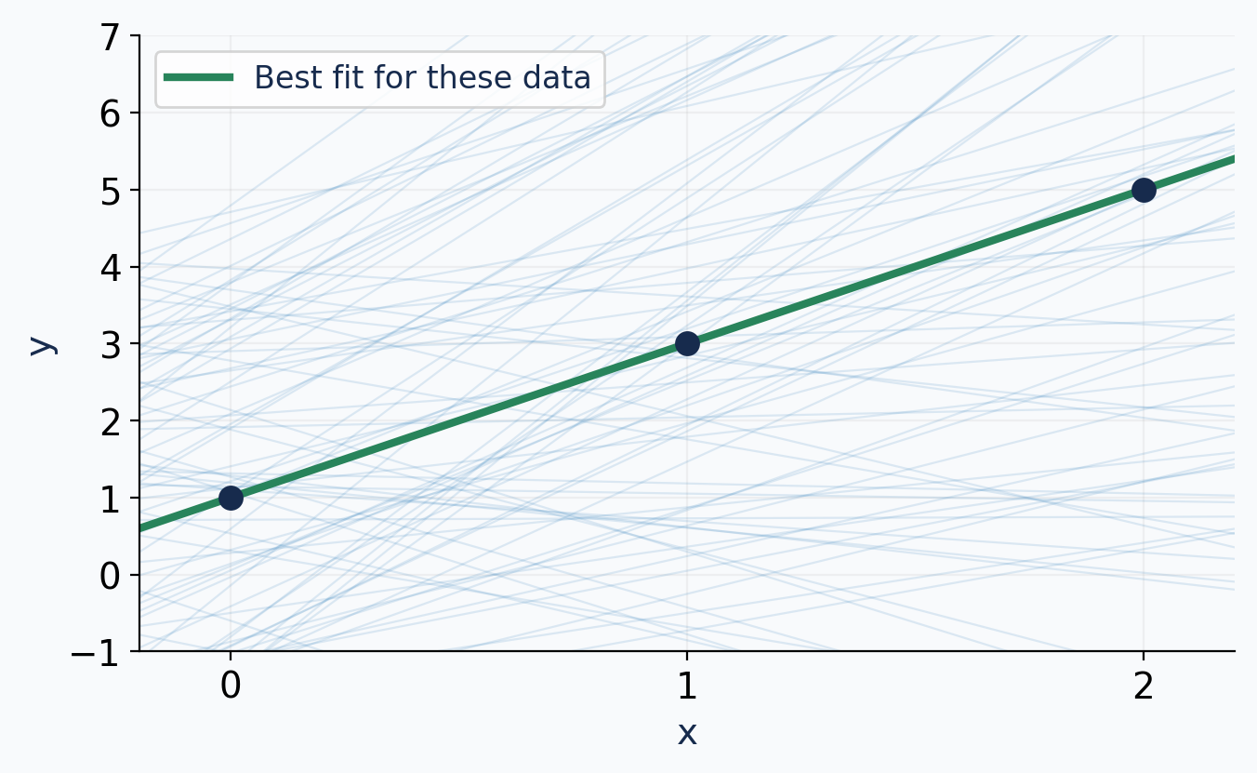
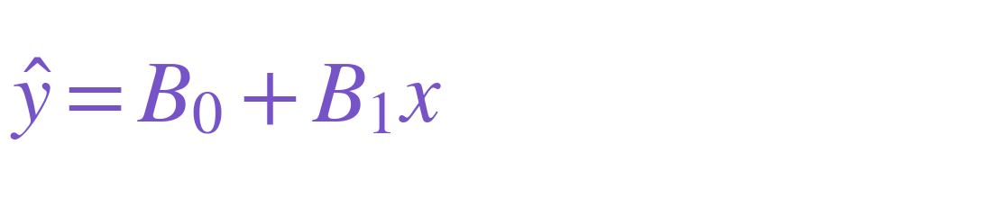
Infinitely many lines. Which one fits best?
Each choice of B₀ and B₁ gives a different candidate line.
B₀ sets the intercept.
B₁ sets the slope.
Our goal: find the pair that produces the best-fitting line.
Data: (0, 1), (1, 3), (2, 5). Only a sample of the infinitely many candidate lines is shown.
1
Notes:
TIME 0–2 minutes (2 minutes)
TEACH
The dots are fixed observations. The faint lines sample 80 possible coefficient pairs; there are infinitely many pairs. They do not represent extra observations. The green line is the exact fit for these deliberately simple noiseless data: B₀=1 and B₁=2. In real data the best line usually has nonzero error. Explain that training searches parameter space.
ASK
What changes when we try another line?
EXPECTED RESPONSE / DEBRIEF
The two parameters B₀ and B₁. The observed x and y values remain fixed.
TRANSITION
We need a common score to compare lines.
SOURCES

Slide 2
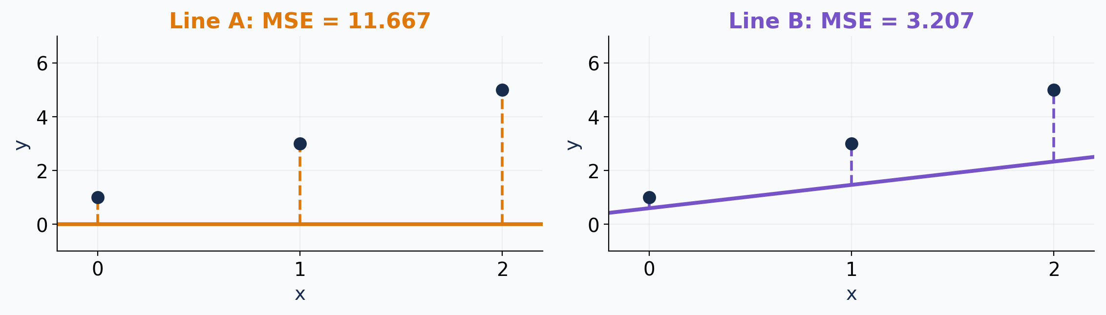
Loss gives every candidate line a score
Mean squared error (MSE) averages the squared vertical prediction errors.
Lower is better: Line B fits better than Line A. Dashed segments show prediction errors.
2
Notes:
TIME 2–5 minutes (3 minutes)
TEACH
Line A is B₀=0,B₁=0. Line B is B₀=0.6,B₁=13/15. Their exact MSE values are 35/3 and 3.207407. Squaring prevents positive and negative errors from cancelling, and gives larger errors more weight. n is the number of observations, three here. We use MSE without a factor of one-half. The green exact fit from slide 1 would have MSE zero.
ASK
Why use the same loss function to compare both lines?
EXPECTED RESPONSE / DEBRIEF
It puts both candidates on the same measurement scale.
TRANSITION
Use calculus to find a direction that lowers this score.
SOURCES

Slide 3
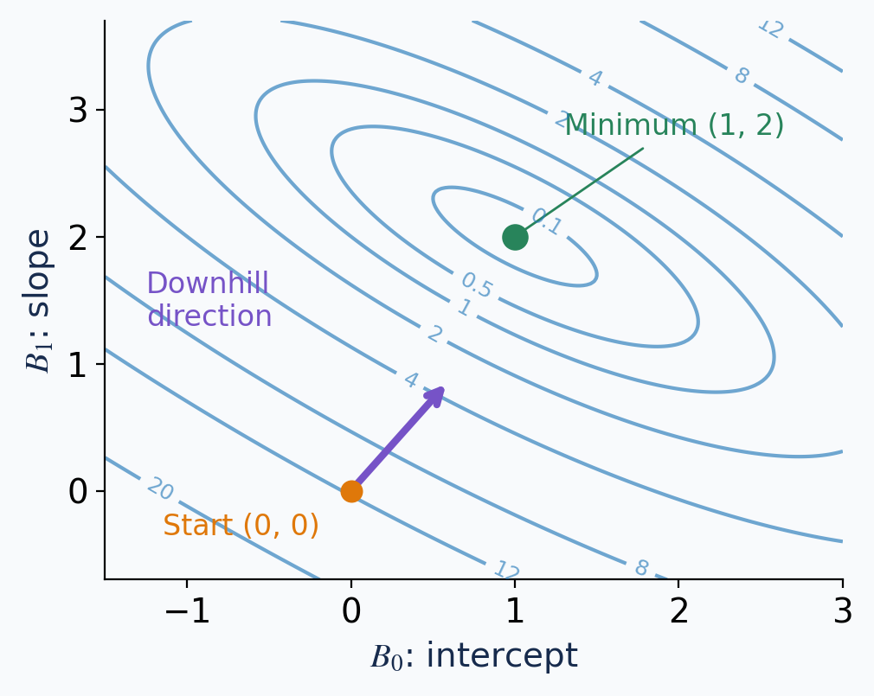
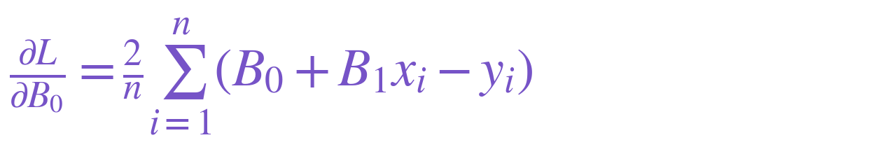
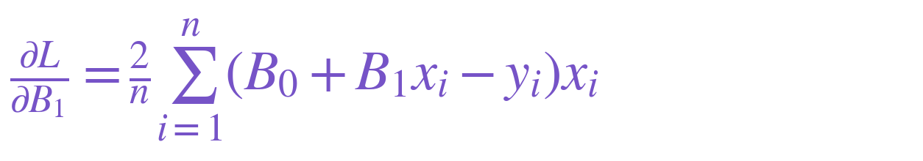
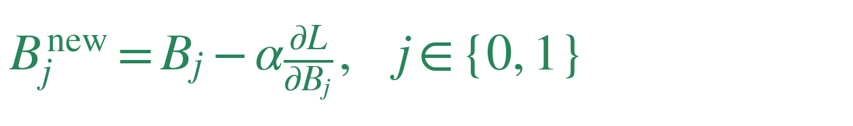
Use the gradient to choose a downhill step
Now the axes are the parameters B₀ and B₁. Each position represents one whole line.
One sensitivity for each parameter
Use every observed pair (xᵢ, yᵢ).
Contours join equal loss. Subtract a fraction α of the gradient; α is the learning rate.
3
Notes:
TIME 5–8 minutes (3 minutes)
TEACH
This is a top-down view of the convex MSE bowl. Each contour joins coefficient pairs with equal MSE; its number is the loss. The two derivatives form the gradient. The full expression B₀+B₁xᵢ−yᵢ is prediction minus actual. The following slide derives each partial derivative explicitly by the chain rule. Evaluate both derivatives at the current B₀,B₁ using the fixed training observations. An input x alone does not supply the loss or gradient; the target y is also needed. The negative gradient is a local downhill direction. The update formula applies to j=0 and j=1.
ASK
Is the derivative with respect to B₁ the same thing as B₁ itself?
EXPECTED RESPONSE / DEBRIEF
No. B₁ is the slope of the fitted line; this derivative is the sensitivity of loss to B₁.
TRANSITION
Derive these two formulas using the chain rule.
SOURCES

Slide 4
How the two partial derivatives are obtained
Differentiate the square, then multiply by the derivative of the expression inside it.
With respect to B₀: hold B₁, xᵢ, and yᵢ fixed.
With respect to B₁: hold B₀, xᵢ, and yᵢ fixed.
The square contributes the factor 2. The expression inside contributes 1 for B₀ and xᵢ for B₁.
4
Notes:
TIME 8–11 minutes (3 minutes)
TEACH
We use the full expression B₀+B₁xᵢ−yᵢ throughout. Bring the partial derivative inside the finite sum and keep the constant 1/n. The derivative of a square is twice the expression times its own derivative. For B₀, the derivative of B₀+B₁xᵢ−yᵢ is 1+0−0=1. For B₁ it is 0+xᵢ−0=xᵢ. The observed values xᵢ,yᵢ and sample count n remain fixed during differentiation. Simplify the constant factor to 2/n. These are sensitivities of loss, not the slope of the fitted line itself.
ASK
Why does the B₁ derivative contain an additional xᵢ?
EXPECTED RESPONSE / DEBRIEF
Because the derivative of B₁xᵢ with respect to B₁ is xᵢ.
TRANSITION
Substitute the current parameter values and observations, then apply the learning rate.
SOURCES

Slide 5
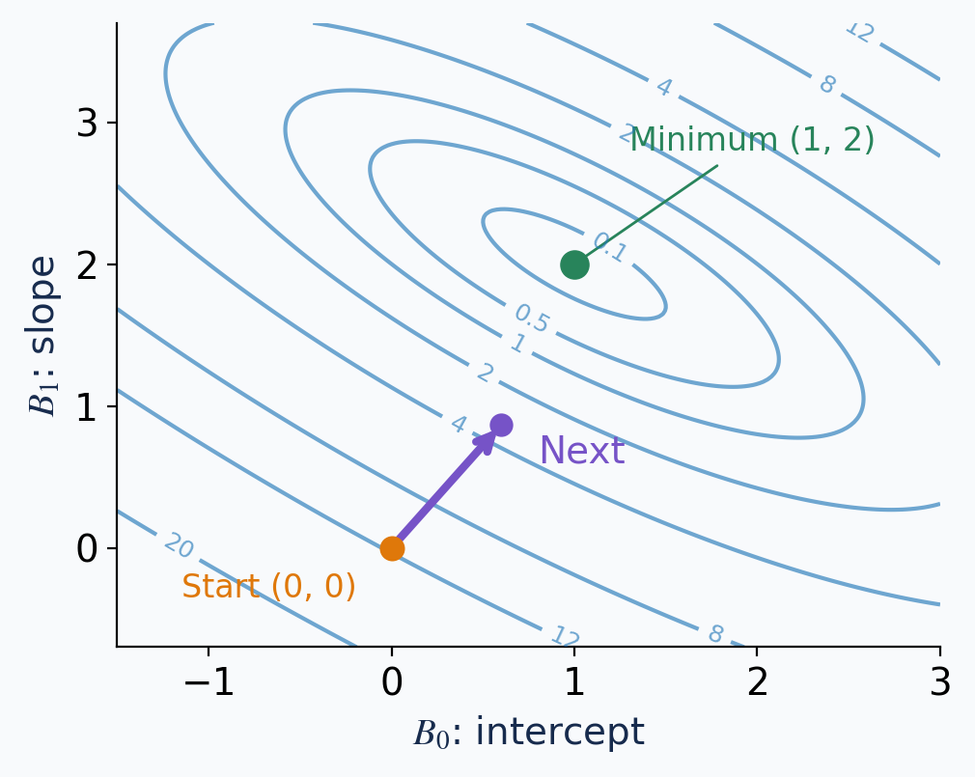
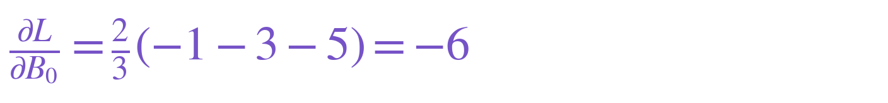
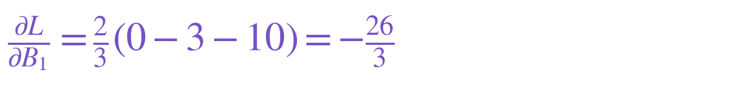
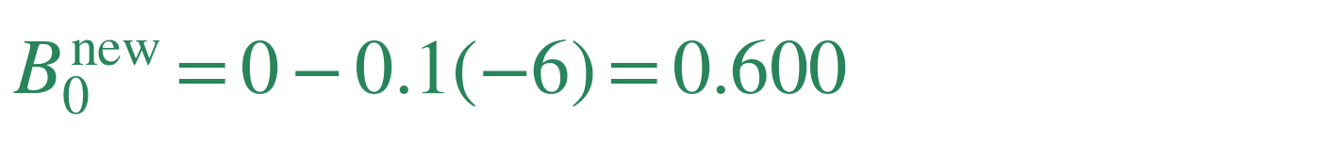
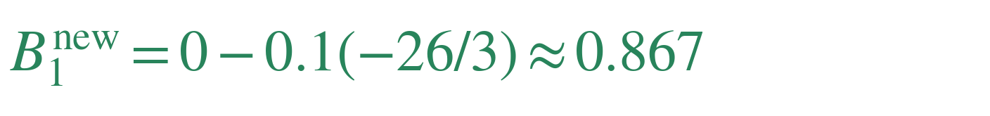
One step: calculate, update, repeat
Start at B₀ = B₁ = 0. Predictions are (0, 0, 0), so errors are (−1, −3, −5).
Calculate both derivatives from all 3 rows
Apply learning rate α = 0.1
MSE: 11.667 → 3.207. Recalculate predictions and gradients at the new parameters, then repeat.
5
Notes:
TIME 11–14 minutes (3 minutes)
TEACH
The coordinate pair (0,0) is a parameter starting point, not a training observation. Use x values 0,1,2 and y values 1,3,5 to calculate the errors. The intercept gradient is −6; the slope gradient is −26/3. Multiplying the negative gradient by 0.1 gives the step (0.6,13/15). Both parameters update simultaneously from the same old values. The plotted arrow shows this parameter change. For mini-batch or stochastic training we would use a subset or a single paired x,y observation, but this example uses all three.
ASK
Do we reuse these same two derivatives for every subsequent step?
EXPECTED RESPONSE / DEBRIEF
No. Recalculate them at the new parameter values.
TRANSITION
The size of the step matters as well as its direction.
SOURCES

Slide 6
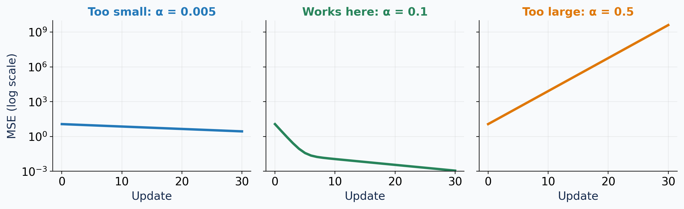
The learning rate controls the step size
Same data, same starting point, same update rule. Only α changes.
Small steps make
slow progress.
A suitable step size
reduces loss steadily.
Large steps overshoot.
Loss grows.
All three plots use the same logarithmic loss scale. A suitable learning rate depends on the problem.
6
Notes:
TIME 14–16 minutes (2 minutes)
TEACH
Every plotted value is calculated using full-batch gradient descent from B₀=B₁=0. The rates are 0.005,0.1,0.5. For this quadratic, 0.5 is unstable and produces growing oscillations in parameter space. Small overshoots do not necessarily imply divergence, but repeated excessively large updates can diverge. A log vertical scale allows reductions and growth over many orders of magnitude to share an axis. Thirty updates are shown. The 0.1 value works for this example; it is not a universal recommendation.
ASK
What would you try if loss repeatedly grows during training?
EXPECTED RESPONSE / DEBRIEF
Reduce the learning rate, while also checking the data and implementation.
TRANSITION
The same basic process trains larger neural networks, with additional practical choices.
SOURCES

Slide 7
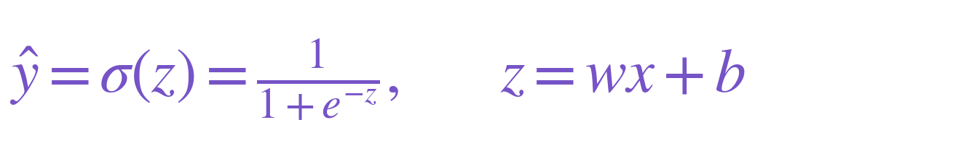
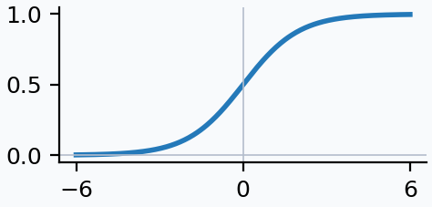
One neuron: a weighted input plus an activation
One input x, one learned weight w, one learned bias b, and one output ŷ.
× w
Input x
Weighted sum
z = wx + b
Sigmoid
σ(z)
Output ŷ
Together, these operations form one neuron.
The sigmoid maps the weighted sum to (0, 1). Training adjusts w and b.
7
Notes:
TIME 16–18 minutes (2 minutes)
TEACH
The diagram has one scalar data input and one scalar output. The bias is a learned offset, not a second data feature. Weighted sum and activation are two operations within one neuron, not two neurons. Relate w to B₁ and b to B₀. Sigmoid converts any finite real weighted sum to an output strictly between zero and one. Here e in the exponential is Euler’s number, not error shorthand.
ASK
What is new compared with the linear prediction?
EXPECTED RESPONSE / DEBRIEF
The sigmoid activation applied after the weighted sum.
TRANSITION
Differentiate through this additional operation.
SOURCES

Slide 8
The neuron gradient: apply the chain rule
Use MSE for one observed pair (x, y). Keep x and y fixed while changing w or b.
1. Differentiate with respect to w
2. Differentiate with respect to b
Three factors: derivative of squared loss × derivative of sigmoid × derivative of wx + b.
8
Notes:
TIME 18–22 minutes (4 minutes)
TEACH
For the outer squared loss, derivative with respect to prediction is 2(prediction−y). Sigmoid derivative is σ(z)[1−σ(z)], obtained by differentiating (1+exp(−z)) to the power −1: exp(−z)/(1+exp(−z))². Weighted sum derivative with respect to w is x and with respect to b is 1. Multiply these three sensitivities. The expanded formulas use σ(wx+b) and the full prediction-minus-target expression, with no error shorthand. For n observations, average the per-observation losses and gradients, just as in linear regression. MSE keeps continuity with the preceding lesson; binary cross-entropy is commonly preferred for binary classification with sigmoid output, and gives different gradients.
ASK
Why is there an extra sigmoid factor compared with linear regression?
EXPECTED RESPONSE / DEBRIEF
A weight now affects loss through both the weighted sum and a nonlinear activation.
TRANSITION
Evaluate the formulas at one concrete starting point.
SOURCES

Slide 9
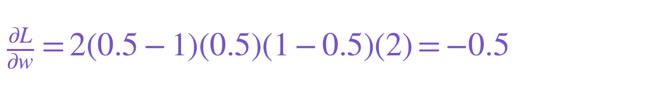

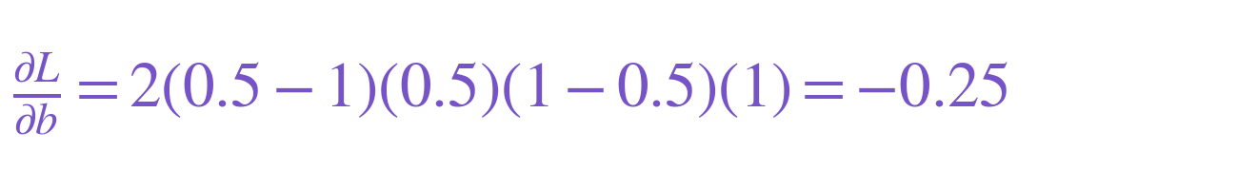
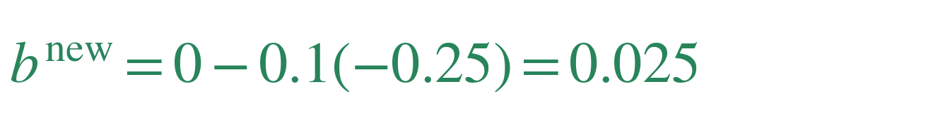
One neuron: calculate and apply one update
One training observation: x = 2, y = 1. Start at w = b = 0. Learning rate α = 0.1.
Calculate the gradients
Subtract α × each gradient
New output ≈ 0.5312. MSE falls from 0.2500 to 0.2198.
Recalculate the output and gradients at the updated w and b, then repeat.
9
Notes:
TIME 22–25 minutes (3 minutes)
TEACH
The starting weighted sum is zero, so sigmoid output is 0.5. The loss derivative is 2(0.5−1)=−1. The sigmoid derivative is 0.5(1−0.5)=0.25. Multiplying by x=2 gives weight gradient −0.5; multiplying by 1 gives bias gradient −0.25. Update simultaneously to w=0.05,b=0.025. New weighted sum is 0.125; sigmoid is 0.531209373 and squared error is 0.219764652. These are computed values. At n=1, MSE is a single squared error.
ASK
Why is the weight gradient twice the bias gradient here?
EXPECTED RESPONSE / DEBRIEF
The last chain-rule factor is x=2 for the weight and 1 for the bias.
TRANSITION
The activation derivative changes when we choose a different activation function.
SOURCES

Slide 10
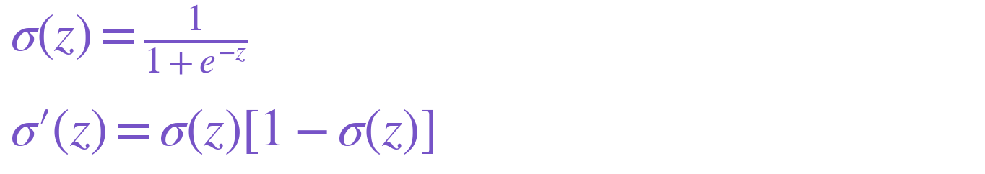
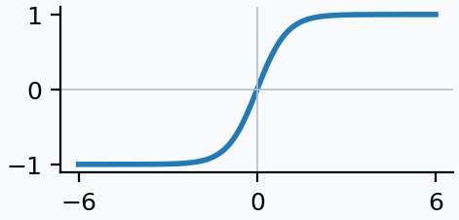
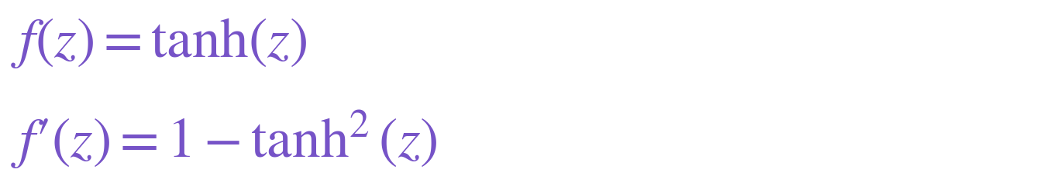
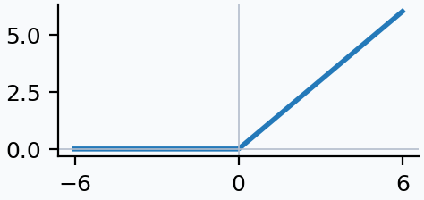
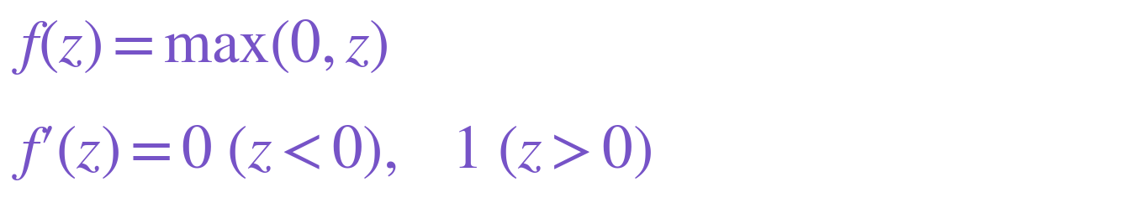
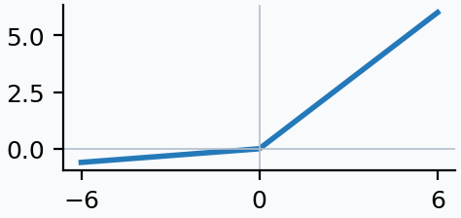
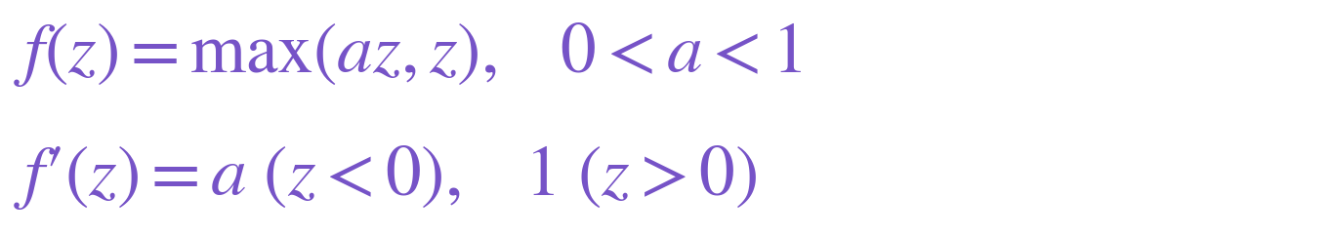
Common activation functions and their derivatives
The activation derivative is the middle factor in the neuron’s chain rule.
Activation
Shape
Function and derivative
Sigmoid
Tanh
ReLU
Leaky ReLU
ReLU and Leaky ReLU have a corner at z = 0; implementations choose a backward value there.
10
Notes:
TIME 25–28 minutes (3 minutes)
TEACH
Primes denote derivatives with respect to z, the input to the activation. Sigmoid derivative follows from differentiating 1/(1+exp(−z)) and rewriting the result as sigmoid times one minus sigmoid. Tanh derivative is one minus tanh squared. ReLU is zero below zero and identity above zero, so its derivative is zero or one. Leaky ReLU uses a fixed small positive negative-side slope a; the plot uses a=0.1. At zero the classical derivatives of ReLU and Leaky ReLU do not exist; libraries choose a backward convention. Sigmoid and tanh derivatives approach zero for large absolute inputs, contributing to vanishing gradients in deep compositions. This is a reference slide, not a claim that one activation is always best.
ASK
Where does sigmoid have its largest derivative?
EXPECTED RESPONSE / DEBRIEF
At z=0, where the derivative is 0.25.
TRANSITION
Connect these derivatives to deeper networks and training choices.
SOURCES

Slide 11
An RNN neuron: its output becomes its memory
Standard RNN with one hidden unit. The same hidden value can also feed a prediction head.
Previous memory
hₜ₋₁
× input weight
× recurrent weight
Current input
xₜ
Weighted sum
then tanh
Hidden state
hₜ
Output head
weights + g
Same hₜ,
carried forward
Memory for
the next step
Prediction ŷₜ
hₜ is the cell’s output and stored memory. The head’s prediction ŷₜ is a separate quantity.
11
Notes:
TIME 28–31 minutes (3 minutes)
TEACH
This diagram shows a standard Elman RNN with one scalar hidden unit, so the hidden state is one number. At step t, current input xₜ and previous hidden state hₜ₋₁ enter a weighted sum with bias, followed by tanh. That activation value hₜ is both the cell output and the stored state passed to the next step. Copying it does not apply another learned weight. The next step multiplies that saved value by the learned recurrent weight w_h while calculating its new hidden state. A separate head can transform hₜ through w_y,b_y and an activation g to produce a task prediction ŷₜ; g may be sigmoid, softmax or identity depending on the task and output dimension. Some diagrams call hₜ the RNN output, while others call the prediction ŷₜ the output; name the level explicitly. This example has one input and one hidden unit. With four hidden units, hₜ contains four numbers and a dense recurrent matrix mixes all four previous values into each new hidden unit. An LSTM also has a distinct cell state, so the simple-RNN equivalence is not a statement that all recurrent state variables are identical. Read w_x,w_h,w_y as input, recurrent and head weights.
ASK
Is hidden state an extra weighted version of this neuron’s output?
EXPECTED RESPONSE / DEBRIEF
No. In this standard RNN, the neuron’s activation output is the hidden state. Recurrent weighting happens when computing the next state, while the optional head computes a separate prediction.
TRANSITION
Long sequences repeat this computation many times, linking RNNs to deep-network gradient challenges.
SOURCES

Slide 12
What comes next in a deep learning course?
Neural networks extend this idea to many weights and biases across layers.
Initialization
Choose starting weights that help signals and gradients move through the network.
Optimization algorithms
SGD, momentum, and Adam use gradients differently to choose parameter updates.
Vanishing or exploding gradients
Across many layers or RNN time steps, gradients can shrink or grow too much.
You would also learn how residual connections, normalization, and gradient clipping help training.
12
Notes:
TIME 31–33 minutes (2 minutes)
TEACH
Keep this a preview. Initialization methods such as Xavier and He aim for useful signal scales. Momentum smooths update directions; Adam adapts parameter-wise scaling using moving gradient statistics. Deep networks and unrolled RNNs can suffer from products of derivatives that vanish or explode. Residual paths and suitable initialization help gradient flow, normalization can stabilize optimization, and clipping limits large gradients. These techniques do not guarantee successful optimization. Nonlinear networks usually lack a simple closed-form parameter solution and use iterative optimization. Linear least squares can also be solved directly; we use gradient descent here to introduce the method shared with deep learning.
ASK
Which core loop remains the same in a deep network?
EXPECTED RESPONSE / DEBRIEF
Predict, calculate loss, calculate gradients, update parameters, repeat.
TRANSITION
Continue with the architecture lesson.
SOURCES

