Slide 1
Software Engineering Class Presentation
2025/11/11
Josh Trutwin – Sr. Cloud Engineer
Thrivent Financial for Lutherans - Engineering Productivity / Provision Domain

Slide 2
Disclaimer
Even though the Thrivent logo is on this presentation I am not acting on behalf of Thrivent. My views are my own and not a reflection of the company, but as an employee and therefore representative of Thrivent I shall endeavor to uphold their core values:
Empathy: Genuinely care for the concerns of others.
Authenticity: Sincerely share what you believe and respect the lived experiences of others.
Impact: Drive for tangible outcomes that solve problems and help people.
Commitment: Strive for excellence and growth each day.
Gratitude: Appreciate the true value of every moment.
My experience through the world of IT is vastly different than most and will be reflected in my views and opinions. I will do my best, but I may say something that is completely counter to what you experience over your career.
TL;DR – YMMV
Resources: https://github.com/joshtrutwin/cs340-presentation

Slide 3
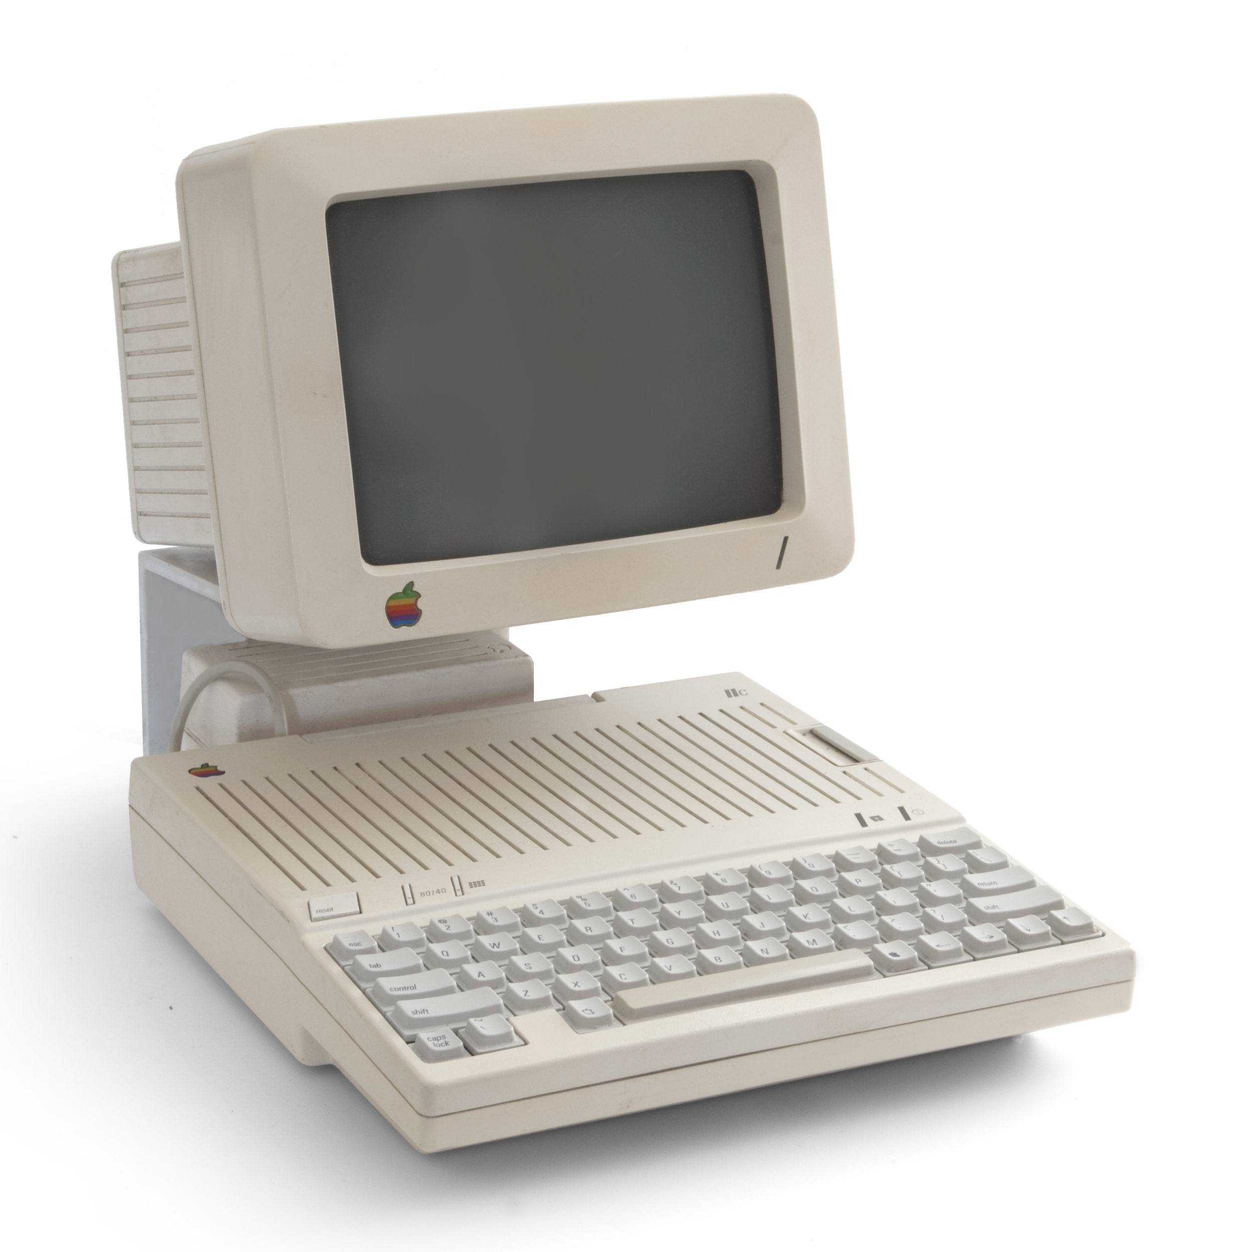
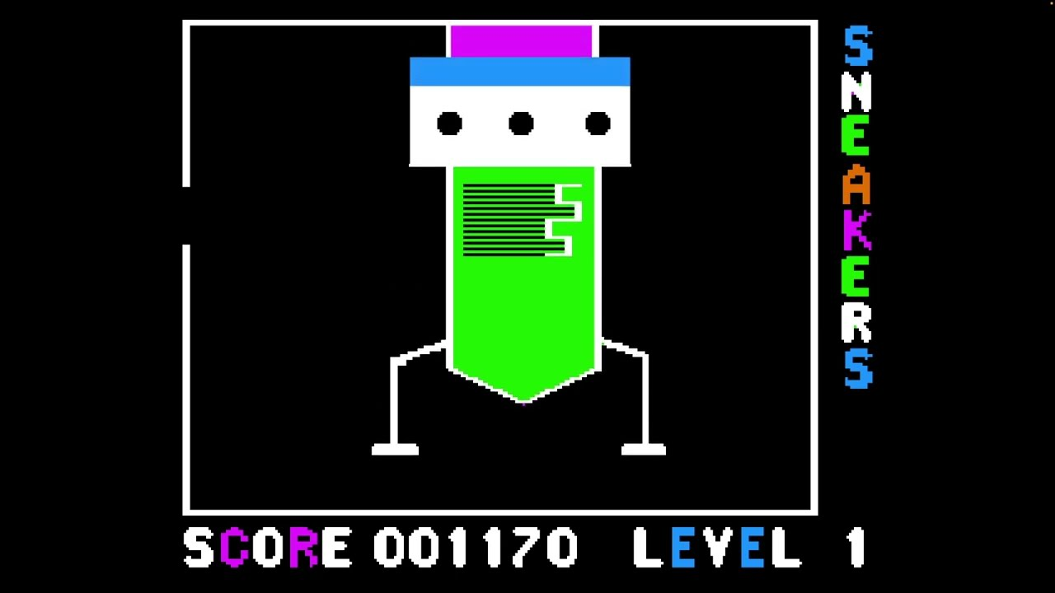
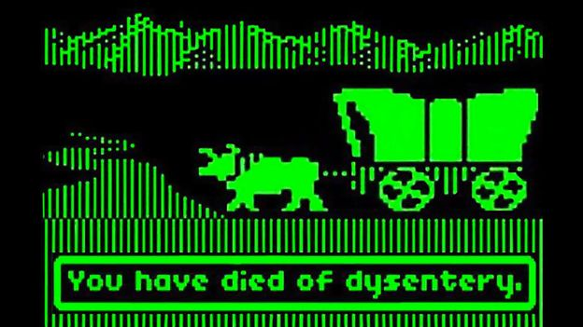
A Little About Me….
Born in 1975 and grew up on a farm in central MN – band kid, shy, first computer was Apple 2C – Oregon Trail and typing practice every Wednesday in grade school!

Slide 4
A Little About Me….
My dad as the oldest was denied the opportunity to finish college and had to take over the farm, he knew small farming had no future so encouraged me to go to college. My mom worked overnight shifts as a nurse at St. Cloud Hospital to help pay the bills.
Went to St. John’s University, started out as a Chemistry major until gen chem 2 wrecked me. Switched to Math, then switched to Math/CS (combined major), then added a double major in Music and did a 4.5 year. Best years of my life, studied abroad in Ireland, got out of my shell a bit.
Got picked out by a monk who was my FR in my dorm to work in the Administrative Computing Center starting my sophomore year, stayed on thru summer. My first real experience with IT. Mainframes, VAX, Command Line, line printers. It was real work too which is a rarity for students.
Spent part of my later summers also working for the Unix administrator doing hardware / software upgrades etc. Built a web phone book app for him using perl / cgi-bin.
LOVED my CS classes, just ate it up. Math classes were more challenging and frustrating, not sure how I passed Linear Algebra. Music classes I focused on Piano performance but joined a band and a choir.
C/C++, Perl, FOCUS, COBOL, VAX VMS, SIS, SGI Irix OS, Windows 3.1!

Slide 5
My First Real Job – United Defense
One of the CSCI profs went back to industry and recruited heavily at CSB/SJU. I had about 8 different job offers (it was different back then) but I went here because the work seemed interesting, and matched my skills (C/C++ and SGI Irix)
Fridley, MN – the farm kid moves to the metro…
Modeling and Simulation Team – rapid development methodologies.
Army program – “Crusader” SPH (Self Propelled Howitzer) – created computer based models on state of the art SGI rendering workstations (keep in mind this was 1999) which showed a user interface, an external view, and an internal CAD view of hardware in motion.
Lots of red tape, lots of document review, very weird building to work in
Learned how to deal with nerves, demo’d to a lot of high ranking members of US Army and numerous congressional staffers and occasionally senators
MSSE 2-year terminal degree from U of M paid for by United Defense. Master of Science in Software Engineering. Lot of fluff classes but the Database course was my favorite. Started self studying for Oracle database certs.
C/C++, Ada (!), VAPS, CVS/SVN, SGI Irix
aws_cloudwatch_event_rule

Slide 6
This job stuff sucks, self employment?
While working at United Defense I did a lot of self study and decided I really liked doing web development and server hosting. I wanted to eventually be a sys or database administrator. United Defense didn’t have a lot of opportunity for this.
Set up Netbits, Inc. and partnered with Fastconcepts, Inc. both 1-person S-Corp entities, Fastconcepts was another coworker at United Defense. He left before me and enjoyed the self-employed life.
I made a go of it, but it didn’t last long as a full time activity that paid the bills. Took on some debt while trying to get off the ground.
Worked for a lot of shady people and other self-employed people who had less money than me
I hated the marketing and billing aspects of this and after about half a year decided that was enough
I kept the business and used it more for part time work and hosting web sites for myself, my friends and a few clients I kept, and all of Fastconcepts clients…
Started teaching adjunct classes at Metropolitan State University to supplement income.
Co-Lo server hosting, Linux Systems Administration, Email Hosting, SPAM Filtering, Web Hosting, DNS Hosting, PhP, MySQL, etc
.5 years full time, still have the S-Corp to this day but want to terminate it…

Slide 7
Bankers Systems – Commuting I
Self-employment was an interesting idea, but I could never manage the non-technical aspects.
Talked to a head-hunter type company who was able to place me at Bankers Systems in St. Cloud.
My wife and I knew we would eventually live in the St. Cloud area to be closer to grandparents and away from the grind of the metro so this seemed like a good idea at the time…
Started reverse commuting from Minneapolis to St. Cloud. Freeways were less crowed this way but still winters were tough, and the time was brutal. 694 was 2 lanes still... Listened to many audio books.
Work as a contractor was brutal, XML docs, large shared “pod” style room
Helped a person in legal with an Excel macro and raised my hand a lot for other projects, eventually got noticed enough to get an opportunity to convert to full time as a Data Analyst
Worked with a large Access Database and wrote scripts against it using perl
Bankers was acquired by Wolters Kluwer
When Ben was born, the late night bottle feeding was my job and I drove to work often half asleep…
XML, XSLT, perl, Access, Excel (!)
2+ years. The commute eventually killed me…

Slide 8
Back to United Defense – commuting II
I came crawling back to United Defense. Now they were BAE Systems though.
We were still living in Minneapolis and this was a short bike ride away from the house.
My supervisor welcomed me back but the tech stack had changed a lot
Got promoted to a Senior Engineer
More python, Java, and Ruby (yuck) now than C/C++. I felt behind on everything and was frustrated…
Then we finally moved to St. Cloud and I had to start commuting again, this time INTO the metro (though by now 694 had 3 lanes!)
Same tech stack as before but worse and the SGI’s were replaced
1.25 more years. The commute killed me even harder…

Slide 9
Intrcomm – the Middle Ground
I found myself frustrated with the big corp and self-employment, so I found a little web hosting company in Delano, MN. It was still a 45 minute commute but all scenic country backroads.
I finally started to get the systems administration experience I wanted so badly
It came with stress, especially with the size of the team (3 developers)
It also came with hornets in the bricks and days where I played WoW at work (#ashamed)
It didn’t have the niceties, retirement plans, decent insurance, etc
PhP, webdev, CSS, CMS, PostgreSQL, Linux administration, git
5+ years but an opportunity arose….

Slide 10
CSB/SJU – My Dream Job!
The Linux Administrator job opened up at my alma mater, they reached out
I interviewed with people I used to work with as a student worker and the CSCI chair was the same guy when I was a student.
Even though I lacked a lot of Linux admin experience they took a chance on me
Summers were amazing, I would take a hammock over lunch next to Lake Sagatagan, many memories
Fell back in love with St. John’s campus and trails
Staff was very low turnover, everyone was pretty happy, great crew
Working for Computer Science and Physics departments was …. Interesting, very demanding
Did a lot of adjunct professor work, taught intro to CS class, Java, Database, got my name on a department created textbook
Linux Admin, Data Center Hardware, RedHat, CentOS, Bash, VDI, Banner, all sorts of things
11+ years. I had everything but one thing….

Slide 11
TCFBank / Huntington – a Tale of 2 Banks
My headhunter laughed when I told her my years of experience at my position and my salary
Back to the grind, back to the commute… sigh
But I was able to avoid the damn freeway so it wasn’t horrible
I quickly tried to fit in, I raised my hand for many things and got to be the automation guy. Learned a nifty tool called “ansible” and used it to automate server requests from our ticketing system (ServiceNow) and eventual server decom requests.
Became a member of the TOIL Team, a cross team collab group trying to automate “toil” related jobs
Covid years, after around a year I stopped having to commute altogether…
Went through an acquisition of another bank (ChemicalBank) then shortly after we were acquired by Huntington National Bank
Due to my knowledge of server decom I was given a retention package to stay on with HNB and help them decom TCF servers. Miserable
HNB was a step backwards in IT by about 10 years. Frustrated, after retention was done I started looking again
Ansible, Nutanix, VMWare, Linux, Red Hat, ServiceNow, automation, git
2-3 years

Slide 12
Thrivent – the Last Stop?
I made a lot of noise at TCF and tried to insert myself into many places, leadership took notice.
When HNB acquired TCF, many folks went to Thrivent
I was hired to be a Cloud Engineer at Thrivent with pretty much ZERO cloud experience, but based on my prior work at TCF and the leadership’s knowledge of what I could do, they found me a place
AWS was more difficult for me to pick up on but eventually things started to stick.
No longer automating with Ansible, now it was through pipelines like github, bamboo, etc.
AWS infrastructure all provisioned “as code” using terraform. Pull request == plan, merge == apply
AWS is the ultimate jack of all trades technology to learn, it has everything
Politics! New manager and new director almost every year. People I respected let go because they didn’t fit in with new leadership. People quit over new leadership’s direction. And another re-org is happening…
I was one of the only ones left and now I’m the primary AWS administrator for nearly 4m of cloud infra. Eek…
AWS, terraform, git
3.5 years, I hope to retire here…

Slide 13
So What Have I Learned?
Quiz: What would a CEO say is their company’s most important asset?
Never burn a bridge as tempting as it is… It rarely even works.
There probably is no perfect job…
Change is the only constant…
Your network is one of your key strengths, make friends in high places if you can
No one is safe from the chopping block
No code is safe from the chopping block, do not take it personally when your code is targeted for decom
No company is safe from the chopping block, acquisitions are not fun
Always stay relevant
Don’t over generalize, but also, don’t under specialize
AI is already here, adapt, learn, use, innovate
Beg, borrow and steal
In corporate America, you are helping someone at the top get rich, don’t have to like it though

Slide 14
Recommendations for Tomorrow’s CS Grad
Ask yourself today, do I like this major? This field?
Ask yourself today, how much more schooling do I want (Masters? PhD?)
Use your connections and don’t be ashamed of it
Get a summer internship and start the process soon, for many Juniors it might already be too late
Be professional, look nice, groom yourself, look at your background in your video call set up
If you do an in person interview take it up a notch, suit and tie, haircut, fragrance
Know something about the company you’re interviewing for, know your job description
Highlight your ability to work with others, almost no one wants to hear “I like to work alone”
Don’t be afraid to say “I don’t know that but it sounds interesting and I’d love to dive into that”
Self train - many jobs expect / desire experience but you cannot gain experience without getting a job…
Do not get complacent at your first job, make yourself as indispensable as possible, raise your hand, learn from anyone you can
Stay positive, stay vigilant, interview often, don’t be afraid to bail on a bad situation
Don’t be afraid to pay $$ for help (head hunters, resume reviewers, certifications, etc)
Don’t be afraid of rejection, one of our core DevOps principles at Thrivent is “Fail Fast”
Learn something from every company that chooses not to hire you, follow up with questions asking what you could have done to been their top candidate
Embrace AI! (more on this later)

Slide 15
What Assets Would a CEO Say are Most Important to their Company?
Context: Corporate America / Fortune 500 type companies – IT heavy operations. What would a CEO fear most to lose?
Guesses?

Slide 16
What Assets Would a CEO Say are Most Important to their Company?
In My Opinion I think #3 is:
3. Their People
They will tell everyone that can listen “The most important thing at my company is the employees” but don’t believe it, people are easily replaced especially at a larger company. I’ve seen it over and over and I know I’m getting to be more and more expendable and more and more expensive the older I get…

Slide 17
What Assets Would a CEO Say are Most Important to their Company?
In My Opinion I think #2 is:
2. Their Code
After all their employees I think an IT Heavy company CEO would fear losing all their code that was built over their existence, but I still think this is not the top fear. Companies can still rebuild much of what was there before and with distributed applications and cloud-based source code control this has been less of a cause of fear than it used to be.

Slide 18
What Assets Would a CEO Say are Most Important to their Company?
In My Opinion I think #1 is:
1. Their Data
I think nothing gives a CEO nightmares more than massive internal data loss or data breach/leak. Things such customer lists, financial data, proprietary intellectual property, historicals, internal emails / communications, call logs, everything that the company has amassed over time and used to make their fortune.
I bring this up despite it’s depressing outlook because I think it’s important to understand where the lower level employees fits in the grand scheme of things.

Slide 19
What are the Top 3 Things you should learn?
Will skip the guesses
#3 – Cloud Computing
Every company that has some advancement in IT is using the cloud in some way. Even thru the use of cloud based services like github, moodle, touchnet, banner, etc are often hosted in the cloud.
While data centers are still very entrenched many companies are seeking to replace their data centers entirely or reduce their hardware footprint via migrations to cloud. Thrivent is currently on this path.
The AWS us-east-1 outage did not put much of a dent in this.
AWS in my opinion is one of the easier cloud providers to learn as a student, you can get many “free tier” services. After that I think learning Azure is not a bad idea especially if you love Windows OS. I have no experience with GCP other than a painful app connection to their Contacts service.
https://aws.amazon.com/free/

Slide 20
What are the Top 3 Things you should learn?
#2 – AI
I bet you expected this to be #1 but I think it’s a close race but for me I still have this behind one other item.
Every company that has some advancement in IT is trying to figure out how to use AI in some way. It’s so bad it’s getting meme’d. CEOs are hearing all sorts of crazy about how AI will replace workforce, accelerate development, find new business. If you disagree with my CEO’s take on how valuable their employees are, consider how AI is being used to consider workforce reduction…
AI is actually quite amazing. And IMHO it’s your worst enemy AND your best friend.
Every interview will likely ask you something about how you use AI and your views on it. Every interviewer will likely expect that you know how to prompt.
What companies struggle with is finding people that know how to build an application in AI that is able to use item #1 on the list of the CEO’s most important things, their company’s proprietary and secret data. LEARN THIS: How can I train AI models on non-public data…

Slide 21
What are the Top 3 Things you should learn?
#1 – Git
Every job you will apply to that isn’t run out of someone’s basement (and even some of those) will expect you to know how to manage your code. This single skill is relatively easy to pick up, difficult to master, and is probably one of the quickest ways to get on the good side of a technical interview because coding is now a team activity and git is the de-facto standard for managing code at scale.
Jr / Associate programmers will be learning a lot of tools, languages, skillsets, etc. and the expectation is not that you will be a rock star programmer at a specific language, but that you can actually manage your code.
GitHub provides a student access to GitHub Education – take advantage while you can:
https://github.com/education
To really stand out, look into GitHub Actions for automation of activities based on events in coding lifecycle.

Slide 22
AWS Bedrock Demo
This was an agentic AI nightmare I wrapped up around midnight last night, but it really only should’ve taken 15 minutes.
Submitting to classroom via github as no time left…

Slide 23
Class Submitted Questions
As time allows, I can email responses to those I don’t get to.
Submitting to classroom via github as no time left…

Slide 24
Conclusion
Thank you for your time
Don’t hesitate to reach out if you would like to talk more about any of this or Thrivent as a place of employment.
LinkedIn: https://www.linkedin.com/in/josh-trutwin-aa188b3/
jtrutwin@gmail.com

