Slide 1
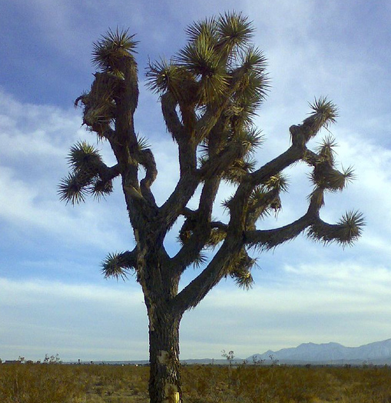
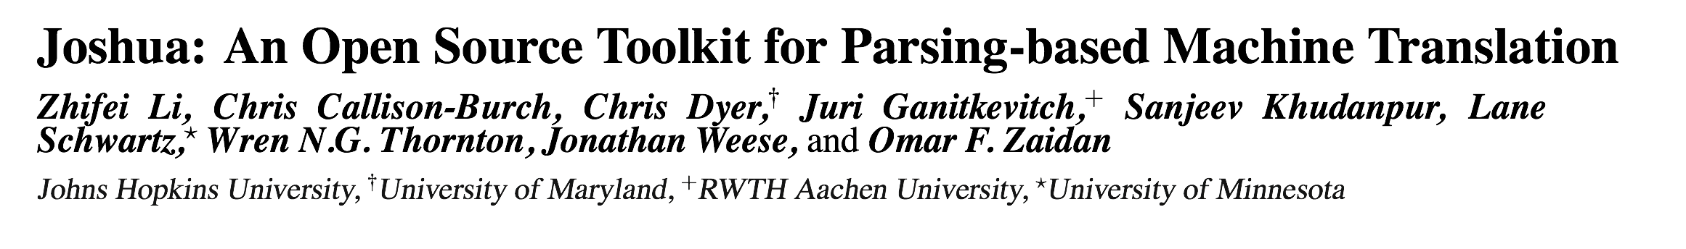

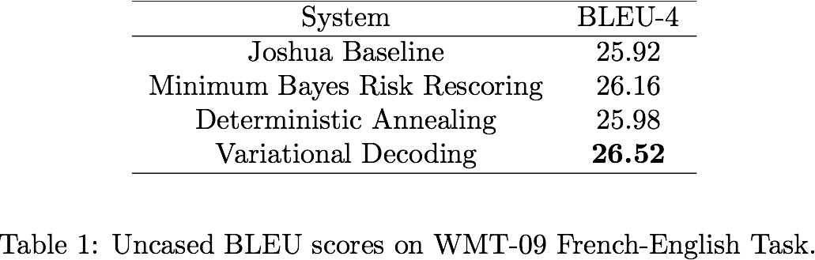
Highlights
  A fully featured toolkit
        chart-parsing, n-gram language model integration, beam and cube pruning, k-best extraction, parallel and distributed decoding
        suffix-array grammar extraction
        minimum error rate training
  Easy to extend
        decoder is organized into three general packages: chart parsing, feature functions, and hypergraph
        say sth about suffix-array??
        MERT module agnostic to metric and parameters
  Scalable
        decoding with less than one second per sentence
        say sth about suffix-array??
        Highly optimized and efficient MERT module.
  Achieving state of the art translation performance
        ranked top-?? in WMT-09 french-english task
Chart-parsing Decoder
CYK parsing algorithm
Feature functions are evaluated along the parsing
Constituents may get pruned during parsing
Parsing results are stored in a hypergraph
K-best extraction on the hypergraph
zhifei will add a diagram here to show the relations?????
Experimental Results
Suffix-array Grammar Extraction???
Say sth
      say sth
Quick Start
svn co https://joshua.svn.sourceforge.net/svnroot/joshua/trunk joshua
Prepare monolingual and bilingual training data
Train a language model using the SRI LM toolkit
Train a translation model
      sub-sampling bilingual data (optional)
      run GIZA++ word alignment
      run suffix-array grammar extraction
Minimum error rate training
Decoding test sets
Synchronous Context Free Grammars
Example rules??
Example derivation trees??
      a derivation tree here
X → il , he
X → X1 ne X2 pas , X1 does not X2
X → va , go
X1
X1
MERT Module
MERT module optimizes parameter weights so as to maximize performance on a development set.
Series of line-optimizations along the dimensions corresponding to the parameters (using Och’s method).
Each iteration consists of multiple greedy weight updates, and also optimizes several random “intermediate initial” points.
Module also available as a standalone application (Z-MERT) that is modular regarding evaluation metric and parameters, and can be used with other MT systems.
      Software: http://cs.jhu.edu/~ozaidan/zmert.
Future Directions
Handle grammars with linguistic annotations
      tree to string, string to tree, and tree to tree
Incorporate more decoding schemes
      semiring parsing, variational decoding, and hypergraph rescoring
Enhance training algorithms
      discriminative training with millions of features
      minimum risk annealing
      human in the loop MERT
Implement bloom-filter language models
与
X2
有
X3
have
X3
with
X2
北韩
邦交
diplomatic
relations
North
Korea

