Slide 1

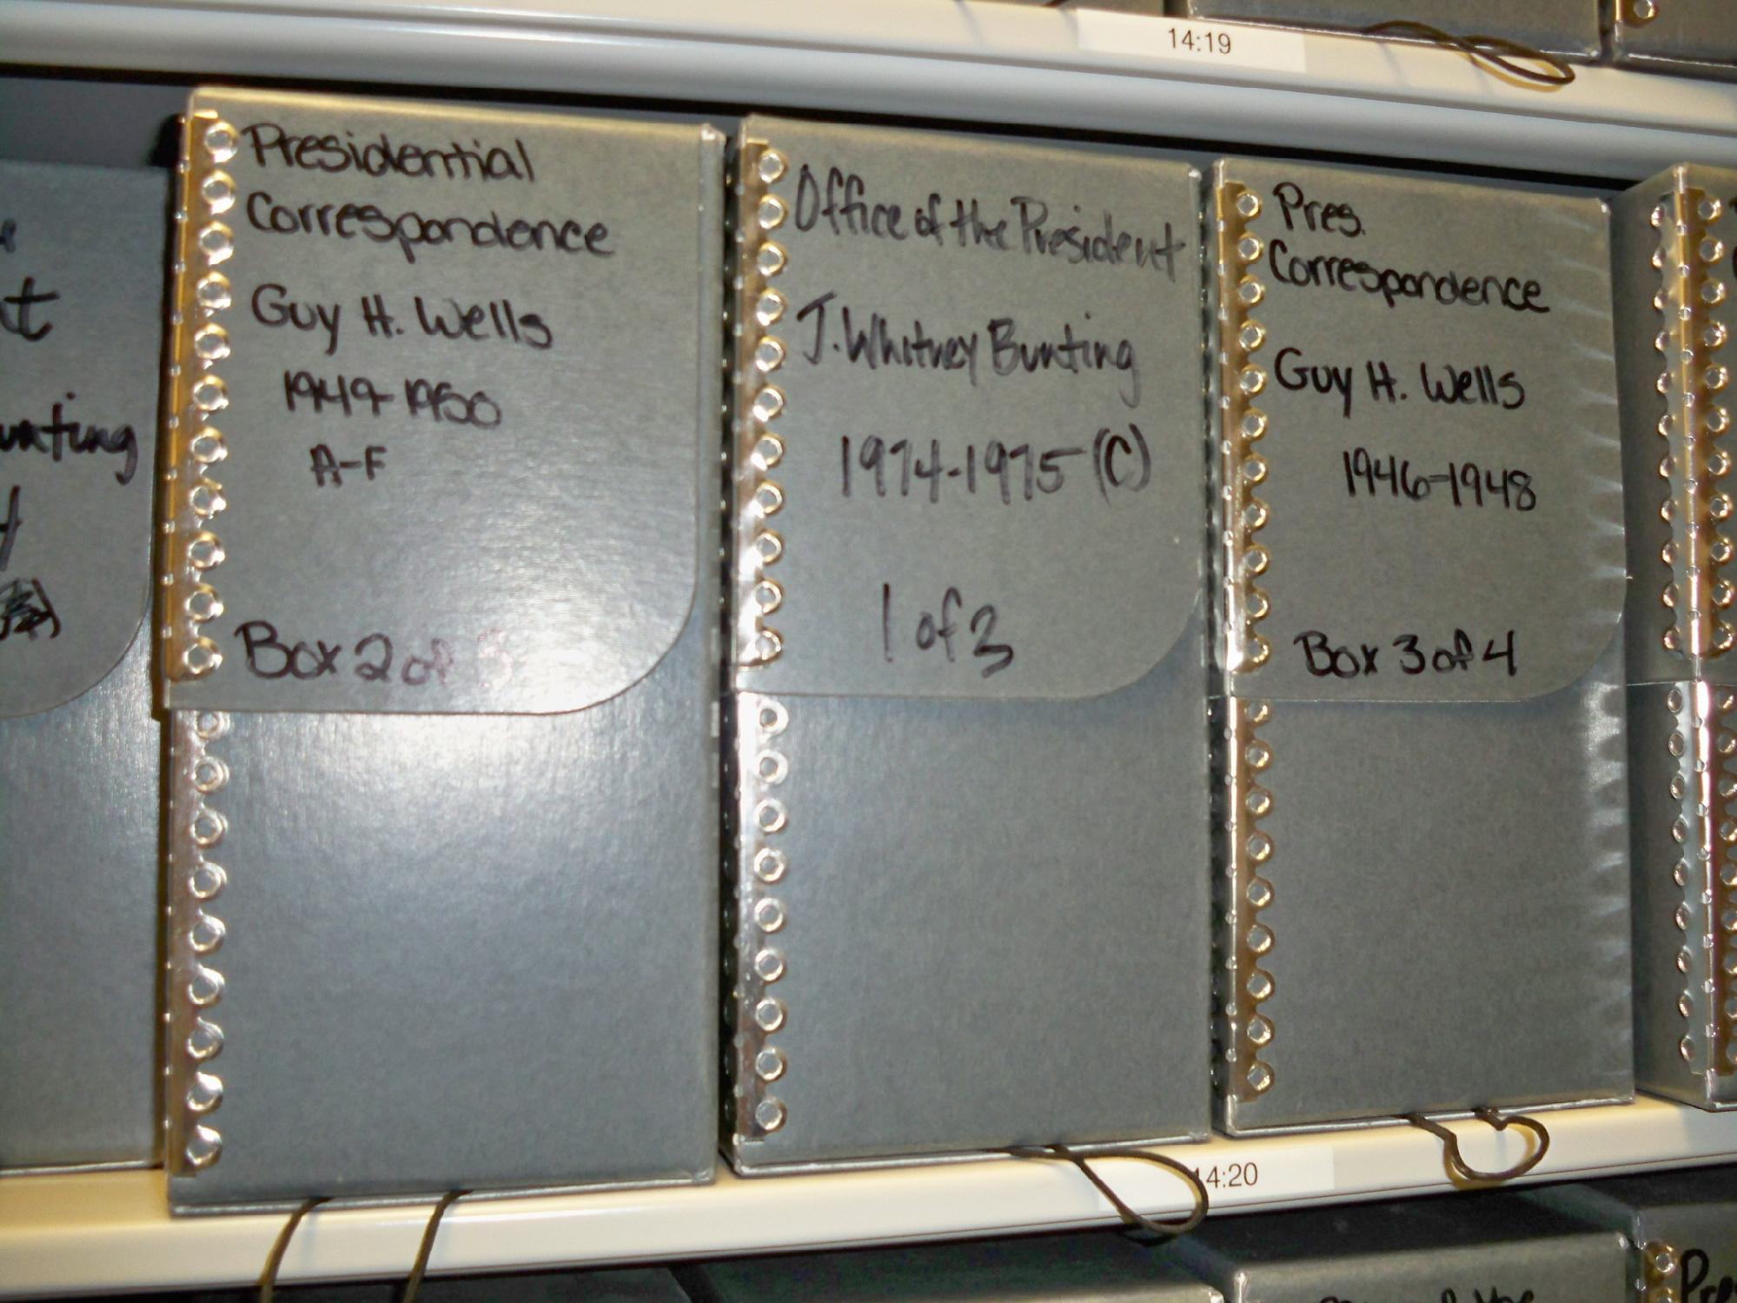
Primary Sources?

Slide 2
What are the types of sources?

Slide 3
Types
Tertiary
Secondary
Primary

Slide 4
Primary Sources
A primary sources is a record of an event or occurrence in some format and comes from a particular point of view.

Slide 5
What makes Primary Sources So Special?

Slide 6
Working With Primary Sources
Who
What
When
Where
Why
What else do I need?

Slide 7
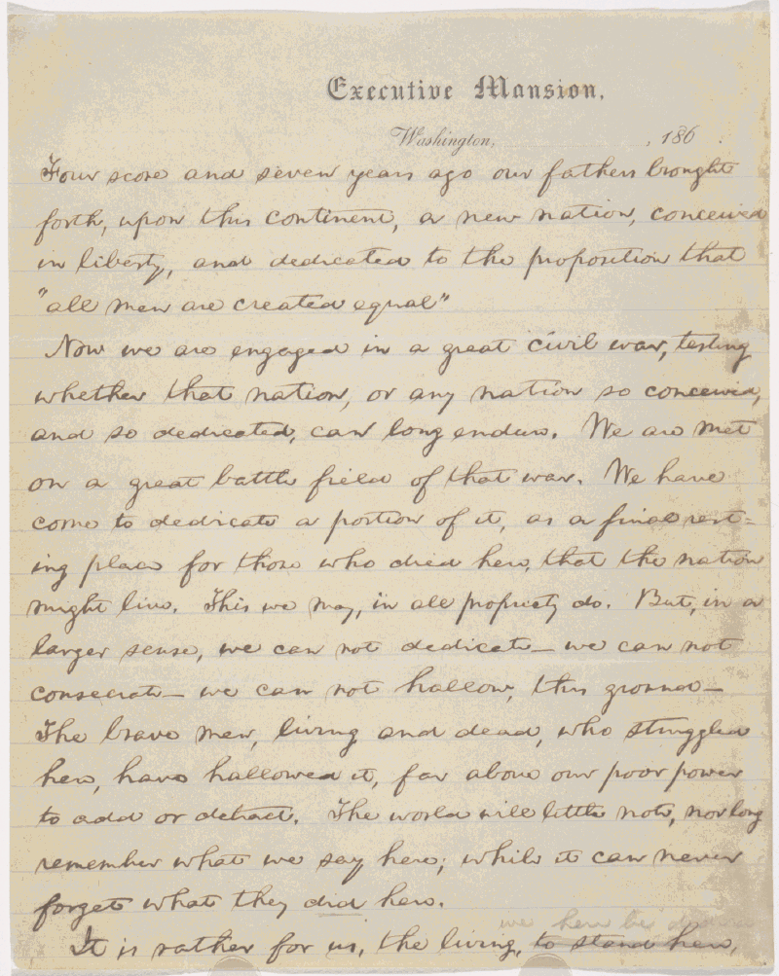
Who
Who made this?
What group made this?
Is the creator important for some reason?

Slide 8
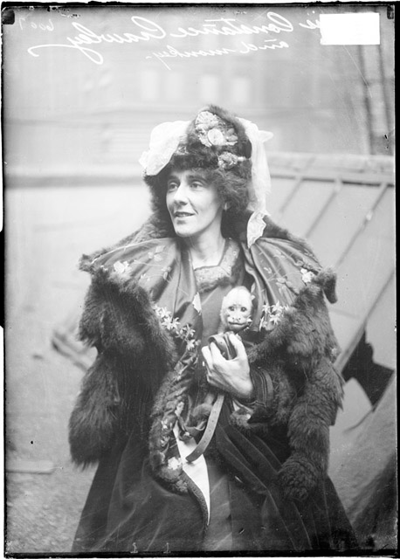
What?
What is this?
Is the “what” important?
Think format, design, layout?
What does it tell you?

Slide 9
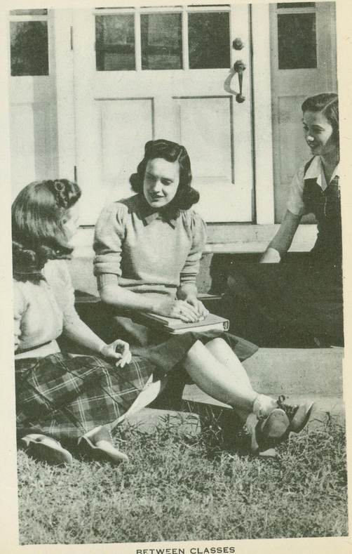
When?
What’s the date of the record?
Can we guess at the date?

Slide 10
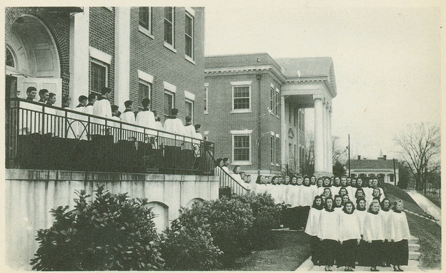
Where
Where was this made?
Why is the where important?

Slide 11
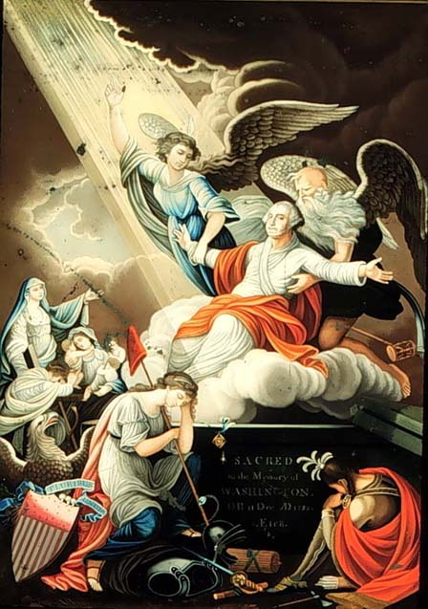
Why?
Why was this created?
What was the purpose for the creation of this record?
1802, Barralet
"The Apotheosis of Washington"

Slide 12
What else?
What other information do I need to understand this source?
What contextual information do I need to

Slide 13
How do you locate Primary Sources?
Specific Database (library.gcsu.edu)
Digital Library of Georgia
Library Catalogs
GALILEO
Web (www.google.com)
Google them
Visiting an Archive

