Slide 1
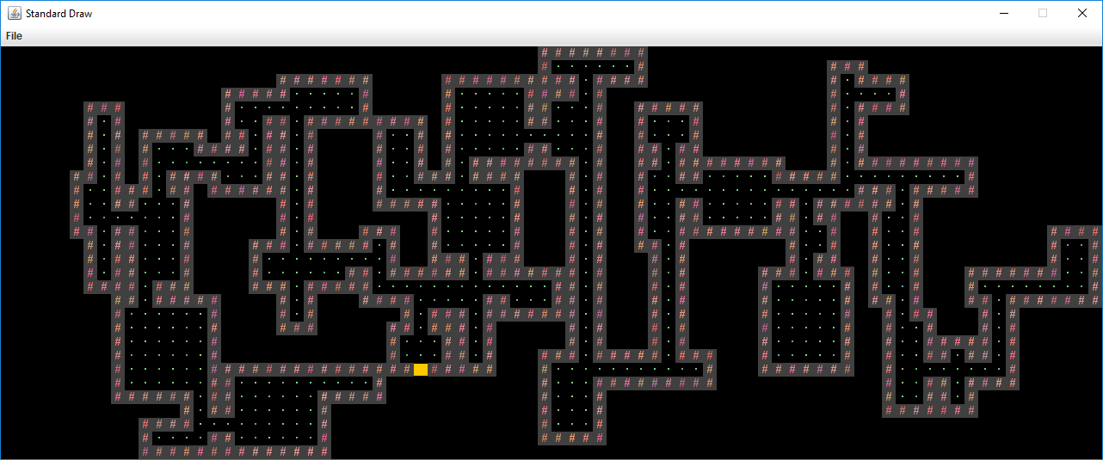

Slide 2
newRoom
doorA
doorB
roomToBeConnected

Slide 3
Different from course designed, which the origin should be at left bottom;
So I change ’y’ to ‘numYTiles-1-y’ at line 92 in byog.TileEngine.TERenderer.java file

