Slide 1
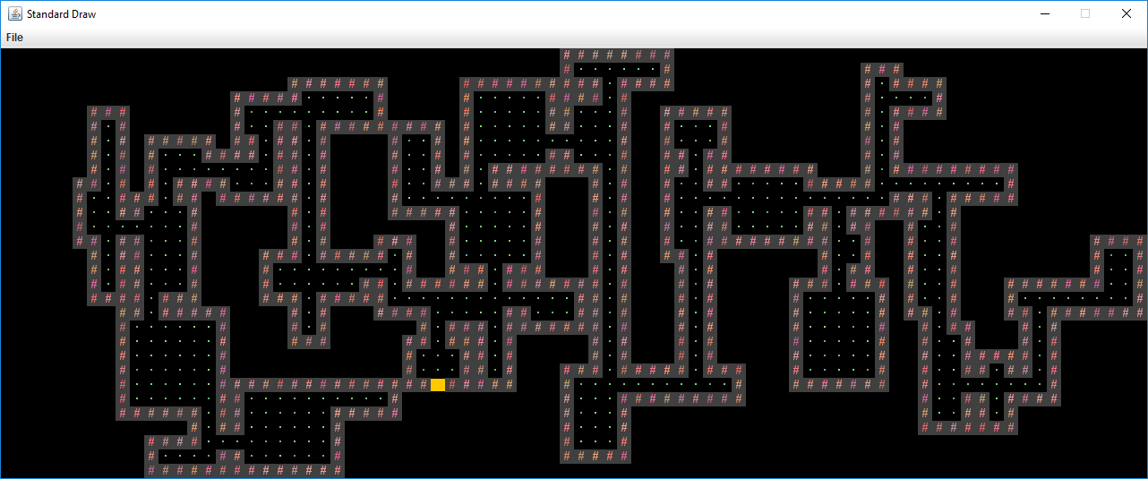

Slide 2
newRoom
doorA
doorB
roomToBeConnected

