Slide 1
Team 1 CS4347.502
Personal Finance Database System

Slide 2
System Description
The system consists of three parts:
A database consisting of users and their financial information.
A server application which retrieves and submits data from clients to the database.
A client application which interacts with the server and users.

Slide 3
Database Description (MySQL)
Users → An entity that tracks each unique user in the system.
User_Accounts → An entity that records account information of a unique account associated with user entities.
Transaction → An entity that records a unique financial transaction associated with an account entity.
UserToAccount and AcctToTrans exist to support many-to-many relationships between the users and accounts and accounts to transactions.

Slide 4
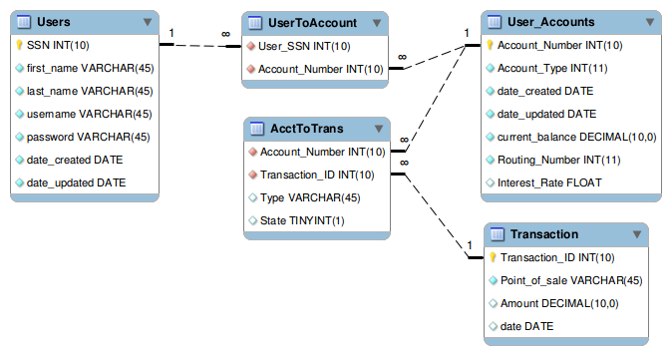
ER Diagram

Slide 5
Client Application (CL/GUI)
Allows a user to perform:
View accounts information.
View transaction information.
Transfer funds from one account to another.
Change the user password.

Slide 6
Server (Java JDBC)
The server connects to the database and subsequently handles client requests:
The server spawns a separate thread for each client connection.
The server authenticates the client via username and password.
The server receives requests from the client, executes SQL on the database, performs data checks as necessary, and returns the results to the client.

Slide 7
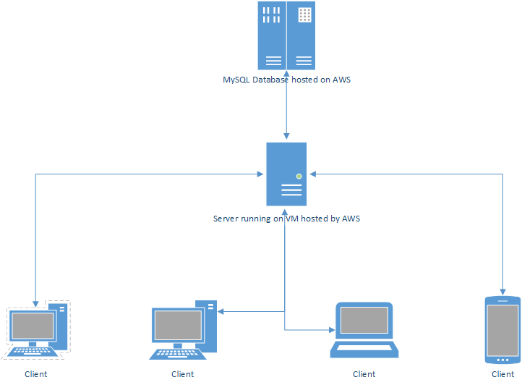
System diagram

Slide 8
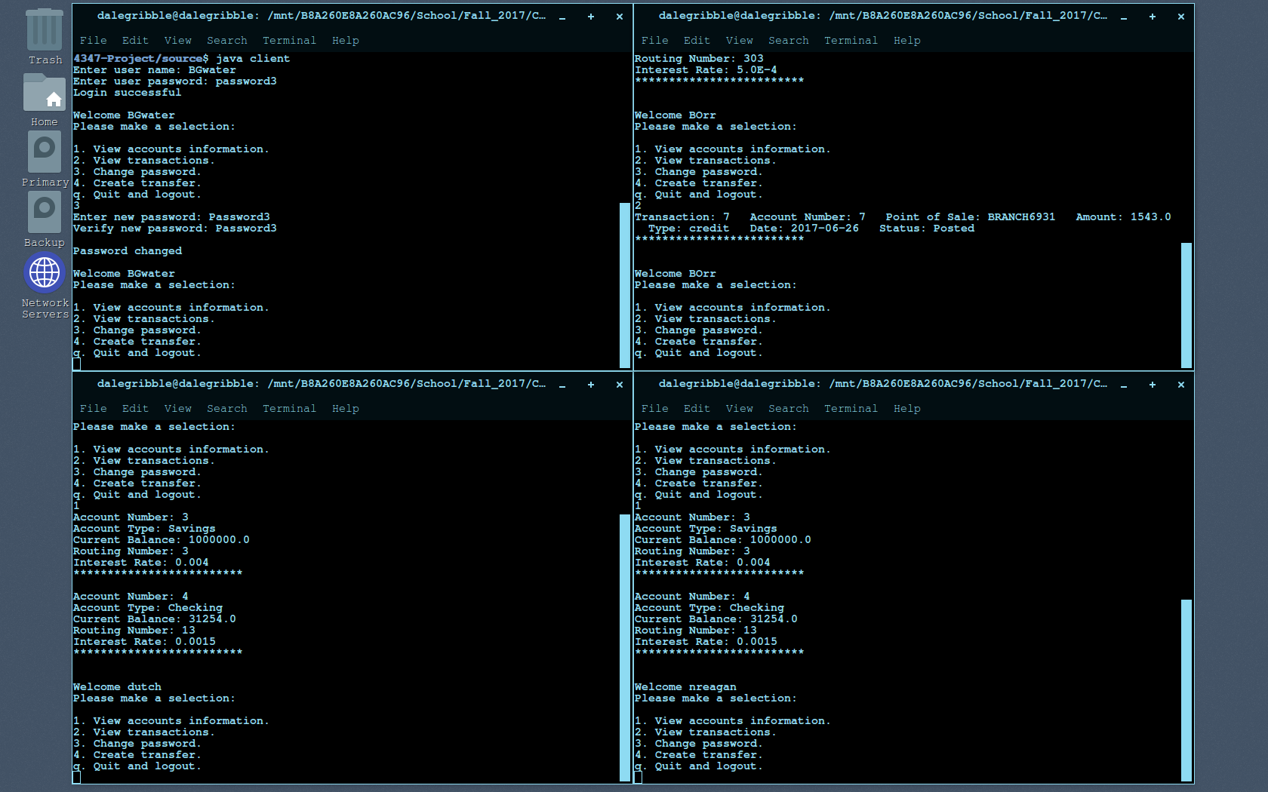
Four CL Clients

Slide 9
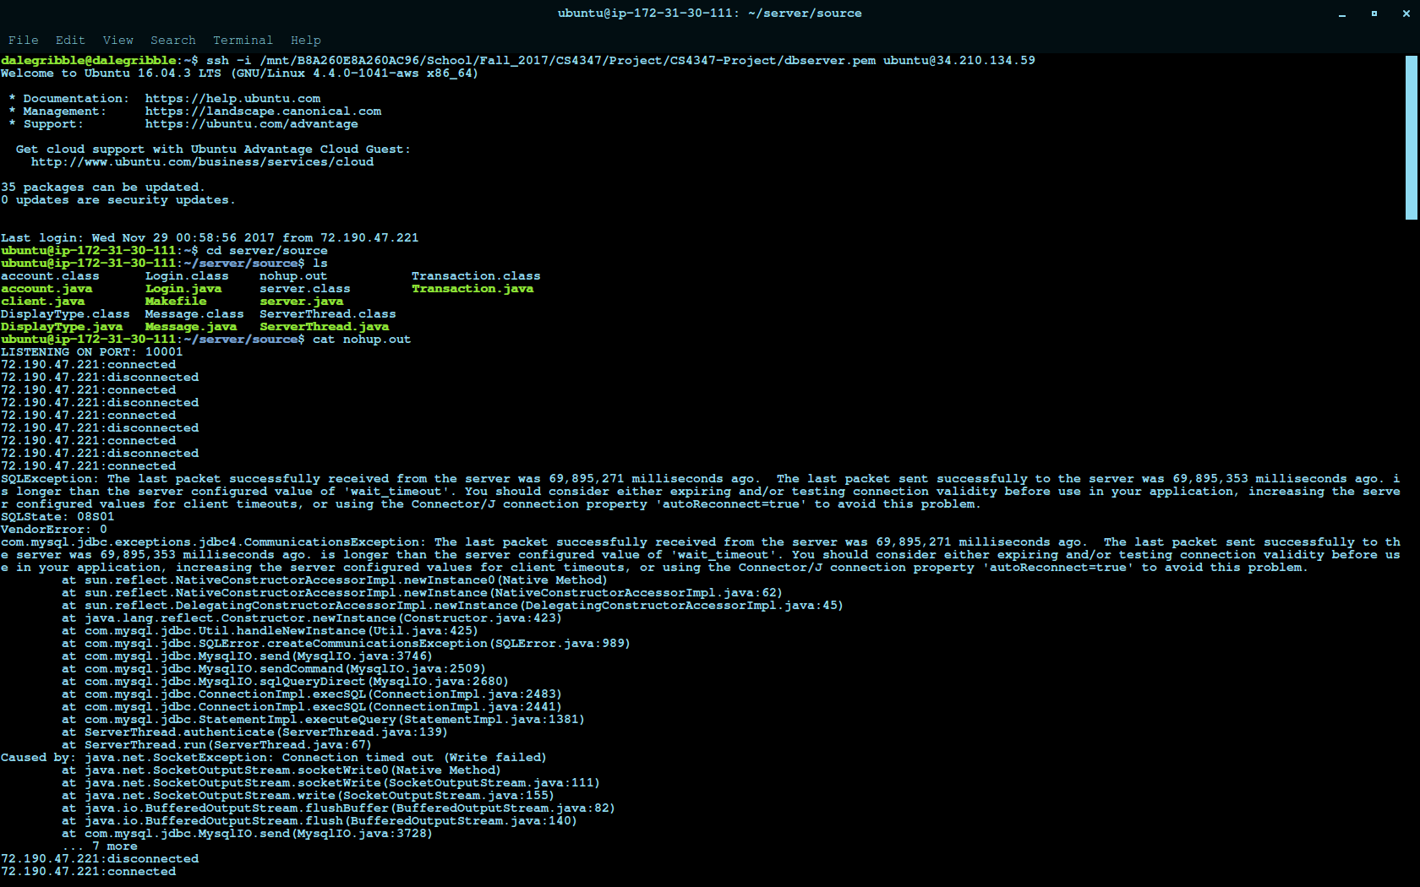
Server Log

Slide 10
GUI
More user friendly
Performs same function as CL client
Current status:
Front end is complete and looking good
Still needs to tie in java backend to be fully functional

Slide 11
GUI Images

