Slide 1
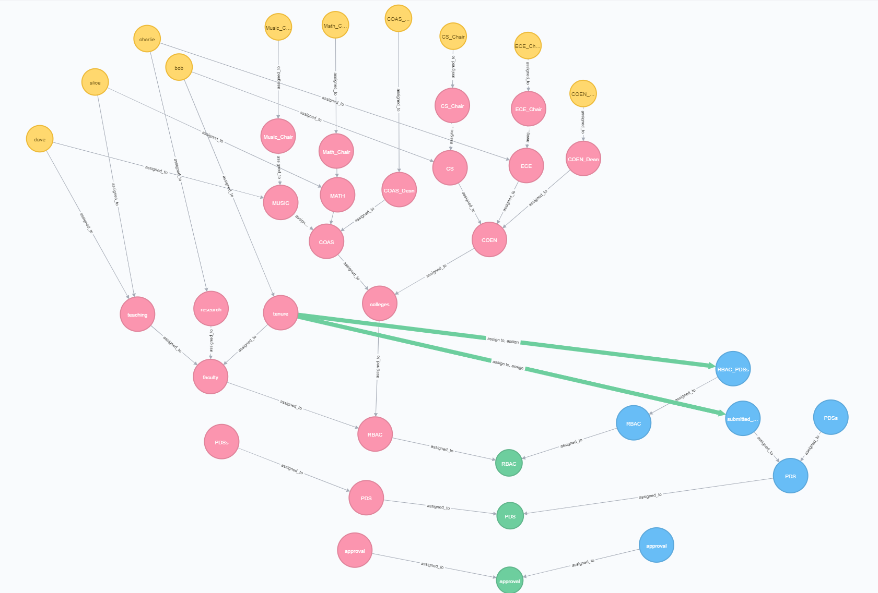
Notes:
This is the initial configuration that stores the colleges hierarchy and grants users in the tenure UA (assign, assign to) on the RBAC_PDSs container (allows them to create PDSs). Note that permissions are given to tenure under the RBAC policy class.

Slide 2
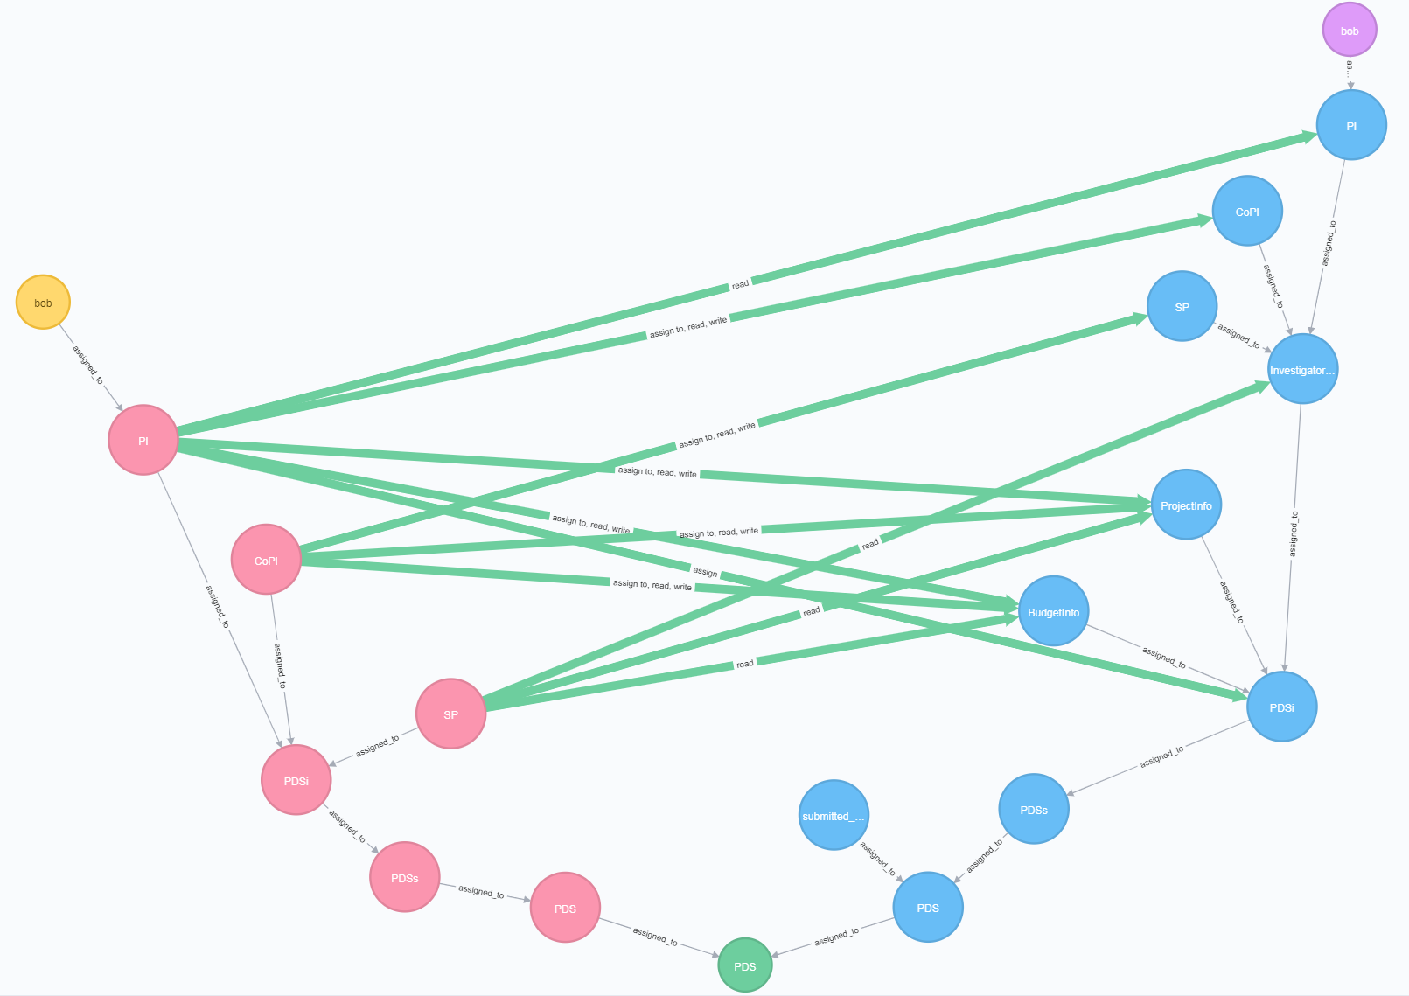
Notes:
This is after bob creates a PDS. Bob only creates the “PDSi” OA, the rest of the PDS structure is created through the obligation. The event that triggers the obligation is bob assigning to the “RBAC_PDSs” container. Part of the response to this event is to delete this very assignment so that the PDS permissions are contained to only the PDS policy class.
Since bob is the creator of the PDS, he is assigned to the PI UA.

Slide 3
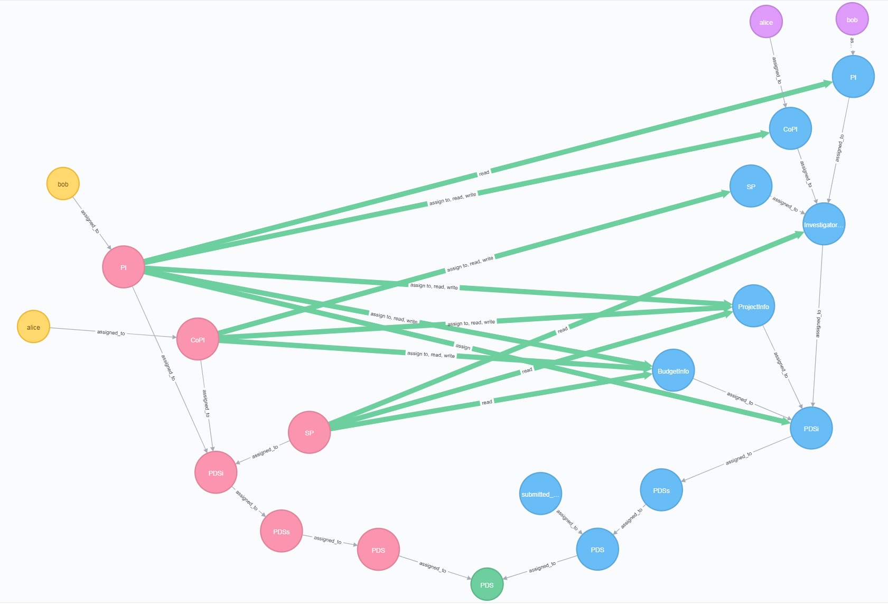
Notes:
This is after bob adds alice as a CoPI. Alice is assigned to the CoPI UA which already has a set of associations to components of the PDS.
Event: bob assigning an object named “alice” to the CoPI OA.
Response: get the user with the same name and assign them to the CoPI UA.

Slide 4
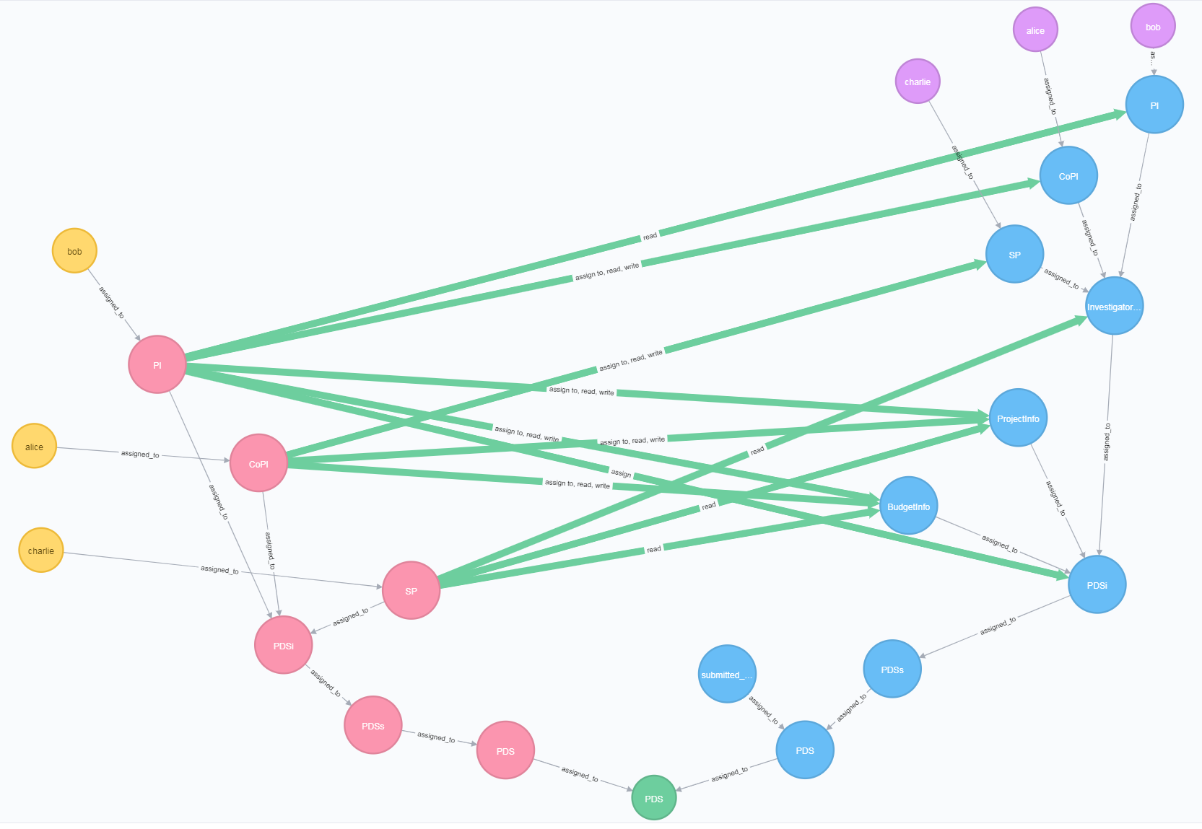
Notes:
This is the result of alice adding Charlie as a SP. Charlie is assigned to the SP UA.
Event: alice assigning an object named “charlie” to the SP OA.
Response: get the user with the same name and assign them to the SP UA.

Slide 5
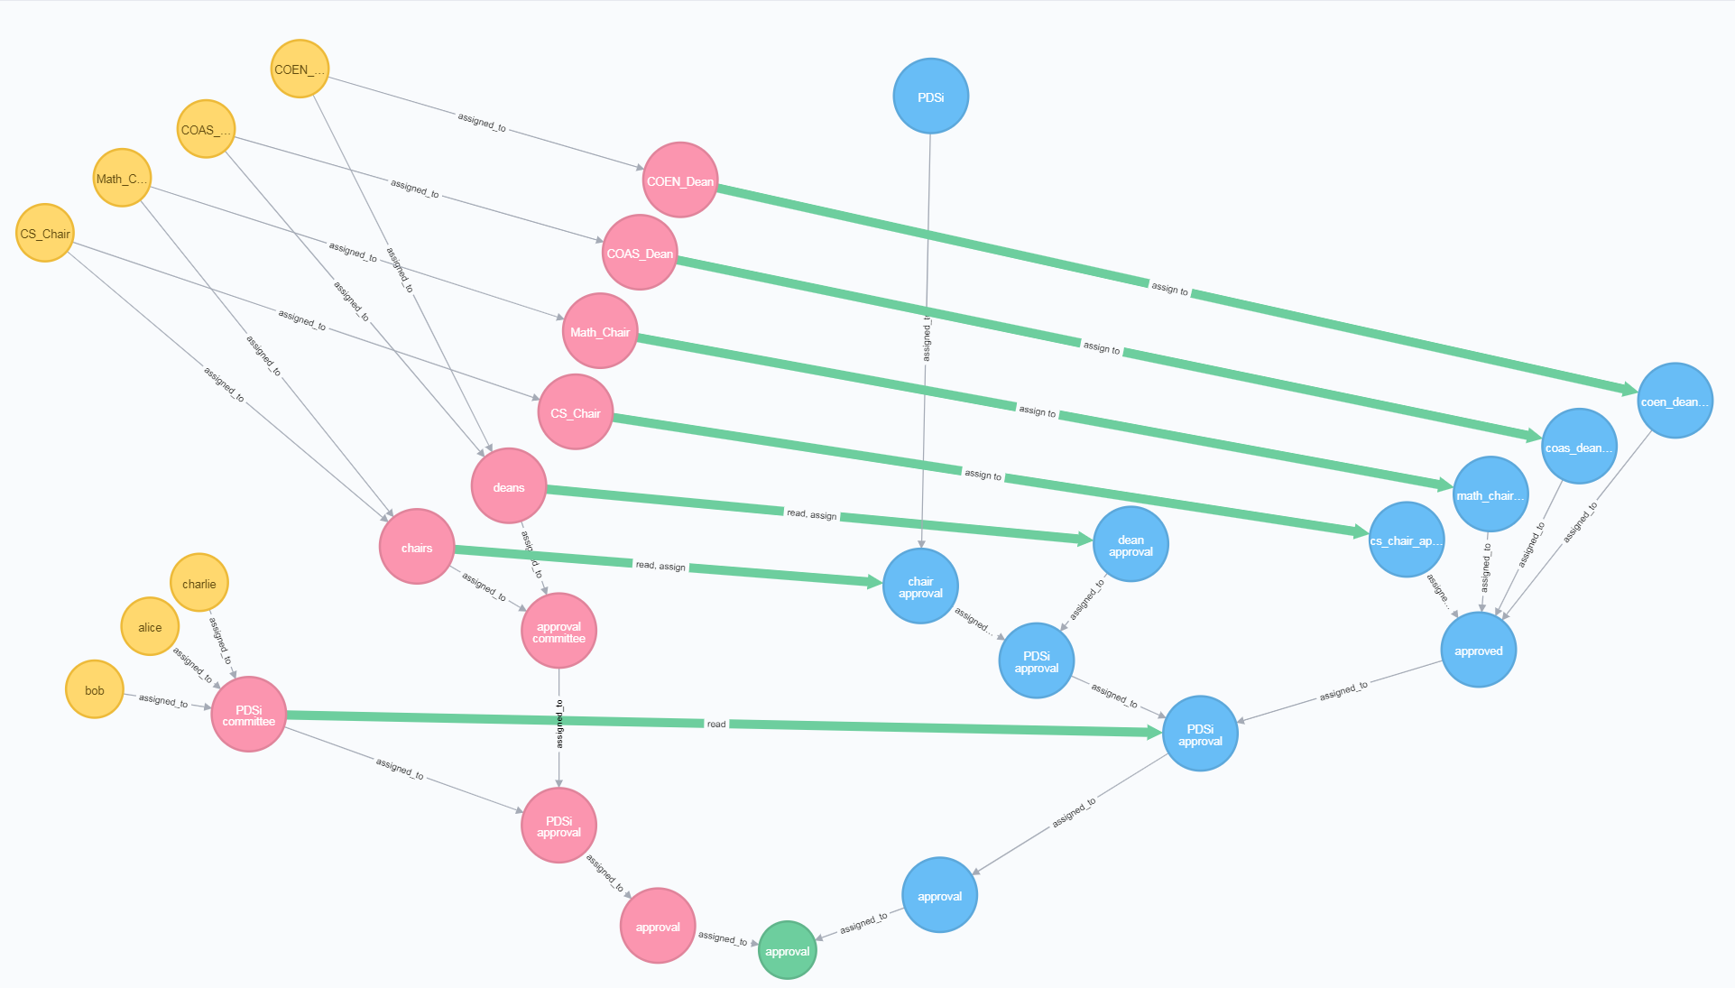
Notes:
This is the result of bob submitting the PDs for approval.
The PDS has been deassigned from the PDS policy class and only exists under the approval policy class now.
Event: bob assigns “PDSi” to the submitted_pdss container
Response: This while approval configuration is created.
the users in PI, CoPI, and SP are assigned to the PDSi committee
the chairs and deans of the PI and CoPI are added to the approval committee UA
containers are created for each chair/dean to indicate their approval.
initially, only the deans have access to the PDS because “PDSi” is assigned to the “chair approval” container.

Slide 6
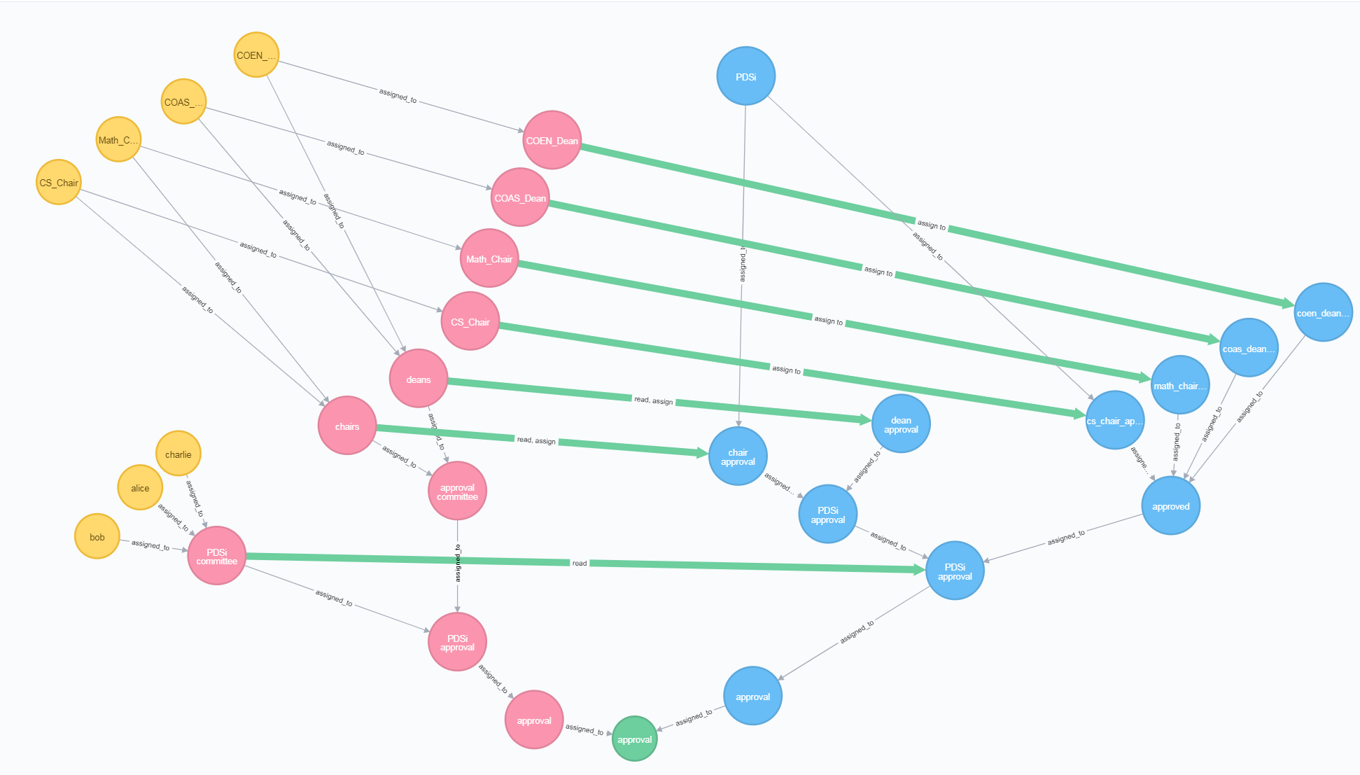
Notes:
This is the result of the CS Chair approving the PDS. There is a rule in the obligation that says (paraphrasing) “when any user assigns to cs_chair_approval OR math_chair_approval, check that the PDS is assigned to BOTH cs_chair_approval and math_chair_approval, if it is continue the approval process, if not, do nothing.”
Since the math chair has yet to “approve” (assign it to the math_chair_approval container) it, nothing happens.

Slide 7
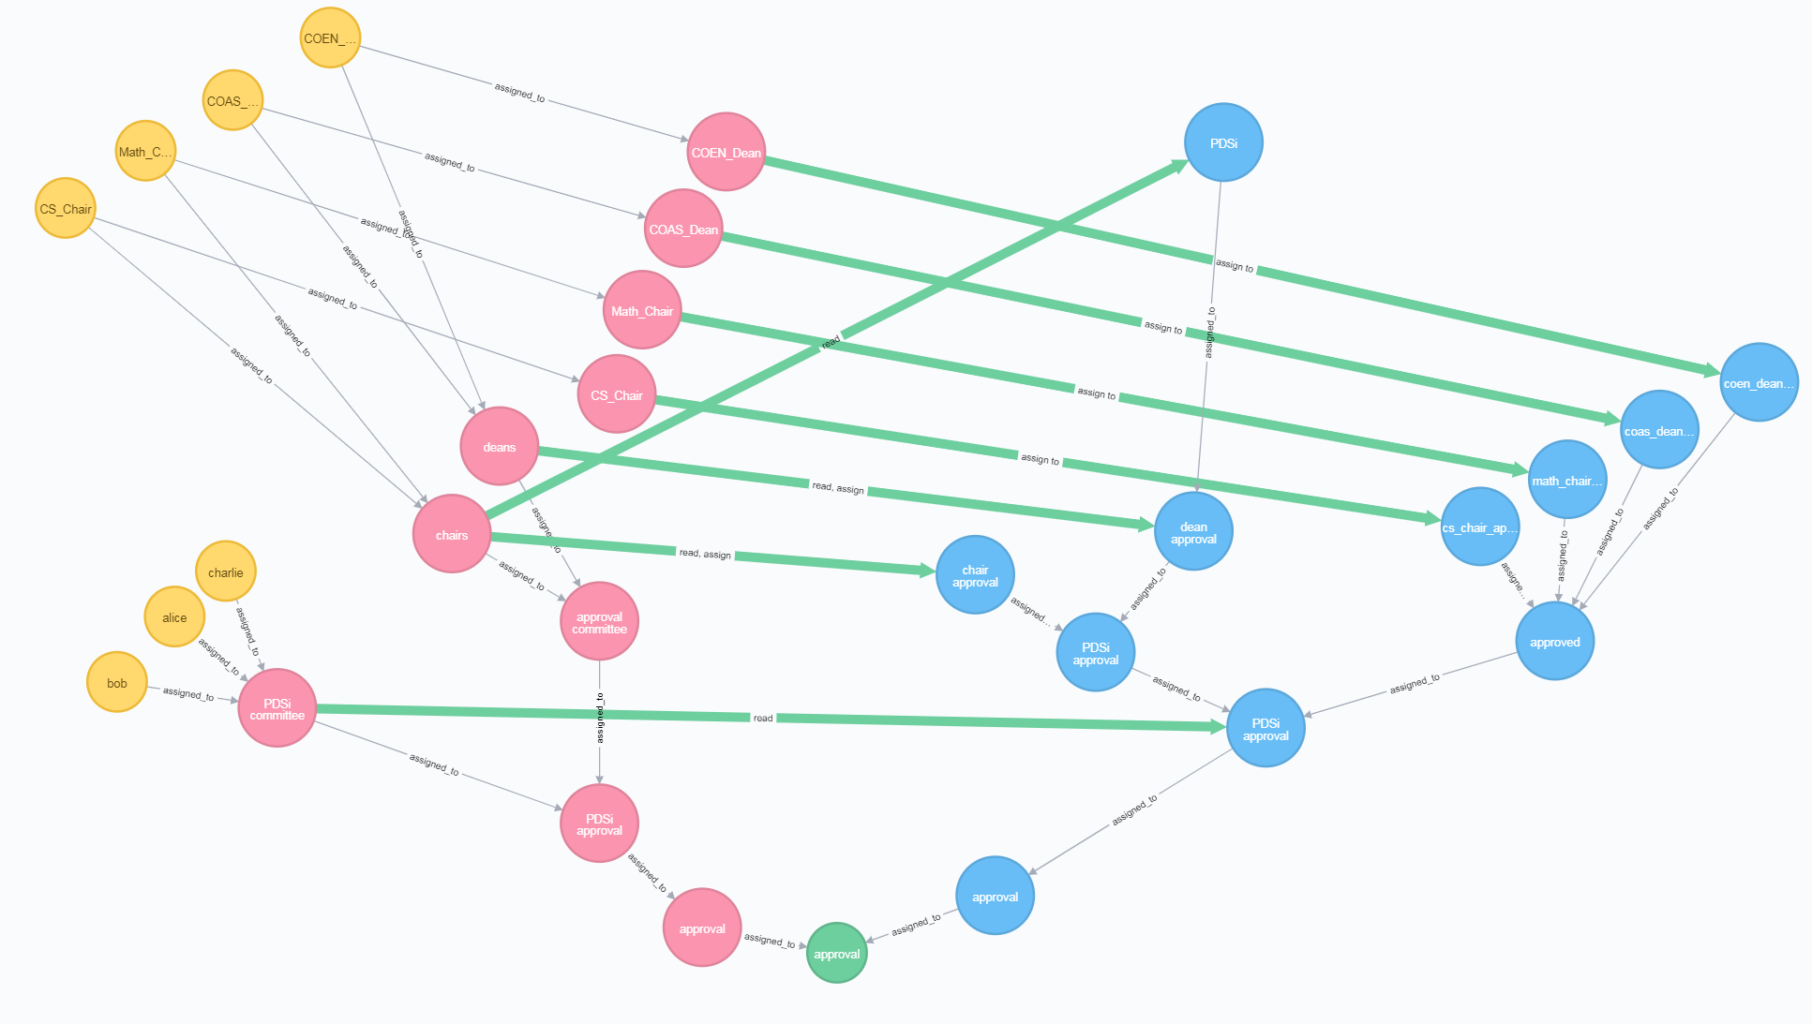
Notes:
This is the result of the Math Chair approving the PDS.
Event: Math Chair assigns the PDS to the math_chair_approval
Response: PDSi is assigned to both cs_chair_approval and math_chair_approval, now do the same thing but with the deans.

Slide 8
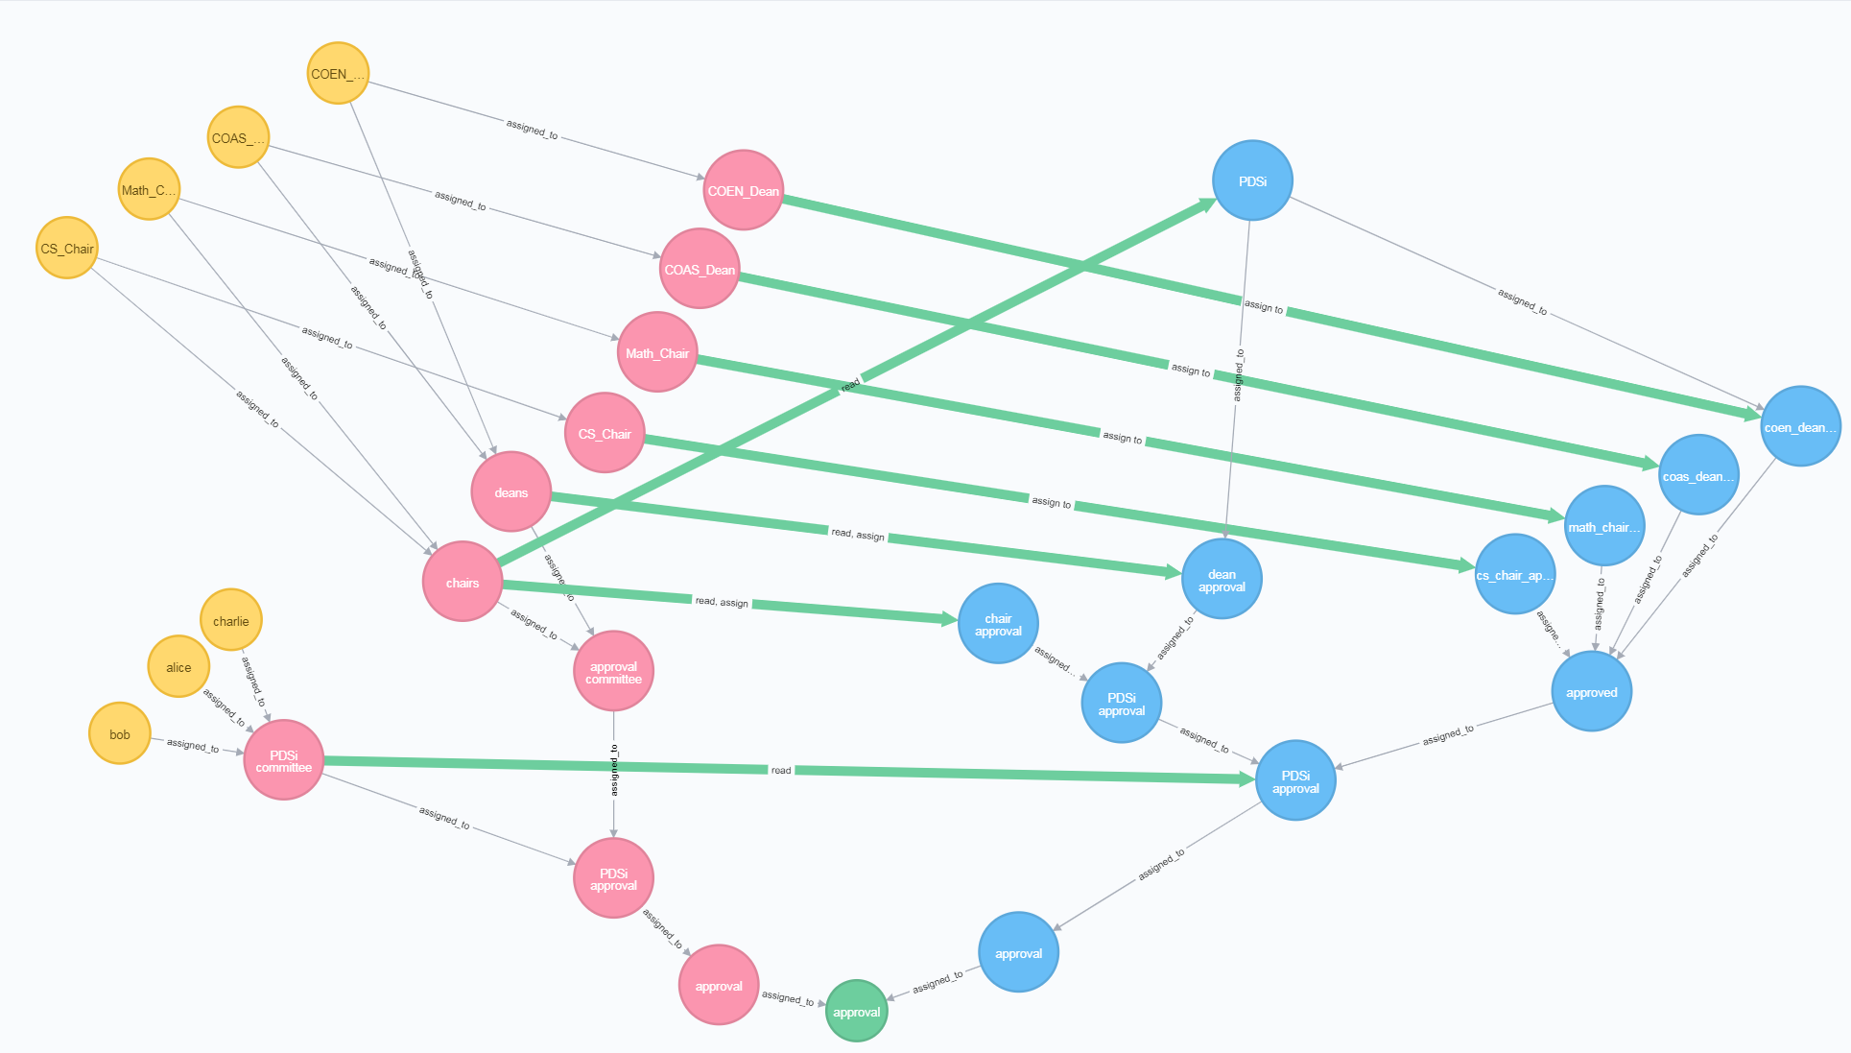
Notes:
Result of COEN Dean approving the PDS. Since COAS Dean has not approved it yet, nothing else happens.

Slide 9
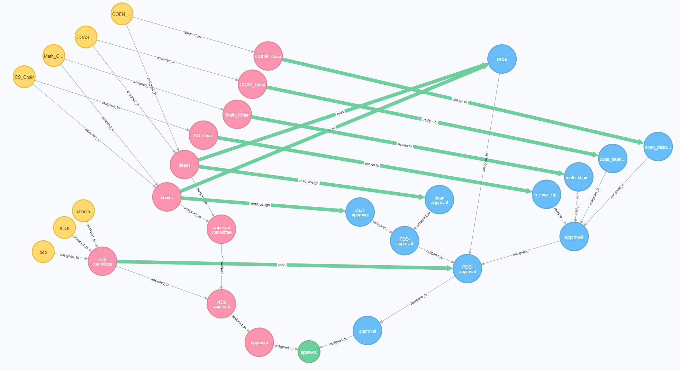
Notes:
Result of COAS Dean approving the PDS. PDSi is assigned to the PDSi approval container where the PDSi committee can only read it. The chairs and deans UA both have permissions to read the PDSi. No one has the permission to write to PDSi now that it is approved.

