Slide 1
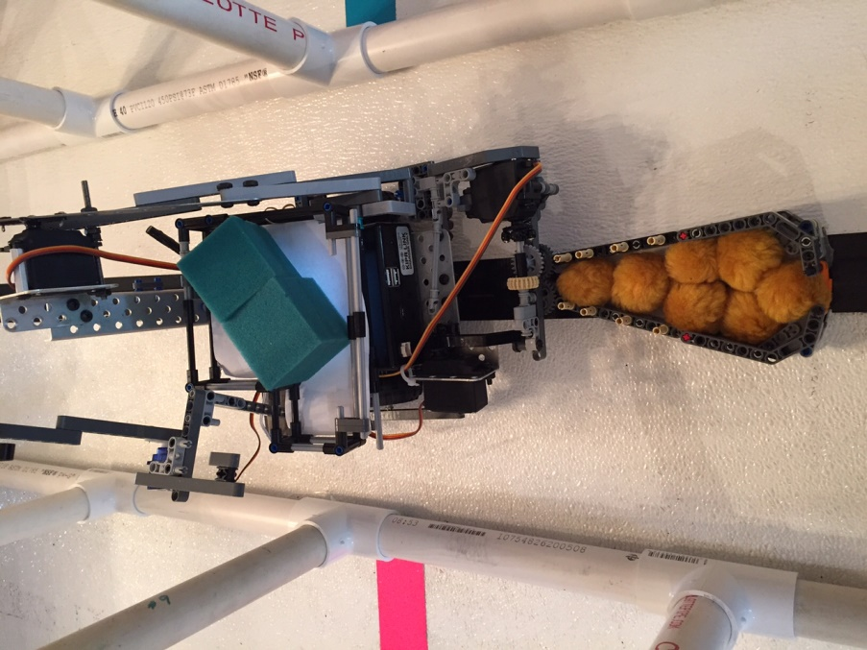
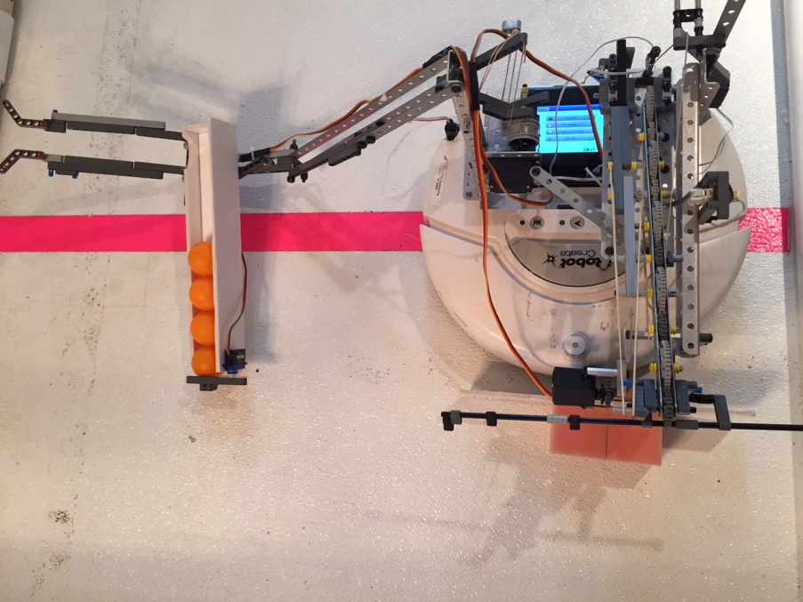
Los Altos Community Botball Team 15-0636
Los Altos
Northern California

