Slide 1
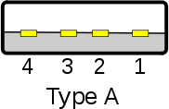

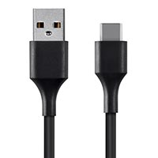

Slide 2
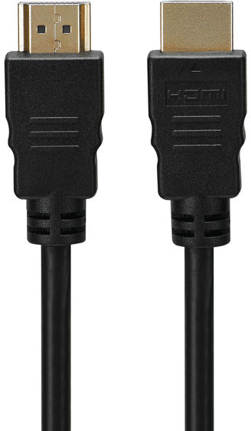


Slide 3

I/O +5V Ground
PWM +5V Ground
Input +5V Ground

Slide 4

+5V SDA SCL Ground

Slide 5


M1
M0

Slide 7
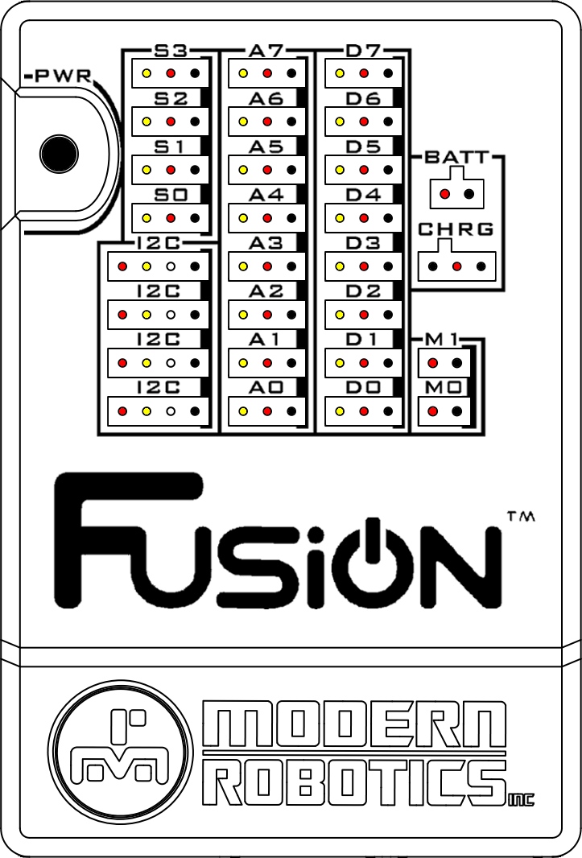


Wi-Fi

Slide 8
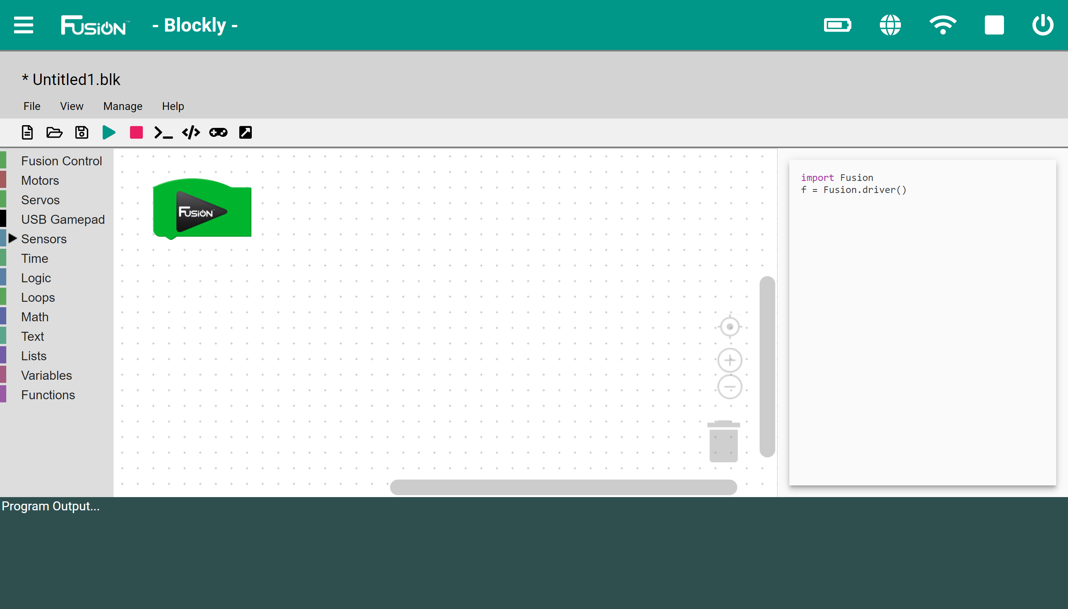
5
1
4
2
3

Slide 9
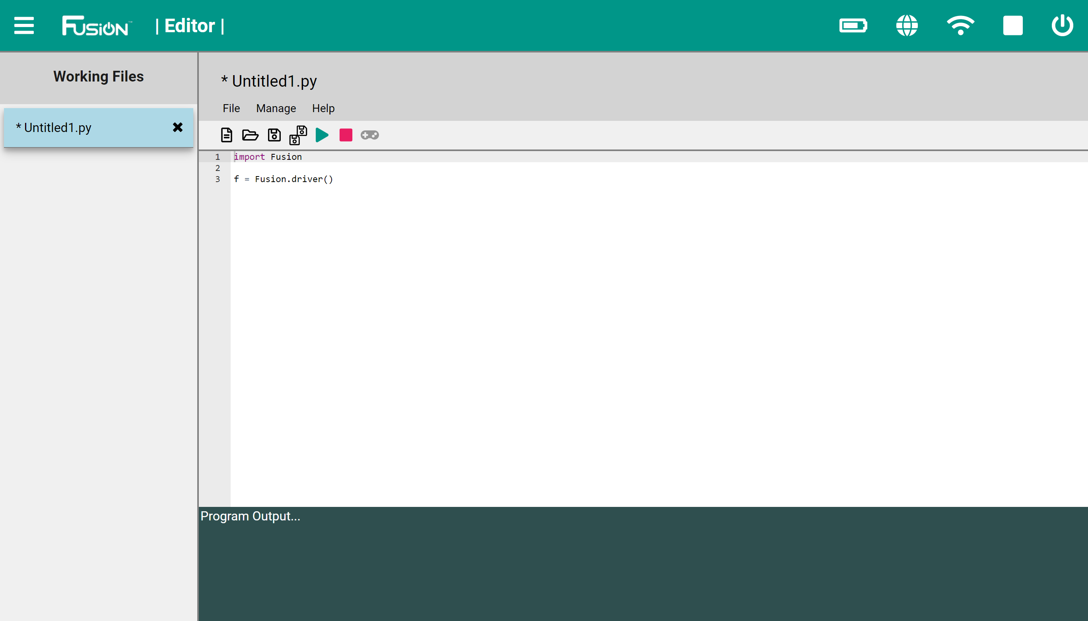
4
2
1
3

Slide 11
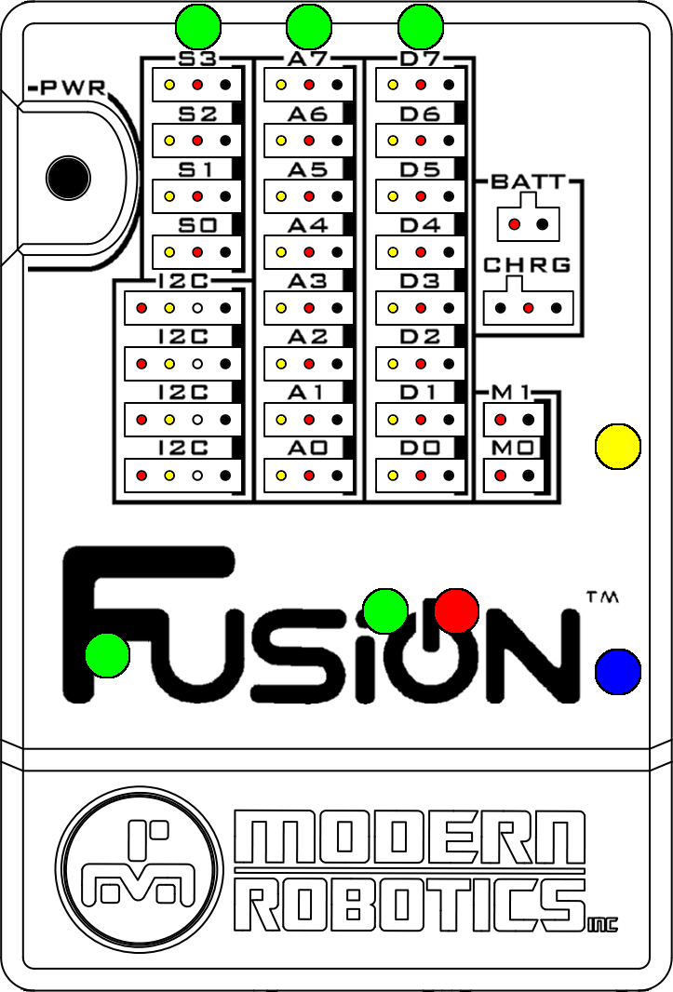
Raspberry Pi
Power
Fusion
Power
5V
Power
Battery
Power
User Controlled
LED (Yellow)
Status
Indicator
USB Power
Error/Low Battery
User Controlled
LED (Blue)

Slide 12
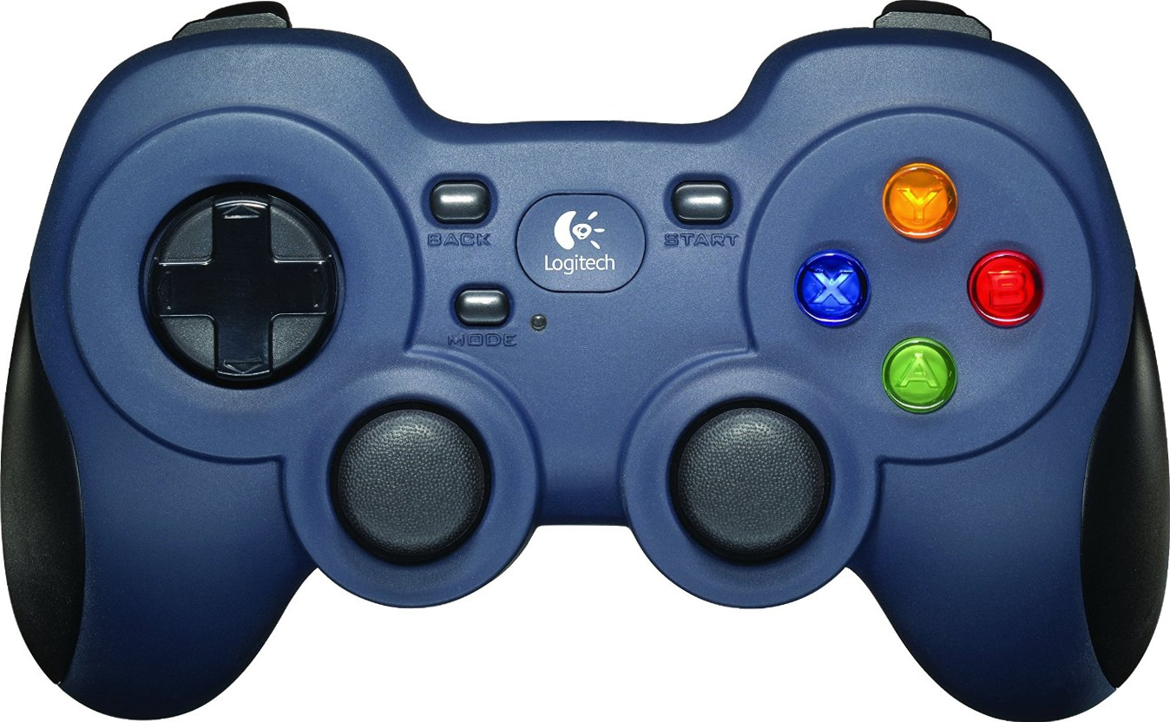
Button 6
Button 7
Button 4
Button 8
Button 9
Button 5
Button 10
Button 11
Button 0
Button 3
Hat
Button 2
Button 1
Axis 1
Axis 3
Axis 0
Axis 2

Slide 13
Axis 0 | Left Joystick X
Axis 1 | Left Joystick Y (inv)
Axis 2 | Right Joystick X
Axis 3 | Right Joystick Y (inv)
Button 0 | X
Button 1 | A
Button 2 | B
Button 3 | Y
Button 4 | Left Bumper
Button 5 | Right Bumper
Button 6 | Left Trigger
Button 7 | Right Trigger
Button 8 | Back
Button 9 | Start
Button 10 | Left Joystick (click)
Button 11 | Right Joystick (click)
Hat | Directional Pad (X, Y)

Slide 14
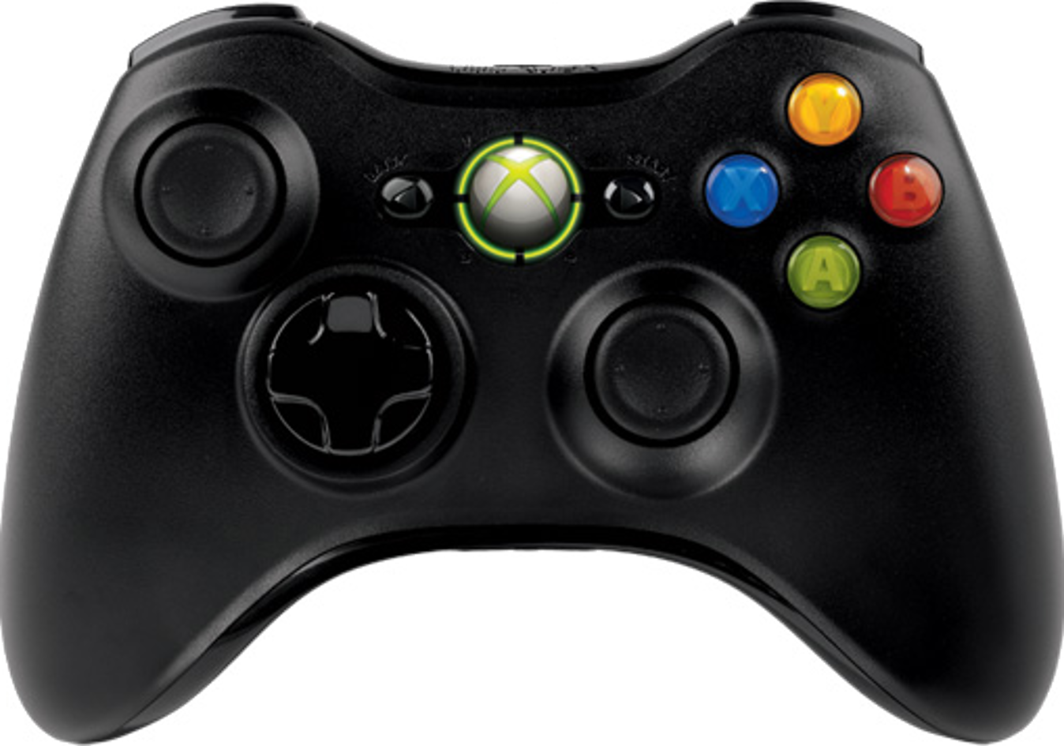
Axis 2
Button 8
Axis 5
Button 4
Button 9
Button 5
Button 7
Button 2
Button 3
Axis 1
Button 1
Axis 0
Button 0
Axis 4
Hat
Button 6
Axis 3
Button 10

Slide 15
Axis 0 | Left Joystick X
Axis 1 | Left Joystick Y (inv)
Axis 2 | Left Trigger
Axis 3 | Right Joystick X
Axis 4 | Right Joystick Y (inv)
Axis 5 | Right Trigger
Button 0 | A
Button 1 | B
Button 2 | X
Button 3 | Y
Button 4 | Left Bumper
Button 5 | Right Bumper
Button 6 | Back
Button 7 | Start
Button 8 | Xbox Button
Button 9 | Left Joystick (click)
Button 10 | Right Joystick (click)
Hat | Directional Pad (X, Y)

Slide 16
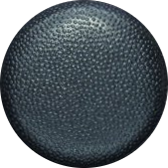
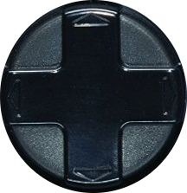
Y Neg
X Neg
X Pos
Y Pos
(0, 1)
(-1, 1)
(1, 1)
(-1, 0)
(0, 0)
(1, 0)
(-1, -1)
(1, -1)
(0, -1)

