Slide 1
Motion Profiling for first tech challenge teams
By Joshua Heinrich | FTC Team 9889

Slide 2
Why use motion profiling?
Repeatability and Redundancy
If encoders die, motion profiling will allow the robot to still be accurate
For Points in Autonomous
Reaches the target/setpoint faster then other methods
Allow Driver to concentrate on other things
Synchronized motions (multi-axis arm, elevator)

Slide 3
Methods
Dead Reckoning
PID
Motion Profile

Slide 4
Dead reckoning
Turn motor on for X seconds
Slower speed is better
Simple
Works if accuracy and precision are not an issue.
Forward(1.0, 1.0);
sleep(400);
Forward(0.0, 0.0);

Slide 5
Bang-bang control
Same as Dead Reckoning except with feedback
Drive if error > zero
Again, accuracy and precision are weak
while (true) {
error = setpoint – wanted;
if (error > 0)
Forward(1.0);
else if (error < 0)
Reverse(1.0);
else
Stop();
}

Slide 6

Pid control
Most common control algorithm
Based on Error (Target - Position)
Output change is determined by time, error, and tuning constants

Slide 7
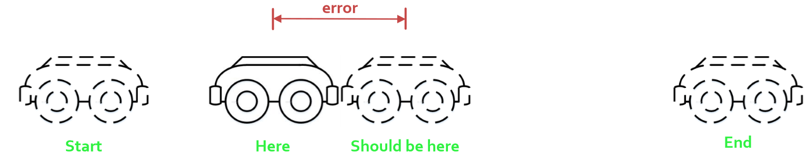
Feedforword/feedback
Feedforward is where you plan to be
Feedback is correction of the error from where you are to where you should be
Feedback requires sensors to determine position

Slide 8
Motion profiles
Start at zero velocity
Accelerate to a maximum
Travel required distance
Accelerate to a stop

Slide 9
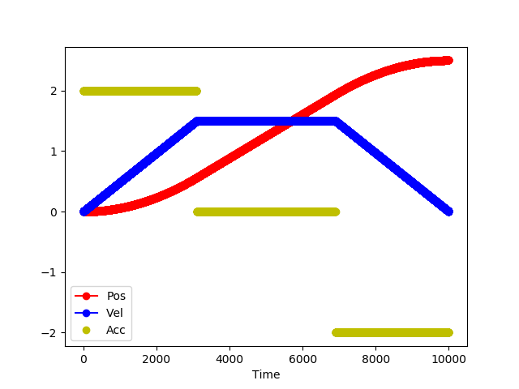
Trapezoidal velocity profile

Slide 10
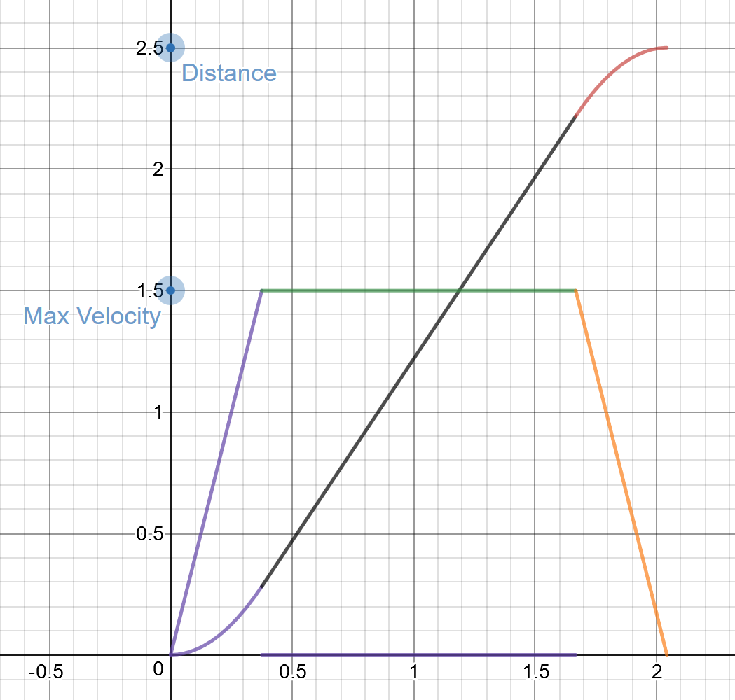
Generating a motion profile
Many different methods, we will cover continuous
A continuous Motion Profile is a continuous function. Think of a sin wave
Discrete Motion Profile
We will be following these equations
desmos.com/calculator/jjzbgscrcn

Slide 11
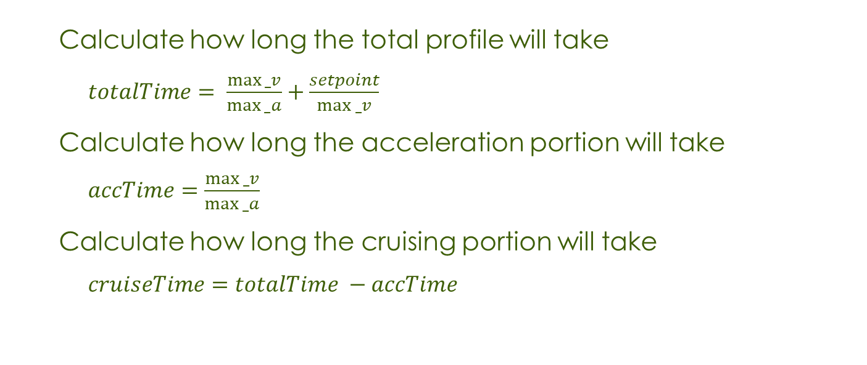
Generating a motion profile
Calculate how long the total profile will take
$totalTime= \frac{max⁡_v}{max⁡_a}+\frac{setpoint}{max⁡_v}$
Calculate how long the acceleration portion will take
$accTime=\frac{max⁡_v}{max⁡_a}$
Calculate how long the cruising portion will take
$cruiseTime=totalTime −accTime$

Slide 12
Generating a motion profile
if(t<= accTime)
Position = (0.5 * max_a) + (t * t)
Velocity = max_a * t
Acceleration = max_a
else if(t<=cruiseTime)
Position = (max_v * t) – ((max_v * max_v) / (2 * max_a))
Velocity = max_v
Acceleration = 0
else if(t<totalTime)
Position = (totalTime * max_v) +
(totalTime * max_a * t) –
(max_v * max_v/max_a) –
(0.5 * ((max_a * t * t) + (max_a * totalTime * totalTime)))
Velocity = (max_a * totalTime) – (max_a * t)
Acceleration = -max_a

Slide 13
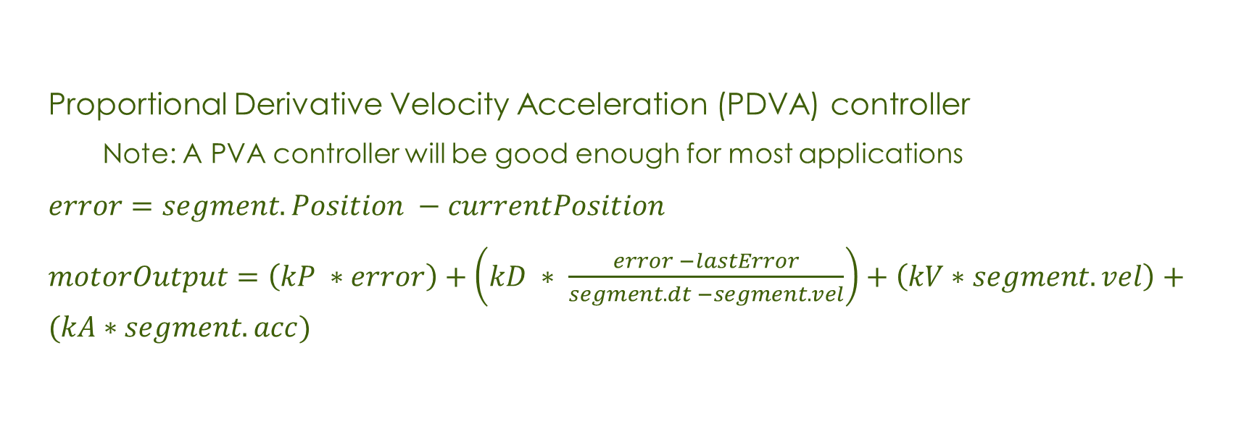
Following a motion profile
Proportional Derivative Velocity Acceleration (PDVA) controller
Note: A PVA controller will be good enough for most applications
$error=segment.Position −currentPosition$
$motorOutput=\left(kP ∗error\right)+\left(kD ∗ \frac{error −lastError}{segment.dt −segment.vel}\right)+\left(kV∗segment.vel\right)+(kA∗segment.acc)$

Slide 14
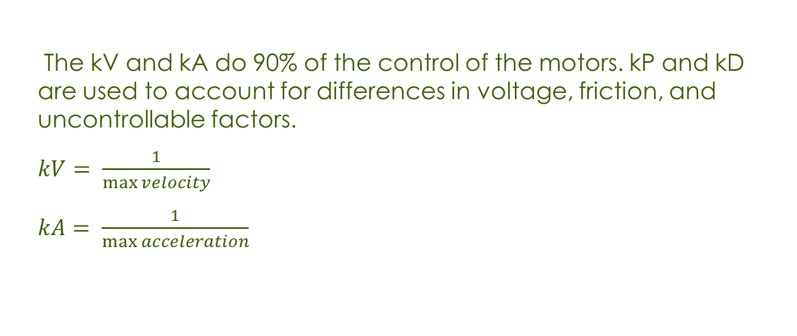
Following a motion profile
The kV and kA do 90% of the control of the motors. kP and kD are used to account for differences in voltage, friction, and uncontrollable factors.
$kV= \frac{1}{\max{velocity}}$
$kA= \frac{1}{\max{acceleration}}$

