Slide 1
R statistics
Useful packages for visualisation, GIS analysis and more

Slide 2
Packages in R
Huge list of packages available (statistics, analysis, visualization, …):
https://cran.r-project.org/
https://support.rstudio.com/hc/en-us/articles/201057987-Quick-list-of-useful-R-packages
Installing package: install.packages(”package_name”)
After installed: library(package_name)
You can also make your own package

Slide 3
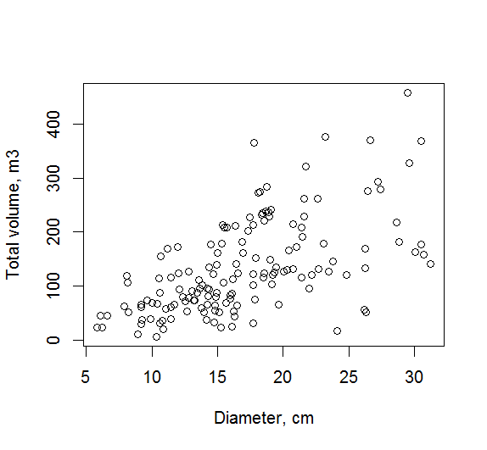
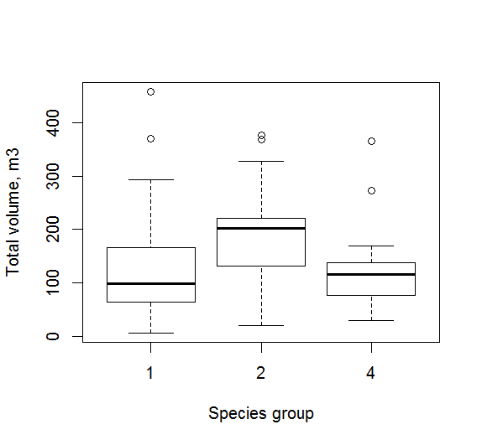
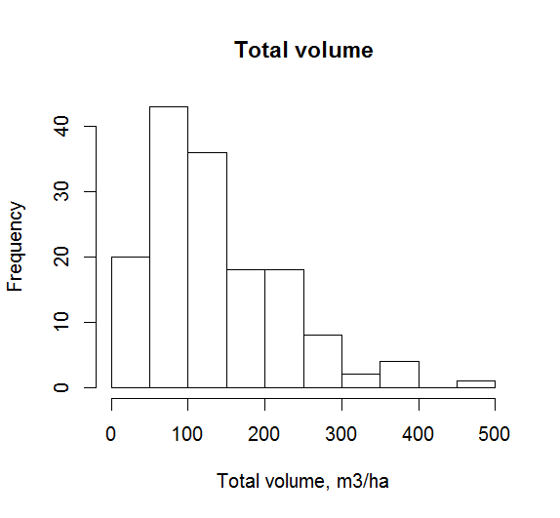
Data visualization in R
Basic commands:
plot(x, y), boxplot(y~x), hist(y), …
plot(A$D, A$VOLUME, xlab=”Diameter, cm”, ylab=”Total volume, m3”)
plot(A$VOLUME~ A$SP_GROUP, xlab=”Species”, ylab=”Total volume, m3”)
hist(A$VOLUME, xlab=”Total volume, m3/ha”)

Slide 4
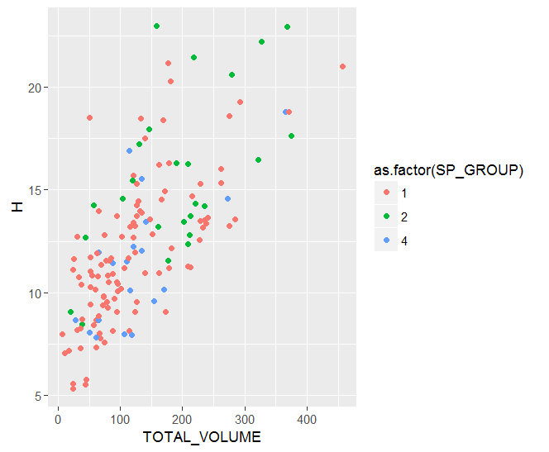
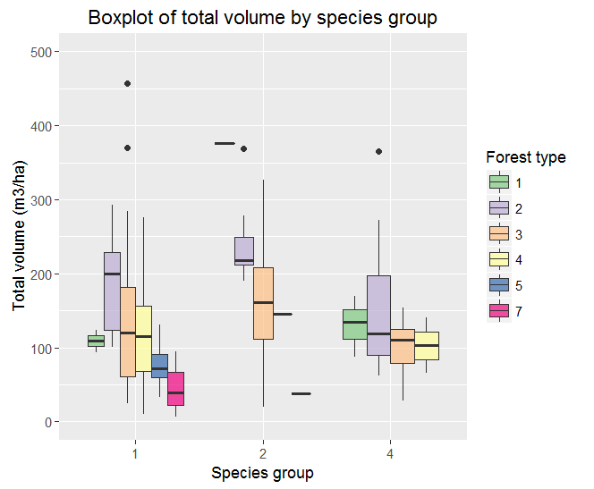
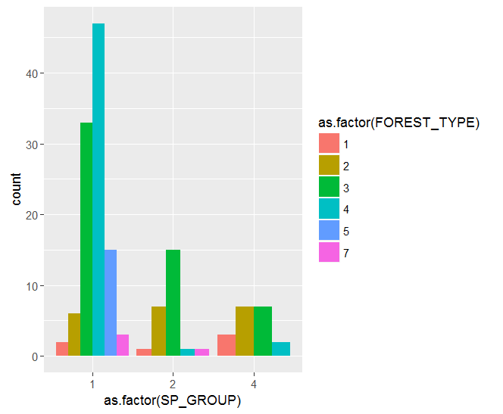
Ggplot2 package for visualization
http://r4stats.com/examples/graphics-ggplot2/
http://t-redactyl.io/blog/2016/04/creating-plots-in-r-using-ggplot2-part-10-boxplots.html

Slide 5
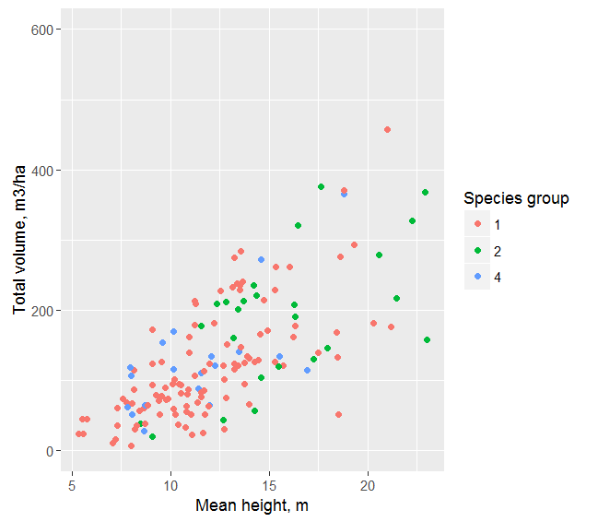
Code examples
Plotting with class-specific colours and modifying y-axis range
ggplot(A2, aes(y=TOTAL_VOLUME, x=H)) +
geom_point(aes(colour = as.factor(SP_GROUP)))+
xlab("Mean height, m")+
ylab("Total volume, m3/ha")+
guides(colour=guide_legend(title="Species group"))+
ylab(range(0,600))

Slide 6
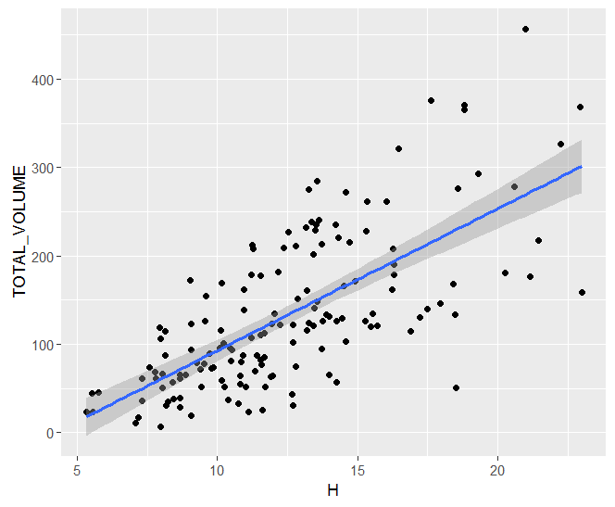
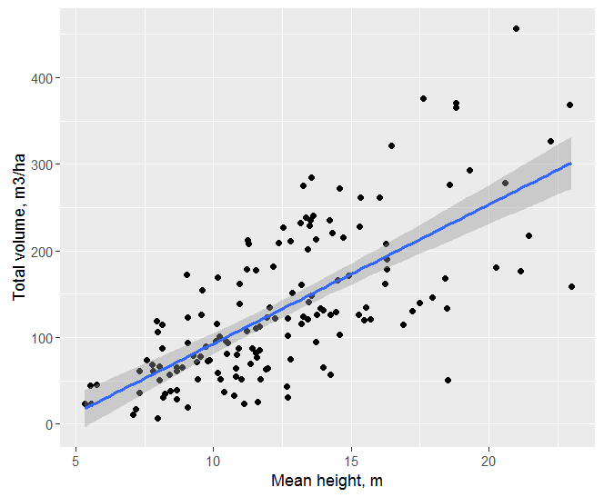
Code examples
Adding also axis labels and ranges:
ggplot(A2, aes(y=TOTAL_VOLUME, x=H)) +
geom_point() + geom_smooth(method=lm)+
xlab(”Mean height, m”)+
ylab(”Total volume, m3/ha”)
Plotting data with fit line using data set called A2:
ggplot(A2, aes(y=TOTAL_VOLUME, x=H)) +
geom_point() + geom_smooth(method=lm)

Slide 7
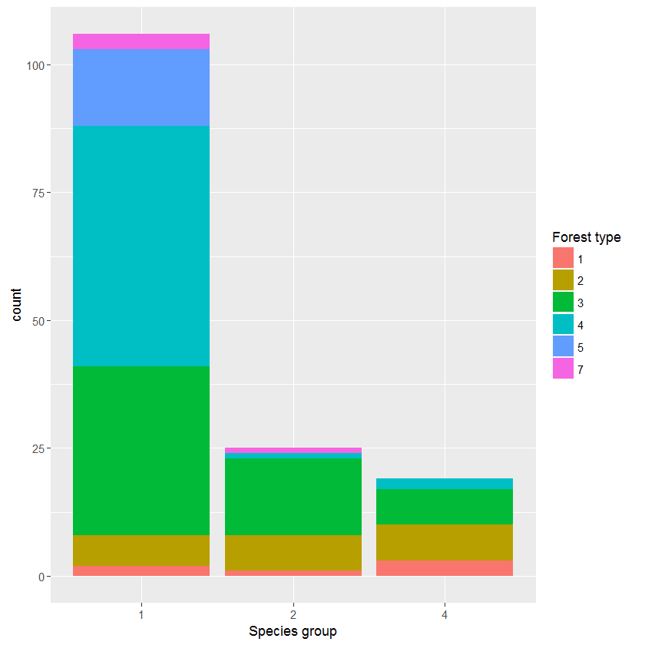
Code examples
Barplot showing frequency in different forest types classified by species group
ggplot(A2, aes(x = as.factor(SP_GROUP), fill = as.factor(FOREST_TYPE)) ) + geom_bar() + guides(fill=guide_legend(title="Forest type"))+ xlab("Species group")

Slide 8
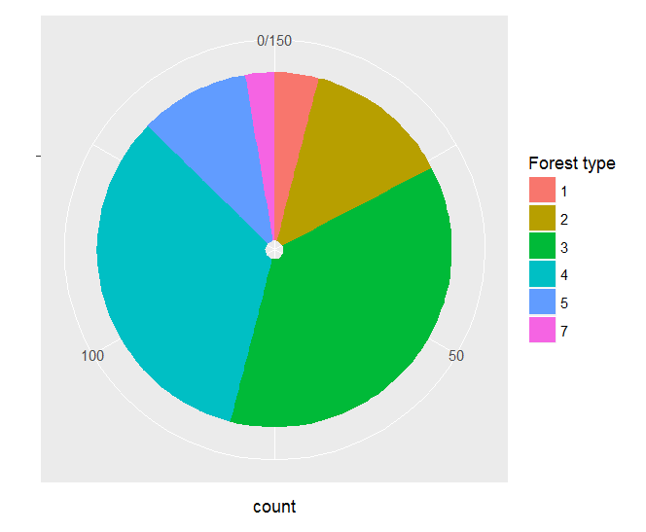
Code examples
Pie chart showing frequency in different classes
ggplot(A2,
aes(x = factor(""), fill = as.factor(FOREST_TYPE)) ) +
geom_bar() +
coord_polar(theta = "y") +
scale_x_discrete("")+
guides(fill=guide_legend(title="Forest type"))

Slide 9
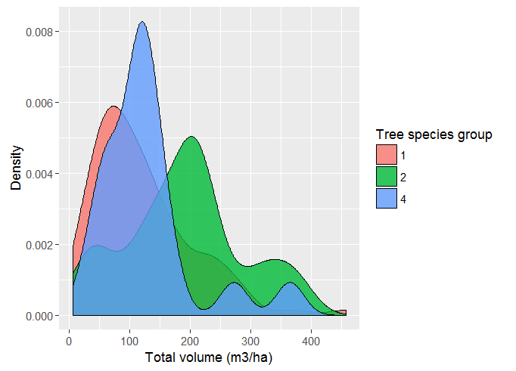
Code examples
Visualising several distributions in one graph
ggplot(A2, aes(x=TOTAL_VOLUME)) +
geom_density(aes(fill=factor(A2$SP_GROUP)), alpha=.8) +
guides(fill=guide_legend(title="Tree species group"))+
xlab("Total volume (m3/ha)")+
ylab("Density")

Slide 10
GIS analysis in R
Several packages available
raster
sp
rgdal
Nice tutorials are available, check e.g.
http://neondataskills.org/R/Raster-Data-In-R/

Slide 11
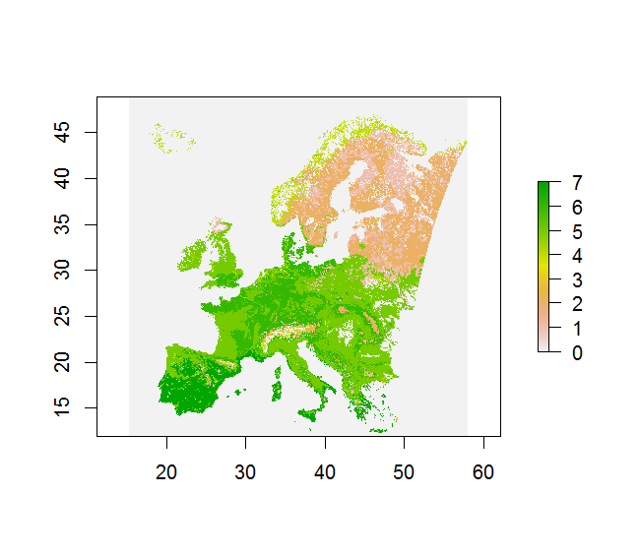
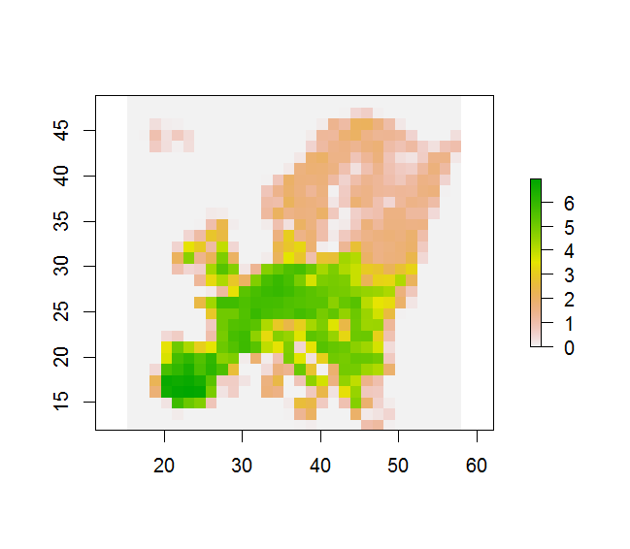
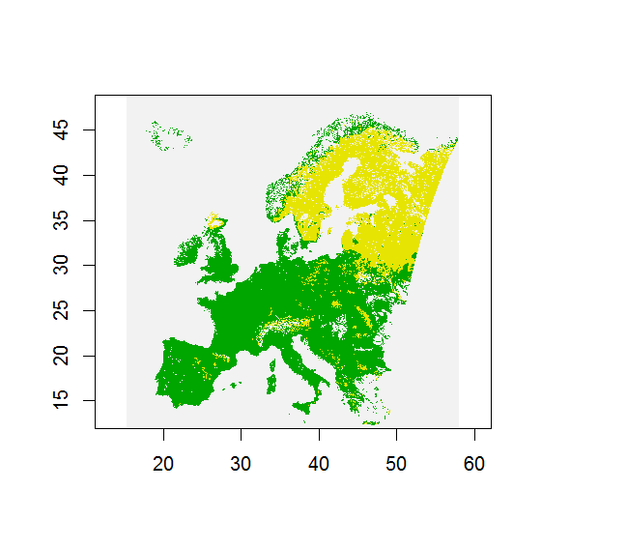
Code examples
Reading raster data in: P <- raster(”C:/Temp/testraster.tif”))
Resample to lower resolution (current pixel size*100): P2 <- aggregate(P, 100, mean)
Reclassify:
classes <- c(1, 3, 1, 4, 7, 2) #here 1-3 reclassified to 1, 4-7 reclassified to 2
reclassify(P, classes)

Slide 12
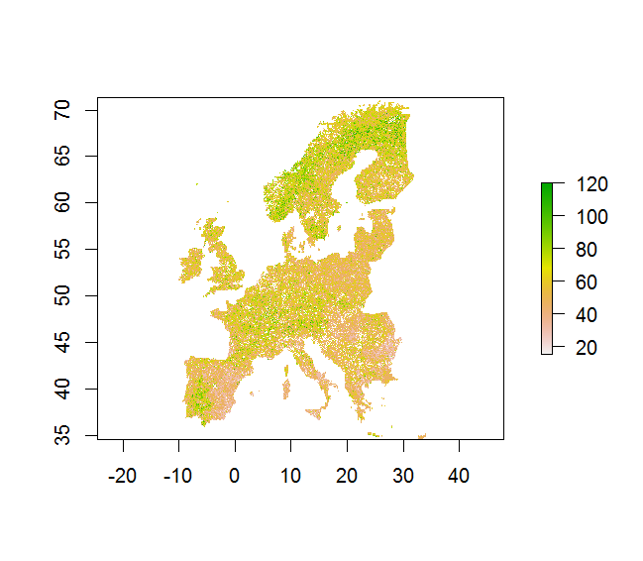
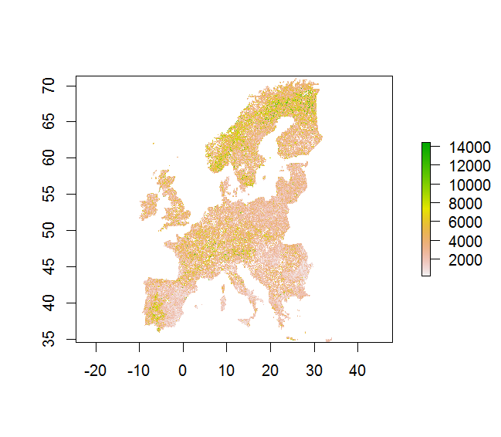
Code examples
VAR1 <- raster(”C:/Temp/mytestdata.tif”)
VAR2 <- raster(”C:/Temp/mytestdata2.tif”)
# Calculating new raster by applying some (here # just some nonsense) function
# to the input rasters
VAR3 <- VAR1^2 + 0.51*VAR2

Slide 13
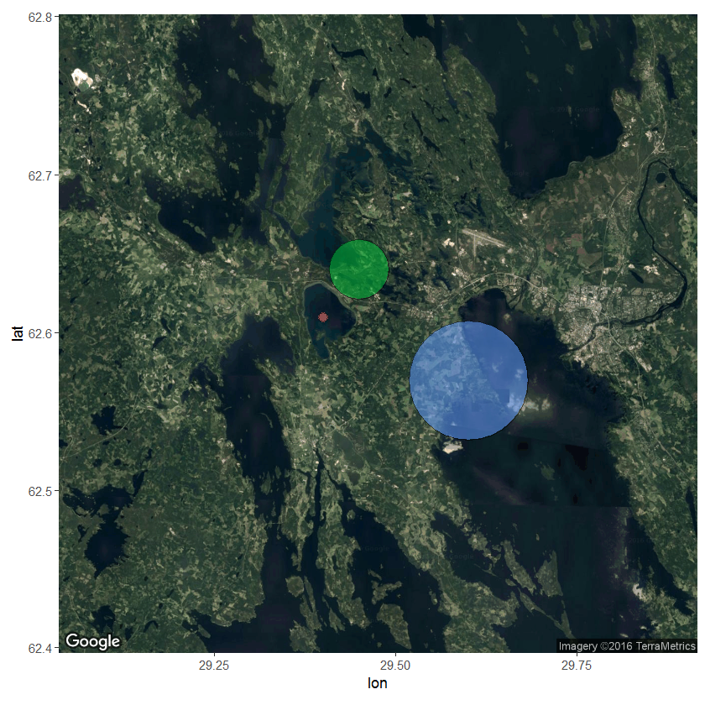
Ggmap
https://journal.r-project.org/archive/2013-1/kahle-wickham.pdf
# Example using data frame df, which contains following columns: lat, lon, class on 3 # locations nearby Joensuu
library(ggmap)
mapsat <- get_map(location = c(lon = mean(df$lon), lat = mean(df$lat)), zoom = 10, maptype = "satellite", scale = 2)
# plotting the map with some points ggmap(mapsat)+
geom_point(data = df, aes(x = lon, y = lat, fill = as.factor(class), alpha = 0.8), size=df$class, shape = 21)+
guides(fill=FALSE, alpha=FALSE, size=FALSE)

Slide 14
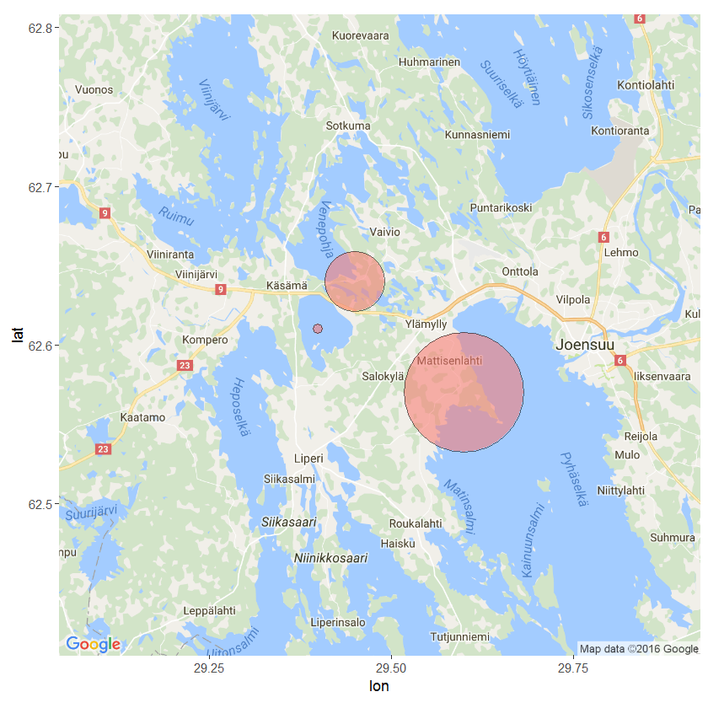
maproad <- get_map(location = c(lon = mean(df$lon), lat = mean(df$lat)), zoom = 10, maptype = "roadmap", scale = 2)
# plotting the map with some points
ggmap(maproad) +
geom_point(data = df, aes(x = lon, y = lat, fill = "red", alpha = 0.8), size = df$class, shape = 21) +
guides(fill=FALSE, alpha=FALSE, size=FALSE)

Slide 15
Questions?

Slide 16
R modeling exercise in nutshell
Linear regression
Check visually the correlation of dependent vs independent variables in your data set
Check normality of the variables
Do you need to do transformation for some variables?
Try fitting with the most relevant variables
Check model output: significance of variables, R-squared, residuals (homoscedasticity, normality)
Model validation
RMSE, bias, significance of bias (T-test)
Applying the selected model with raster data
Making thematic map by reclassifying the resulting raster

