Slide 1
Chapter 3
Digital Design and Computer Architecture: ARM® Edition
Sarah L. Harris and David Money Harris

Slide 2
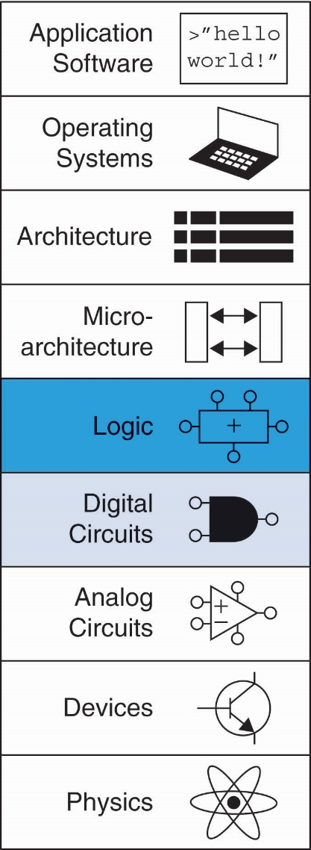
Chapter 3 :: Topics
Introduction
Latches and Flip-Flops
Synchronous Logic Design
Finite State Machines
Timing of Sequential Logic
Parallelism

Slide 3
Introduction
Outputs of sequential logic depend on current and prior input values – it has memory.
Some definitions:
State: all the information about a circuit necessary to explain its future behavior
Latches and flip-flops: state elements that store one bit of state
Synchronous sequential circuits: combinational logic followed by a bank of flip-flops

Slide 4
Sequential Circuits
Give sequence to events
Have memory (short-term)
Use feedback from output to input to store information

Slide 5
State Elements
The state of a circuit influences its future behavior
State elements store state
Bistable circuit
SR Latch
D Latch
D Flip-flop

Slide 6
Bistable Circuit
Fundamental building block of other state elements
Two outputs: Q, Q
No inputs

Slide 7
Bistable Circuit Analysis
Consider the two possible cases:
Q = 0:
then Q = 0, Q = 1 (consistent)
Q = 1:
then Q = 1, Q = 0 (consistent)
Stores 1 bit of state in the state variable, Q (or Q)
But there are no inputs to control the state

Slide 8
SR (Set/Reset) Latch
SR Latch
Consider the four possible cases:
S = 1, R = 0
S = 0, R = 1
S = 0, R = 0
S = 1, R = 1

Slide 9
SR Latch Analysis
S = 1, R = 0:
then Q = 1 and Q = 0
S = 0, R = 1:
then Q = 0 and Q = 1
1

Slide 10
SR Latch Analysis
S = 1, R = 0:
then Q = 1 and Q = 0
Set the output
S = 0, R = 1:
then Q = 0 and Q = 1
Reset the output
1
1

Slide 11
SR Latch Analysis
S = 0, R = 0:
then Q = Q_{prev}
S = 1, R = 1:
then Q = 0, Q = 0
1

Slide 12
SR Latch Analysis
S = 0, R = 0:
then Q = Q_{prev}
Memory!
S = 1, R = 1:
then Q = 0, Q = 0
Invalid State
Q ≠ NOT Q
1

Slide 13
SR Latch Symbol
SR stands for Set/Reset Latch
Stores one bit of state (Q)
Control what value is being stored with S, R inputs
Set: Make the output 1
(S = 1, R = 0, Q = 1)
Reset: Make the output 0
(S = 0, R = 1, Q = 0)
Must do something to avoid
invalid state (when S = R = 1)

Slide 14
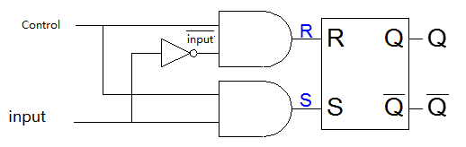
How to avoid S=1, R=1 in SR Latch Internal Circuit
Can the following circuit avoid S=1, R=1?
Two AND gates are added before S,R; One inverter is added to create input_bar.
When Control=0, R=0, S=0
When Control =1, R= input_, S=input, S is opposite to R
Hence R=1, S=1 could be avoided

Slide 15
D Latch
Two inputs: CLK, D
CLK: controls when the output changes
D (the data input): controls what the output changes to
Function
When CLK = 1,
D passes through to Q (transparent)
When CLK = 0,
Q holds its previous value (opaque)
Avoids invalid case when
Q ≠ NOT Q

Slide 16
D Latch Internal Circuit

Slide 17
D Latch Internal Circuit

Slide 18
D Flip-Flop
Inputs: CLK, D
Function
Samples D on rising edge of CLK
When CLK rises from 0 to 1, D passes through to Q
Otherwise, Q holds its previous value
Q changes only on rising edge of CLK
Called edge-triggered
Activated on the clock edge

Slide 19
D Flip-Flop Internal Circuit
Two back-to-back latches (L1 and L2) controlled by complementary clocks
When CLK = 0
L1 is transparent
L2 is opaque
D passes through to N1
L1 is called Master latch, L2 is called Slave latch

Slide 20
D Flip-Flop Internal Circuit
Two back-to-back latches (L1 and L2) controlled by complementary clocks
When CLK = 1
L2 is transparent
L1 is opaque
N1 passes through to Q
L1 is called Master latch, L2 is called Slave latch

Slide 21
D Flip-Flop Internal Circuit
Two back-to-back latches (L1 and L2) controlled by complementary clocks
When CLK = 0
L1 is transparent
L2 is opaque
D passes through to N1
When CLK = 1
L2 is transparent
L1 is opaque
N1 passes through to Q
Thus, on the edge of the clock (when CLK rises from 0 1)
D passes through to Q
L1 is called Master latch, L2 is called Slave latch

Slide 22
D Latch vs. D Flip-Flop
CLK
Latch symbol
Flip flop symbol

Slide 23
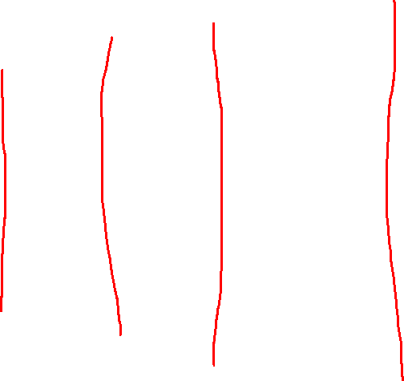
D Latch vs. D Flip-Flop
Latch
CLK=1
0
CLK=0
1
0
Assume two different initial values: 0, 1
D changes
In latch, when CLK=1, Q=D, output Q will follow the input D when CLK=1; when CLK=0, output keeps the previous value;

Slide 24

D Latch vs. D Flip-Flop
Flip-flop
CLK rising edge
1
1
0
CL
1
0
Assume two different initial values: 0, 1
In flip-flop, Q only copies D at CLK rising edge; in the other times, Q keeps previous value
D value at clock edge

Slide 25
D Latch vs. D Flip-Flop
Latch
Flip-flop
1
0
1
0
Assume two different initial values: 0, 1
In latch, when CLK=1, Q=D, output Q will follow the input D when CLK=1; when CLK=0, output keeps the previous value;
In flip-flop, Q only copies D at CLK rising edge; in the other times, Q keeps previous value

Slide 26
Flip flop is edge-triggered (specifically only on the rising edge for the previous example; Q = D on those rising edges and Q=Qprev otherwise)
Latch is level-sensitive (if clock is high, Q = D. Otherwise, Q = Qprev)

Slide 27
Registers: Multi-bit Flip-Flop
Registers are a group of flip fops sharing the same CLK
All bits are updated at the same time.
Registers are the key building block of most sequential circuits
The symbol of a 4 bit register is in the slide
If you have a 4 bit data D_{3:0}: D3, D2, D1, D0, you can use a 4 bit register to store that data

Slide 28
Appendix

Slide 29
Enabled Flip-Flops
Inputs: CLK, D, EN
The enable input (EN) controls when new data (D) is stored
Function
EN = 1: D passes through to Q on the clock edge
EN = 0: the flip-flop retains its previous state

Slide 30
Resettable Flip-Flops
Inputs: CLK, D, Reset
Function:
Reset = 1: Q is forced to 0
Reset = 0: flip-flop behaves as ordinary D flip-flop

Slide 31
Resettable Flip-Flops
Two types:
Synchronous: resets at the clock edge only
Asynchronous: resets immediately when Reset = 1
Asynchronously resettable flip-flop requires changing the internal circuitry of the flip-flop
Synchronously resettable flip-flop?

Slide 32
Resettable Flip-Flops
Two types:
Synchronous: resets at the clock edge only
Asynchronous: resets immediately when Reset = 1
Asynchronously resettable flip-flop requires changing the internal circuitry of the flip-flop
Synchronously resettable flip-flop?

Slide 33
Settable Flip-Flops
Inputs: CLK, D, Set
Function:
Set = 1: Q is set to 1
Set = 0: the flip-flop behaves as ordinary D flip-flop

