Slide 1
Search Query Monopoly
Joshua Baroni

Slide 2
Inspiration
Interested in Data Science and Statistics; would like to pursue post-grad
Worked with SciKit-Learn during my summer internship and abroad at Korea University
Love for monopoly and games!
Found a Hampton Roads monopoly game at Walmart and realized you can make a monopoly game out of anything

Slide 3
Technologies
Search Query Engines
APIFY – $$$
ParseHub – FREE
Maybe my own implementation? Tweaking scrape to my needs?
Looking for other technologies
Contacted through REST API calls
Monopoly JavaScript Game Engine
https://github.com/intrepidcoder/monopoly
AI Resources (Python Implementation)
Scikit-Learn
PyTorch, SciPy, NumPy
Languages
Java (HttpClient)
JavaScript (Game Engine), JSON
Python (Categorization Ai)

Slide 4
Implementation and Final Deliverable
User will enter a phrase. SQM will make a monopoly game using that phrase as the theme.
Machine Learning approach to categorizing the raw scrape data.
K-Nearest Neighbor (KNN)
Which queries have the most keywords?
Which queries have loose relativity?
More keyword similarities will be placed in the same color category on the board
Majority of work done for capstone on this portion.
Query results chosen will be locally related to your key word or phrase
Images will be added to tiles
Ex: Searching “pizza” will generate tiles such as Supreme pizza, Veggie pizza, Cheese pizza for your monopoly board.
Ranked based on price, value, quality, number of toppings, etc.
Ex: Searching “pizza places” will generate tiles such as Chanellos, Mellow Mushroom, Dominoes.
For places, yelp and/or online rating and number of online reviews will be taken into account
Potentially hosted on a Docker Container if time allows

Slide 5
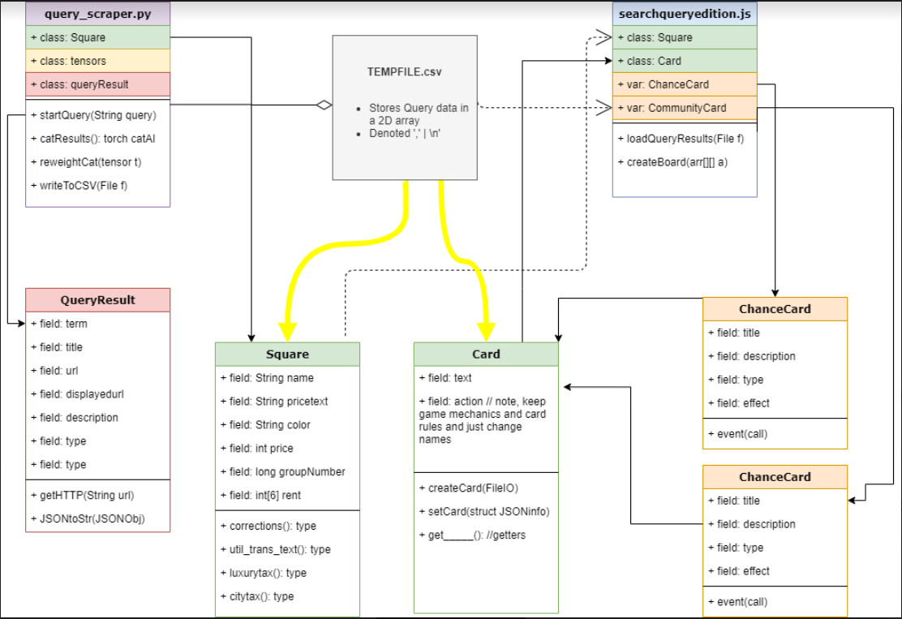
Project Architecture

Slide 6
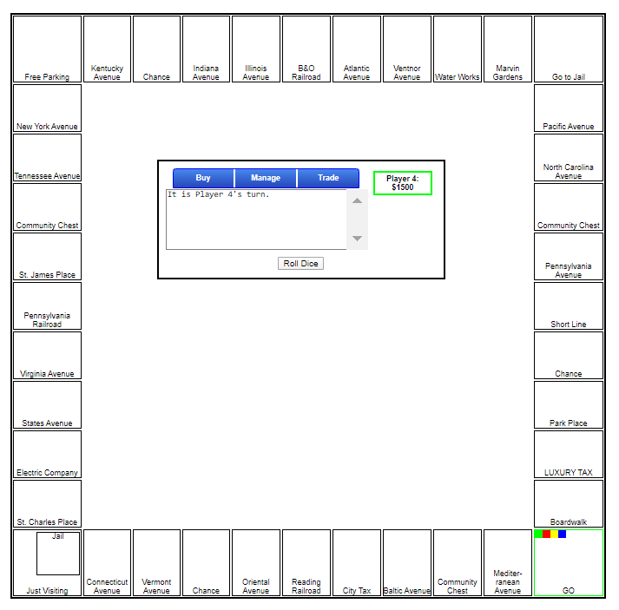
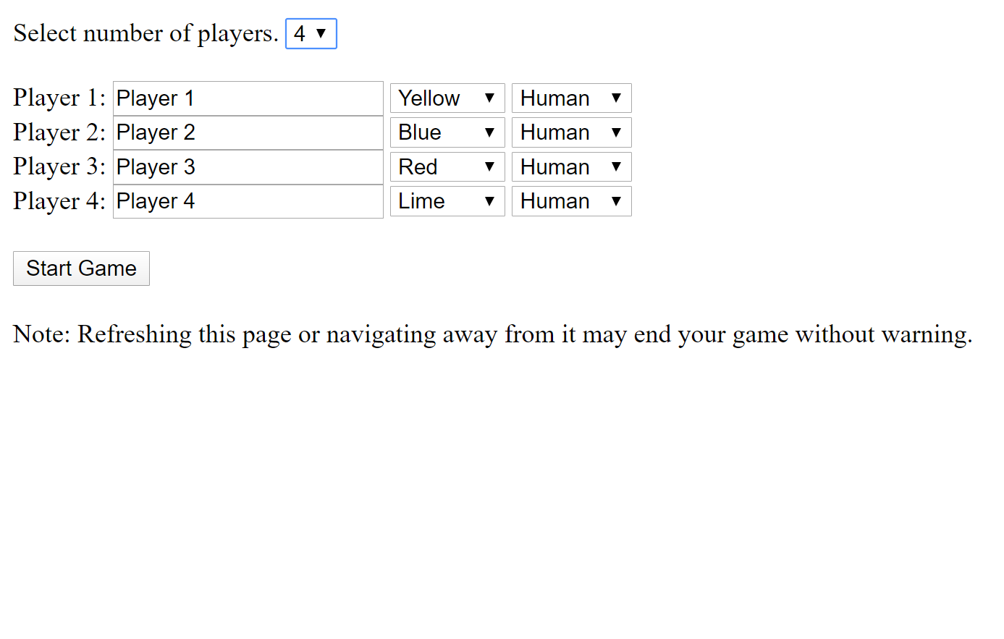
Monopoly GUI
http://localhost:3333/

Slide 7
Milestone Presentation/Demo
2 pieces completed thus far:
Java Backend
Performs a google search on the user’s input monopoly theme
Scrapes the returned html page containing a JSON object and stores that in the raw.json temporary output file
Parses the JSON object and places one website title and one link in the format.txt output file per query result
Monopoly Game Board
SQMonopoly is in progress; JavaScript file reading process is not yet completed
Game mechanics fully debugged and work as an actual monopoly game
**Will demo both pieces in class here**
Final Portion: Will combine the two and read query results into the game board

Slide 8
Next Steps
Allow others to play it as it is developed
Search data will be improved through the process of others playing the game
Will take into consideration the game’s response to parsing through each query
Clickable links in the gameboard to go to the target websites

