Slide 1
Reinforcement Learning for Prompt Optimization
Joshua Bello

Slide 2
Prompting
Prompts are important the paper (Language Models are Few-Shot Learners) showed that very large LLMS can perform a wide range of tasks with just a few shot promptings and examples rather than fine tuning
Question: How to systematically create good prompts for a downstream task

Slide 3
Prompt Optimization
Discrete Prompt Optimization
Goal: Optimize actual tokens prepended to the prompt
Interpretable, actual tokens
Because tokens are discrete you cannot backprop
Often created by “enumeration (e.g., paraphrasing)-then-selection” heuristics
Soft Prompt Optimization
Goal: Optimize continuous vector prepended to the the prompt
Not interpretable
Can directly be trained via backprop because continuous
Non transferable across LLMs
Token 1
Token 2
Prompt
Embedding 1
Embedding 2
Prompt

Slide 4
RLPrompt (Discrete Prompt Optimization)
Framed prompt generation as an RL problem (classification datasets),
  State: The partial prompt generated so far
  Action: Selecting the next prompt token
  Policy: A trainable MLP that maps LM hidden states → token logits
  Environment: A frozen LLM (DistilGPT-2)
  Reward: A gap reward computed by a separate LLM (DistilRoBERTa-base) evaluating the final prompt on the classification task
Generating a prompt
Current Prompt
ie: [BOS] + [Classification] + [prompt ids…]
Frozen
LLM
Output: last hidden layer state
MLP
Output: modified last hidden layer state
LM Head from Frozen LM
Output: logits over next token
Top K sampling to choose next prompt token

Slide 5
What is Gap reward for classification (in RLPrompt)
Measures how much more likely the model thinks the correct class is compared to the best incorrect class
  c = class
  Gap(c) = Prob(correct class) - max Prob(incorrect class)
  Correct = 1[Gap (c) > 0] (Bernoulli)
  Reward = λ_1^(1 - correct) * λ_2^(correct) * Gap(c) | λ_1 = 180, λ_2 = 200
# questions = 16x per class
[BOS] + [Prompt A] + [Question 1] + [Yes]
[BOS] + [Prompt A] + [Question 1] + [No]
Gap Reward (R_A_1)
Reward LLM
Uses logits from the LM head to compute probability of each answer
Reward
R(A) = (1/n)∑R_A_i
[BOS] + [Prompt A] + [Question 2] + [Yes]
[BOS] + [Prompt A] + [Question 2] + [No]
Gap Reward (R_A_2)
Notes:
To prevent reward hacking

Slide 6
What is Soft Q Learning (in RLPrompt)
One-to-one correspondence between LM logits f_θ(a∣s) and soft Q-values Q(s,a): the logits over the vocabulary can be directly interpreted as Q-values for each action (token).
This allows RL to use the entire LM vocabulary as the action set, updating all Q-values in parallel via the softmax, rather than updating only the sampled action as in standard Q-learning.
In Soft Q-Learning, the optimal policy is the Boltzmann (max-entropy) policy:
π(a∣s)=exp⁡(Q(s,a))/ ∑a′exp⁡(Q(s,a′))
RLPROMPT uses only the on-policy component of SQL: no multi-step path consistency; prompt generation is treated as a single-step MDP, which reduces the loss to
L=(Q(z)− [R + 𝛾V(z)])^2, V(z) = ⍺ * log ∑e ^(Q(z, a) / ⍺
Notes:
Soft Q learning comes from maximum-entropy RL which aims not only to maximize reward, but also the randomness of the policy.
V(z) is the maximum-entropy value of state z, defined as a temperature-scaled log-sum-exp over all action-values, representing the optimal expected future reward plus an entropy bonus.

Slide 7
Experiment
Datasets (16 examples per class)
  BoolQ – yes/no reading comprehension dataset
  GSM8K – grade-school mathematical reasoning
Reward functions
  Log-Likelihood Reward (LL) – Mean log-likelihood of the correct answer sequence
  Gap Reward (GAP)
    BoolQ
    GSM8K: LL(correct answer) − max LL(negative answers)
    Negative answers generated dynamically (k = 4)
RL Algorithms
  Soft Q-Learning
  GRPO-like Token-Level PPO
    Batch-relative advantage normalization
    Reference policy = snapshot of initial MLP

Slide 8
Experiment Cont’d
Prompt Policy Architecture
  Base LLM frozen: distilgpt2
  Learned module: PromptMLP
    Hidden size → 2048 → hidden size
    Prefix "Reasoning" inserted before learned tokens
    Prompts are discrete tokens, sampled via top-k (k = 256)
Training Configuration
  1,000 training steps per experiment (RLPrompt used ~10k steps)
  Prompt length: 5 tokens
  16 sampled prompts per step
  Reward normalization: z-score

Slide 9
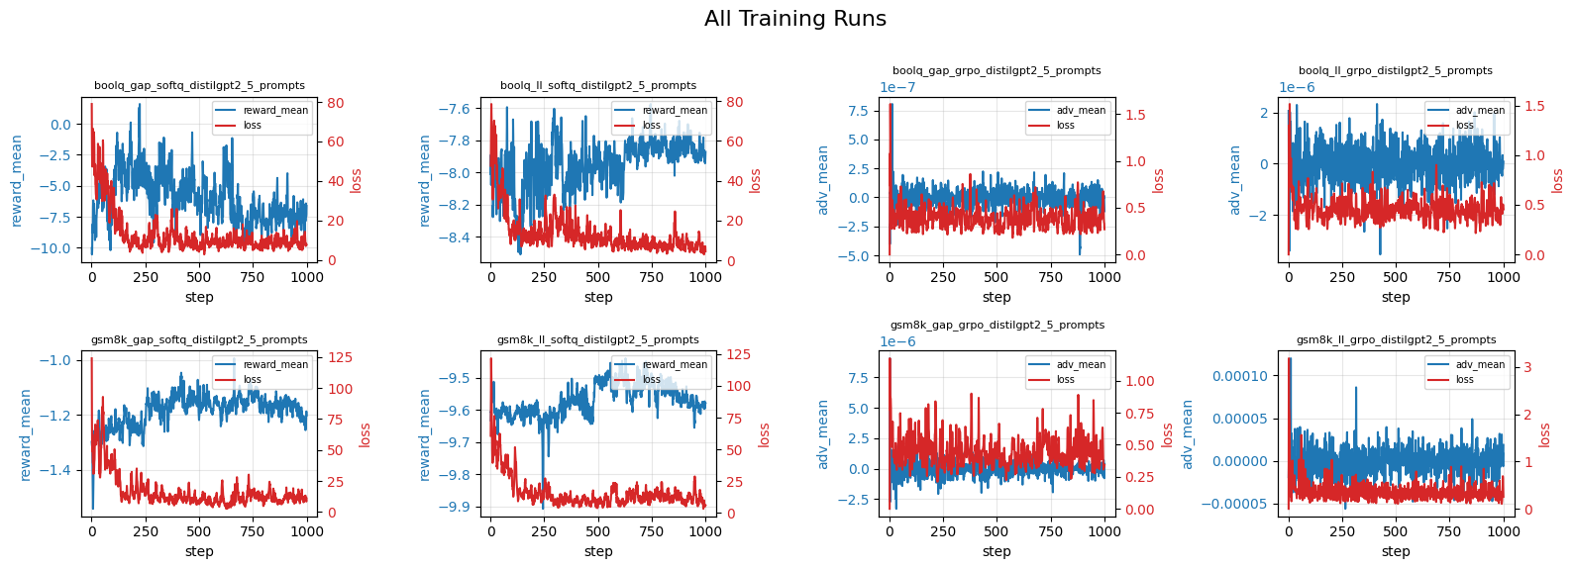
Training Results
Notes:
GRPO seems to improve the policy alot more noisely than soft q learning. In the equation for GRPO the advantage is signed depending on whether a reward is better than on average. This menas gradients are signed which leads to more noising updates of the models parameters compared to soft Q learning where the gradient is always positive.
∇θ​LGRPO​=−Ek​​s[(rk​−rˉ)​​∇θ​logπθ​(yk​)​]
∇θ​LSoftQ​=−Ey[exp(βr(y))​​∇θ​logπθ​(y)​]
GRPO is a Monte Carlo method which is a higher variance estimator than TD methods which Soft Q learning falls under the category of.
It is also only over 1/10th the number of steps so the model could still have time to be timprove

Slide 10
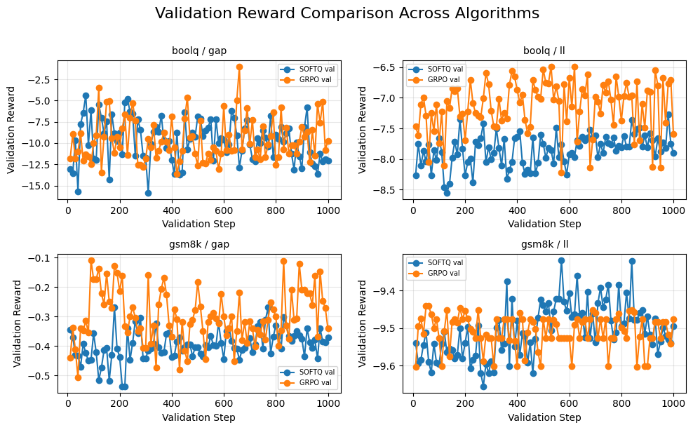
Validation Results (every 10 steps)
Notes:
Similar trend of higher variance results in Soft Q than GRPO

Slide 11
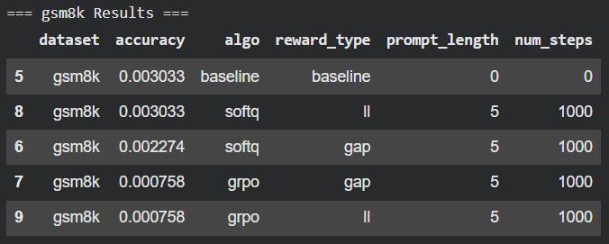
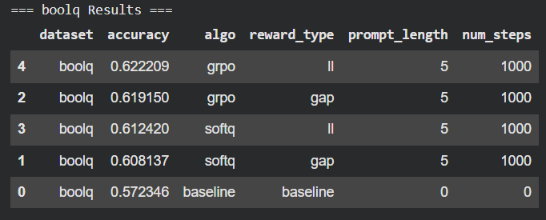
Test Results
Notes:
Slight improvement over the baseline for the boolq dataset. Interestingly enough it seems like there is not substantial difference between softq, grpo, for ll and
dsitillbert on gsm8k typically gets around 0%, grpo seemed to substrionally drop perofrmance whereas soft kept or slightly dropped.
Part of this may be a result of the fact that small models suhc as dsitillbert-2 already show teh ability to do classification so there exitist promtps that cna improve it, whereas reasoning is much harder to encode especially for smaller model so it needs more time to better refine prompts or it may not even be possible.
It would be interesting to see there techniques applied to larger model LAMMA models and evalue them on the gsm8k dataset

Slide 12
Current Prompt
ie: [BOS] + [Classification] + [prompt ids…]
Frozen
LLM
Output: last hidden layer state
MLP
Output: modified last hidden layer state
LM Head from Frozen LM
Output: logits over next token
Top K sampling to choose next prompt token
# questions = 16x per class
[BOS] + [Prompt A] + [Question 1] + [Yes]
[BOS] + [Prompt A] + [Question 1] + [No]
Gap Reward (R_A_1)
Reward LLM
Uses logits from the LM head to compute probability of each answer
Reward
R(A) = (1/n)∑R_A_i
[BOS] + [Prompt A] + [Question 2] + [Yes]
[BOS] + [Prompt A] + [Question 2] + [No]
Gap Reward (R_A_2)

Slide 13
Token 1
Token 2
Prompt
Embedding 1
Embedding 2
Prompt

