Slide 1
Bayesian hierarchical regression for SARS-CoV-2 viral load trajectories
Joshua Blake and David Pascall
Bayesian inference methods for infectious diseases research workshop
27th March 2023

Slide 2
Question
How does SARS-CoV-2 viral load vary over individuals and the course of infection?
Dataset
ATACCC: daily PCR testing of exposed individuals
Assume that cycle threshold value from PCR is proportional to log viral load
Max Ct value that can be observed is 40
Analysis here is from a preliminary dataset (unpublished), for a larger dataset with similar analysis see Hakki et al. (2022, Lancet Resp Med)

Slide 3
Challenges
Some infections only minimally observed
Want to generalize to what unseen individuals look like
False negatives and limit of detection
Negative result does not mean absence of virus: could mean too little virus, poor swabbing etc.
Solution
Hierarchical model: assume that individuals are “similar”
Often referred to as “random effects” or “mixed model”
Borrows information between individuals
After parameters estimated, can simulate unseen individuals
Bayesian paradigm: natural inclusion of false negative results

Slide 4
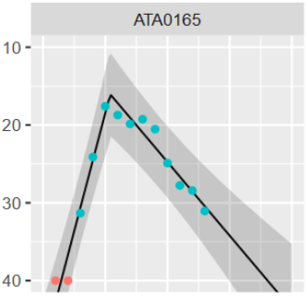



A simple model for viral load
$$\left(t_{peak},C_{peak}\right)$$
Piecewise linear model
Good approximation to more mechanistic ODE-based models
$$β_{down}$$
$$\left(t_{0},40\right)$$

Slide 5
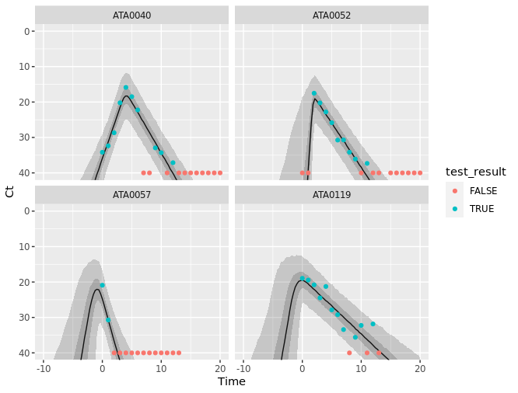
Results

Slide 6
Implementation and today’s workshop
Custom Stan code
Allows use of piecewise linear (rather than linear)
Custom likelihood for the negatives model
Modifications for today
Use data we have simulated for you
Consider just the decline
Peak time is time 0
Implement in brms: a package for Bayesian linear regression, using Stan on the back-end

