Slide 1
Bayesian hierarchical regression for SARS-CoV-2 viral load trajectories
Joshua Blake and David Pascall
Bayesian inference methods for infectious diseases research workshop
27th March 2023

Slide 2
Problem
Viral load is the amount of virus in your body
May mediate many processes of interest
Sensitivity of testing (PCR and rapid testing)
Infectiousness
Severity

Slide 3

Measuring viral load
Number of cycles to positive in a PCR test: cycle threshold (Ct)
Lower Ct = higher viral load
$Ct∝−log{(viral load)}$
40 is maximum value to be called positive
Around 30 or lower is infectious on average (Singanayagam et al.)
Can vary between labs

Slide 4
Previous estimates
Non-representative populations
E.g.: Professional athletes (Kissler et al. 2020)
Few samples per individual (e.g.: Jones et al. 2021)

Slide 5
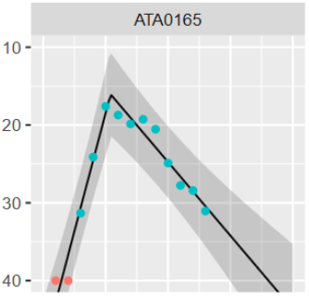



A simple model for viral load
$$\left(t_{peak},C_{peak}\right)$$
Piecewise linear model
Good approximation to more mechanistic ODE-based models
$$β_{down}$$
$$\left(t_{0},40\right)$$

Slide 6
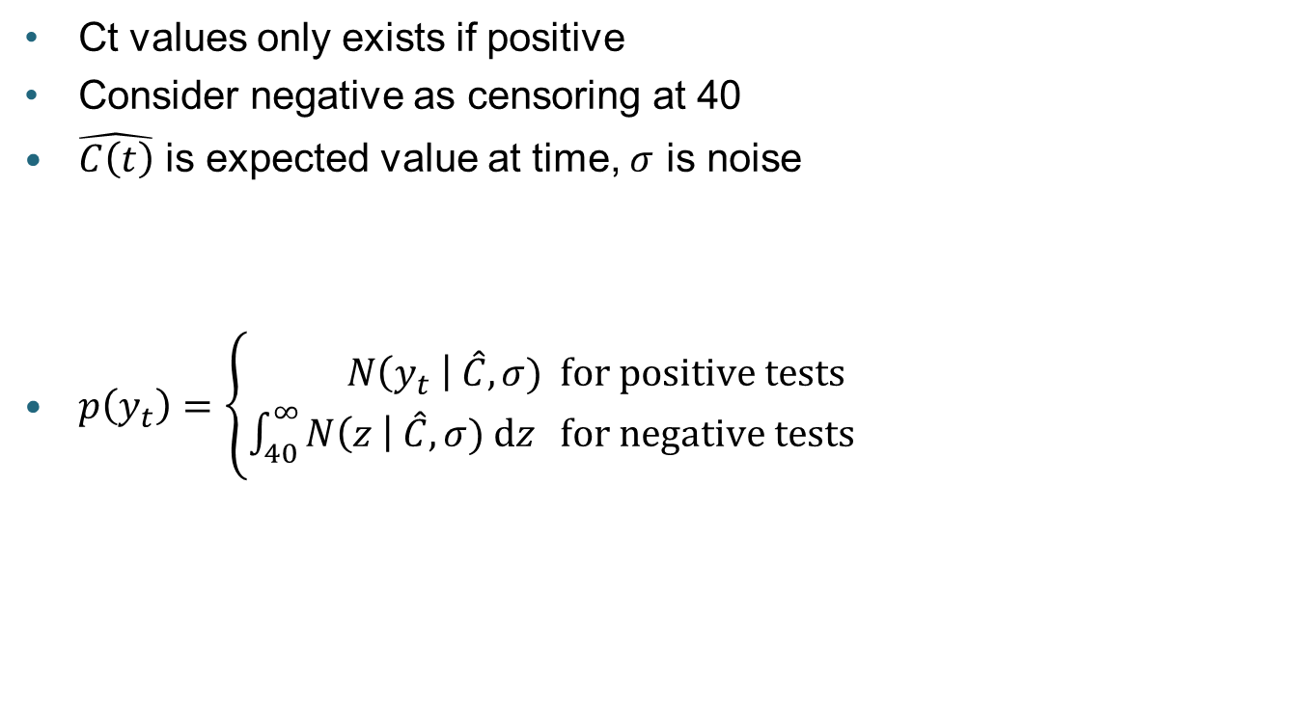
Relating to data
Ct values only exists if positive
Consider negative as censoring at 40
$\hat{C\left(t\right)}$ is expected value at time, $σ$ is noise
$p\left(y_{t}\right)=\left\{\begin{aligned}N\left(y_{t} \right| \hat{C},σ)& &for positive tests \\ \int_{40}^{∞}{N\left(z \right| \hat{C},σ) dz}& & for negative tests\end{aligned}\right.$

Slide 7
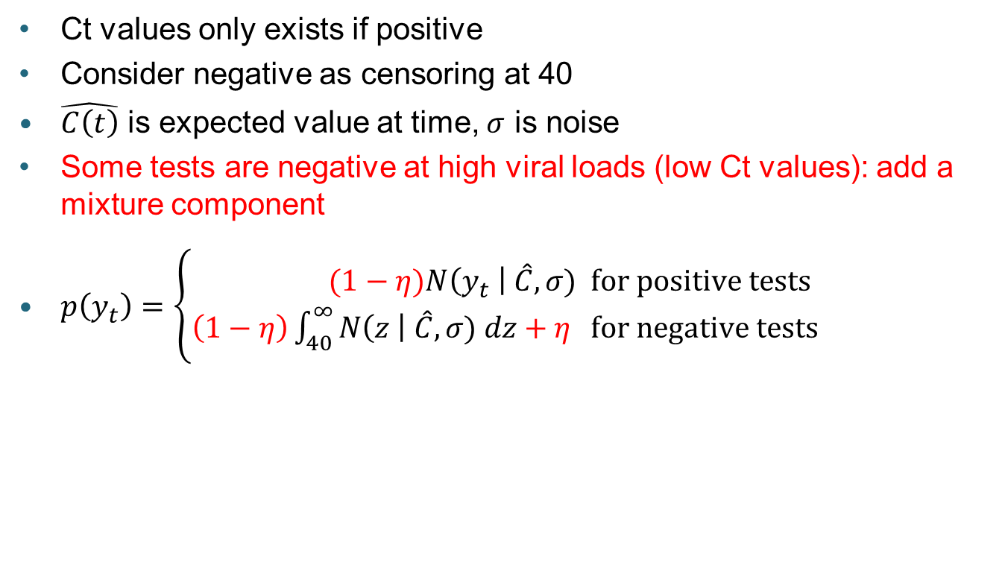
Relating to data
Ct values only exists if positive
Consider negative as censoring at 40
$\hat{C\left(t\right)}$ is expected value at time, $σ$ is noise
Some tests are negative at high viral loads (low Ct values): add a mixture component
$p\left(y_{t}\right)=\left\{\begin{aligned}(1−η)N\left(y_{t} \right| \hat{C},σ)& &for positive tests \\ \left(1−η\right)\int_{40}^{∞}{N\left(z \right| \hat{C},σ) dz+η}& & for negative tests\end{aligned}\right.$

Slide 8
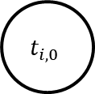
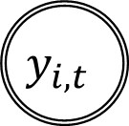
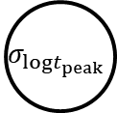
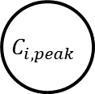
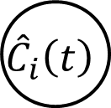
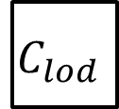


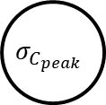
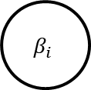
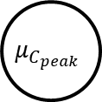


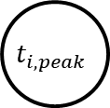


Adding a hierarchical structure
$$μ_{logt_{peak}}$$
$$σ_{logt_{peak}}$$
$$μ_{C_{peak}}$$
$$σ_{C_{peak}}$$
$$μ_{\log{β_{i}}}$$
$$σ_{\log{β_{i}}}$$
$$t_{i,0}$$
$$t_{i,peak}$$
$$C_{i,peak}$$
$$β_{i}$$
$$θ_{i}$$
$${\hat{C}}_{i}\left(t\right)$$
$$σ_{obs}$$
$$η$$
$$C_{lod}$$
$$y_{i,t}$$

Slide 9
Data
79 individuals, recruited as contacts of people testing positive in pillar 2
62 are household contacts
Tested every day for up to 20 days (quite variable number of tests per individual)
13 had negatives before first positive

Slide 10
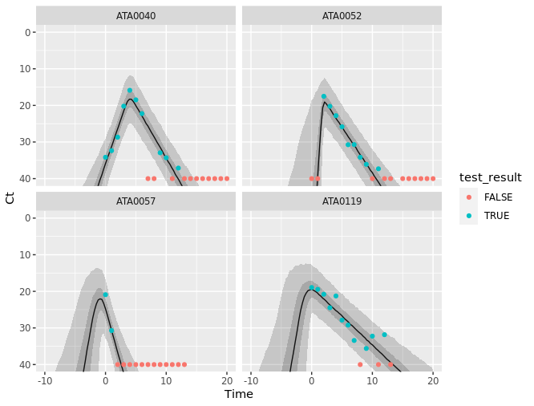
Results

Slide 11
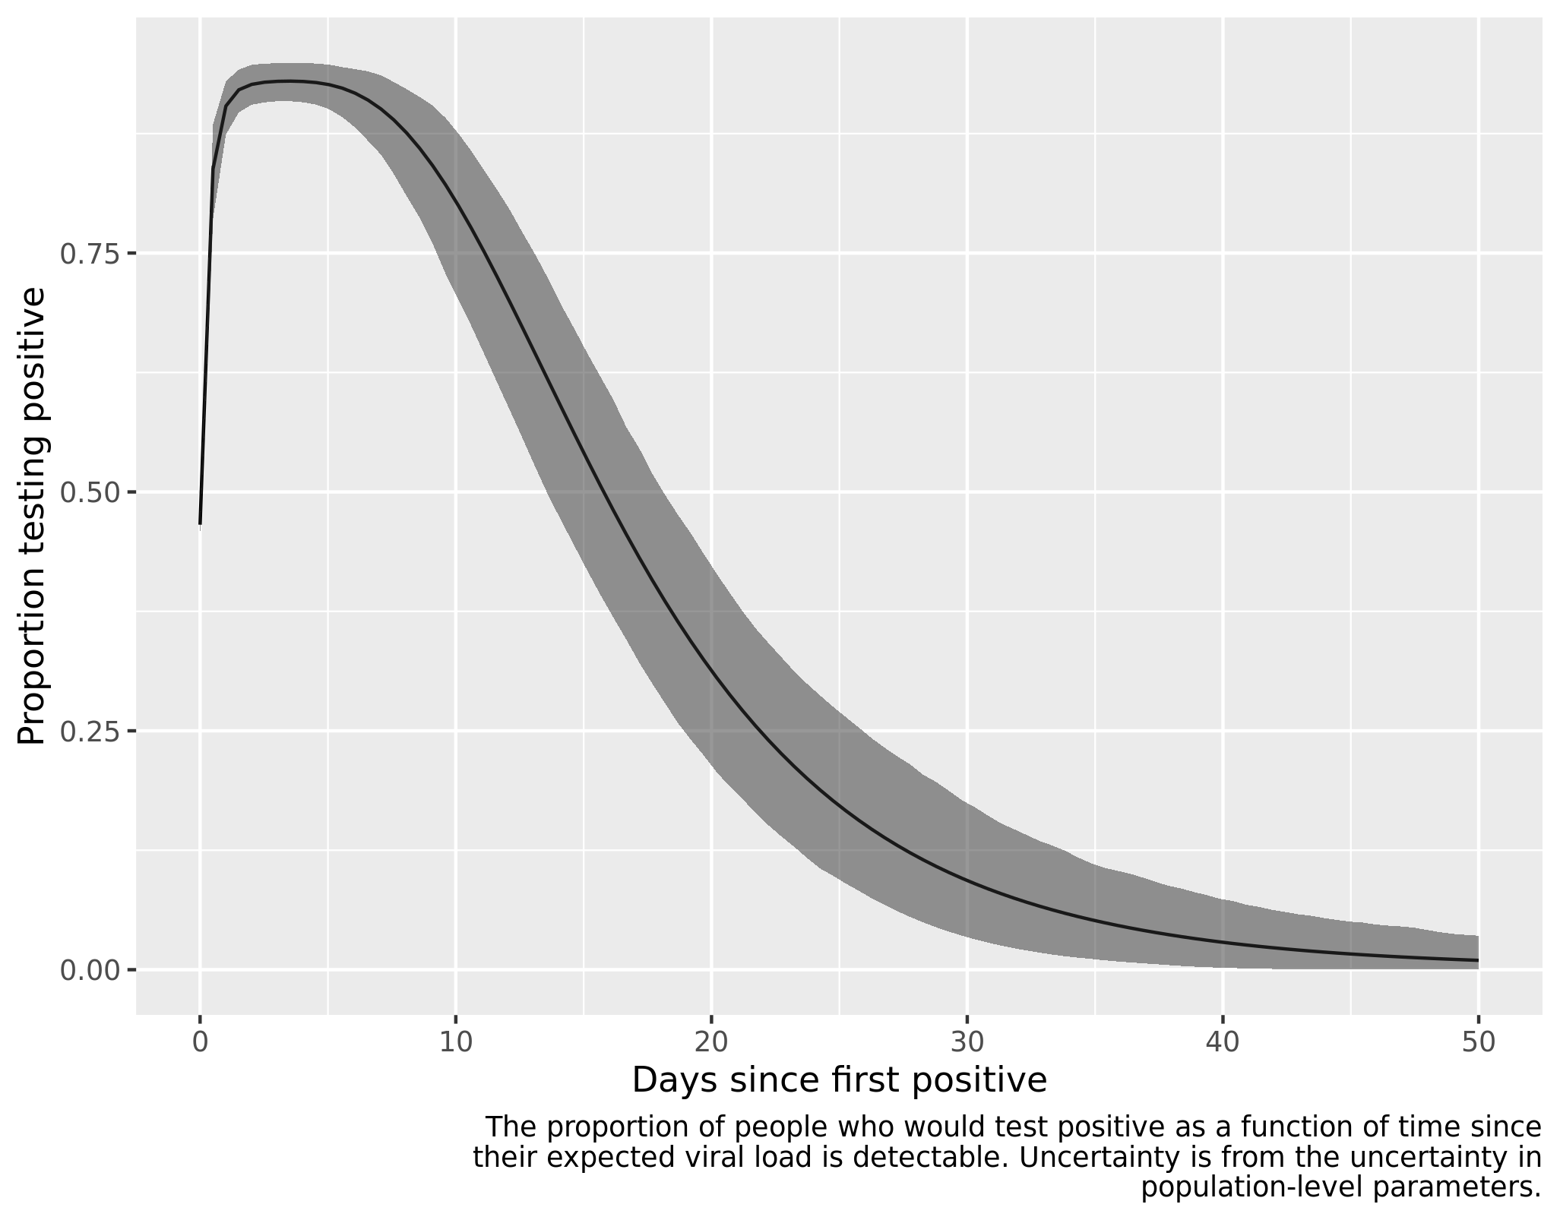
Results

Slide 12
Results
Mean time to peak: 2.4 (1.5, 3.4) days
Kissler et al.: 3.2 (2.4, 4.2)
Mean peak Ct: 17.84 (17.05, 18.11) Ct
Kissler et al.: 22.4 (20.7, 24.0)
Mean down slope gradient: 1.64 (1.45, 1.85) Ct / day
Kissler et al.: 2.1 (1.7, 2.6)
False negative rate: 6.8% (5.0, 8.8)
All are median (95% credible interval)

Slide 13
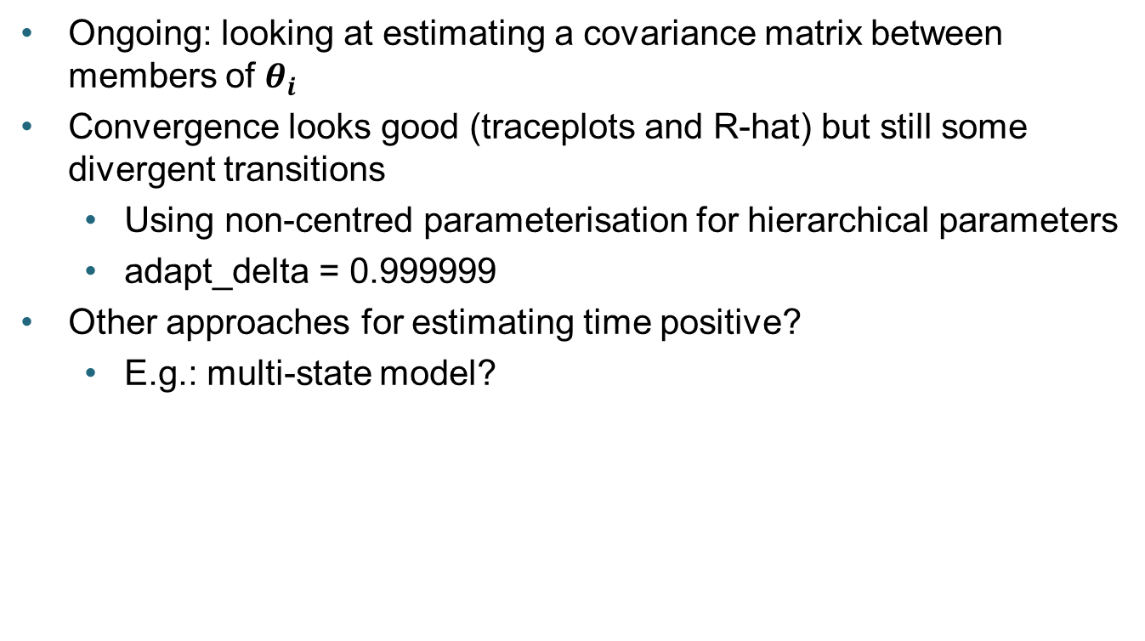
Issues
Ongoing: looking at estimating a covariance matrix between members of $θ_{i}$
Convergence looks good (traceplots and R-hat) but still some divergent transitions
Using non-centred parameterisation for hierarchical parameters
adapt_delta = 0.999999
Other approaches for estimating time positive?
E.g.: multi-state model?

