Slide 1


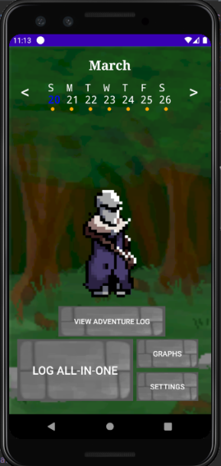
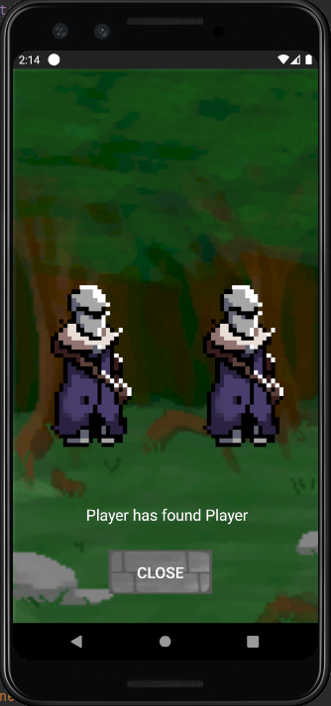
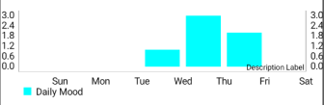
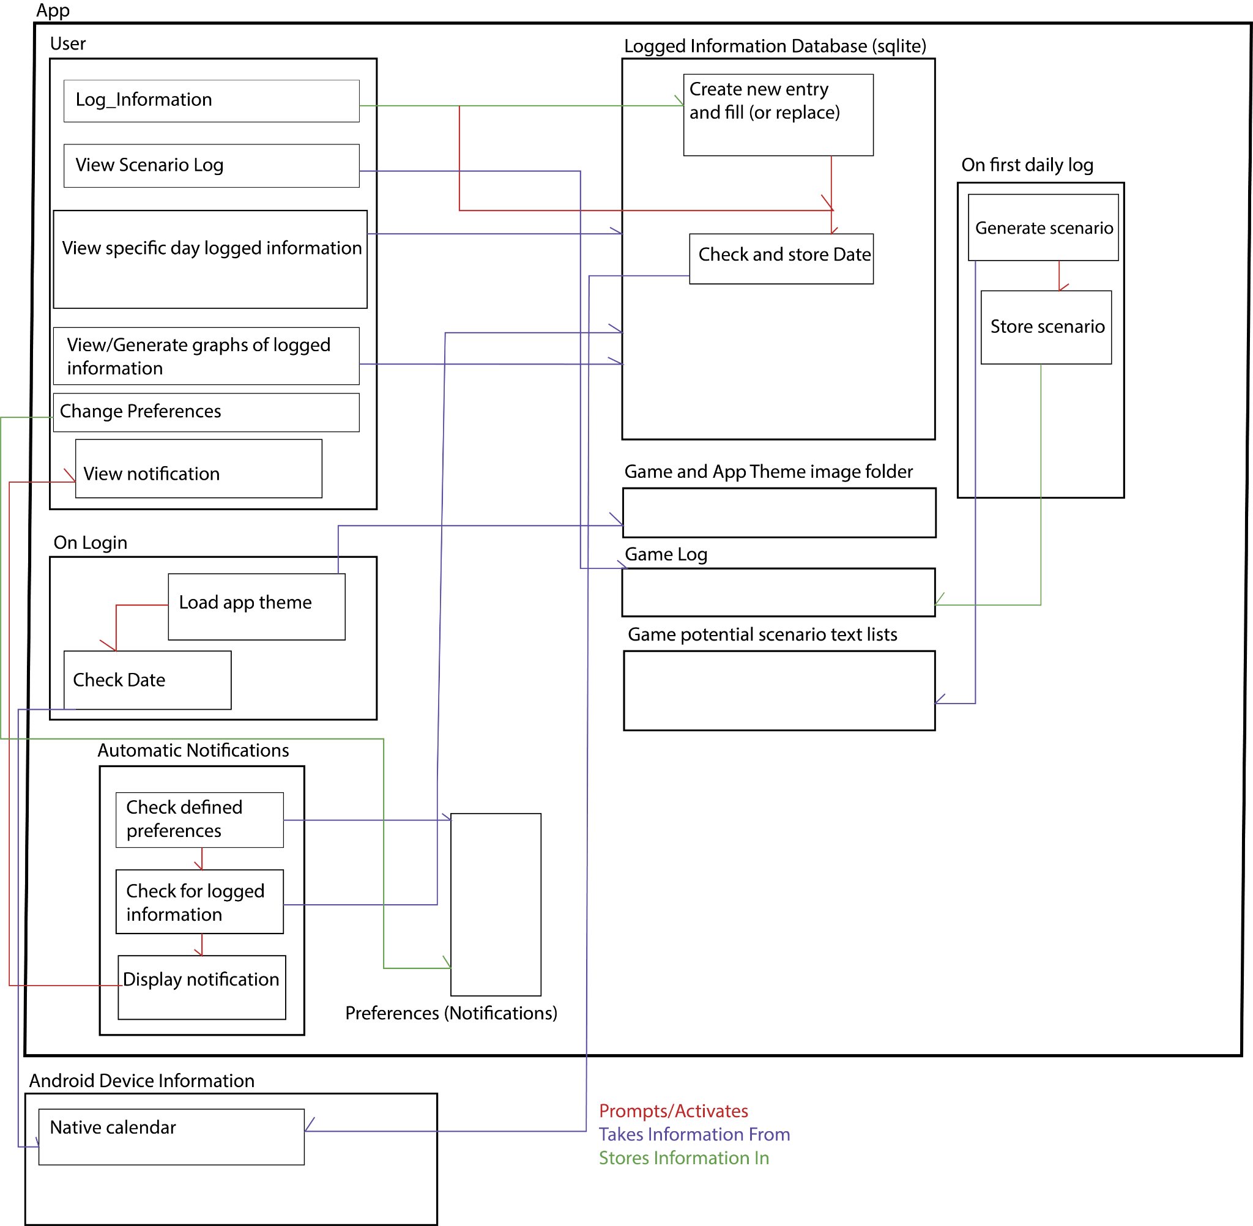
Daily Log App
Joshua Breininger, Phi Duong, Daniel Bornemann
Faculty Advisor(s): Dr. Philip Bernhard, Dept. of Computer Engineering and Sciences, Florida Institute of Technology
Motivation
Many college students have difficulty balancing school life with maintaining health related aspects of their lives such as diet and exercising
College age people have a trend of negative mental health
Mental health is partially influenced by factors such as food choices and exercising
Apps used to measure these factors for noticing trends are often unwieldy and feature bloated
Excess hurdles serve as walls to those who lack the motivation to log their habits
Goal
Create an Android application designed to be streamlined, quick and intuitive to use
Log information about the user, allowing the user to choose what information they want to give
Display and notify trends that could contribute to negative mood and mental health
Provide a simple game to give a sense of progression and motivate the few minutes required to log daily information
Approach
Log Daily Information
Keep track of if a certain food group was eaten in a day
Log minutes spent exercising
Record user rating of mood for each day
Logged Graphs
View daily, weekly, and monthly logs through graphs to monitor trends visually
Graphs for diet, exercise and mood available, including the ability to overlay them
Notifications and Settings
The app sends notifications to the user when launched based on user settings on when and whether to be notified or not based on trends
Directly reminds to consider making certain choices, such as eating beneficial food groups
Game
The app depicts a fantasy character going through daily life on an adventure alongside the user
Every day the user logs information, the character undergoes some kind of scenario that is told to the player with accompanying art
These scenarios are stored in a log for the user to view over time
As the months change, the app’s background changes to depict time passing
As the user performs certain actions or logs certain information in a trend, achievements are unlocked that add new possible scenarios to occur
Evaluation
User Surveys
Average time of logging daily information = [TBD]
Average time of logging daily information and viewing all graphs = [TBD]
Space occupied by empty app = [TBD]
Space occupied with 6 months of logs = [TBD]
Logged information is pruned after 1 years time (SUBJECT TO CHANGE IN NEXT MILESTONE BEFORE SHOWCASE)
Home Screen Sample Scenario
Sample Graphs using Mood [WILL BE CHANGED IN M6]
Implementation
FUTURE WORK
Expand game to have direct gameplay
Provide more scenarios and art
Create optional ability to provide more in depth information to the app to record
ACKNOWLEDGEMENTS
Dr. Chan for continued support through the project
Dr. Bernhard for advising and aid as we worked
Thanks to those who participated as clients and users in the development
MPAndroidChart for providing free open source graphing libraries

