Slide 1
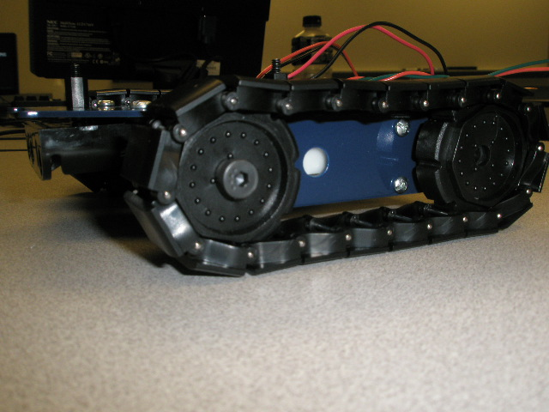
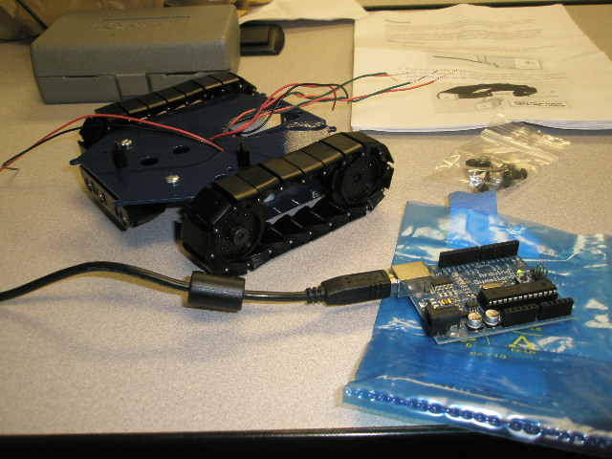
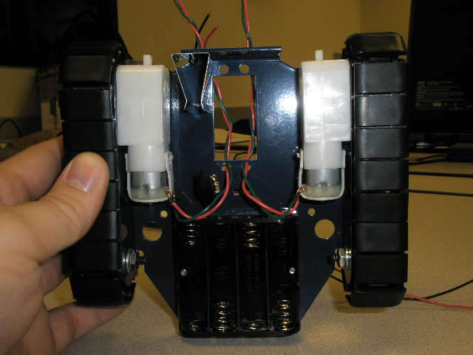
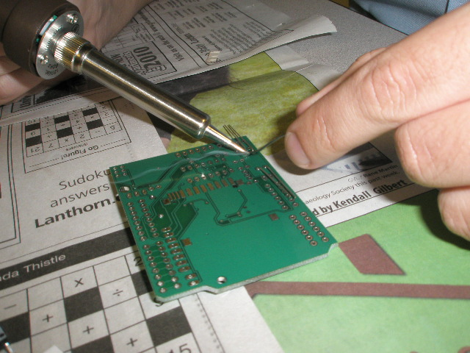
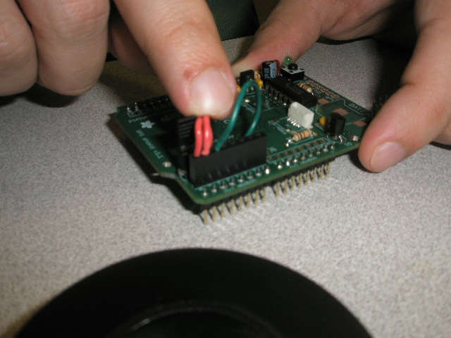
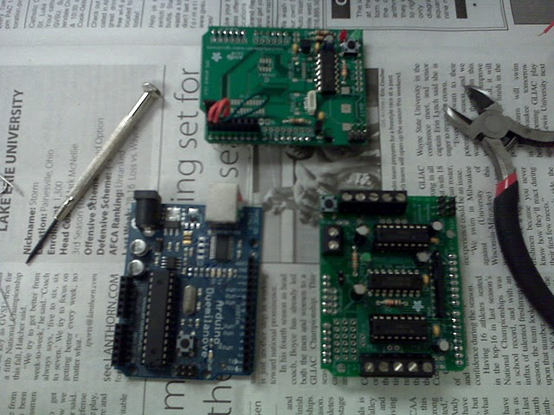
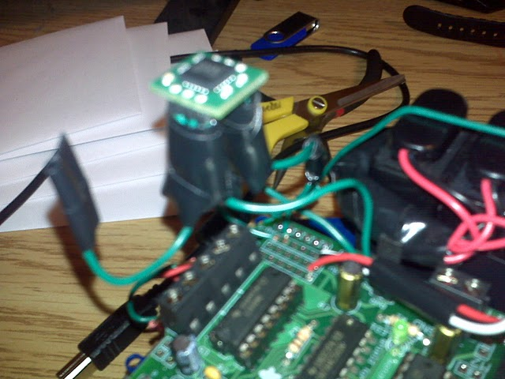
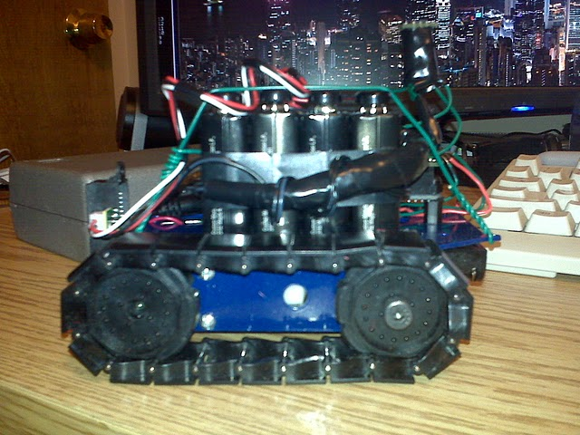
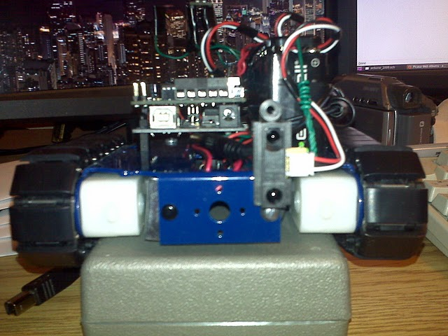
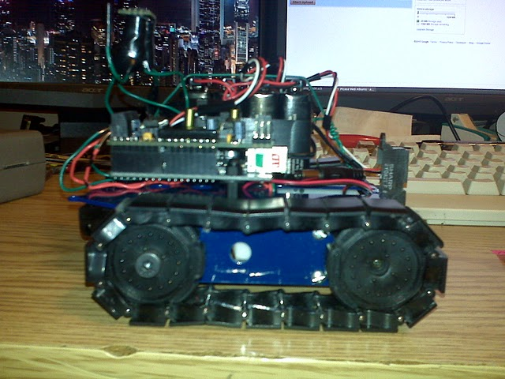
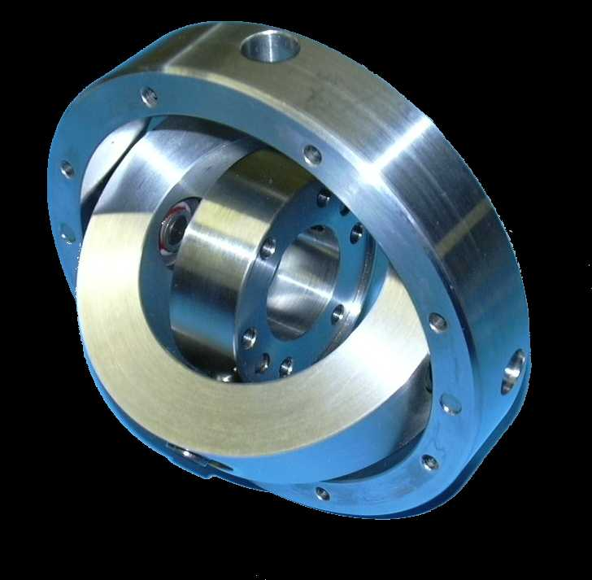
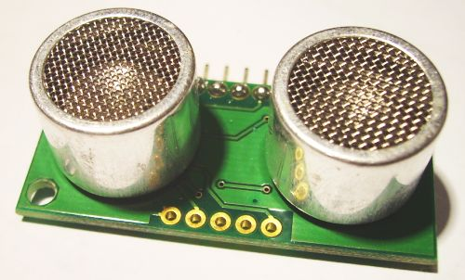
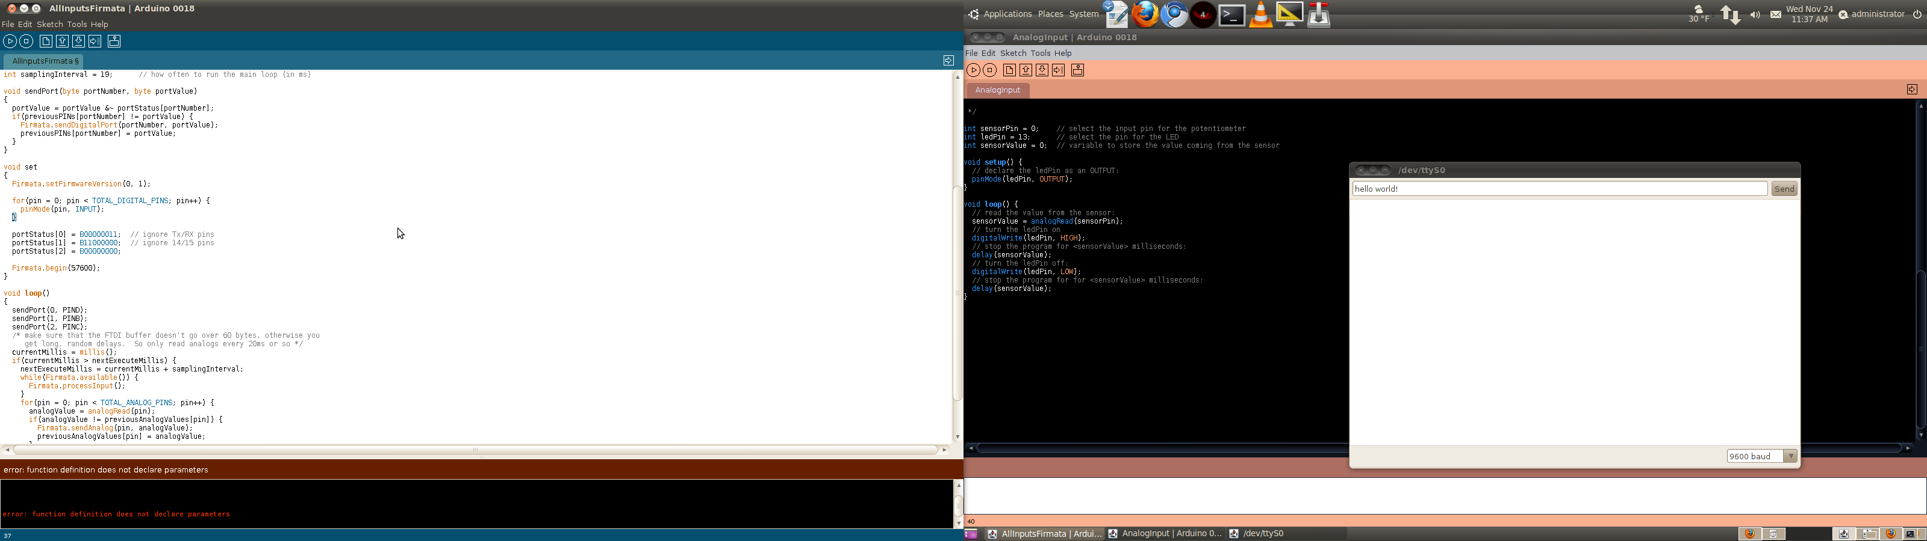
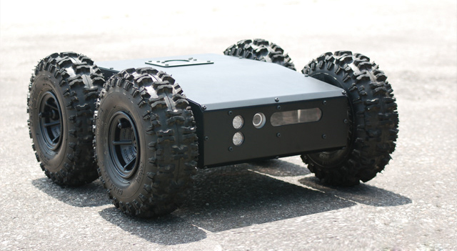
(Joshua Burkhart && Greg Braman)
Autonomous Vehicle
Digital Compass
Photos
fromHeading
/*
This function replaces the under-powered '%' function
@return - the result of (x mod m)
*/
int mod(int x, int m) {
return (x%m + m)%m;
}//end mod function
…
int left = mod((toHeading - fromHeading),360), right = mod((fromHeading – toHeading),360);
…
if(right > left){//if fromHeading is left of toHeading
//turn right in small increment
mturn(RIGHT, (left * abs(15 - numTurns)));
}//end if
else{//fromHeading is right of toHeading
//turn left in small increment
mturn(LEFT, (right * abs(15 - numTurns)));
}//end else
toHeading
Is it faster to turn right or turn left? This seems an obvious question for you and I, but a problem arises when trying to communicate this to an autonomous rover. The digital compass is capable of returning numerical heading information (0 to 360 degrees), making West 90 degrees from North, but North -90 degrees from East. To solve the problem we had to write our own modulus function, replacing the typical '%.'
Development Environment
Wish List: Parts We Couldn't Afford
  Gimbal – would have helped the compass correctly align to terrain grade, resulting in a more accurate sense of direction
  Ultrasonic Range Finder – would have assisted in collision avoidance due to increased precision of distance measurement
  Large Chassis – would have allowed us more ground clearance, giving us more opportunities to perform outdoor testing
The arduino microcontroller uses the 'processing' language and has its own IDE. Features include:
serial monitor
example programs
code verification
hassle-free code pushing to the arduino
Download free at “http://www.arduino.cc/en/Main/software”

