Slide 1
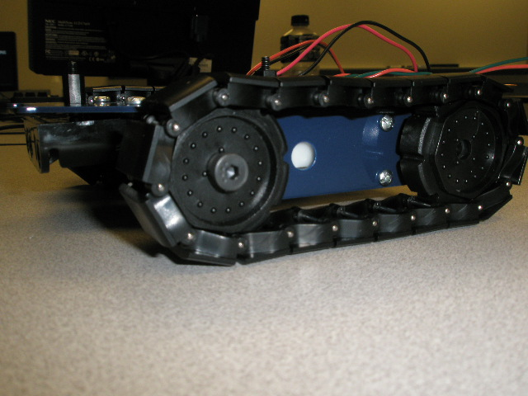
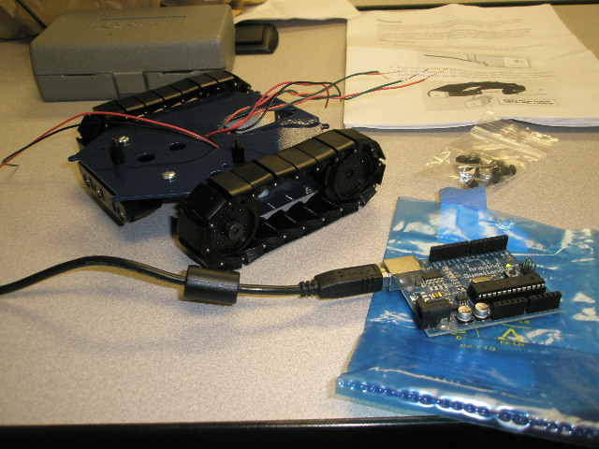
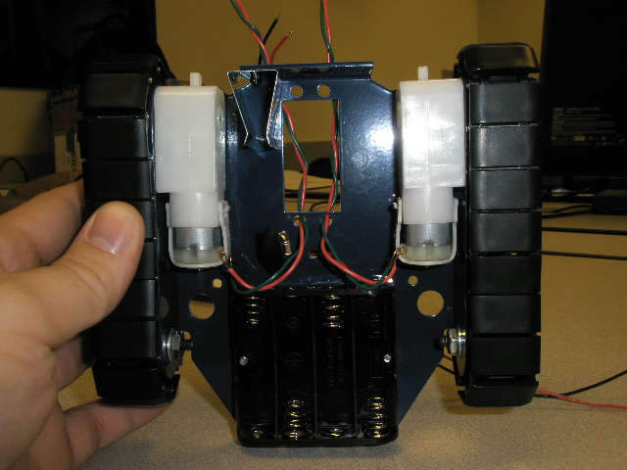
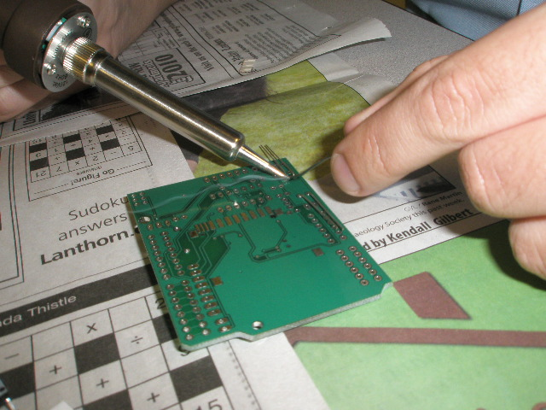
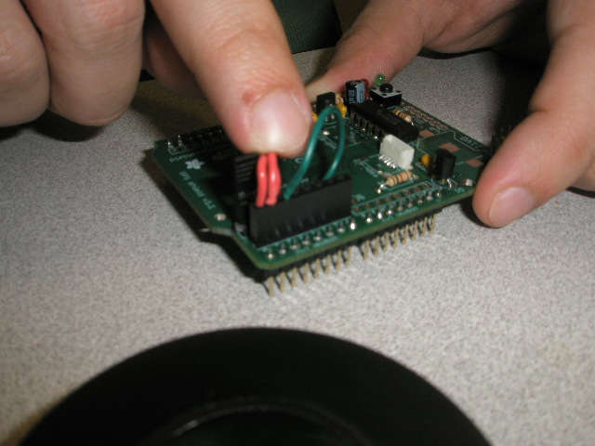
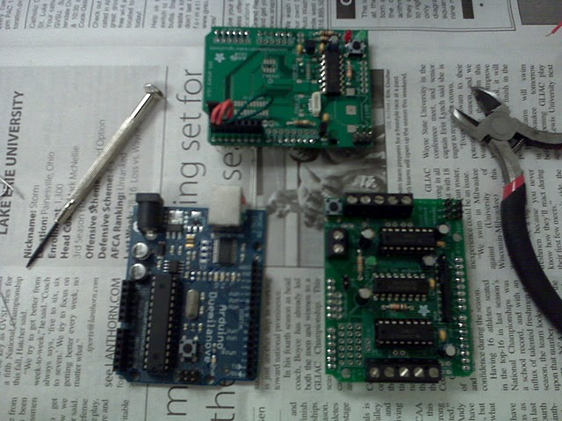
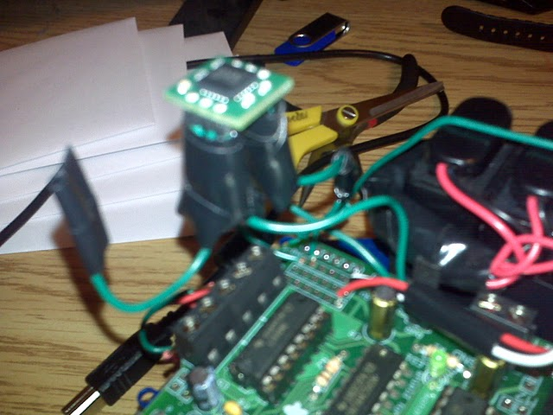
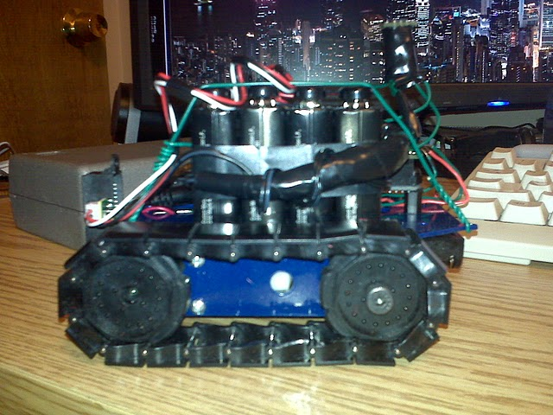
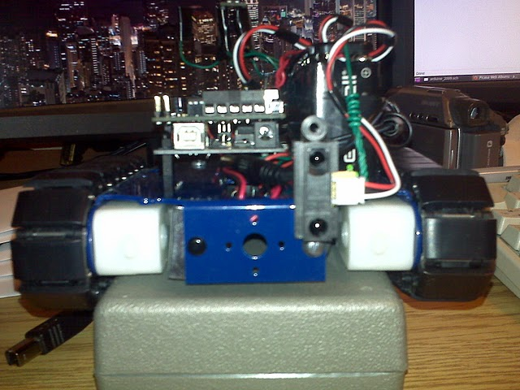
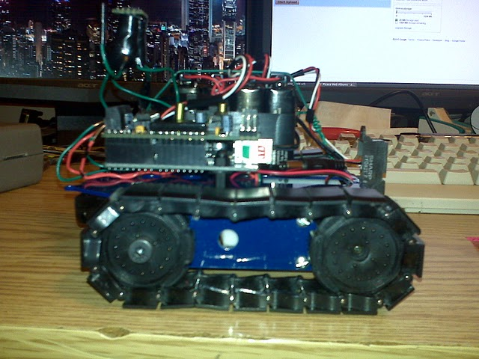
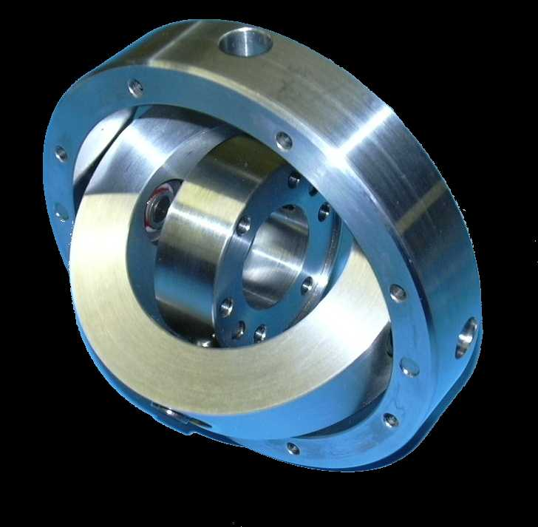
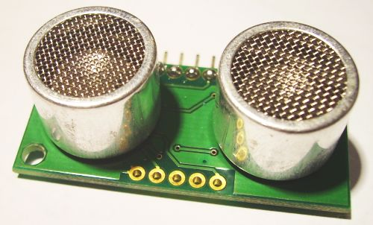
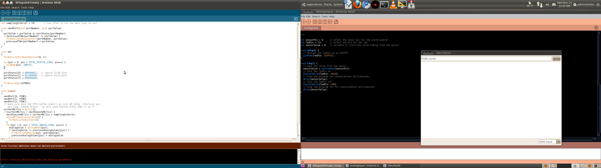
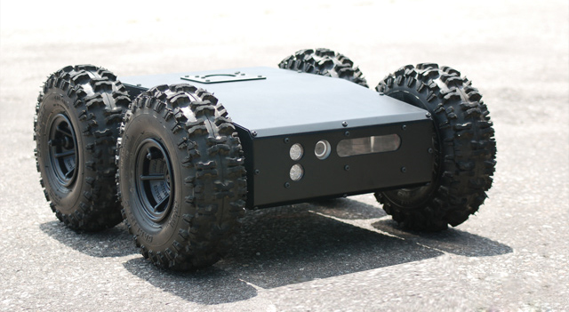
(Joshua Burkhart && Greg Braman)
Autonomous Vehicle
Summary
Digital Compass
Photos
The goal of this project was to create an autonomous vehicle that could navigate itself to predetermined GPS way-points by using several key pieces of hardware:
An Arduino Platform
A digital compass
A GPS receiver
Small electric motors
In addition to these pieces of hardware, an optoelectronic device was added to the device in order to provide collision avoidance.
/*
This function replaces the under-powered '%' function
@return - the result of (x mod m)
*/
int mod(int x, int m) {
return (x%m + m)%m;
}//end mod function
…
int left = mod((toHeading - fromHeading),360), right = mod((fromHeading – toHeading),360);
…
if(right > left){//if fromHeading is left of toHeading
//turn right in small increment
mturn(RIGHT, (left * abs(15 - numTurns)));
}//end if
else{//fromHeading is right of toHeading
//turn left in small increment
mturn(LEFT, (right * abs(15 - numTurns)));
}//end else
fromHeading
Implementation
The vehicle was built on a tracked chassis with one DC motor controlling each track.
Each motor has the ability to turn both forward and backward.
The motors are wired to a 'motor shield' that acts as an interface between the motors and the Arduino.
A digital compass provides directional readings to the Arduino through digital communication.
A 'GPS shield' provides NMEA coordinates to the Arduino through serial communication.
An optoelectronic device provides distance readings through voltage readings. (voltage indirectly maps to distance)
toHeading
Is it faster to turn right or turn left? This seems an obvious question for you and I, but a problem arises when trying to communicate this to an autonomous rover. The digital compass is capable of returning numerical heading information (0 to 360 degrees), making West 90 degrees from North, but North -90 degrees from East. To solve the problem we had to write our own modulus function, replacing the typical '%.'
Select Source Code (full source at “http://www.github.com/joshuagburkhart/Autonomous-Vehicle-GVSU”)
Development Environment
Wish List: Parts We Couldn't Afford
  Gimbal – would have helped the compass correctly align to terrain grade, resulting in a more accurate sense of direction
  Ultrasonic Range Finder – would have assisted in collision avoidance due to increased precision of distance measurement
  Large Chassis – would have allowed us more ground clearance, giving us more opportunities to perform outdoor testing
/*
Begin continuous loop
*/
void loop(){
int k,j;
double dir;
for(k = 0; k < 10; k++){ //go through the lat and long arrays
setCurWayPoint(); //update the current waypoint
while(desiredWayPointNotReached(k)){ //while not desired waypoint has not been reached
while(getIrReading(10,10) < IR_TOLERANCE){ //while rover is not too close to an object
setCurWayPoint(); //update the current waypoint
dir = calcDirFromGPS(k); //calculate the direction from the current waypoint to the desired waypoint
setCurHeading(0); //set the current heading
turnToHeading(dir); //turn the rover from the current heading to dir heading
straight(AHEAD,250,50);
}//end while
//begin evasive maneuvers
straight(BACK,255,500); //go straight back
stp(0); //stop
turnTillClear(200); //turn until there is nothing blocking the rover's path
for(j = 0; j < 10; j++){ //for a limited amount of time
if(getIrReading(10,10) < IR_TOLERANCE){ //check that nothing is infront of rover
stp(0); //stop
break;
}
straight(AHEAD,250,50); //travel straight
}//end for
}//end while
delay(5000);
}//end for
}//end loop function
void turnTillClear(int irThresh){
int irVal;
do{
mturn(emergencyDir,100);
irVal = getIrReading(10,10);
} while(irVal > irThresh); //end do while
emergencyDir = mod(emergencyDir + 1,2); //switch emergencyDir btwn RIGHT & LEFT
}//end turnTillClear function
/*
This function reads from the gps and sets the waypoint
*/
void setCurWayPoint(void){
int x = -1, //this value is the lat trigger code for gps
y = -2; //this value is the lon trigger code for gps
double tmp,
lat = 42.9633333, //Grand Rapids' latitude is 42.9633333
lon = -85.6680556; //Grand Rapids' longitude is -85.6680556
Serial.print(x); //send the lat trigger code to gps
delay(1000); //wait for response
if(Serial.available() > 0){ //if the gps responded to trigger
tmp = Serial.read(); //expect a value like "429633333"
lat = (double) (tmp / (double) 10000000); //this will be wrong if tmp is
}//end if
Serial.print(y); //send the lon trigger code to gps
delay(1000); //wait for response
if(Serial.available() > 0){ //if gps responded to trigger
tmp = Serial.read(); //expect a value like "-856680556"
lon = (double) (tmp / (double) 10000000); //this will be wrong if tmp is
}//end if
curWayPoint[0] = lat;
curWayPoint[1] = lon;
}//end setCurWayPoint function
/*
This function returns the current latitude of the device
@return - the current latitude
*/
double getCurrentLat(){
return curWayPoint[0];
}//end getCurrentLat function
/*
This function returns the current longitude of the device
@return - the current longitude
*/
double getCurrentLong(){
return curWayPoint[1];
}//end getCurrentLong function
/*
Travel straight while ir sensor reads acceptable distances
@param n - the number of samples to take
@param msecsi - the amount of miliseconds to wait
@param direc - the direction to travel (AHEAD or BACK)
@param spd - the speed at which to travel (0-255)
@param msecss - the number of miliseconds to spend traveling
@param reps - max times to execute loop or -1 for infinity
*/
void safeStraight(int n, int msecsi,int direc,int spd,int msecss,int reps,double dir){
int reset = 10,
x = reps;
while(getIrReading(n, msecsi) < IR_TOLERANCE || x == 0){//while we're not close to anything
if(reset == 0){
reset = 10;
setCurHeading(0);
turnToHeading(dir);
}//end if
straight(direc,spd,msecss);
reset--;
x--;
}//end while
}//end safeStraight function
/*
This function retuns false if device is not near its next desired waypoint
@return - whether or not the device is near waypoint
*/
boolean desiredWayPointNotReached(int wayPoint){
if(distFromWayPoint(wayPoint) < GPS_TOLERANCE){
return false;
}//end if
return true;
}//end desiredWayPointNotReached function
/*
This function calculates the distance from the next waypoint
@param wayPoint - the next waypoint
@return - the distance from the next waypoint
*/
double distFromWayPoint(int wayPoint){
double y1 = getCurrentLat(),
y2 = latArray[wayPoint],
x1 = getCurrentLong(),
x2 = longArray[wayPoint];
Serial.print("Y1 is -------> ");
Serial.print(y1);
Serial.print("\n");
Serial.print("Y2 is -------> ");
Serial.print(y2);
Serial.print("\n");
Serial.print("X1 is -------> ");
Serial.print(x1);
Serial.print("\n");
Serial.print("X2 is -------> ");
Serial.print(x2);
Serial.print("\n");
Serial.print("distance is -------> ");
Serial.print(sqrt(pow((y1 - y2),2) + pow((x1 - x2),2)));
Serial.print("\n");
Serial.print("Y1 - Y2 is -------> ");
Serial.print(y1 - y2);
Serial.print("\n");
Serial.print("X1 - X2 is -------> ");
Serial.print(x1 - x2);
Serial.print("\n");
double distance = sqrt(pow((y1 - y2),2) + pow((x1 - x2),2));//distance formula
Serial.print("distFromWayPoint returns ");
Serial.print(distance);
Serial.print("\n");
return distance;
}//end distFromWayPoint function
/*
This function calculates the direction of the next waypoint
@param wayPoint - the next waypoint
@return - the distance from the next waypoint
*/
double calcDirFromGPS(int wayPoint){
double y1 = getCurrentLat(),
y2 = latArray[wayPoint],
x1 = getCurrentLong(),
x2 = longArray[wayPoint];
double angle = atan2((y2 - y1),(x2 - x1)),//gives +/- angle from x plane
degree = (angle * 180) / 3.14, //convert radiens to degrees
bearing = mod(360 - degree,360), //gives direction as 0 - 359 degrees
mbearing = mod(bearing + 180,360); //maps the direction correctly for compass
Serial.print("angle is --------------> ");
printDouble(angle,10000000);
Serial.print("\n");
Serial.print("degree is --------------> ");
printDouble(degree,10000000);
Serial.print("\n");
Serial.print("bearing is --------------> ");
printDouble(bearing,10000000);
Serial.print("\n");
Serial.print("mbearing is --------------> ");
printDouble(mbearing,10000000);
Serial.print("\n");
return mbearing;
}//end calcDirFromGPS function
/*
This function sets and returns the voltage read by analog pin 0
@return - the integer interpretation of analog 0's volatage
*/
int ir(){
irReading = analogRead(0);
return irReading;
}//end ir function
/*
This function returns true if the device is on course
@return - whether or not the device is on course;
*/
boolean onCourse(){
return abs(fromHeading - toHeading) < CMP_TOLERANCE;
}//end onCourse function
/*
This function returns an average reading from ir sensor
@param n - the number of samples to take
@param msecs - the amount of miliseconds to wait
@return - the average reading of the samples
*/
int getIrReading(int n, int msecs){
int p,
avg = 0;
for(p = 0; p < n; p++){
delay(msecs);
avg = (avg + ir());
}//end for
return (avg / n);
}//end getIrReading function
/*
This function replaces the under-powered '%' function
@return - the result of (x mod m)
*/
int mod(int x, int m) {
return (x%m + m)%m;
}//end mod function
/*
Turn the vehicle toward the direction
@toHeading - the direction in which to turn
*/
void turnToHeading(int ltoHeading){
int numTurns = 15;
fromHeading = (avgHeadingValue / 10);//divide for most significant digits of heading
toHeading = ltoHeading;
while((abs(fromHeading - toHeading) > CMP_TOLERANCE)){//while current heading is not "close" to toHeading
printHeading();
int left = mod((toHeading - fromHeading),360),
right = mod((fromHeading - toHeading),360);
Serial.print("ir reading ----------------> ");
Serial.print(ir());
Serial.print("\ntoHeading: ");
Serial.print(toHeading);
Serial.print("\nfromHeading ------> ");
Serial.print(fromHeading);
Serial.print("\nright: ");
Serial.print(right);
Serial.print("\nleft: ");
Serial.print(left);
Serial.print("\n");
if(right > left){//if fromHeading is left of toHeading
Serial.print("Turn left!\n");
//turn right in small increment
mturn(LEFT, (left * numTurns) + 50);
}//end if
else{//fromHeading is right of toHeading
Serial.print("Turn right!\n");
//turn left in small increment
mturn(RIGHT, (right * numTurns) + 50);
}//end else
//reset current heading
setCurHeading(10); //wait 10ms between readings
fromHeading = (avgHeadingValue / 10);
numTurns = (numTurns - 1);
if(numTurns < 0){
numTurns = 0;//we don't want negative turns
}//end if
}//end while
}//end turnToHeading function
/*
Read the 2 heading bytes, MSB first
The resulting 16 bit word is the compass heading in 10th's of a degree
ex: a heading of 1345 == 134.5 degrees
do 10 times and divide for avg heading
@msecs - the number of miliseconds to wait between compass readings
*/
void setCurHeading(int msecs){
avgHeadingValue = 0;
int k;
for(k = 0; k < 10; k++){
getCmpData();
Wire.requestFrom(slaveAddress, 2); //request 2 byte heading (MSB comes first)
i = 0;
while(Wire.available() && i < 2)
{
headingData[i] = Wire.receive();
i++;
}//end while
headingValue = headingData[0]*256 + headingData[1]; //put MSB and LSB together
avgHeadingValue = abs(avgHeadingValue + headingValue);
delay(msecs);
}//end for
avgHeadingValue = (avgHeadingValue / 10);
}//end setCurHeading function
/*
Travel straight
@direction - the direction to travel (AHEAD or BACK)
@speed - the speed at which to travel (0-255)
@msecs - the number of miliseconds to spend traveling
*/
int straight(int direction,int speed,int msecs){
if(speed > 0 && speed < 256){//if the speed is valid
rmotor.setSpeed(speed);
lmotor.setSpeed(speed);
if(direction == AHEAD){
rmotor.run(FORWARD);
lmotor.run(FORWARD);
delay(msecs);
}//end if
else if(direction == BACK){
rmotor.run(BACKWARD);
lmotor.run(BACKWARD);
delay(msecs);
}//end else if
else{
Serial.print("Attention: direction entered '");
Serial.print(direction);
Serial.print("' invalid.\n");
return 1;
}//end else
}//end if
else{//if the speed is invalid
Serial.print("Attention: speed entered '");
Serial.print(speed);
Serial.print("' invalid.\n");
return 1;
}//end else
return 0;
}//end straight function
The arduino microcontroller uses the 'processing' language and has its own IDE. Features include:
serial monitor
example programs
code verification
hassle-free code pushing to the arduino
Download free at “http://www.arduino.cc/en/Main/software”

