Slide 1
UWLES Survey Walkthrough

Slide 2

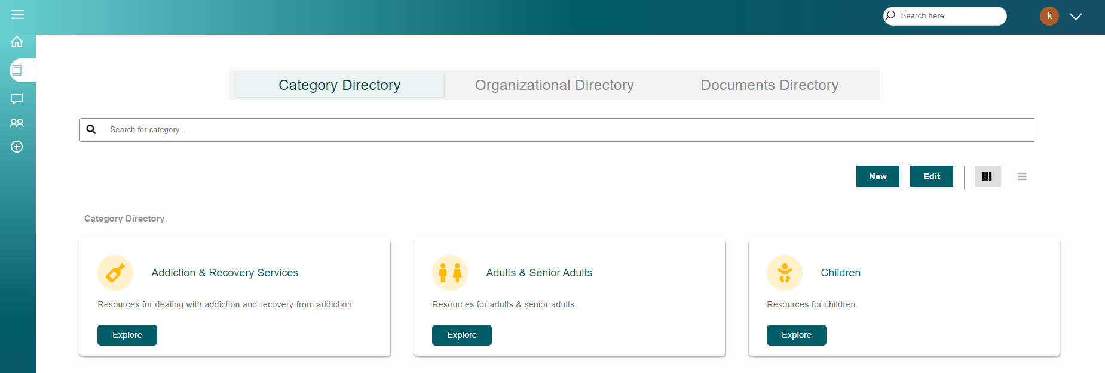
1) Adding Organizational Data
To start, go to the resource directory. To get to the resource directory, click the book icon on the left:
Now you should see a screen that looks something
like this:

Slide 3

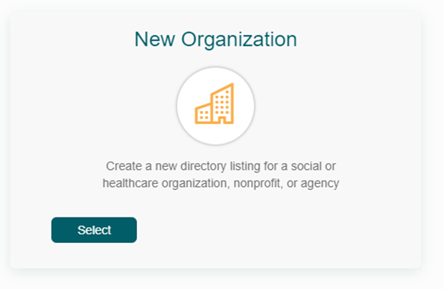
1) Adding Organizational Data
Next, click the “new” button:
Then under New Organization click “Select”:

Slide 4
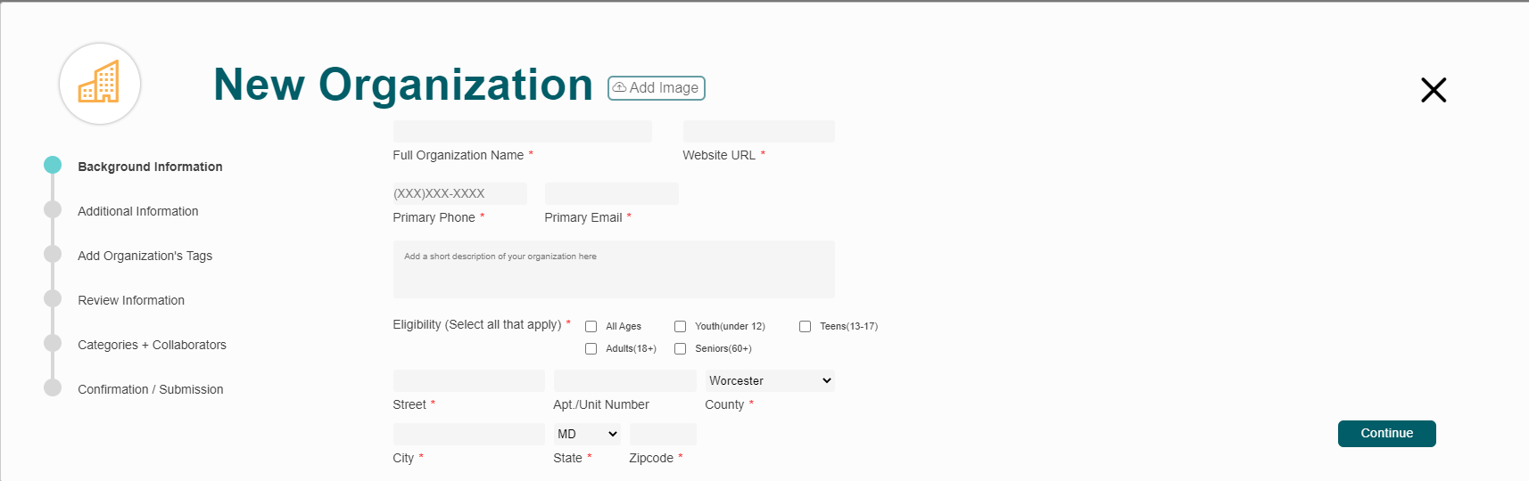
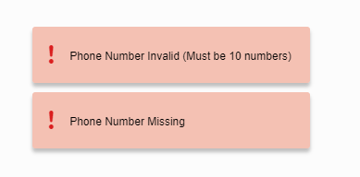

1) Adding Organizational Data
Now you will see this window:
From here please fill out the information needed. The fields required are those marked with a red asterisk (*). If you make an error, or miss a field, there will be a red box that will tell you what the error is. The circle next to the section you are on, on the left, will also be red and show you how many errors there are:

Slide 5

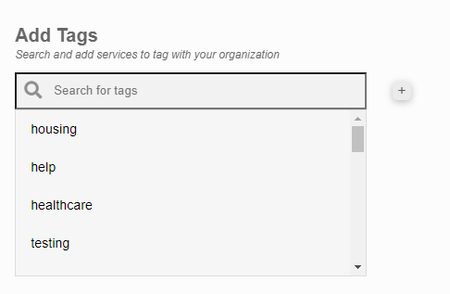
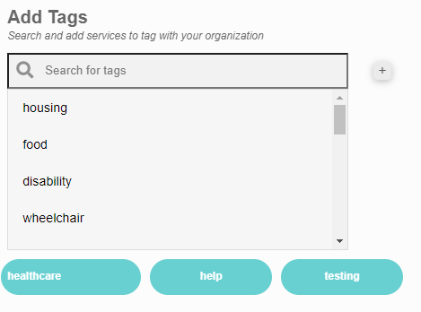
1) Adding Organizational Data
To move on pass each section, click the Continue button:
After you get past the “Background Information” and “Additional Information Section” you will move on to adding Tags, which you can see here:
To add tags, simply click on the tag you want. If you want to add new tags that are not in the system, click on the + button to add new tags.
Once you are done, you will see the tags you selected below, like this:

Slide 6
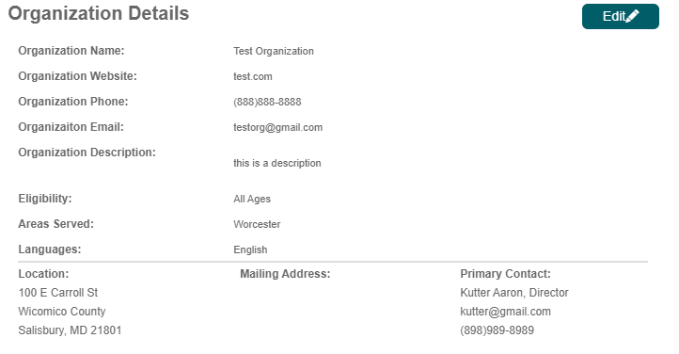
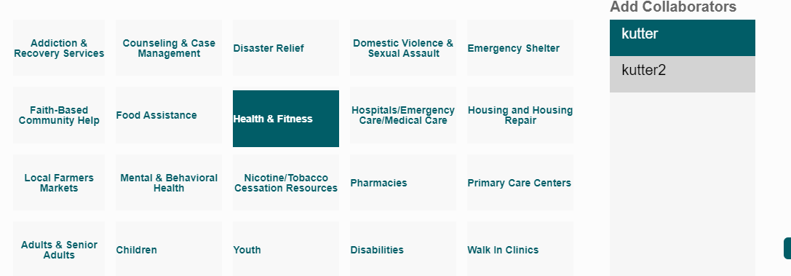
1). Adding Organizational Data
The next section is the review information section, which will show you all the information you have put in:
The second to last section is the categories + collaborators section. To click on a category, or collaborator, simply click on it and it will be highlighted in blue:

Slide 7
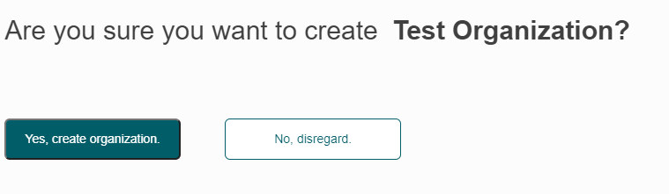
1) Adding Organizational Data
Finally, you will be presented the option of either adding the organization, or not:
Now that you have created an organization, please fill out the first section of the Google Form.

Slide 8

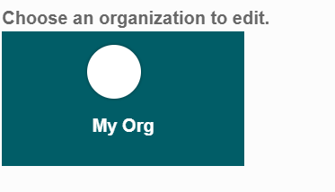

2) Editing Organizational Data
To edit your organization, click on the edit button:
Next, click on the organization you just created, and select continue:

Slide 9


2) Editing Organizational Data
Now you will be presented with a window identical to what you just saw in the adding organizational data section.
Now edit the information that you want to change. For example here I will change the phone number:
From to

Slide 10
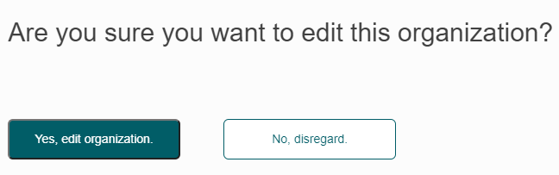
2) Editing Organizational Data
Once you are done, you will be presented the option of either editing the organization, or not:
Now that you have created an organization, please fill out the second section of the Google Form.

Slide 11
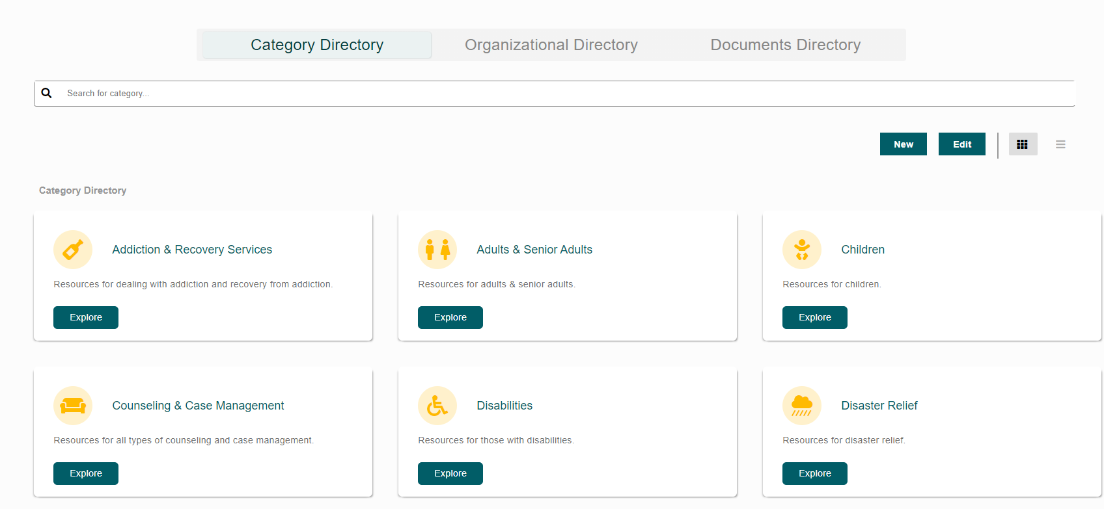
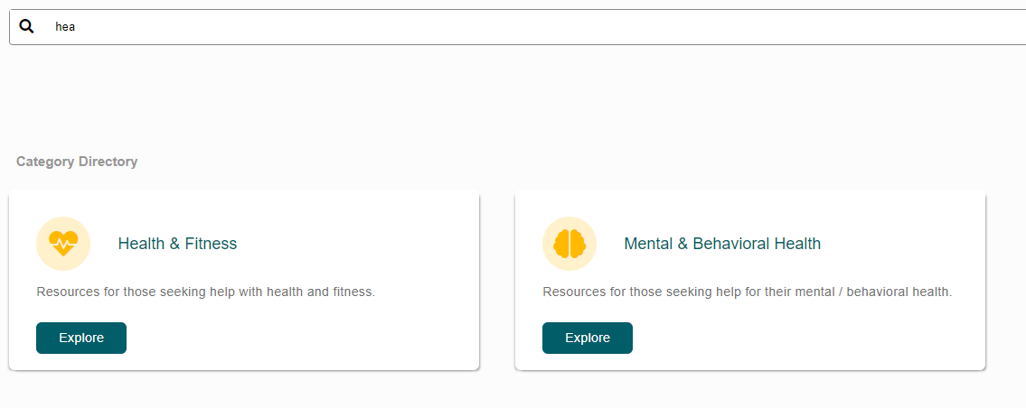
3) Finding Organizations
For the first way to find your organization, make sure you are in the Category Directory, which looks like this:
Next, find a category where you put your organization in, which you can do by using the search bar to look for categories easier:

Slide 12
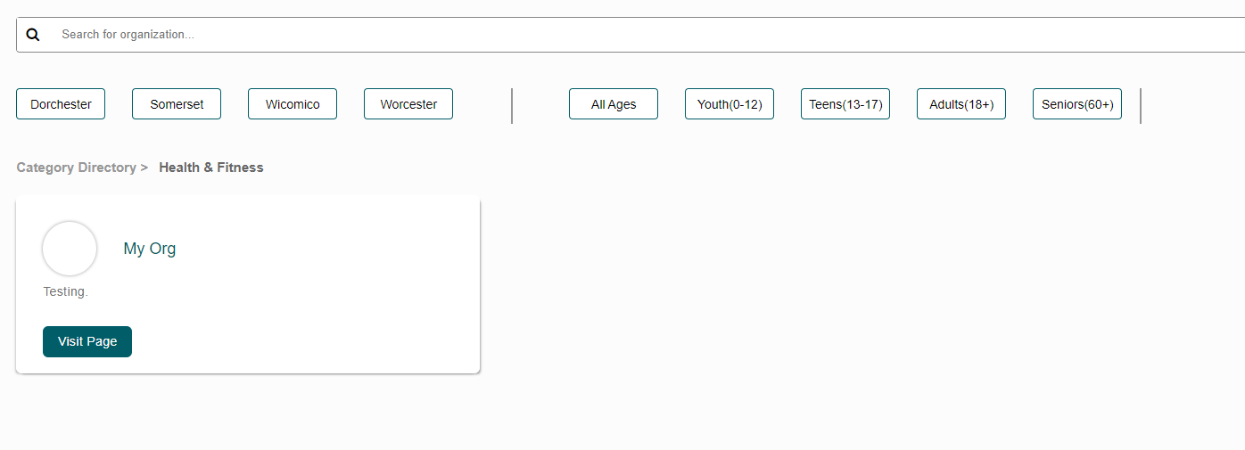
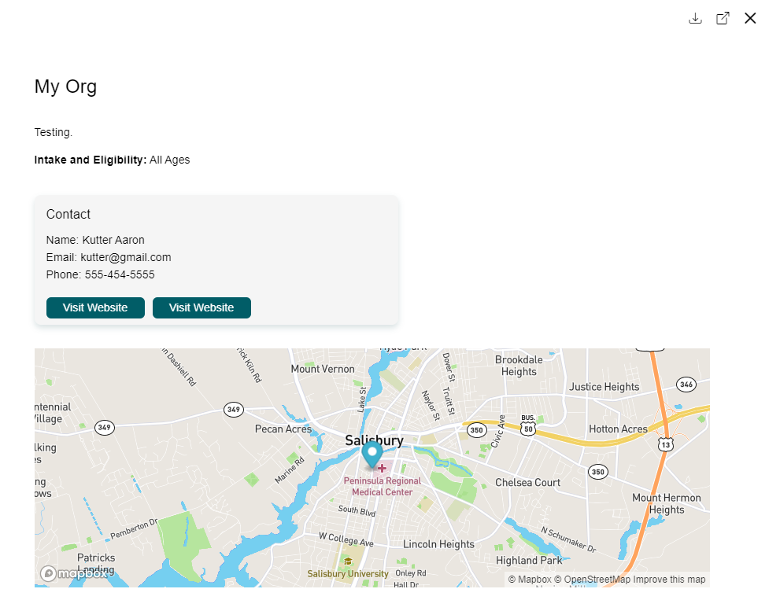
3) Finding Organizations
Once you find the category you want, click on the explore button, and you will see a page that has all the organizations in that category, like this:
Now look for your organization, either by scrolling or using the search bar (or county and age filters if you choose). Once you find it, click on visit page, and you will see this screen:

Slide 13
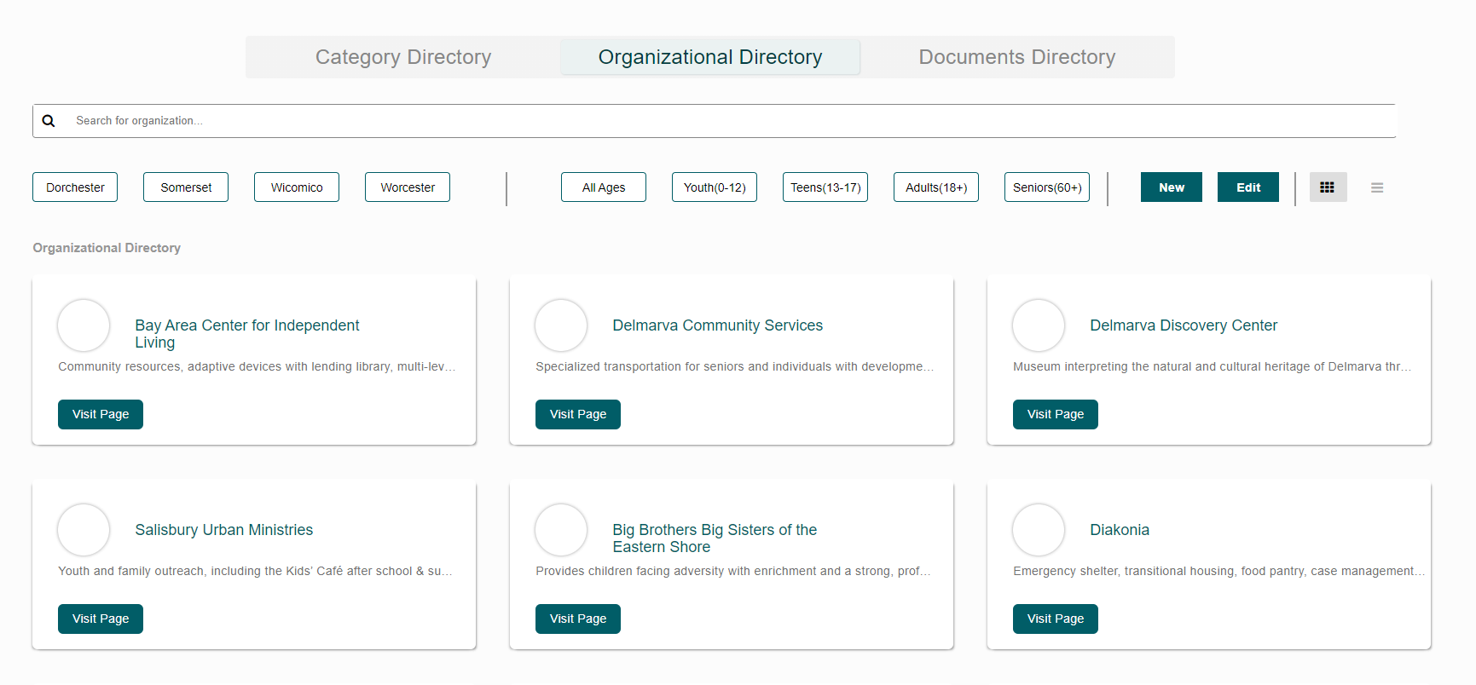
3) Finding Organizations
The other way to find your organization is through the organizational directory, so click on “organizational directory” at the top:
From here you will see a screen that looks like this:

Slide 14
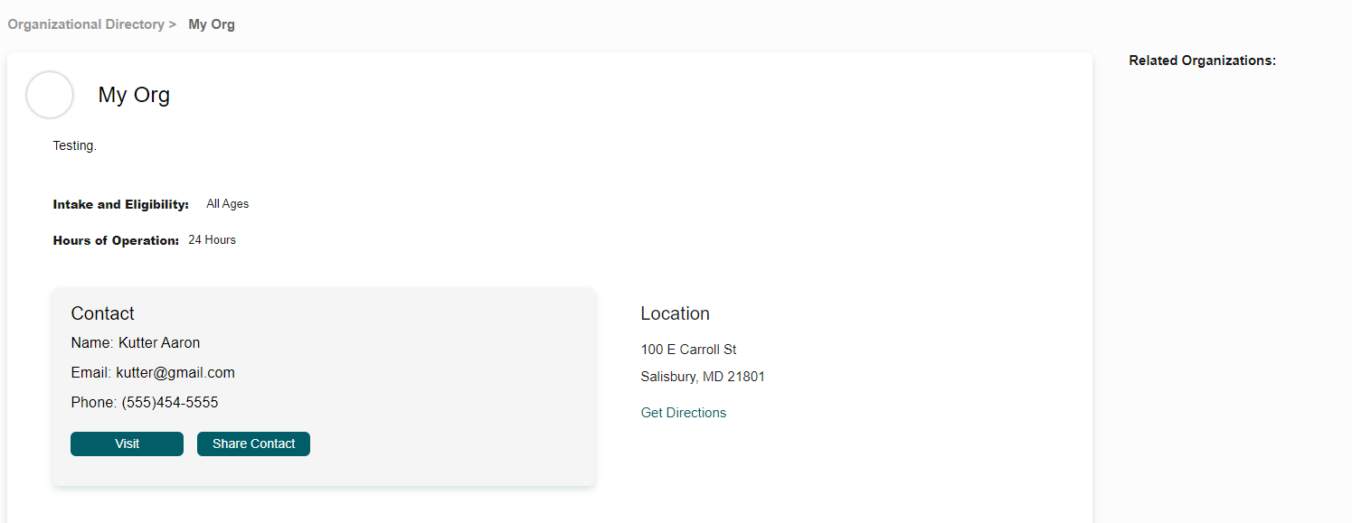
3) Finding Organizations
Find your organization and click on visit page, and you will see a screen that looks like this:
This page will have more information, so scroll to the bottom to see it all!
Now that you have found your organization, please fill out the third section of the Google Form.

Slide 15
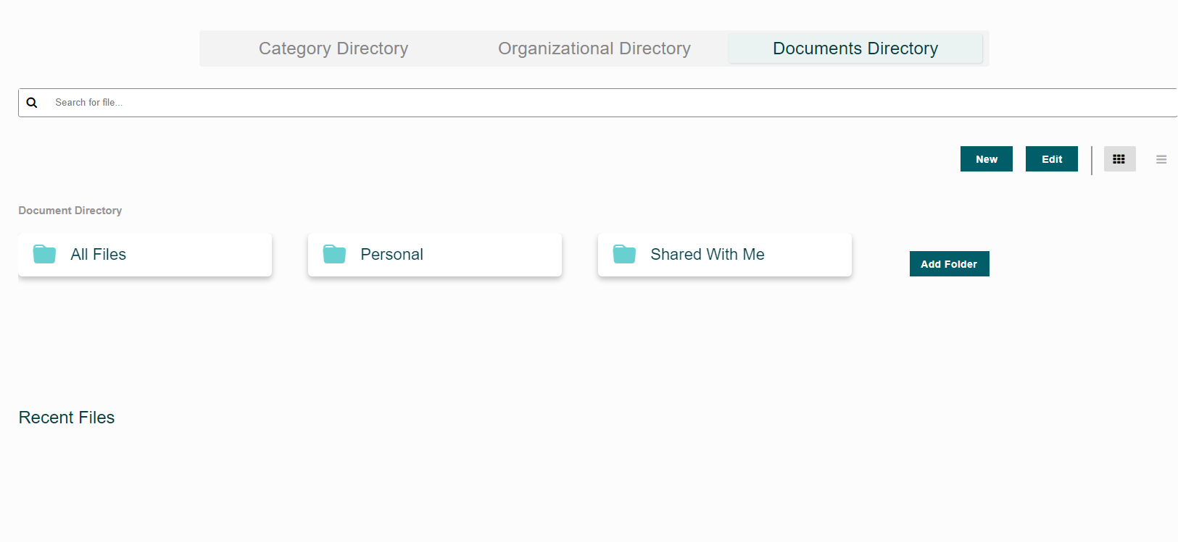
4) Adding Folders + Documents
Now we will add folders + documents. To start, go to the Documents Directory by clicking “Documents Directory” at the top:
You will see a page that looks like this:

Slide 16

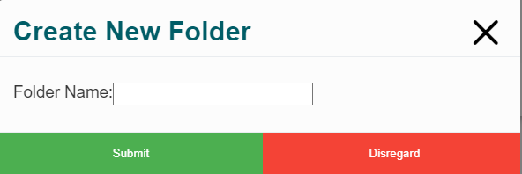
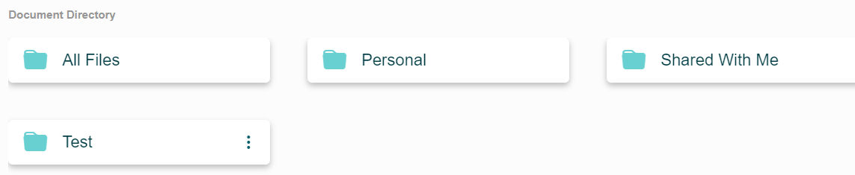
4) Adding Folders + Documents
Now to add a new folder, click add folder:
You will then see this screen:
Put the name you want for the folder, and hit submit, then you will see the folder in your folder list:

Slide 17
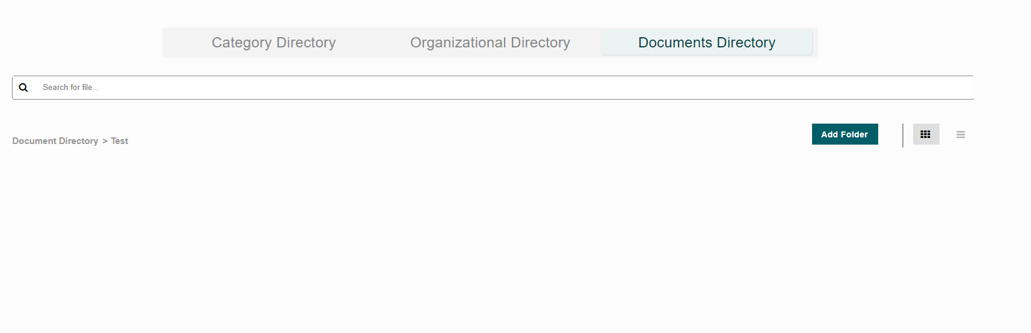
4) Adding Folders + Documents
Now click on the new folder you created, and you will see a blank page like so:
Now, you can either add a new folder, or not. After you are done click on “Documents Directory” again to go back.

Slide 18

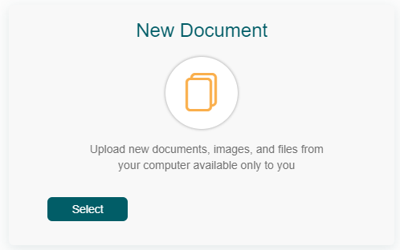
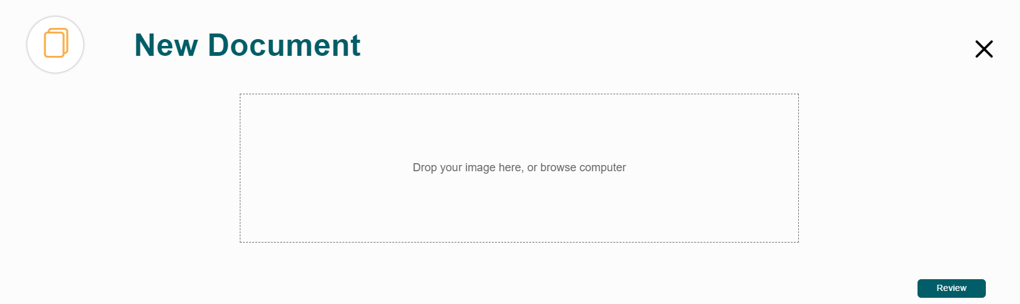
4) Adding Folders + Documents
Once you are back in the document's directory, click the “new” button:
Then click “Select” under New Document:
Once you have do so, you will see this:

Slide 19
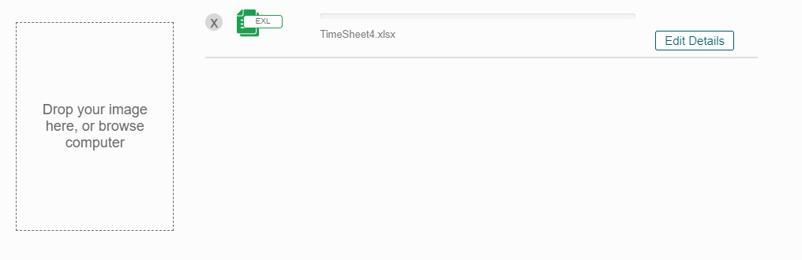
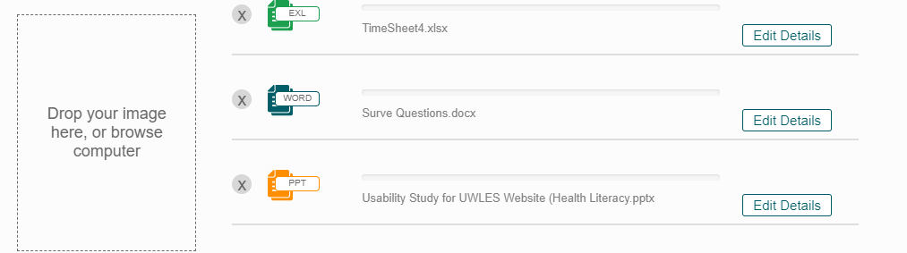
4) Adding Folders + Documents
From here, either click on the box to select which document to upload, or drag and drop the file. Once you do, the box will shift to the left and the document you uploaded will be displayed on the side, like this:
Now you can add as many documents as you would like, like so:

Slide 20
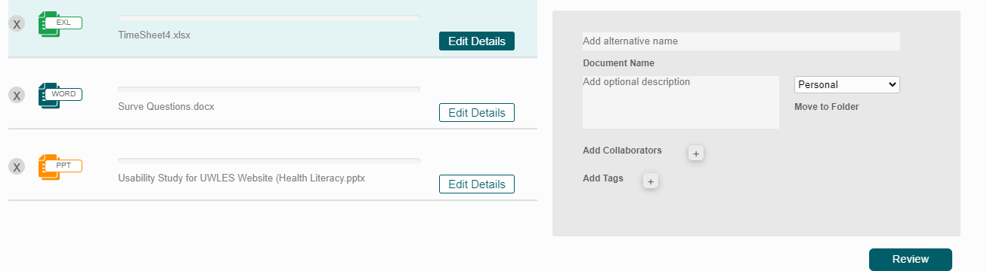
4) Adding Folders + Documents
If you click on the “edit details button” you will see this:
From here, feel free to edit any of the details you wish. Also make sure that the file is being uploaded to where you want it to go.

Slide 21

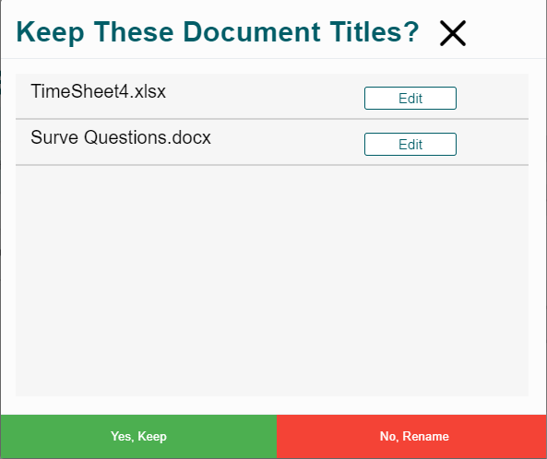
4) Adding Folders + Documents
Once you are done selecting the documents you wish to upload, click the “review” button:
Once you do, you will see a screen asking you to confirm the given document names, like this:
If you are comfortable with the names, click yes, if not, click no (or edit) and rename the documents until you are happy with their names.

Slide 22

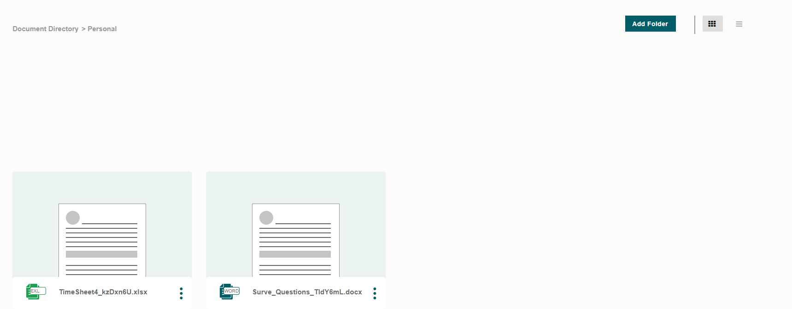
4) Adding Folders + Documents
Once you have hit yes on the previous screen, the previous “review” button will now say “Submit”. Once you are sure of everything you have, click it to upload the documents:
Now, go to whichever folder you put your documents in, and you will see your documents:

Slide 23
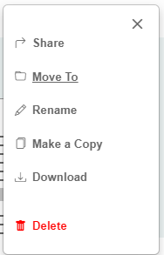
4) Adding Folders + Documents
From here you can click on the ellipses as shown here
Once you have clicked them, you will see various options for your files. Feel free to mess around with them to see what they do:
Now that you have found your organization, please fill out the final section of the Google Form.
Thank you for your participation, have a great rest of your day!

