Slide 1

mpi4py: Parallelisation in Python
Josh Crawford
S4S, 31st March 2023

Slide 2

Context
We have a system of equations which we need to solve by $χ^{2}$ minimisation.
$$\left(\begin{matrix}R_{1} \\ R_{2} \\ R_{3} \\ R_{4}\end{matrix}\right)=\left(\begin{matrix}c_{11} & c_{12} \\ c_{21} & c_{22} \\ c_{31} & c_{32} \\ c_{41} & c_{42}\end{matrix}\right)×\left(\begin{matrix}F_{1} \\ F_{2}\end{matrix}\right)$$
But, we solve this same system over 200 bootstrap samples, for up to 17 different $Q^{2}$ values.
That’s a total of $200×17=3400$ optimisations we need to perform.
This is a hideously slow process. But I want results NOW. How do I get them?

Slide 3
The Need for Parallelisation
How do I solve my problem faster?
Can I simultaneously perform a bunch of tasks?
Parallel computing is a way of speeding up your code by making full-use of your computer’s hardware.
However, it comes with its own set of rewards, challenges and terminology.
When should I parallelise?
You have a calculation you need to perform regularly, that is slow and (ideally) is embarrassingly parallelisable.
You have profiled your code and identified the bottleneck to be a calculation step, rather than file I/O.

Slide 4
Why Should I Parallelise?
The problem at hand creates or requires too much data for a single machine.
The sun would explode before the computation would finish.
The algorithm is embarrassingly parallelisable.
The physics itself cannot be simulated at all with smaller resources.

Slide 5
How to Measure Computation Size
The notion of size in computing is often referred to as the scale.
However measuring computation scale can be a bit ambiguous.
We will use a simple measure:
Scale is proportional to the number of processes that are used.
You should try to scale your code up slowly and methodically.
Scalability: How easy/hard it is to go up in scale.
Run-time performance will be our measure of scalability.

Slide 6

How to Measure Computation Size
Strong Scaling:
How the run-time changes as a function of the number of processors for a fixed problem size.
We can compute the speed-up $s(P)$ as a function of the number of processors $P$:
$$s\left(P\right)=\frac{t_{1}}{t_{P}}$$
In a perfect system, doubling the number of processors would halve the run-time.
Weak Scaling:
How the run-time changes as a function of the number of processors for a fixed problem size per processor.
We compute the size up $z(P)$ :
$$z\left(P\right)=\frac{t_{1}}{t_{P}}×\frac{N_{P}}{N_{1}}$$
In a perfect system, doubling the number of processors would double the size of the problem that can be solved.

Slide 7
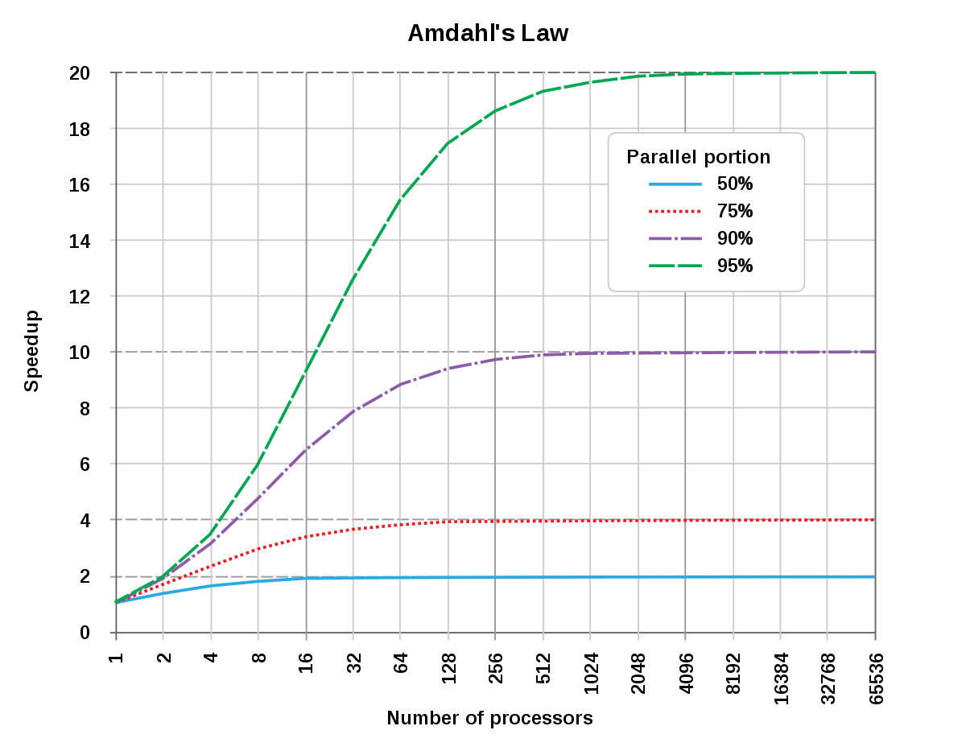

Amdahl’s Law
Both Strong and Weak scaling are constrained by Amdahl’s law.
Say that some fraction $α$ of your code cannot be parallelised. Then the maximum speed up (size up) possible using $P$ processors is then:
$$\max{s\left(P\right)}=\frac{1}{α−\frac{1−α}{P}}$$
Taking the limit as $P→∞$,
$$\sup{s\left(P\right)}=\lim_{P→∞}{\frac{1}{α−\frac{1−α}{P}}}=\frac{1}{α}$$
Say 10% of your code cannot be parallelised, then the maximum speed up you can achieve is a factor of 10.

Slide 8





WA Tourism Break: Rottnest Island
30 minute Ferry (19km) from Fremantle.
No permanent residents (except Quokkas).
Everywhere easily accessible by bike or bus.
Some of the best beaches in WA, plenty of reefs for snorkelling.

Slide 9
Problem Classification
Problems with a high degree of independence are called “Embarrassingly parallelisable”
Examples:
Summing arrays of numbers.
Monte Carlo simulations.
Rendering the Mandelbrot set.
However many types of problems do not fall into this category.
One such example is matrix inversion – every element of the inverse is dependent on every element in the original matrix.
However all is not lost, as there may be some mathematical transformations you can make to decrease the degree of dependence.
If the matrix is sparse or block-diagonal, then there are algorithms to parallelise the computation of the inverse.

Slide 10
MPI Review
MPI (Message Passing Interface) is the gold-standard for parallelisation.
MPI effectively allows for inter-process communication when running code across multiple processes.
Node 0
Node 0
Node 1
Node 2
Node 3
Nodes communicate amongst each other
Node 0
Node 1
Node 2
Node 3
Node 0

Slide 11


Essential Functions: Setting Up
Data
Initialisation:
Set up a communicator between processors.
Enumerate each process with an integer (rank).
Identify number of processes (size)
Finalisation:
Close the communicator.
$$\left(\begin{matrix}1 & ⋯ & 0 \\ ⋮ & ⋱ & ⋮ \\ 1 & ⋯ & 1\end{matrix}\right)$$

Slide 12
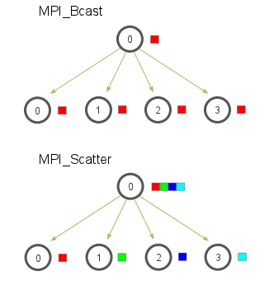
Essential Functions: Sending Data
Collective Sending Functions:
Broadcasting:
Sending the same set of data to each processor.
Scattering:
Splitting the data across all processors.
Point-to-point Sending Functions:
Send:
Send a copy of the data from one process to another process.

Slide 13
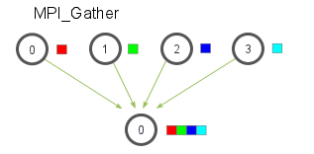
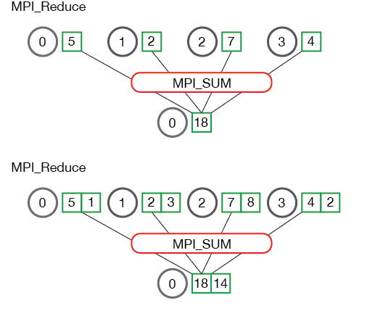
Essential Functions: Receiving Data
Collective Receiving:
Gathering:
Combines data from separate processors into a single array.
Reducing:
Similar to Gather, but performs an operation on the resulting array to collapse the array to a single value (e.g. sum, product).
Point-to-point Receiving:
Receive:
Accept data from a different process.

Slide 14


WA Tourism Break: “Down South”
3 hour drive from Perth City.
Margaret River wineries, breweries and distilleries.
Beautiful beaches and rock pools, Indijup springs pictured.
4WD tracks to more secluded beaches and surf spots.

Slide 15
A Simple Example Script
We’re going to sum an array the hard way.
How would we parallelise this problem?
Pseudo-code for Parallel Summation:
MPI Initialise.
Define array on head process.
Distribute sub-arrays to other processes.
Perform sums on sub-arrays on individual processes.
Collect sums back on head node and sum result.
MPI Finalise.

Slide 16
A Simple Example Script
Check out the script “SimpleSummation.py” on the GitHub page.
Try running for yourself on your machine.

Slide 17
Turning Up the Difficulty
Okay, summing an array isn’t that hard. Let’s do something more interesting. Let’s integrate a function over a domain.
How would we parallelise this process?
Check out the script “IntegrationExample.py” on the GitHub page.
Try running for yourself on your machine.

Slide 18
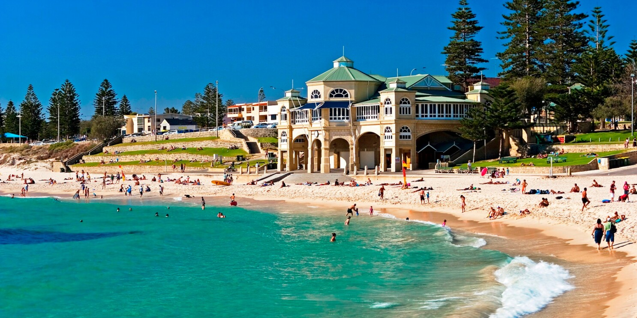

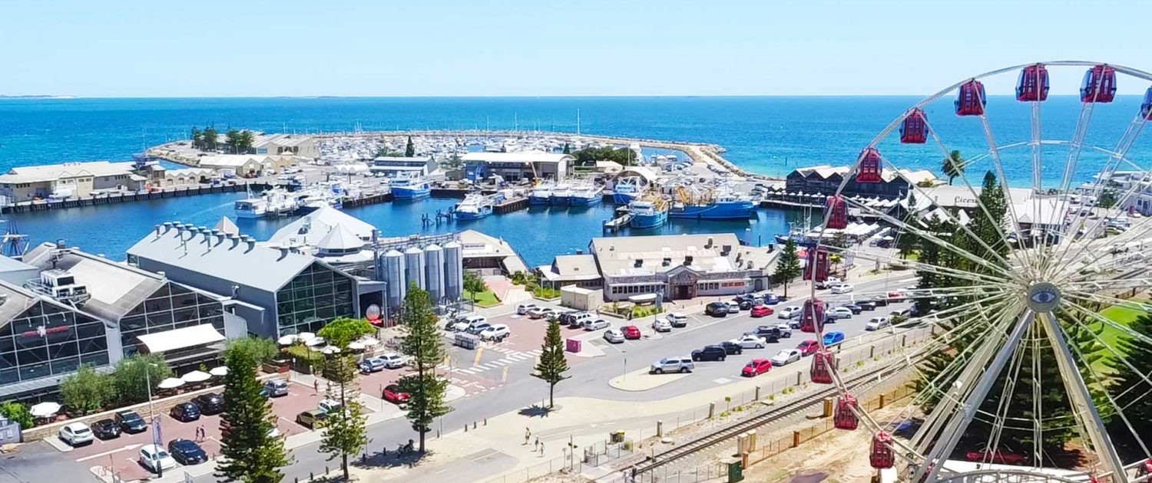
WA Tourism Break: Hot Tips for Perth
Northbridge is our “Hindley Street” but a whole suburb.
Visit for a free king hit.
Cottesloe beach is the most recognisable beach in WA.
Fishing boat harbour in Freo is a great day out.
Kings park has great views over the CBD

Slide 19

Conclusion
You now know as much as I do about parallel programming in Python.
Hopefully you can apply these skills to your projects and speed up some slow code.
Tommi should do an S4S on code profiling as a follow up.
Also visit WA

