Slide 1
Basics of Linux

Slide 2
What is Linux
“Linux is the best-known and most-used open source operating system. As an operating system, Linux is software that sits underneath all of the other software on a computer, receiving requests from those programs and relaying these requests to the computer’s hardware.”
- opensource.com

Slide 3

Linux distros

Slide 4
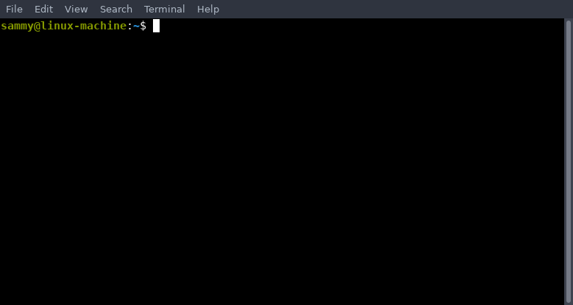
The Terminal

Slide 5
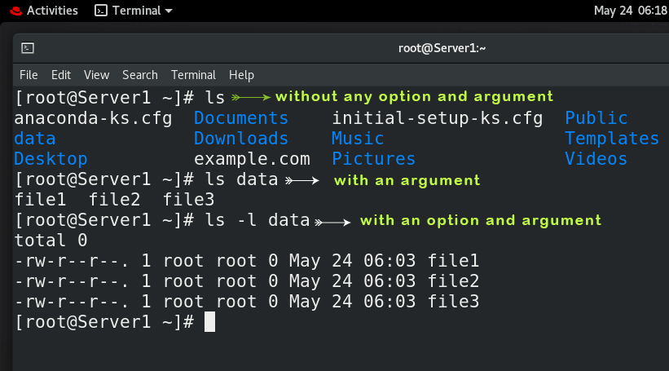
Commands, arguments, and options
The command is the first part in the command line.
Options modify the default behavior of the command.
Arguments are the inputs of the command

Slide 6
Basic Terminal Commands
clear
whoami
date
echo
exit

Slide 7
Terminal manipulation
Command Line editing
Command completion
Command History
Aliasing

Slide 8
Variables
character string to which we assign a value.
Environment / local variabls
System / shell variables

Slide 9
Variables
Variable assignment
variable=value
Variable substitution
echo $variable
Command substitution
ls $(pwd)

Slide 10
Quoting
Backslash (\)
Removes the representation done by metacharacters following it.
Single Quote (‘)
Removes the representation done by metacharacters except the single quote
Double Quotes (”)
Removes the representation done by metacharacters except the double quotes and dollar sign

Slide 11
The Filesystem Hierarchy Standard
reference describing the conventions used for the layout of Linux systems
Directory structure
/ – root directory
/bin, /home, /etc, /var

Slide 12
The Filesystem Hierarchy Standard
Pathname Classifications
Absolute
full path that specifies the location of a file or directory from the root directory
Relative
specifies the location of a file or directory in relation to the current working directory

Slide 13
Navigation
pwd
print working directory
ls
show the full list or content of your directory.
mkdir
create a new directory
rmdir
delete an existing directory
cd
change directory

Slide 14
File Manipulation
touch
create empty files
cat
display the content of a file
less
displays output one screenful at a time.
mv
used to rename / move an existing file or directory
cp
used to copy a file or a directory.
rm
used to remove a file.

Slide 15
File Access and Permission
drwxr-xr-x@ 4 cuestjos staff 128 Oct 7 17:48 Applications

Slide 16
File Access and Permission
rwxrw-r--
Read: able to view content of files and directories Write: able to modify content of files and directories Execute: able to execute scripts; able to set as current directory or view file information

Slide 17
File Access and Permission
chmod
changes file/directory permission
Symbolic notation
Octal notation
RWX -WX R--
421 021 400
Who | What | Which
u → user | + → add permission | r → read
g → group | - → remove permission | w → write
o → other | = → equate permission | x → execute
a → all

Slide 18
File Access and Permission
id
used to print the genuine and effective user ID and group ID
su
allows you to run a shell as another user.
chgrp
used to change the group ownership of a file or directory
chown
used to change a file's ownership, directory, or symbolic link for a user or group.

Slide 19
Activity: Basic Commands
Create a directory named exercise1.dir.
Create a copy of the /etc/profile with a file named file1.txt and paste it inside exercise1.dir.
Change the permission of file1.txt to –rw--wx-w-.
Change the group owner of the file1.txt to _lpadmin.
Rename file1.txt to exercise1.txt.
Delete exercise1.txt file.

Slide 20
Input / Output Redirection
Input redirection (<)
cat < file1.txt
Output redirection (> / >>)
tail –n10 test1.sh > file1.txt
echo END_OF_FILE >> file1.txt
Error redirection (2>)
head missing_file.txt 2> file1.err

Slide 21
Linux pipe
Command-1 | Command-2 | …| Command-N

Slide 22
Filters
head
Displays the first few lines of a file
tail
Displays the last few lines of a file
sort
Displays the file in a sorted manner, arranging the records in a particular order
uniq
Filters out or report repeated lines in a file
wc
Displays the number of lines, words, and bytes contained in files

Slide 23
Filters
sed
used to process and manipulate text in files
nl
used for numbering lines
cut
useful for selecting a specific column or field of a file
tr
used to translate, like from lowercase to uppercase and vice versa or new lines into spaces.
grep
used to retrieve lines containing a satisfied pattern

Slide 24
Activity: Using Filters
Display your current working directory in an all-caps manner.
Display the first field of the /etc/passwd file in an alphabetical manner.
Retrieve all the file owners under /var
Count the number of uncommented lines inside /etc/hosts that contains the word localhost

Slide 25
The vi Editor
A powerful and widely used text editor in UNIX and Linux operating systems, allowing users to create, edit, and manage text files.

Slide 26
The vi Editor
Edit/insert mode
Command mode
Last line mode

Slide 27
The vi Editor: Command mode
i – insert
a – append
x – delete character
y(w/y) – copy
d(w/d) – delete
w – save
q – quit

Slide 28
Activity: Using the vi editor
Create a text file containing the following:
The quick brown fox jumps over the lazy dog.
The quick brown fox jumps over the lazy dog.
The quick brown fox jumps over the lazy dog.
The quick brown fox jumps over the lazy dog.
The quick brown fox jumps over the lazy dog.

Slide 29
Shell Script
Scripting helps you write a sequence of commands in a file and then execute them.

Slide 30
Parts of a Shell Script
#!/bin/bash → Shell script interpreter
# This part does not affect the script.→ Comments
echo This is a sample command → Body
exit

Slide 31
Steps of Creating / Running a Script
Create the script.
vi script1.sh
Set the execute permission of the script.
chmod +x script1.sh
Run the script.
./script1.sh
OR
bash script1.sh

Slide 32
Shell Script: Accepting Inputs
Using the read command
read inputvariable
Using the parametrized technique
script1.sh 0 1
$0 – script name
$1 – first parameter
$2 – second parameter
:
$n – nth parameter

Slide 33
Shell Script: Arithmetic Expression
Using expr
expr 1 + 1
Using (( ))
echo $(( 1 + 1 ))

Slide 34
Shell Script: Arithmetic Operators
Operator | Operation
+ | Addition
- | Subtraction
* | Multiplication
/ | Integer division
% | Modulo division
** | Exponentiation
== | Equality
!= | Not equality
>, >= | Greater than, Greater than or equal to
<, <= | Less than, Less than or equal to

Slide 35
Activity: Creating your first script
Create following scripts that satisfies the following requirements:
Accept an input and use the value to compute for the result.
result = ( var1 * 5) – 7
Count the total number of files under /etc and /var owned by root.

Slide 36
Shell Script: Conditional expressions
Expression | Description
-f file | True if file exists and is a regular file
-d file | True if file exists and is a directory
-s file | True if file exists and has a size greater than zero
-r/-w/-x file | True if file exists and is readable/writable/executable
file1 –nt file2 | True if file1 is newer than file2
file1 –ot file2 | True if file1 is older than file2
-z string | True if length of string is zero
string1 == string2 | True if string1 and string2 are equal
string1 != string2 | True if string1 and string2 are not equal

Slide 37
Shell Script: Conditional Statements(if)
if [ condition ]
then
#statements to execute if condition is true.
fi

Slide 38
Shell Script: Conditional Statements (if-else)
if [ condition ]
then
#statements to execute if condition is true.
else
#statements
fi

Slide 39
Shell Script: Conditional Statements (if-elif-else)
if [ condition1 ]
then
#statements to execute if condition1 is true
elif [ condition2 ]
then
#statements to execute if condition2 is true
else
#statements to execute when condition1 and condition2 are false
fi

Slide 40
Shell Script: Conditional Statements (case-esac)
case $variable in
pattern1)
#statements to be executed if pattern1 is seen in $variable
;;
pattern2)
#statements to be executed if pattern2 is seen in $variable
;;
*)
#default statements to be executed if neither pattern is observed.
;;
esac

Slide 41
Shell Script: Looping statements (while)
while condition
do
#Statement(s) to be executed while condition is true
done

Slide 42
Shell Script: Looping statements (until)
until condition
do
#Statement(s) to be executed until condition is true
done

Slide 43
Shell Script: Looping statements (for)
for var in list
do
#Statement(s) to be executed for every item in the list
done

Slide 44
Shell Script: Loop control
break
terminates execution of the entire loop
continue
causes iteration of the loop to exit, rather than the entire loop

Slide 45
Shell Script: Functions
function_name()
{
#statements to execute when function is called
}
function_name # function call

Slide 46
Activity: Linux scripting
Create a script named script_act1.sh that displays the multiplication table via looping structure
Create a function that checks whether a file exists or not, displaying ERROR if it is non-existent. Create another function that checks whether a directory exists or not, displaying the same when non-existent. Lastly, create a script named script_act2.sh that accepts a directory/filename as a parameter and checks whether both the directory and the file exists using the two functions created.
Create a script named script_act3.sh that reads the content of file and indicates if the file is valid if first line contains A1234 and each line contains the words tst/acc/prd.
Create a script named script_act4.sh that accepts a file and searches for errors in the file: if any of the lines contain the word ERROR, convert all uppercase to lowercase letters and all lowercase to uppercase letters.

Slide 47
Package Management in Linux
 | RedHat / CentOS / Fedora | Debian / Ubuntu
Doesn't Require Internet / Requires Downloaded Package file | RPM | DPKG
Requires Internet / Doesn't require Downloaded Package file | YUM | APT

Slide 48
Package Management: RPM
Installs a package
rpm -i package.rpm
Upgrades an existing package
rpm -U package.rpm
Removes an existing package
rpm -e package.rpm
Queries for info about the package
rpm -q package.rpm
Verifies integrity of installed package files
rpm -V package.rpm
Freshens (installs or upgrades) the package
rpm -F package.rpm

Slide 49
Package Management: DPKG
Installing a package from a .deb file:
dpkg -i package.deb
Removing a package:
dpkg -r package-name
Querying package information:
dpkg -l | grep package-name
View Contents of a .deb Package
dpkg –c package-name
Reconfigures an unpacked package
dpkg –configure package-name OR dpkg-reconfigure

Slide 50
Package Management: APT
Installing a package:
apt-get install package-name
Updating the package list:
apt-get update
Upgrading packages:
apt-get upgrade
Removing a package:
apt-get remove package-name
Searching for packages:
apt-cache search package-name

Slide 51
Package Management: YUM
Installing a package:
yum install package-name
Updating the package list:
yum makecache
Upgrading packages:
yum update
Removing a package:
yum remove package-name

Slide 52
Scheduling jobs
Cron jobs automate repetitive tasks, ensuring they run at scheduled times without manual intervention. Ex. Backing up files, Running system maintenance, or sending email reports.

Slide 53
cron file format
MIN HOUR DOM MON DOW CMD
MIN (Minute) | Specifies the minute when the command will run | It ranges from 0 to 59.
HOUR | Denotes the hour of the day when the command is scheduled to execute. | It spans from 0 to 23.
DOM (Day of Month) | Specifies the day of the month for the task. | It ranges from 1 to 31.
MON (Month) | Indicates the month during which the command will be executed. | It varies from 1 to 12.
DOW (Day of Week) | Specifies the day of the week for the task. | It is represented by numbers from 0 to 7, where both 0 and 7 correspond to Sunday.
CMD (Command | Represents the actual command or script that will run at the scheduled time.

Slide 54
cron file wildcard characters
* → all possible units
, → delimiter for multiple values
- → range of values
/ → selection by intervals

Slide 55
cron file special cases
@yearly
@daily
@hourly
@reboot

Slide 56
crontab
View Current Logged-In User’s Crontab entries:
crontab –l
View crontab entries of other Linux users:
crontab -u [username] –l
Edit Crontab Entries
crontab –e
Remove Crontab Entries
crontab -r

Slide 57
Activity: Package Management & Scheduling Jobs
Install the utility that allows banner command to work.
Download the steam locomotive (sl) debian package. Install the downloaded package without using APT tools.
Schedule a job based on the following requirements:
Run /home/script1.sh every midnight.
Run /home/script2.sh every 4 minutes from 12mn – 4am
Run /home/script3.sh every 3:55pm on first day of January, March, and October
Run /home/script4.sh every first 30 minutes of the hour of the weekends
Run /home/script5.sh every 9:30am and 4:15pm on Christmas Eve.
Run /home/script6.sh every time the system reboots
From the installed utility at step 1, display a banner of "Hello World" at your terminal every minute.

Slide 58
References
https://nixwindows.wordpress.com/2015/02/09/linux-distros/

