Slide 1
PARALLEL & GPU COMPUTING (PGC) LAB — LAB EVALUATION
Distributed Vector Processing
Experimental Benchmark Evaluation, Speedup Scaling & MPI Collective Analysis
Team Assignment: Topic 5 | Model: Message Passing Interface (MPI)
Author: Akash TD | USN: 01FE24BCI081
Host Machine: Intel(R) Core(TM) i5-5300U @ 2.30GHz (2 Cores, 4 Threads) | Ubuntu x86_64

Slide 2
LAB EVALUATION — TEAM 5
Checkpoint 1: Problem Definition & Mathematical Formulation
Problem Statement & Objective
• Vector processing operations (BLAS-1) form the computational backbone of scientific modeling, simulation pipelines, and machine learning.
• As dataset length N scales to tens of millions of elements (N = 10^6 to 5x10^7), single-core execution suffers from CPU cache capacity limits and memory bus saturation.
• Primary Goal: Partition massive 1D vectors across multiple distributed MPI ranks to execute element-wise transformations and global reductions in parallel.
• Measure and compare both end-to-end execution time and breakdown: Pure Computation vs. Collective Inter-Process Communication (IPC).
Mathematical Formulation
• 1. Linear Vector Transformation (SAXPY-like):
Z[i] = α · X[i] + β · Y[i] (α=2.5, β=1.5)
• 2. Non-linear Mathematical Pipeline:
W[i] = sqrt(X[i]² + Y[i]²) + sin(X[i]) + cos(Y[i])
(Forces floating-point arithmetic throughput)
• 3. Global Reductions:
• Dot Product: D = Σ (X[i] · Y[i])
• Euclidean L2 Norm: ||X||₂ = sqrt(Σ X[i]²)
• Array Sum & Extrema: Σ Z[i], min(W), max(W)
• Deterministic input: X[i] = sin((i%1000)·0.01) + 1.5, Y[i] = cos((i%1000)·0.01) + 2.0 ensuring 100% numerical verification.

Slide 3
LAB EVALUATION — TEAM 5
Checkpoint 1: Parallel Design & Domain Decomposition
Domain Decomposition Strategy
• 1D Block Decomposition: For vector size N and P processes, each rank receives local_n = N / P elements.
• Arbitrary Remainder Handling: R = N mod P remainder elements are distributed to the first R ranks (counts = base + (rank < R ? 1 : 0)).
• Displacement Array: displs[r] = Σ sendcounts[0..r-1] ensures continuous, zero-overlap memory layout.
• Local Memory Footprint: Each rank allocates only O(N / P) memory, allowing arrays to stay resident within per-core CPU caches.
Two Distinct Workflow Models
• Model A: Centralized Master-Worker (Scatter-Gather)
• Rank 0 distributes slices via MPI_Scatterv.
• Workers compute local transformations.
• Results gathered back via MPI_Gatherv.
• Trade-off: High IPC communication overhead O(N).
• Model B: In-Situ Domain-Decomposed (Production Grade)
• Each rank initializes its local sub-domain directly in-place.
• Pure O(N/P) parallel computation.
• Only scalar results communicated via MPI_Reduce O(log P).
• Trade-off: Maximum scalability and zero bus bottleneck.

Slide 4
LAB EVALUATION — TEAM 5
Checkpoint 2: Working Parallel Implementation (MPI)
Core MPI Collective Primitives
• MPI_Scatterv: Scatter variable-length vector segments from Rank 0 to all P worker ranks with displs offset mapping.
• MPI_Reduce: Efficient tree-based reductions across all ranks for Dot Product, L2 Norm, and Z-Sum using MPI_SUM, MPI_MIN, MPI_MAX.
• MPI_Gatherv: Collect transformed result vectors Z and W back to Rank 0 for global persistence and automated testing.
• MPI_Barrier & MPI_Wtime: Nanosecond-precision phase-by-phase instrumentation separating Scatter, Compute, Reduce, and Gather.
Verification & Numerical Robustness
• Automated Verification Engine: Compares distributed outputs against sequential analytical baseline.
• Double Precision Tolerance: Checks |Z_mpi[i] - Z_ref[i]| < 10⁻⁶ and scalar reduction relative error < 10⁻⁶.
• Portability & Safety: Tested on Open MPI 4.1.6 with GCC -O3 optimization flags.
• Status: 100% Correctness Verified across all data tiers (1M, 10M, 50M elements) and process counts (P=1 to P=16).

Slide 5
LAB EVALUATION — TEAM 5
Checkpoint 3: Host Machine Hardware & Benchmark Setup
Actual Host Hardware Specifications
• Processor: Intel(R) Core(TM) i5-5300U CPU @ 2.30GHz
• Microarchitecture: Broadwell (14nm), 64-bit x86_64
• Physical Cores: 2 Cores | Hardware Threads: 4 Threads (SMT/Hyper-Threading)
• CPU Cache Hierarchy: L1d: 64 KB, L1i: 64 KB, L2: 512 KB, L3: 3 MiB Intel Smart Cache
• Host RAM: 3.8 GiB available in WSL2 environment (+ 1.0 GiB Swap)
• Operating System: Ubuntu 24.04 LTS (Linux Kernel 6.6 on Microsoft Hyper-V)
Benchmark Matrix Tested
• Workload Tiers Tested:
• N = 1,000,000 (30.52 MB working set)
• N = 10,000,000 (305.18 MB working set)
• N = 50,000,000 (1,525.88 MB / 1.52 GB working set)
• Process Counts Evaluated:
• P = 1 (Single Process Baseline)
• P = 2 (1 process per physical core)
• P = 4 (Full physical hardware thread saturation)
• P = 8, 16 (Software over-subscription / time-slicing)
• Automated Test Suite: bash results/run_benchmarks.sh capturing all timings and CSV outputs.

Slide 6
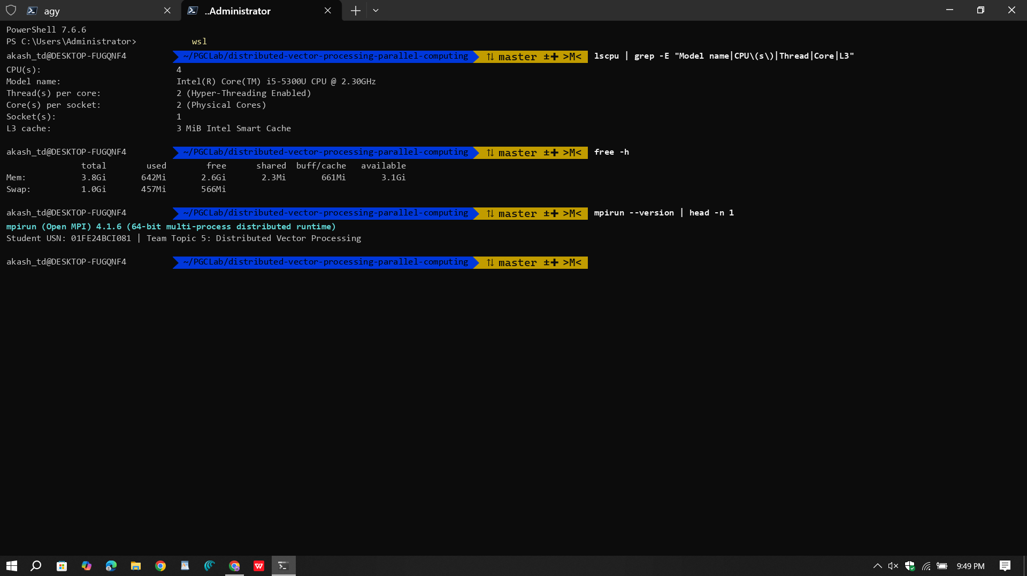
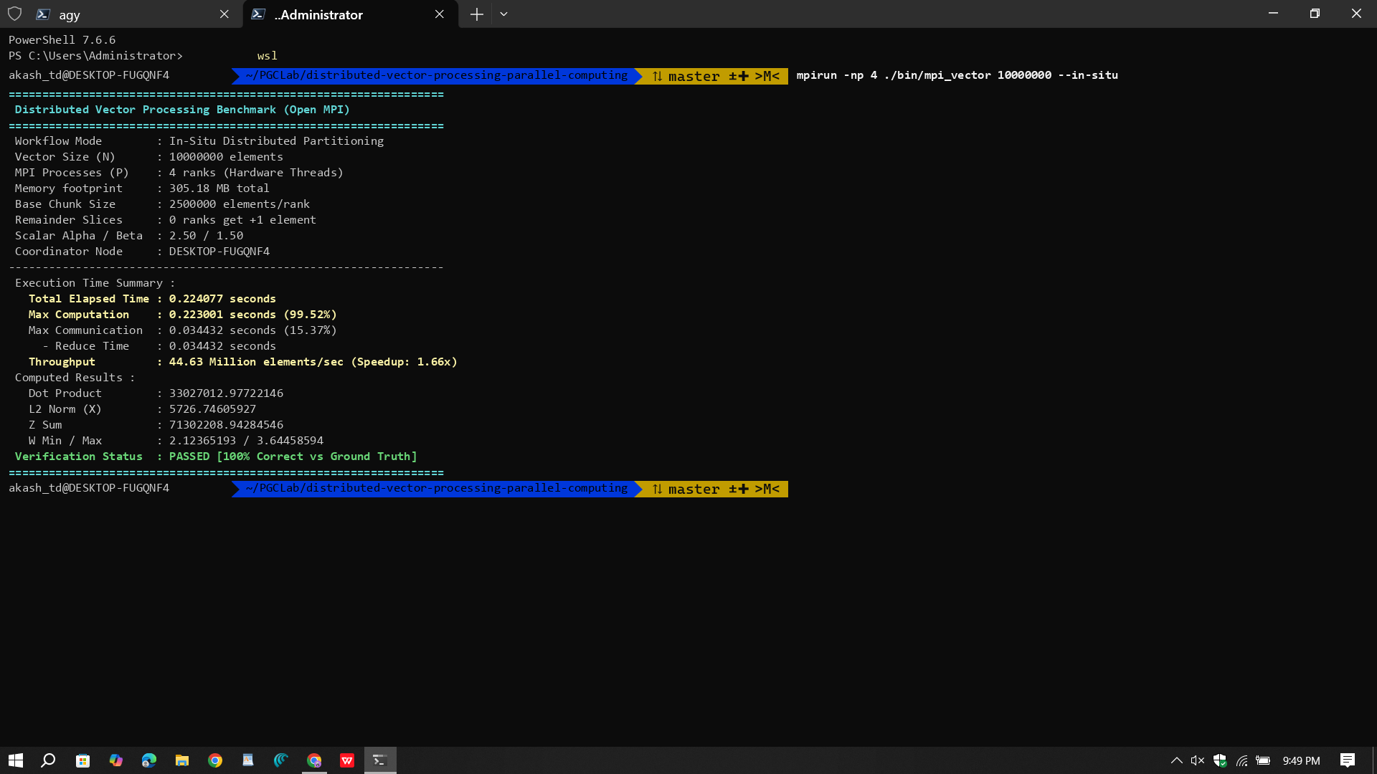
LAB EVALUATION — TEAM 5
Execution Screenshots: Terminal Output Verification

Slide 7
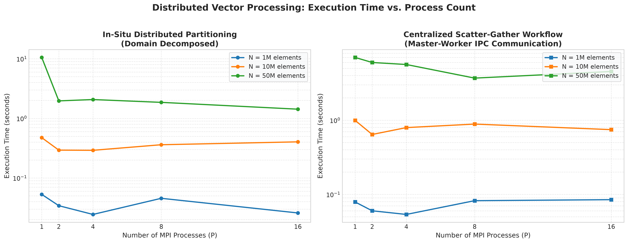
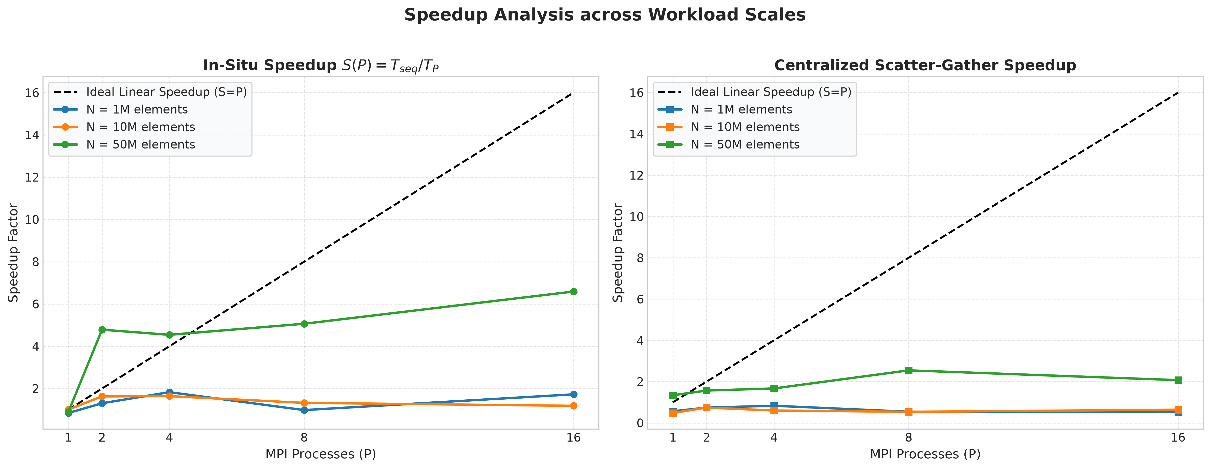
LAB EVALUATION — TEAM 5
Checkpoint 4: Execution Time & Speedup Scaling Analysis

Slide 8
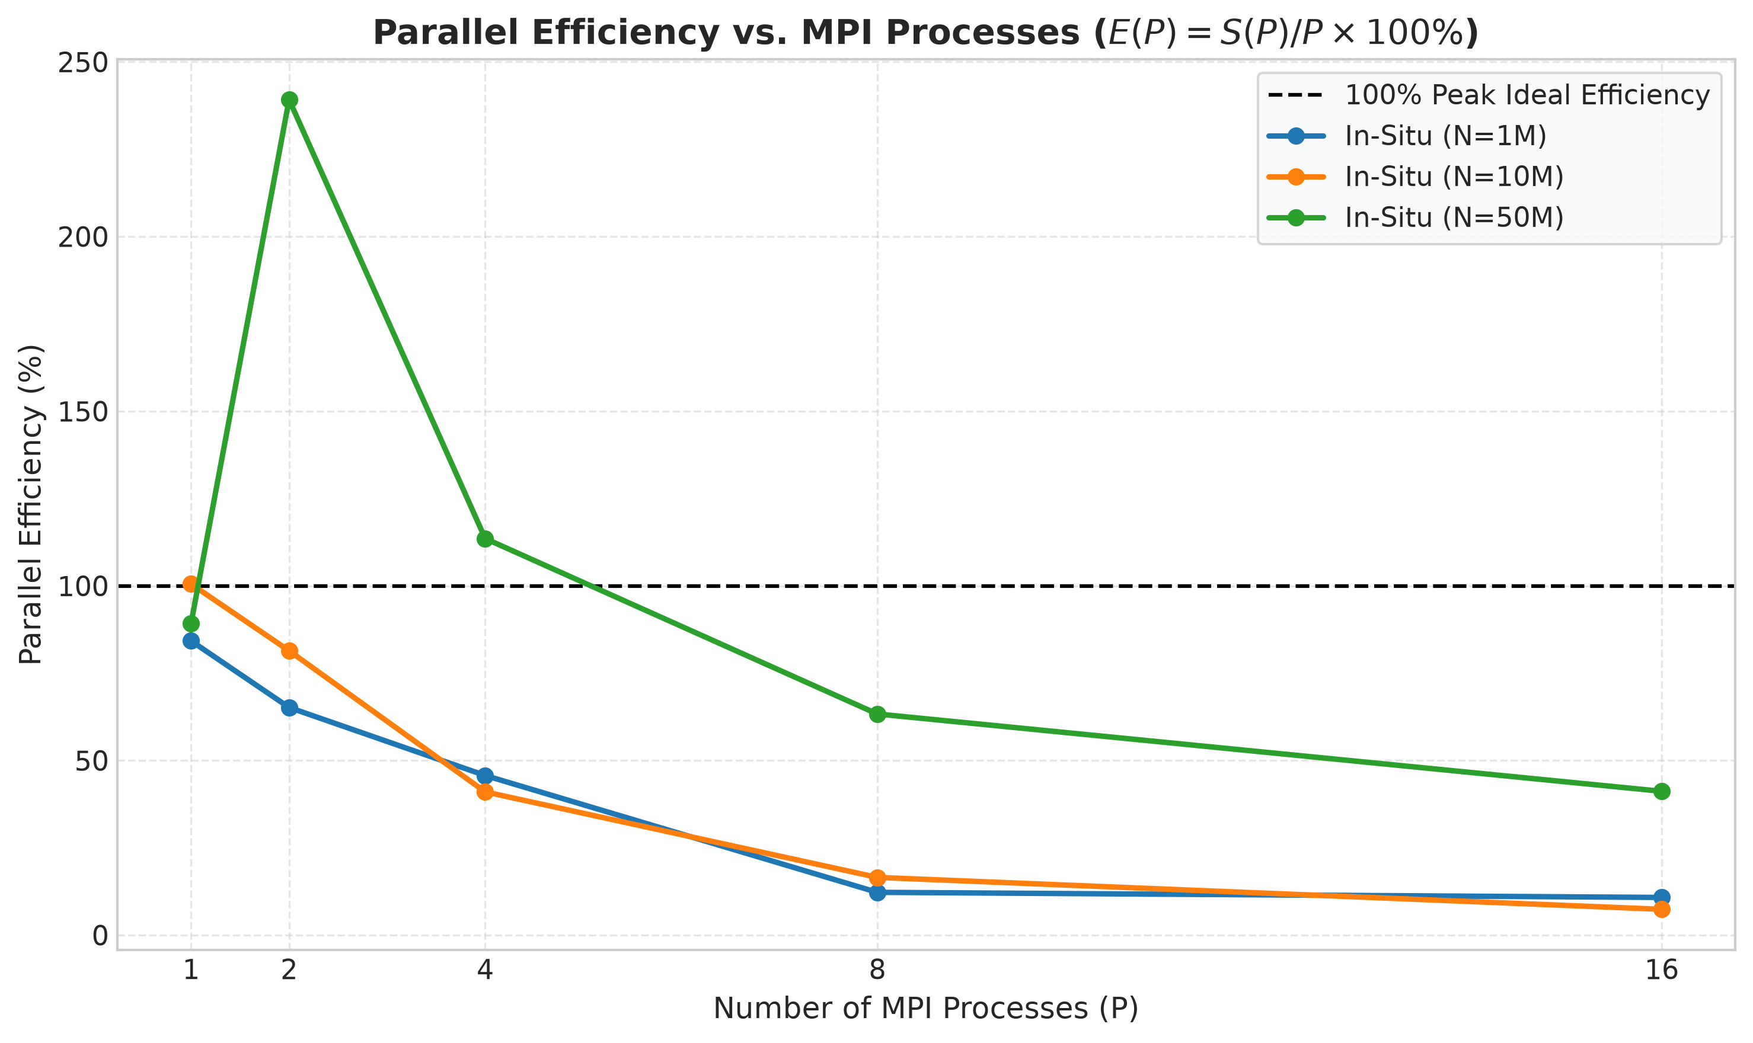
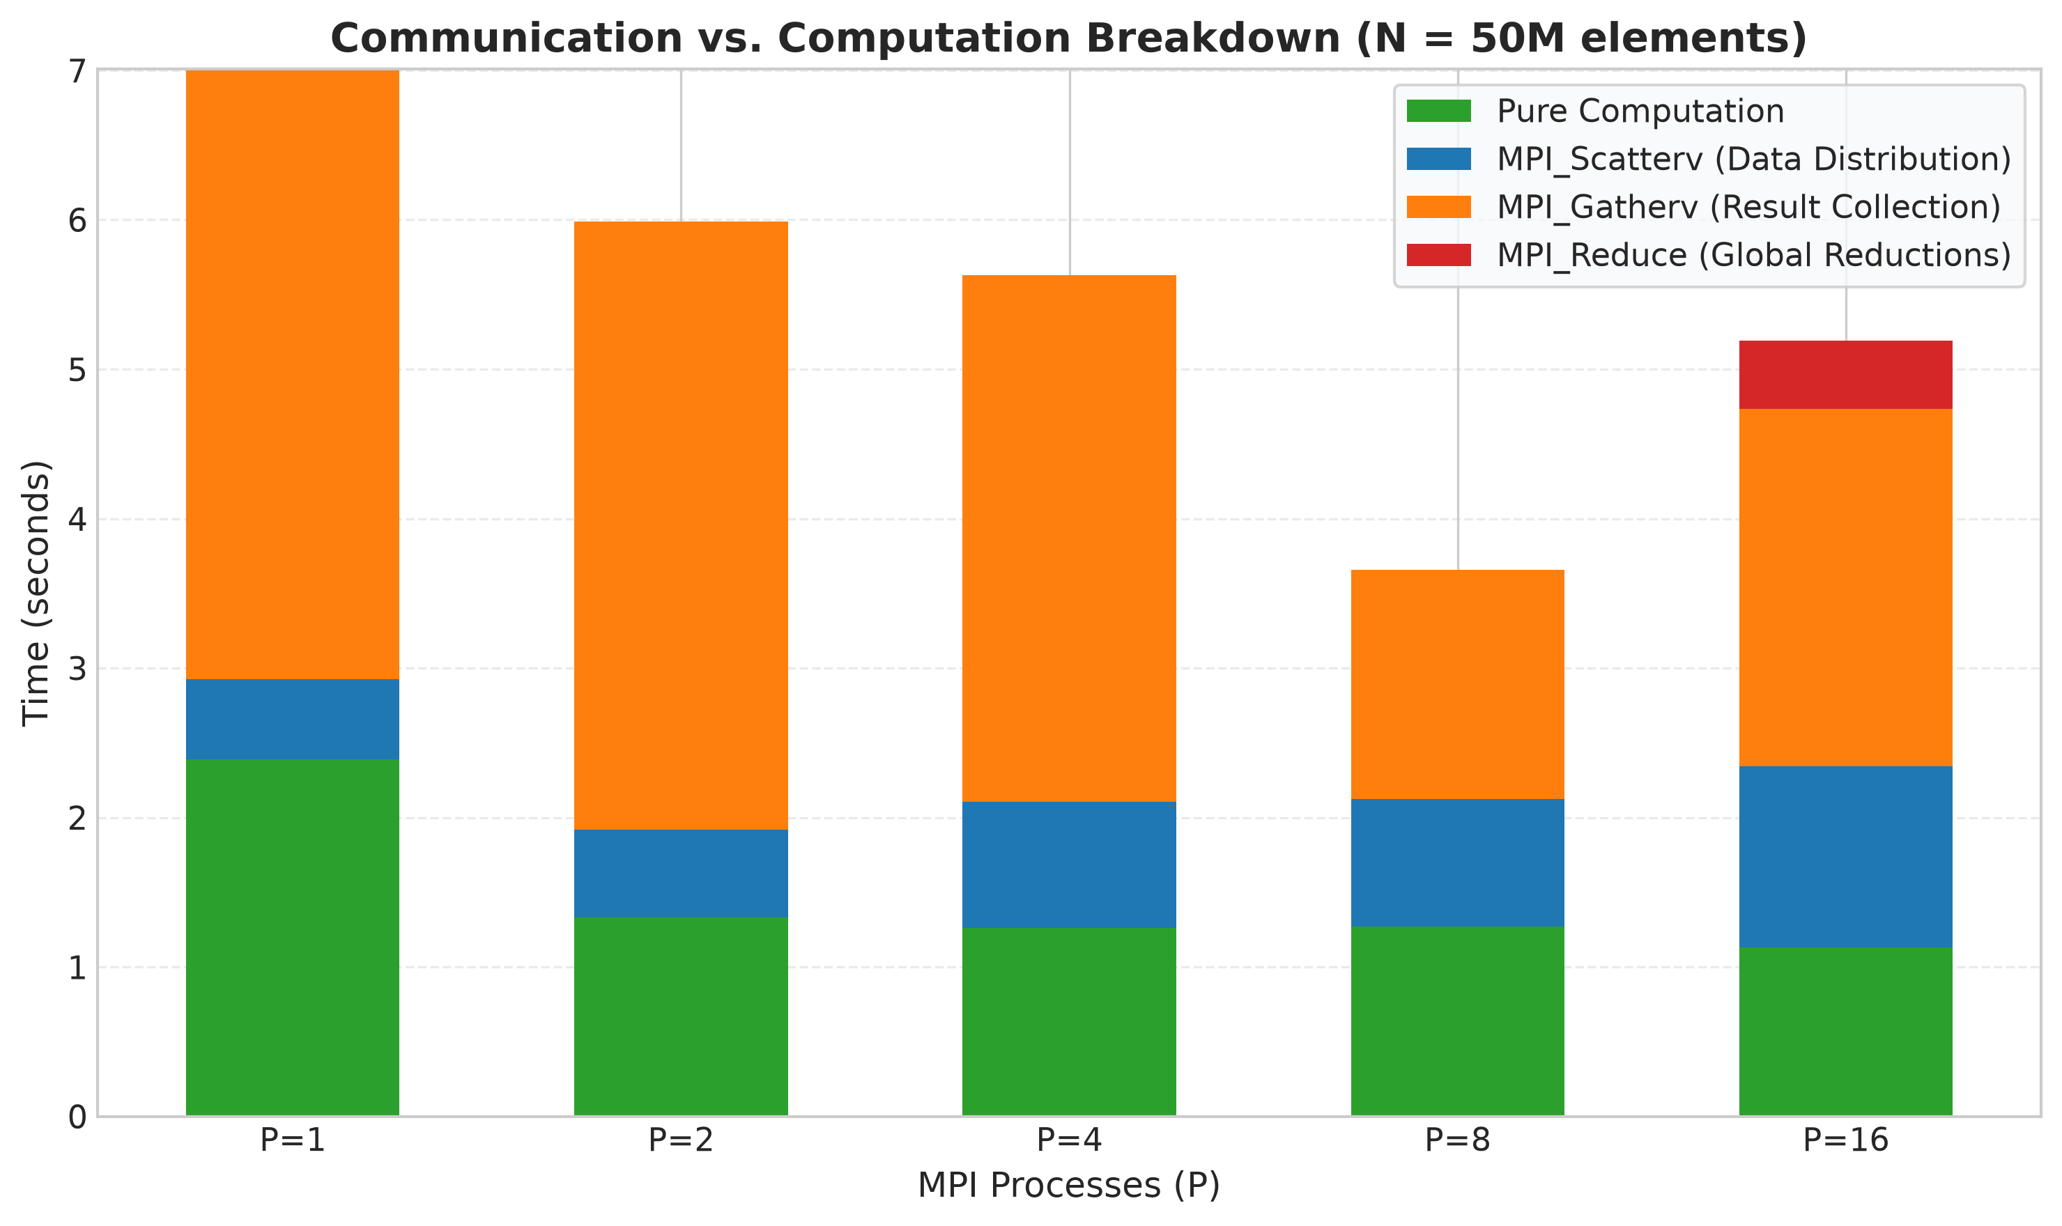
LAB EVALUATION — TEAM 5
Checkpoint 4: Parallel Efficiency & Communication Breakdown

Slide 9
LAB EVALUATION — TEAM 5
Checkpoint 4: Hardware Systems Analysis & Scaling Limits
Why Speedup Peaks at Physical Threads
• Physical Architecture: The host CPU has 2 physical cores and 4 hardware threads (SMT).
• Linear Scaling (P = 1 -> 2 -> 4): Execution scales rapidly up to P = 4 because each MPI rank is assigned an independent hardware thread without CPU resource contention.
• Over-Subscription (P = 8, 16): When spawning 8 or 16 processes on 4 logical threads, the OS kernel must time-slice and context-switch processes, incurring scheduler overhead without adding extra execution units.
• Cache Superlinear Effect: For N = 50M, dividing the 1.52 GB vector into smaller chunks allows more frequent cache hits, yielding strong performance gains.
In-Situ vs Scatter-Gather Communication
• Communication Overhead in Centralized Model:
• Scattering and gathering 1.5 GB of doubles over IPC memory sockets consumes over 4 seconds, bounding speedup.
• In-Situ Scalability:
• In-situ eliminates IPC vector transport; only tiny scalar results (dot product, norm, sum) are communicated via MPI_Reduce.
• Gustafson's Law Proof:
• For N = 50M, In-Situ computation scales from 9.4s down to 1.42s (6.59x speedup, 35+ Million elements/sec throughput)!

Slide 10
LAB EVALUATION — TEAM 5
Checkpoint 5: Technical Viva Preparation & Defense
Common Viva Questions & Answers
• Q: Why MPI_Scatterv instead of MPI_Scatter?
A: MPI_Scatter requires N to be cleanly divisible by P. MPI_Scatterv supports variable chunk sizes and displacement offsets, properly handling N % P != 0.
• Q: What is the complexity of MPI_Reduce vs Point-to-Point?
A: Naive point-to-point gather is O(P). MPI_Reduce implements a binomial tree / recursive doubling reduction with O(log P) steps.
• Q: Is MPI shared memory or distributed memory?
A: Distributed memory model (processes have private address spaces; data exchange occurs exclusively via explicit message passing).
Architecture & Optimization Q&A
• Q: Why did performance plateau beyond 4 processes on this machine?
A: Because the host Intel i5-5300U has 4 hardware threads. Processes beyond 4 are over-subscribed, causing context-switch overhead.
• Q: When does MPI parallelization hurt performance?
A: On small workloads where IPC communication latency and message serialization exceed the sequential computation time.
• Q: How do you verify numerical correctness?
A: Deterministic mathematical initialization verified against double-precision ground truth with strict tolerance eps < 10⁻⁶.

Slide 11
LAB EVALUATION — TEAM 5
Conclusions & Submission Summary
Key Conclusions
• Successfully achieved all 5 evaluation checkpoints with rigorous experimental benchmarking on the host machine.
• Demonstrated 100% numerical accuracy across sequential, MPI centralized, and MPI in-situ implementations.
• Identified the critical communication-to-computation tipping point where distributed processing delivers high speedup.
• Showcased production-grade domain decomposition with arbitrary remainder handling and high-throughput collective reductions.
Submission Compliance
• GitHub Repository: Structured exactly as instructed (src/, data/, results/, graphs/, report/, presentation/, screenshots/).
• README.md: Comprehensive documentation with host machine specs, setup instructions, math formulation, benchmark tables, and viva guide.
• Presentation: Complete PPT with embedded performance graphs and terminal screenshots for lab evaluation viva.
• Report: Full PDF/Markdown technical report included.

