Slide 1
Distributed Vector Processing
PARALLEL & GPU COMPUTING (PGC) LAB | LAB EVALUATION
Rank 0
N / P elements
Rank 1
N / P elements
Rank 2
N / P elements
Rank 3
N / P elements
Open MPI benchmark evaluation: speedup scaling and collective communication analysis
Team 5, Topic 5
Open MPI, distributed-memory model | Intel Core i5-5300U, 2 cores / 4 threads
MPI_Reduce: global result in O(log P)
TEAM MEMBERS
AD
Akash Dani
01FE24BCI081
NM
Neil Mascarenhas
01FE24BCI070
DJ
Dasari Joshua
01FE24BCI078
A
Abhishek
01FE23BCI112
Notes:
Introduce the team and the topic: Distributed Vector Processing using Open MPI (Team 5, Topic 5). Divide a large vector among MPI processes, compute locally, and combine with collective reductions.

Slide 2



Project at a Glance
OVERVIEW
50 M
6.59×
35.06 M/s
100%
double-precision elements (1.52 GB working set)
speedup over single core: 9.40 s to 1.43 s
outputs verified, tolerance ε ≤ 10⁻⁶
peak throughput vs. 5.32 M/s sequential
Problem
Approach
Outcome
Single-core vector kernels saturate the memory bus and cache once N reaches tens of millions of elements.
1D block decomposition across MPI ranks, with in-situ and scatter-gather workflows compared head to head.
In-situ decomposition scales best: only scalars cross processes, while scatter-gather spends up to 72% of its time communicating.
Notes:
Headline results: 50 million double-precision elements (1.52 GB), single-core baseline 9.40 s versus best distributed run 1.43 s, a 6.59x speedup at 35.06 M elements/s. All outputs verified against double-precision ground truth.

Slide 3



Problem Statement and Objective
CHECKPOINT 1 | PROBLEM DEFINITION
Why vector processing
MEMORY-BOUND: TRIVIAL ADDITION
BLAS-1 kernels underpin scientific modeling, simulation and machine learning.
0.04 FLOPs/byte
The bottleneck
One add per 24 bytes moved. DRAM latency of 100 to 200 cycles stalls the cores, so extra cores give almost no speedup.
At N = 10⁶ to 5×10⁷ a single core hits cache-capacity limits and memory-bus saturation.
Objective
Partition 1D vectors across MPI ranks for element-wise transforms and global reductions.
COMPUTE-BOUND: NON-LINEAR PIPELINE
90 to 110 cycles/element
What we measure
End-to-end time, split into pure computation and collective inter-process communication.
√ and trigonometric functions keep the FPUs busy, and the prefetcher hides DRAM latency, so all threads scale.
Notes:
Vector kernels are the backbone of BLAS-1, simulation and ML. At N between 10^6 and 5x10^7 a single core is limited by cache capacity and memory bandwidth. Objective: split the vectors across MPI ranks and measure computation versus communication separately. Contrast memory-bound addition (0.04 FLOPs/byte) with our compute-bound non-linear pipeline.

Slide 4
Mathematical Formulation
CHECKPOINT 1 | MATHEMATICAL FORMULATION
1 LINEAR COMBINATION
2 NON-LINEAR PIPELINE (FPU STRESS TEST)
Z[i] = α × X[i] + β × Y[i]
W[i] = √(X[i]² + Y[i]²)
+ sin X[i] + cos Y[i]
α = 2.5, β = 1.5. Memory-bound kernel with one pass over the data.
Compute-bound: about 90 to 110 cycles per element.
3 GLOBAL REDUCTIONS
4 DETERMINISTIC INPUT
D = Σ X[i] × Y[i] (dot product)
‖X‖₂ = √(Σ X[i]²) (L2 norm)
S_Z = Σ Z[i]; min W, max W
X[i] = sin(0.01 × (i mod 1000)) + 1.5
Y[i] = cos(0.01 × (i mod 1000)) + 2.0
Generated in memory: no disk I/O, fully reproducible, exact verification.
Notes:
Four pieces: SAXPY-style linear combination with alpha 2.5 and beta 1.5; the non-linear pipeline that stresses the FPU; global reductions (dot product, L2 norm, sum, min and max); and deterministic in-memory input so there is no disk I/O and results are reproducible.

Slide 5
1D Block Domain Decomposition
CHECKPOINT 1 | PARALLEL DESIGN
GLOBAL VECTOR | N ELEMENTS PARTITIONED ACROSS P = 4 RANKS
displs[0]
displs[1]
displs[2]
displs[3]
Rank 0
Rank 1
Rank 2
Rank 3
local_n(0) elements
local_n(1) elements
local_n(2) elements
local_n(3) elements
BLOCK SIZES WITH REMAINDER
DISPLACEMENTS
LOCAL MEMORY FOOTPRINT
R = N mod P
local_n(r) = ⌊N/P⌋ + [r < R]
displs[r] = Σ counts[k]
k = 0 … r−1
O(N / P) per rank
The first R ranks take one extra element, so no element is ever truncated.
Prefix sums give a contiguous, zero-overlap layout for MPI_Scatterv and MPI_Gatherv.
Each rank allocates only its slice, so sub-vectors can stay resident in per-core cache.
Notes:
The global vector is cut into P contiguous blocks. The remainder R = N mod P is spread over the first R ranks so there is no truncation for any N. Displacements are prefix sums of the counts, which gives a contiguous, non-overlapping layout, and each rank only allocates O(N/P).

Slide 6
Two Distributed Workflow Models
CHECKPOINT 1 | PARALLEL DESIGN
Model A: Centralized Scatter-Gather
Master-worker architecture
Model B: In-Situ Domain-Decomposed
Scalable cluster architecture
1
Rank 0 holds the full vectors X and Y
1
Each rank initializes its own sub-domain in place
2
MPI_Scatterv sends one slice to every rank
2
Pure O(N/P) local computation, no vector transport
3
Each rank computes Z, W and partial sums locally
3
MPI_Reduce combines scalar results in O(log P)
4
MPI_Gatherv returns Z and W to rank 0
4
Rank 0 verifies output against the reference
Trade-off: O(N) communication overhead
Trade-off: maximum scalability, no bus bottleneck
Notes:
Model A is the classic master-worker: rank 0 holds everything and ships slices out and back, so communication is O(N). Model B, in-situ, has each rank initialise its own sub-domain, so only scalars are communicated through MPI_Reduce. This is how real cluster codes and MPI-IO style pipelines work.

Slide 7

Open MPI Implementation and Verification
CHECKPOINT 2 | WORKING PARALLEL IMPLEMENTATION
MPI primitive | Role in the program | Cost
MPI_Scatterv | Sends variable-length slices from rank 0 using the displs offsets | O(N) data
MPI_Reduce | Combines dot product, L2 norm and Z-sum (SUM), plus W min and max | O(log P)
MPI_Gatherv | Collects the result vectors Z and W back on rank 0 | O(N) data
MPI_Barrier, MPI_Wtime | Phase timing: scatter, compute, reduce and gather | negligible
Verification
Outputs compared with the sequential baseline
|Z_mpi[i] − Z_ref[i]| < 10⁻⁶
Reduction relative error < 10⁻⁶
Open MPI 4.1.6, GCC 13.3 with -O3
100% correct for N = 1M, 10M, 50M and P = 1 to 16
Notes:
Walk through the four primitives we rely on. Verification: every distributed result is compared against the sequential analytical baseline with tolerance 1e-6, on all three data sizes and process counts P=1 to 16.

Slide 8
Hardware and Benchmark Matrix
CHECKPOINT 3 | HOST MACHINE AND BENCHMARK SETUP
Processor | Intel Core i5-5300U @ 2.30 GHz (Broadwell, 14 nm)
Cores / threads | 2 physical cores, 4 hardware threads (SMT)
Cache | L1d 64 KB, L1i 64 KB, L2 512 KB, L3 3 MiB
Memory | 3.8 GiB in WSL2 plus 1.0 GiB swap
Operating system | Ubuntu 24.04 LTS, kernel 6.6, WSL2 on Windows 11
Toolchain | GCC 13.3.0 (-O3), Open MPI 4.1.6
WORKLOAD TIERS
1 M
10 M
50 M
30.52 MB
305.18 MB
1.52 GB
PROCESS COUNTS (RANKS)
P = 1
Single-process baseline
P = 2
One rank per physical core
P = 4
All hardware threads busy
P = 8, 16
Oversubscribed, time-sliced
Notes:
All numbers come from this laptop-class machine running Ubuntu 24.04 inside WSL2: two physical cores with hyper-threading, so four hardware threads. We tested three data sizes and process counts from 1 to 16, including deliberate oversubscription at 8 and 16.

Slide 9
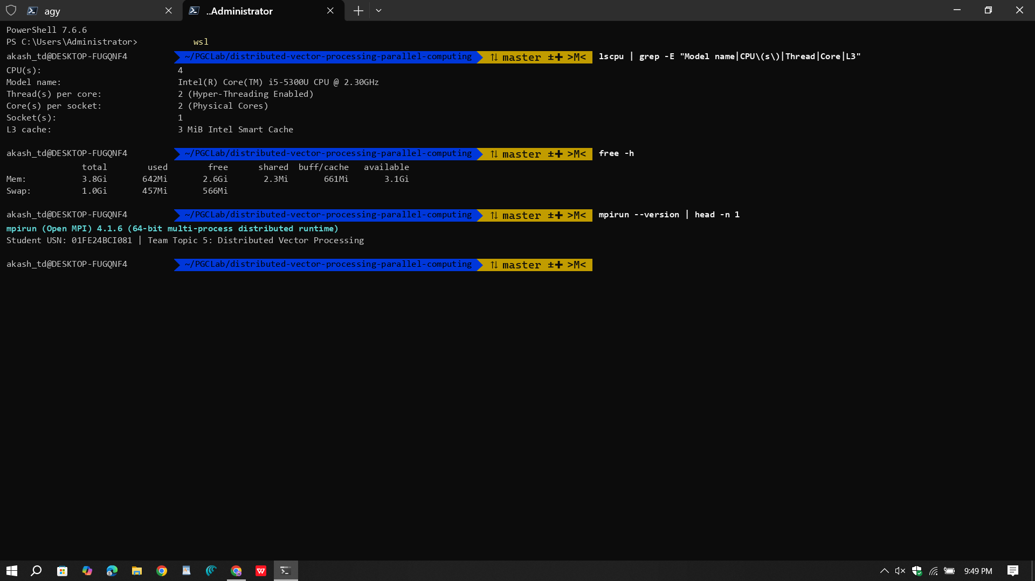
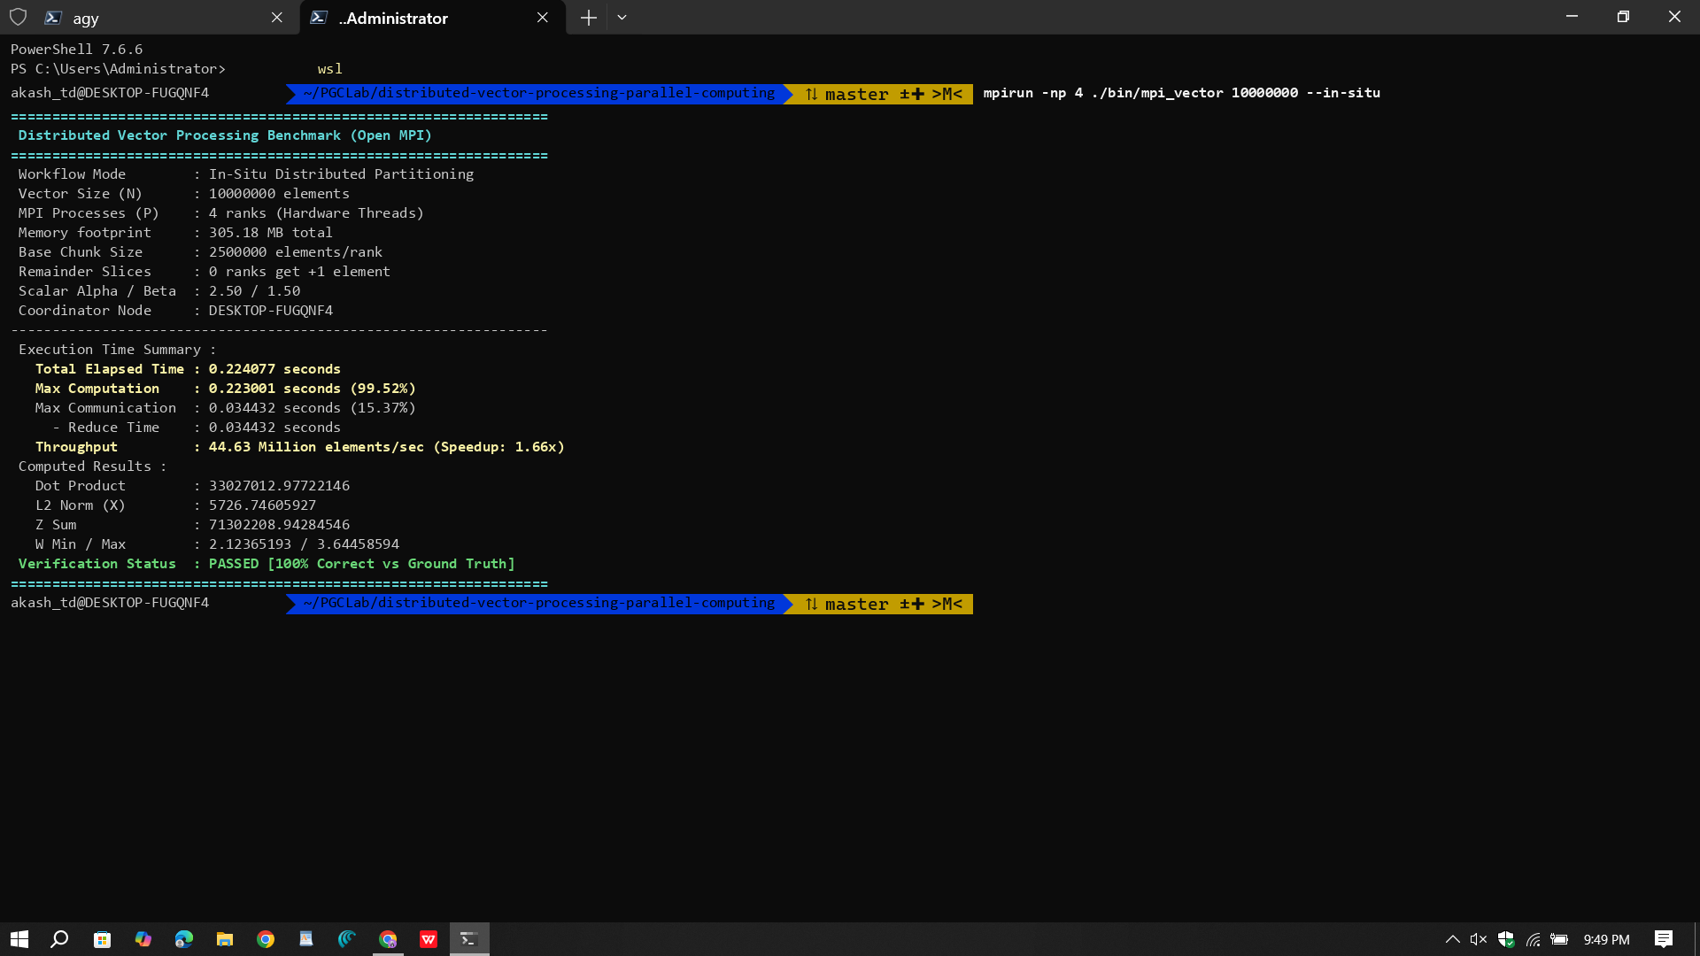
Execution Screenshots: Terminal Verification
CHECKPOINT 3 | LIVE EXECUTION
Host hardware: lscpu, free -h, mpirun --version
In-situ run: N = 10M on 4 ranks, verification PASSED
0.371 s
Sequential, N = 10M (26.96 M elem/s)
0.224 s
In-situ, 4 ranks (44.63 M elem/s)
1.66×
Speedup, 100% correct
Notes:
Left: lscpu, free -h and mpirun --version confirming the host. Right: in-situ run, 10M elements on 4 ranks, 0.224 s, 44.63 M elements/s, 1.66x speedup, verification PASSED. Sequential baseline for the same size took 0.371 s.

Slide 10
Results: 1M and 10M Elements
CHECKPOINT 4 | PERFORMANCE RESULTS
N | Mode | P | Total (s) | Comm (s) | Speedup | Efficiency | Throughput
1,000,000 | Sequential | 1 | 0.0447 | 0.0000 | 1.00× | 100.0% | 22.39 M/s
1,000,000 | In-Situ | 2 | 0.0343 | 0.0001 | 1.30× | 65.2% | 29.19 M/s
1,000,000 | In-Situ | 4 | 0.0244 | 0.0042 | 1.83× | 45.7% | 40.93 M/s
10,000,000 | Sequential | 1 | 0.4774 | 0.0000 | 1.00× | 100.0% | 20.95 M/s
10,000,000 | In-Situ | 2 | 0.2932 | 0.0001 | 1.63× | 81.4% | 34.11 M/s
10,000,000 | In-Situ | 4 | 0.2910 | 0.0730 | 1.64× | 41.0% | 34.36 M/s
Overhead dominates small N
10M plateaus past 2 ranks
At 1M, 4 ranks reach only 1.83× at 45.7% efficiency: fixed startup and reduction costs are a large share of 24 ms.
Speedup stays at about 1.64× from P = 2 to P = 4; communication time grows from 0.0001 s to 0.073 s.
Notes:
For small and medium sizes the gains are modest. At 1M, four ranks reach 1.83x (45.7% efficiency). At 10M, two ranks give 1.63x and four ranks add nothing because the data is already small per rank and communication grows to 0.073 s.

Slide 11
Results: 50M Elements (1.52 GB)
CHECKPOINT 4 | PERFORMANCE RESULTS
Mode | P | Total (s) | Speedup | Efficiency
Sequential | 1 | 9.3976 | 1.00× | 100.0%
In-Situ | 2 | 1.9645 | 4.78× | 239.2%
In-Situ | 4 | 2.0692 | 4.54× | 113.5%
In-Situ | 16 | 1.4262 | 6.59× | 41.2%
Scatter-Gather | 8 | 3.6918 | 2.55× | 31.8%
Highlighted row: best observed run. Efficiency above 100% reflects superlinear cache and memory-pressure effects.
35.06 M/s
9.40 s to 1.43 s
72%
peak throughput, vs. 5.32 M/s sequential
single core to best in-situ run
of scatter-gather time is communication
Notes:
This is the headline experiment. Sequential takes 9.40 s. In-situ drops to 1.96 s on 2 ranks, 2.07 s on 4 ranks and 1.43 s on 16 ranks (6.59x, 35.06 M elements/s). Scatter-gather on 8 ranks takes 3.69 s because 2.65 s of that is communication.

Slide 12
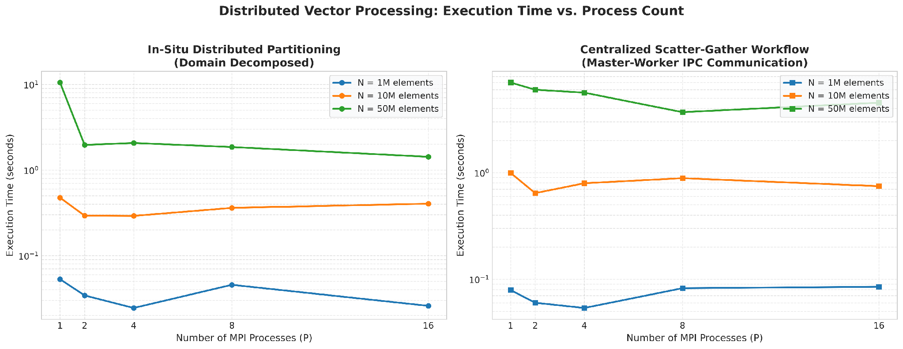
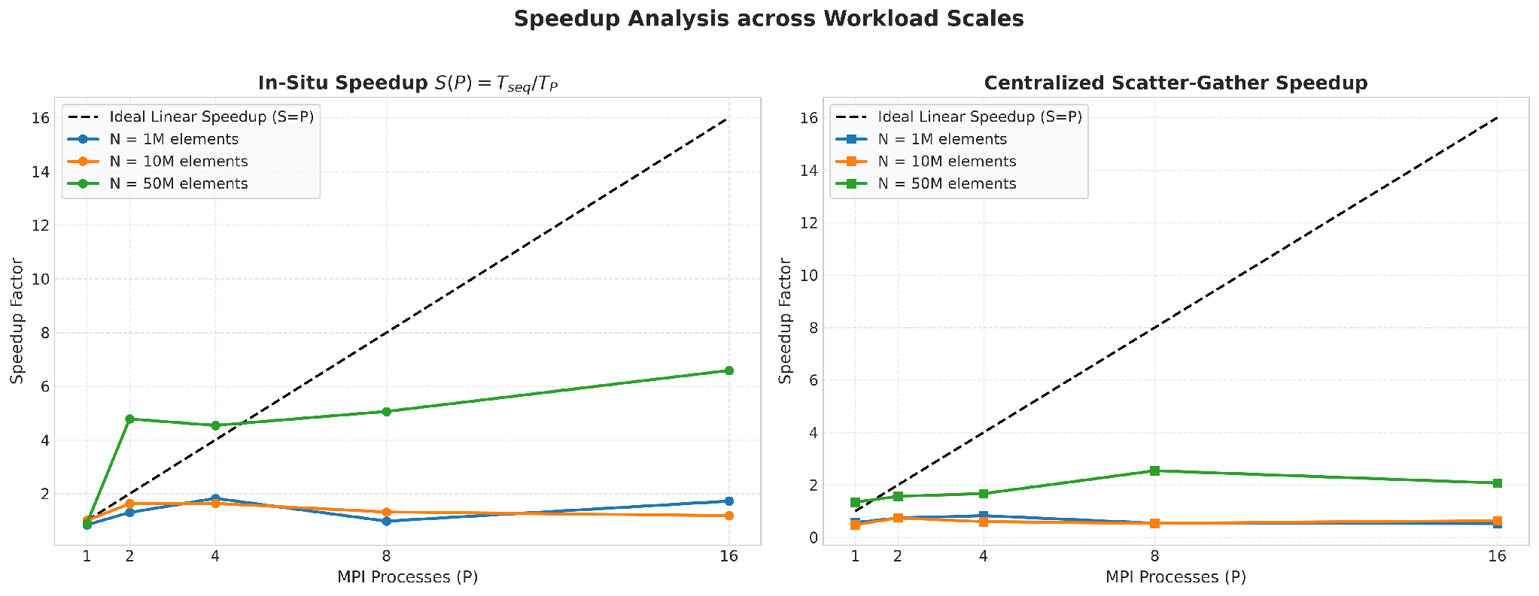
Execution Time and Speedup Scaling
CHECKPOINT 4 | SCALING GRAPHS
What the plots show
Top: wall-clock time vs. P. At 50M, in-situ falls from 9.4 s to 1.4 s.
Bottom: speedup vs. the ideal S = P line.
50M exceeds the ideal line at P = 2 (4.78×), then flattens.
1M and 10M stay near 1× to 2×: overhead dominates.
Scatter-gather never exceeds 2.55× (P = 8).
Notes:
Top: wall-clock time against process count for in-situ and scatter-gather. Bottom: speedup against the ideal linear line. The 50M curve beats the ideal line at P=2 due to cache and memory effects, then flattens. Scatter-gather never gets above 2.55x.

Slide 13
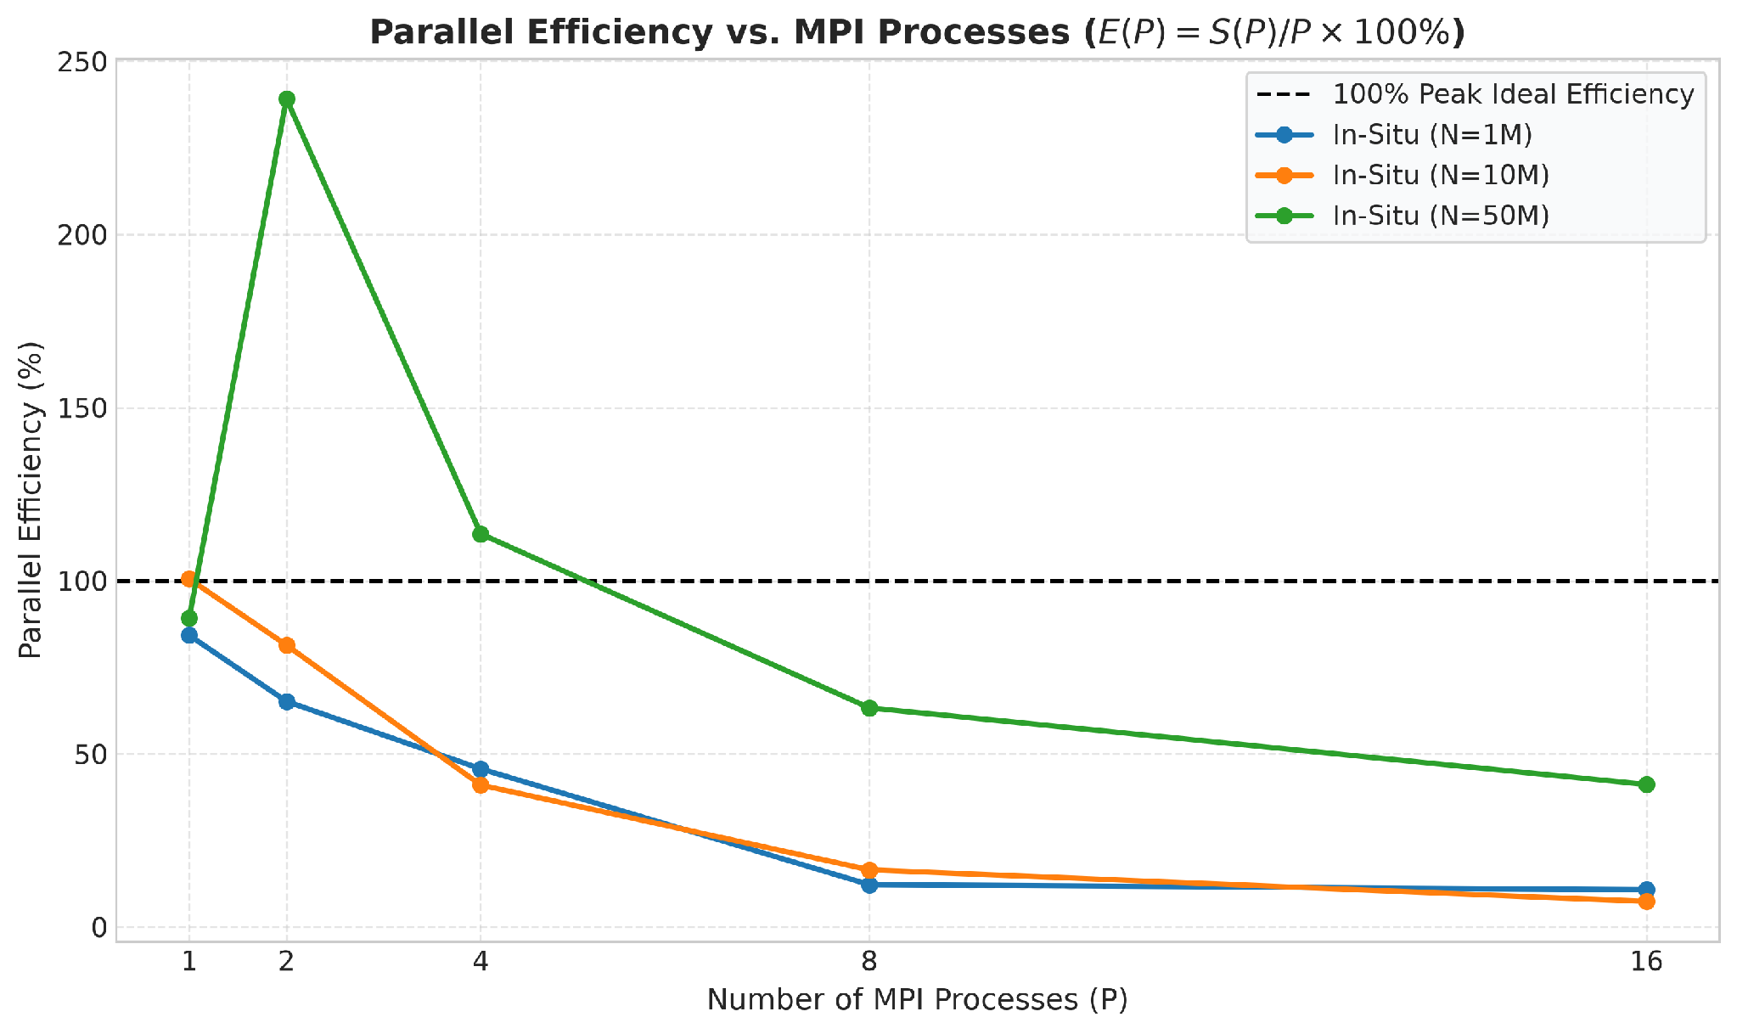
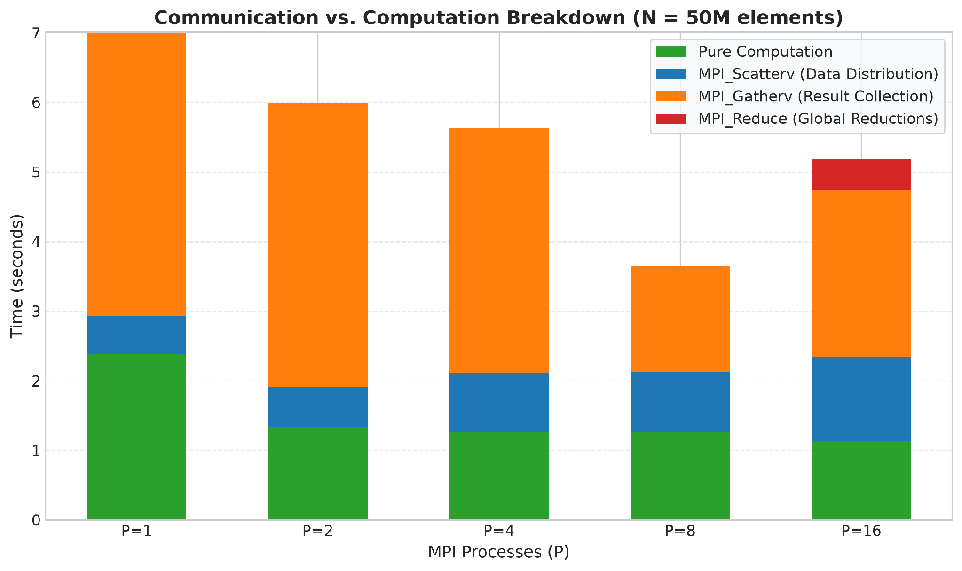
Parallel Efficiency and Communication Breakdown
CHECKPOINT 4 | EFFICIENCY AND COMMUNICATION
Parallel efficiency E(P) = S(P) / P. N = 50M peaks at 239% (superlinear), then decays with P.
Scatter-gather breakdown at N = 50M: scatter and gather time dominate the pure computation.
Takeaway: moving whole vectors between processes erodes speedup; keeping data local scales.
Notes:
Left: efficiency E(P) = S(P)/P. The 50M curve peaks at 239% at P=2 and decays as ranks increase. Right: for scatter-gather at 50M, scatter and gather time grow to dominate, which is why in-situ is the scalable design.

Slide 14



Scaling Behavior and Limits
CHECKPOINT 4 | SYSTEMS ANALYSIS
Scaling tracks hardware threads
Superlinear effect at 50M
2 cores and 4 SMT threads: P = 1, 2, 4 each get an independent thread. Beyond 4, the OS time-slices ranks and adds context-switch overhead.
Splitting the 1.52 GB vectors shrinks each rank's footprint, improving cache residency and easing memory pressure. This gives 4.78× at P = 2.
Scatter-gather pays for transport
In-situ scales with problem size
Moving whole vectors costs 2.65 s of a 3.69 s run at P = 8. Communication, not computation, bounds the speedup.
Only scalars cross ranks via MPI_Reduce. By Gustafson's law, larger N raises the parallel fraction and keeps gains growing.
Notes:
Four reasons behind the curves: the hardware has only four threads, oversubscription costs context switches, the 50M case benefits from smaller per-rank footprints, and the scatter-gather model pays O(N) communication. Gustafson: as N grows the parallel fraction approaches 1 so larger problems keep scaling.

Slide 15
Viva Questions and Answers
CHECKPOINT 5 | TECHNICAL VIVA PREPARATION
Q1
Why MPI_Scatterv instead of MPI_Scatter?
Q2
Reduce vs. point-to-point complexity?
Q3
Shared or distributed memory?
Scatter needs N divisible by P. Scatterv takes per-rank counts and displacements, so N mod P ≠ 0 works.
Naive gathering is O(P). MPI_Reduce uses a binomial tree: O(log P) steps.
Distributed: each process has a private address space and data moves only by explicit messages.
Q4
Why no gain beyond 4 processes?
Q5
When does MPI hurt performance?
Q6
How is correctness verified?
The host has 4 hardware threads. Extra ranks are oversubscribed and pay context-switch overhead.
On small workloads, where communication latency exceeds the sequential compute time.
Deterministic inputs are checked against a double-precision reference with ε < 10⁻⁶.
Notes:
Short, confident answers. The full 15-question bank is in presentation/viva_preparation.md in the repository.

Slide 16

Conclusions and Submission Summary
CONCLUSIONS AND SUBMISSION
All 5 evaluation checkpoints completed with benchmarks measured on the host machine.
Submission compliance
100% numerical accuracy across sequential, scatter-gather and in-situ implementations.
GitHub repo: src, data, results, graphs, report, presentation, screenshots
README with specs, setup, math, benchmarks, viva guide
This presentation with graphs and terminal captures
Full technical report in Markdown
Best result: 6.59× speedup and 35.06 M elem/s at N = 50M, 9.40 s down to 1.43 s.
In-situ decomposition with remainder handling and O(log P) reductions is the scalable design.
TEAM 5
Akash Dani (01FE24BCI081) | Neil Mascarenhas (01FE24BCI070) | Dasari Joshua (01FE24BCI078) | Abhishek (01FE23BCI112)
github.com/akaraj187/distributed-vector-processing-parallel-computing
Notes:
Close: all five checkpoints completed, results correct across all configurations, in-situ domain decomposition is the scalable design. Repository follows the required structure. Thank the evaluators and invite questions.

