Slide 2
9:00-9:30
9:30-9:40 break
9:40-10:10
10:10-10:20 break
10:20-10:50
10:50-11:00 break
11:00-11:30
11:30-11:40 break
11:40-12:10
12:10-12:20 break
12:20-1:00

Slide 3
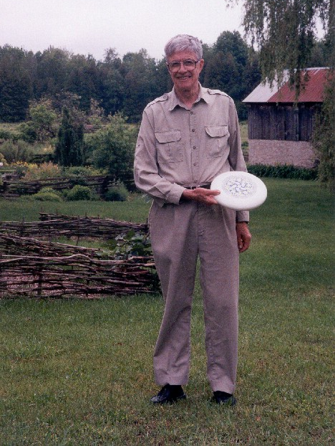
Notes:
“Ken at Kiln Farm with a prototype J Ultimate sportdisc (photo by Jana Michaud)”
http://webbox.lafayette.edu/~reiterc/j/ke_iverson/index.html

Slide 4


Slide 5
Leaping head first into the stream of consciousness is good for your balance

Slide 6
Motivation

Slide 7
Evaluation Rules

Slide 8
You do not need to trouble yourself with the distinction between integers, floats, and complex numbers. If it’s a number, J will handle it properly.
J for C Programmers

Slide 9
Forget the table of operator precedence!
J for C Programmers

Slide 10
Running a J program: No compiling. No linking.
No makefiles. No debugger required. You simply type J sentences and the interpreter executes them and displays any result.
J for C Programmers

Slide 11
Monads & Dyads

Slide 14
That language is an instrument of human reason, and not merely a medium for the expression of thought, is a truth generally admitted.
George Boole, Laws of Thought

Slide 15
Try not to reinvent the rut

Slide 16
Adverbs
Notes:
Loopless coding

Slide 17
A noun holds data; a verb operates on one or two nouns to produce a result which is a noun; an adverb operates on one noun or verb to produce a derived entity; a conjunction operates on two nouns or verbs to produce a derived entity.
J for C Programmers

Slide 18
Atoms, Lists,
Tables, et al.

Slide 19
Any variable can be an array. As for what the type and dimensioning is: you assigned the variable, didn't you? It contains whatever you put into it, a number, a string, an array, a structure... J will remember. If your program logic requires you to find out the current attributes of a variable, J can tell you.
J for C Programmers

Slide 21
Never put a seat belt around your intuition

Slide 22
Rank

Slide 23
The rank of a noun is the count of its axes. An atom has rank 0, a list rank 1, a table rank 2, and an array with 5 axes has rank 5.
J Primer

Slide 24
In J, every operator has a loop built in.
J for C Programmers

Slide 26
If you’re lucky enough to experience a miracle,
try not to micro manage it

Slide 27
Recursion

Slide 29
Devalue having

Slide 30
Hooks, Forks,
Tacit Functions

Slide 31
J uses the names x, y, u, v, m, and n to represent arguments to verbs and other entities. You should avoid using these names for other purposes.
J for C Programmers

Slide 33
Avoid both picking at minutia and sideswiping mountains

Slide 34
Big Data

Slide 35
This is one of the things that makes programming in J so pleasant: you don’t have to worry about allocating storage, or freeing it, or wondering how long is long enough for a character-string variable, or how big to make an array.
J for C Programmers

Slide 36
You may at first worry that you're using too much memory, or that you might misuse the processor's caches; get over it. Apply verbs to large operands.
J for C Programmers

Slide 37
$ card

Slide 39
Live for the destiny that aches for you

