Slide 2
9:00-9:30
9:30-9:40 break
9:40-10:10
10:10-10:20 break
10:20-10:50
10:50-11:00 break
11:00-11:30
11:30-11:40 break
11:40-12:10
12:10-12:20 break
12:20-1:00

Slide 3
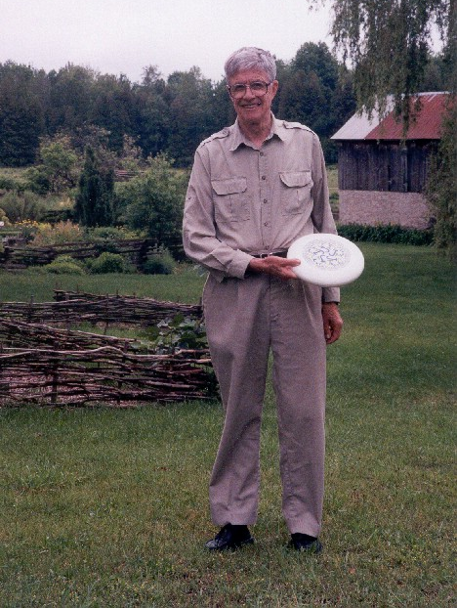
Notes:
“Ken at Kiln Farm with a prototype J Ultimate sportdisc (photo by Jana Michaud)”
http://webbox.lafayette.edu/~reiterc/j/ke_iverson/index.html

Slide 4
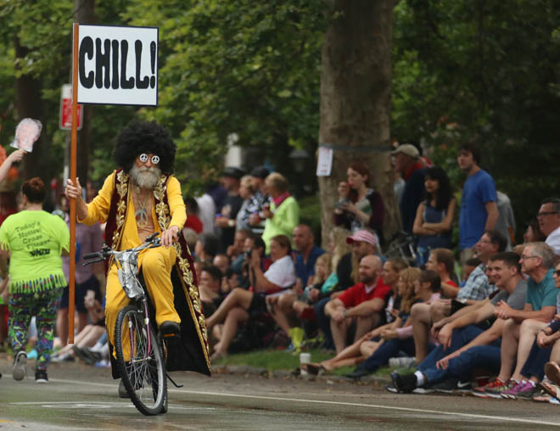

Slide 5
Leaping head first into the stream of consciousness is good for your balance

Slide 6
Motivation

Slide 7
Syntax

Slide 8
Statements are exactly one line long.
Numbers may be written 2, _2, 0.5, 1e3, 2j5, 16b1f, 2p1, _, __
Adjacent numbers make a list: 3 5 2e3 7
Strings have single-quotes: 'hello'
Everything else is a built-in or user-defined word:
Verbs: +, -, etc.
Adverbs: ~, /, }, etc.
Conjunctions: ^:, ", @, &, etc.
Others: =., =:, NB., etc.
Notes:
2p1: 2*pi^1
2p5: 2*pi^5

Slide 9
Running a J program: No compiling. No linking.
No makefiles. No debugger required. You simply type J sentences and the interpreter executes them and displays any result.
J for C Programmers

Slide 10
You do not need to trouble yourself with the distinction between integers, floats, and complex numbers. If it’s a number, J will handle it properly.
J for C Programmers

Slide 11
Evaluation Rules

Slide 12
Forget the table of operator precedence!
J for C Programmers

Slide 13
RTL Evaluation:
2*4+5
18
2+4*5
22
(2*4)+5
13
Notes:
No precedence rules except parentheses ()

Slide 14

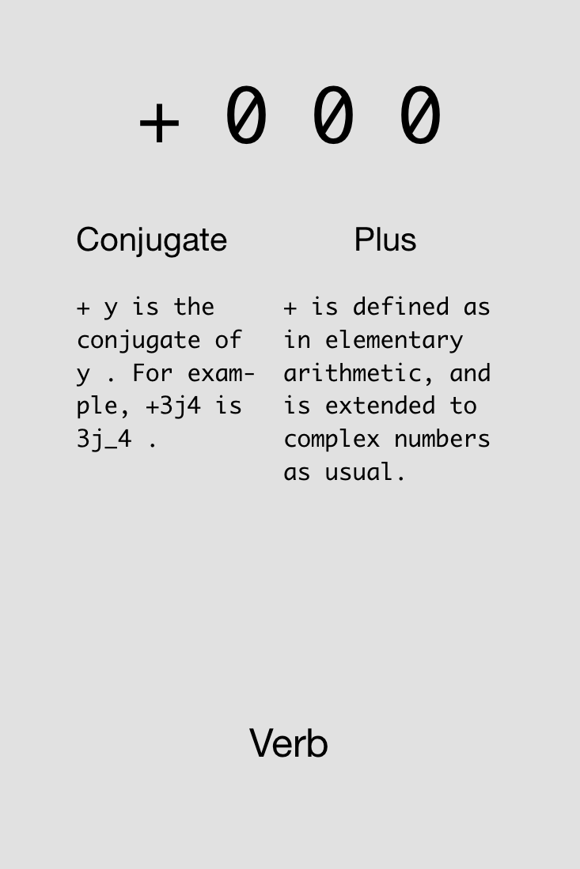
Notes:
Show example in J: 4+5+2

Slide 15

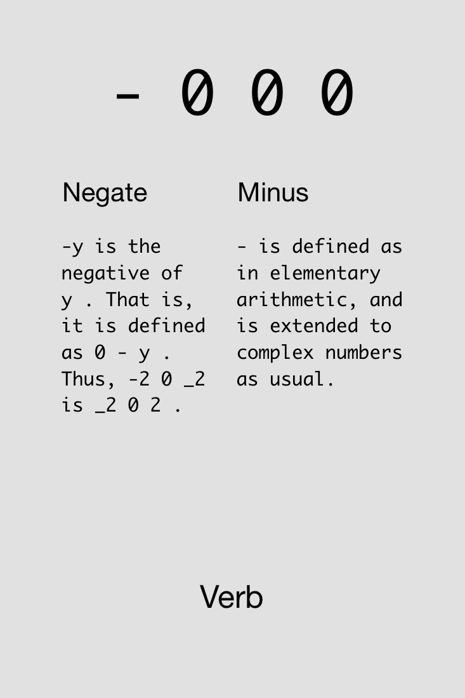

Slide 16

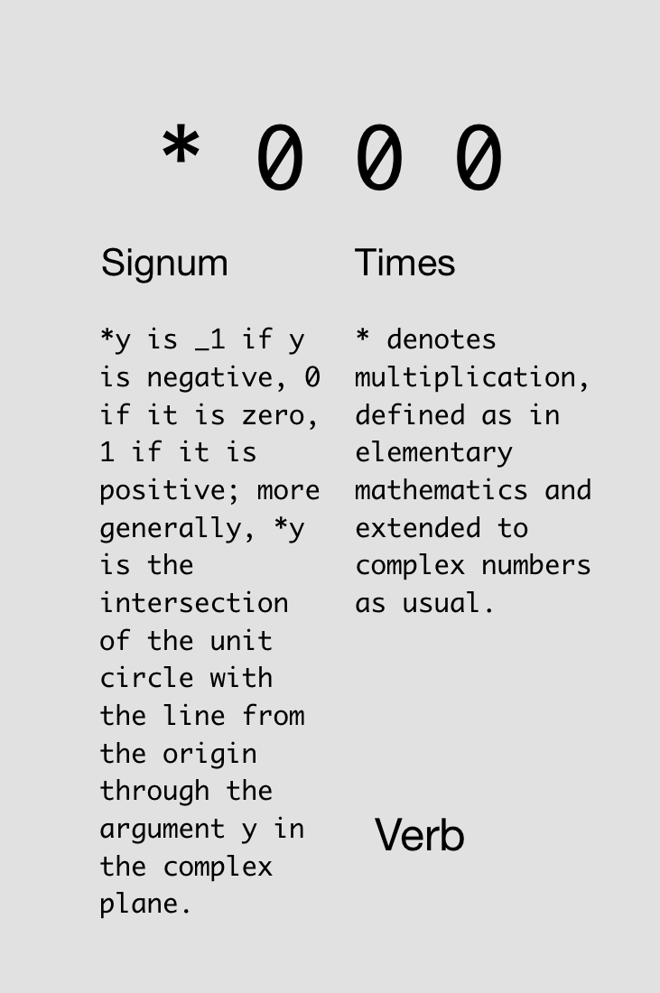

Slide 17

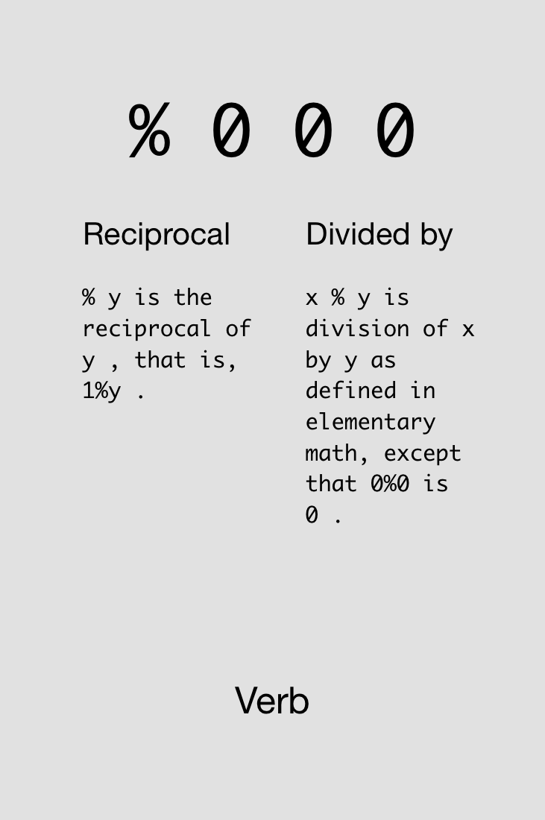

Slide 18
Monads & Dyads

Slide 19
y is right arg
x is left arg,
y is right arg

Slide 20
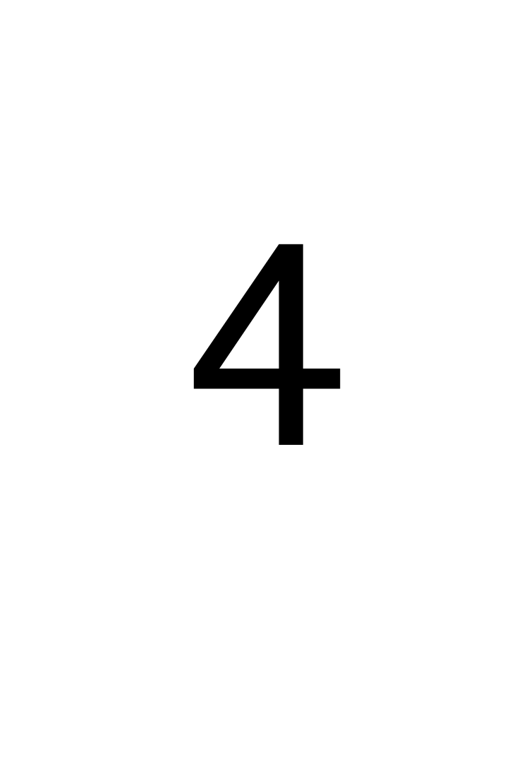
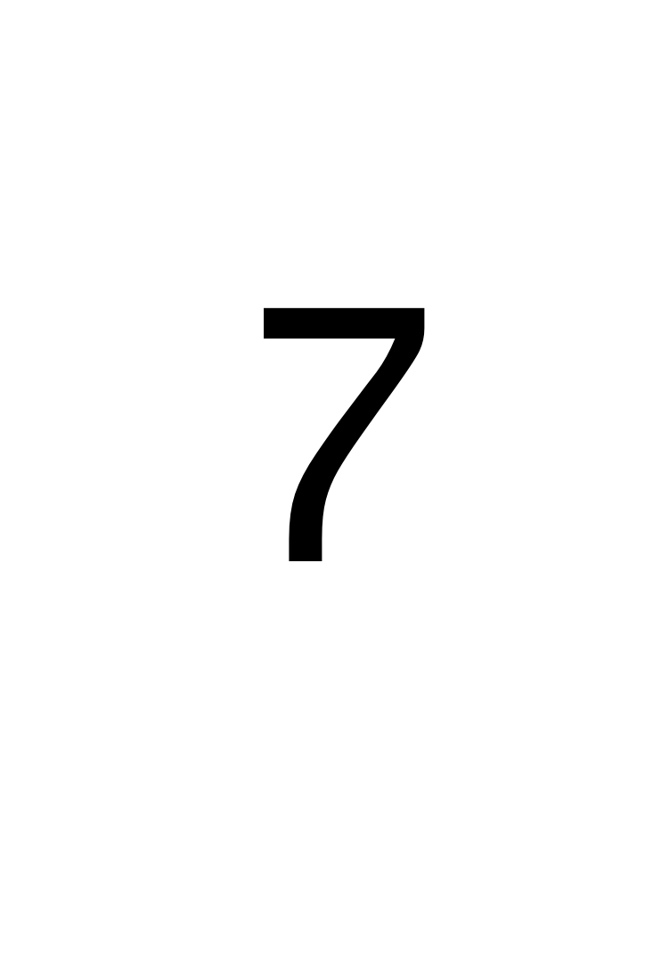
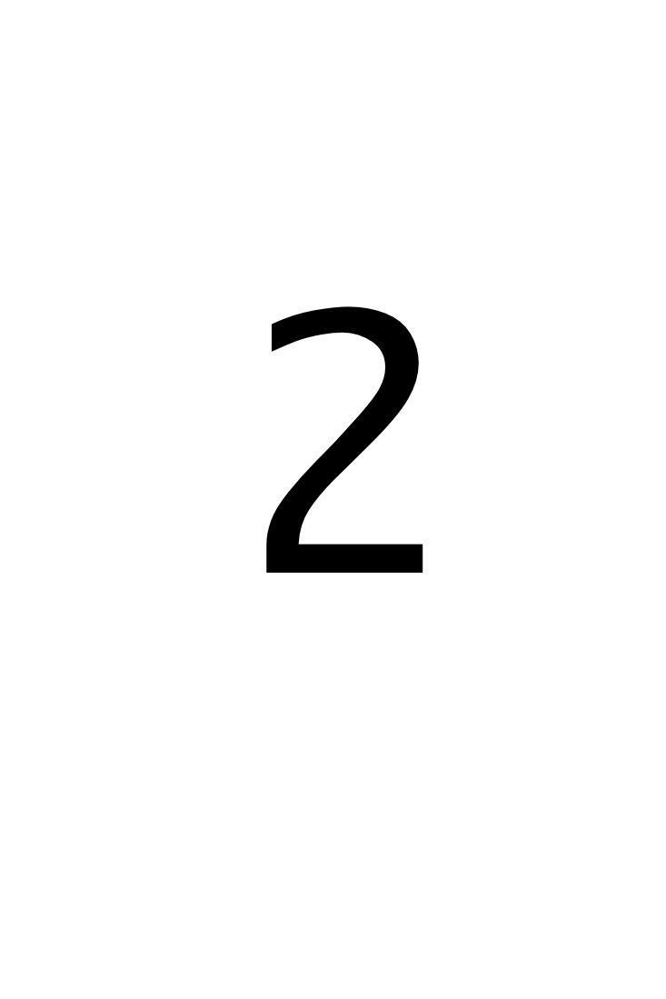


Challenge!
Compute the arithmetic mean of 4 and 7.
Find three solutions using all of these cards simultaneously:
3x
3x
4x
3x
5x
2x
2x

Slide 21
Solutions!
Compute the arithmetic mean of 4 and 7.

Slide 22
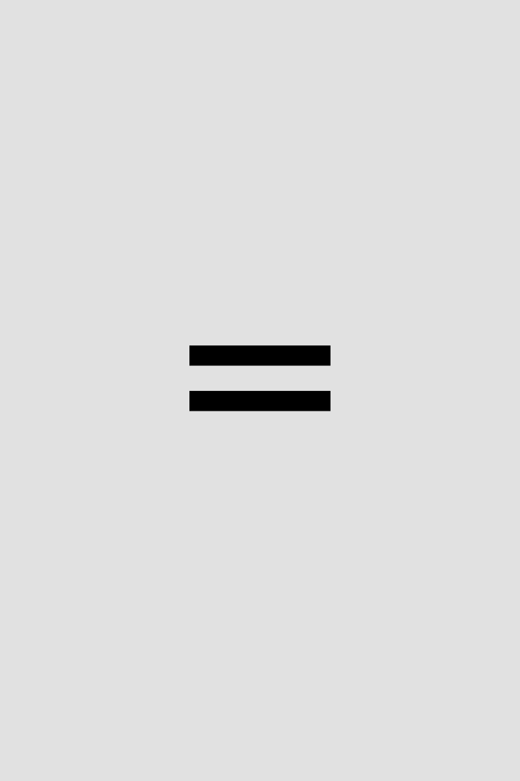
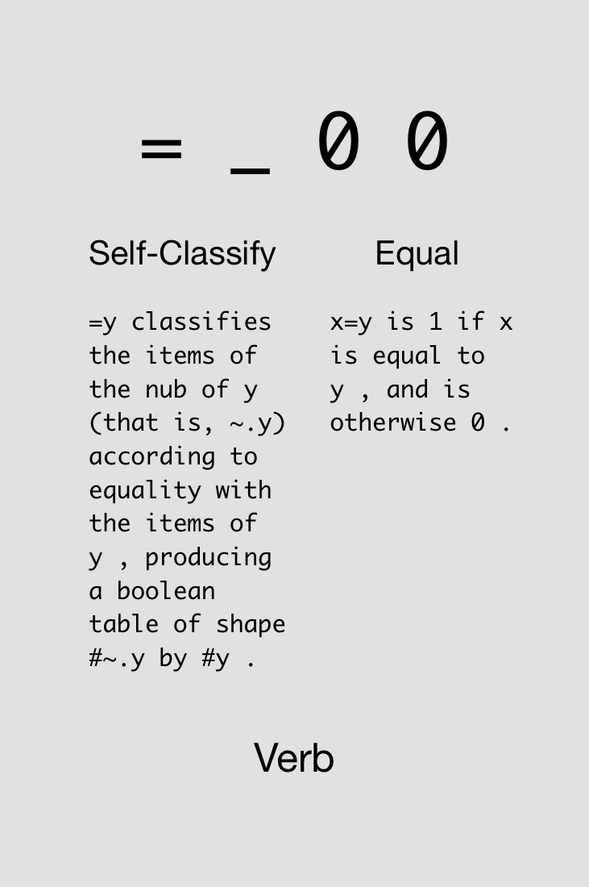

Slide 23

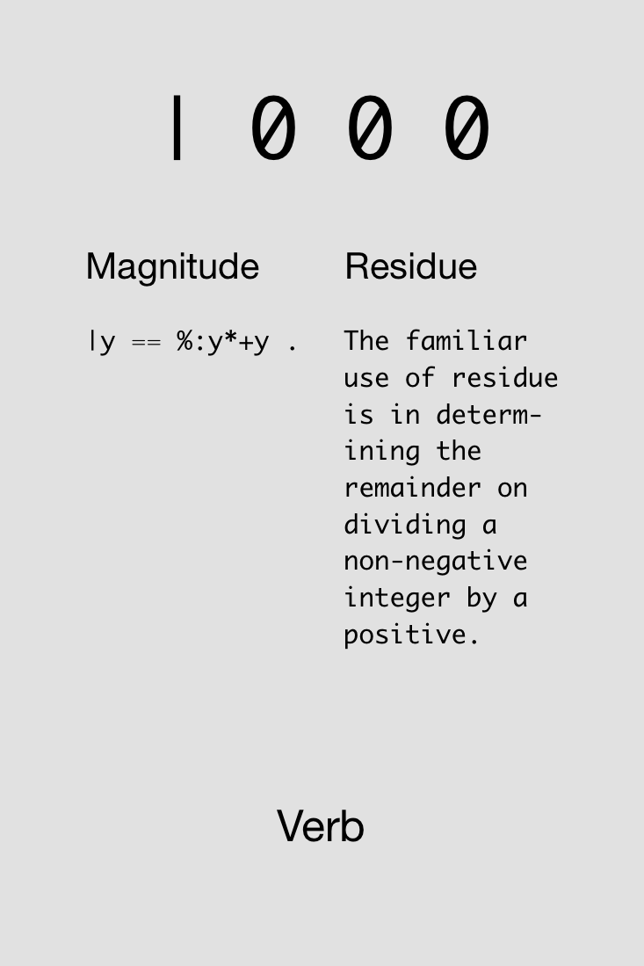

Slide 24
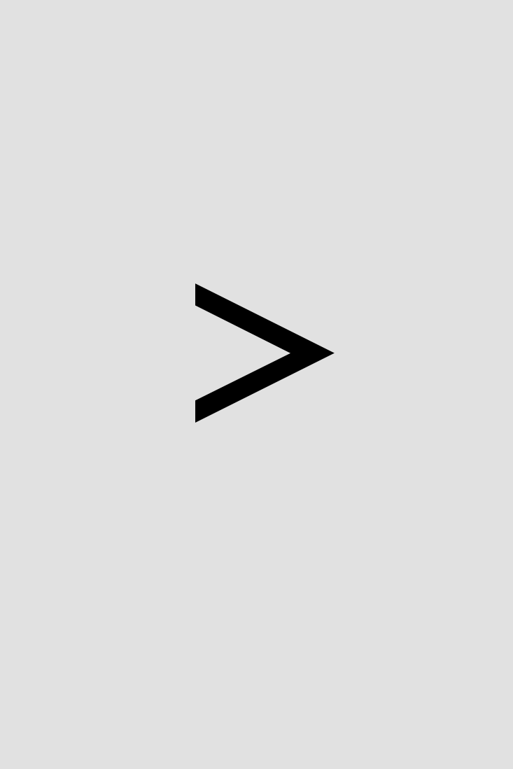
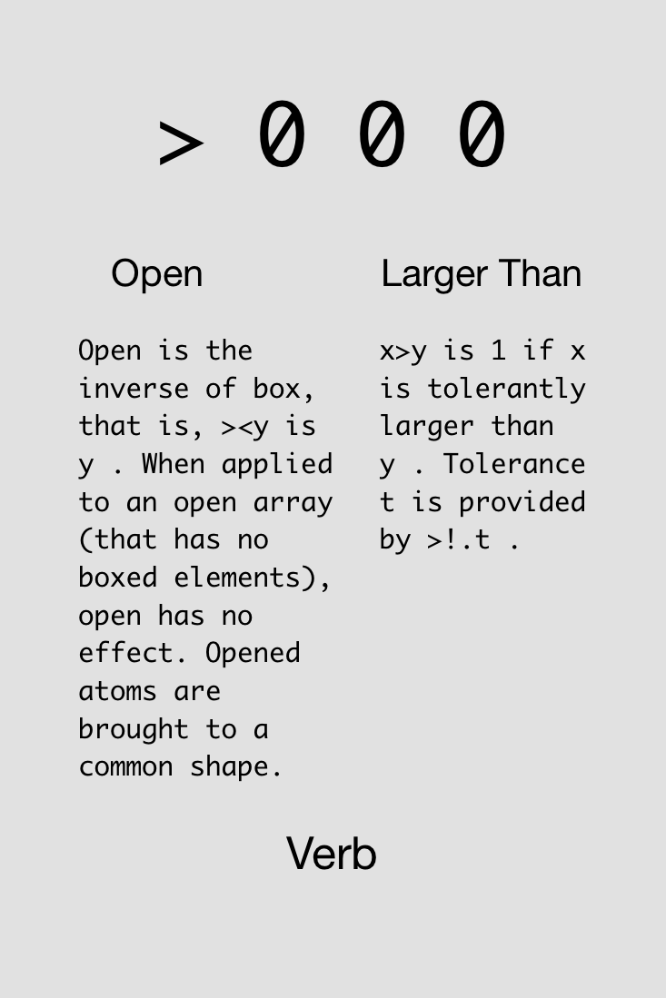

Slide 25

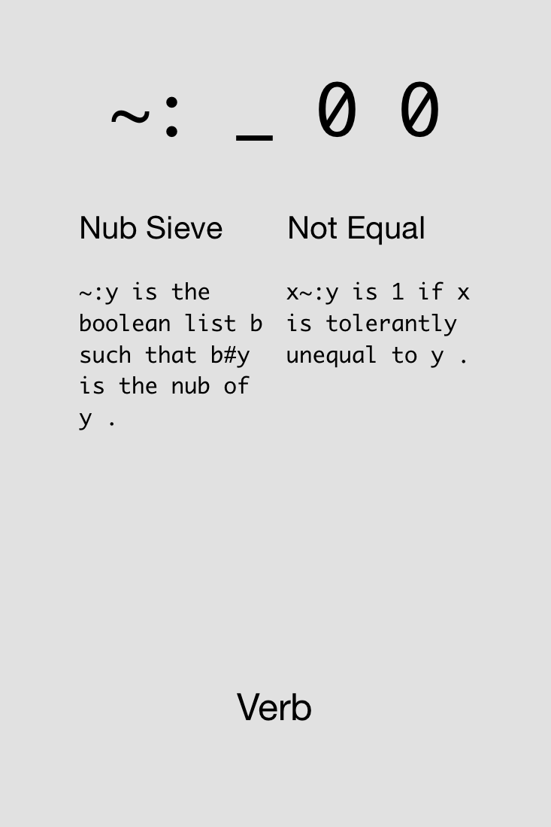

Slide 26

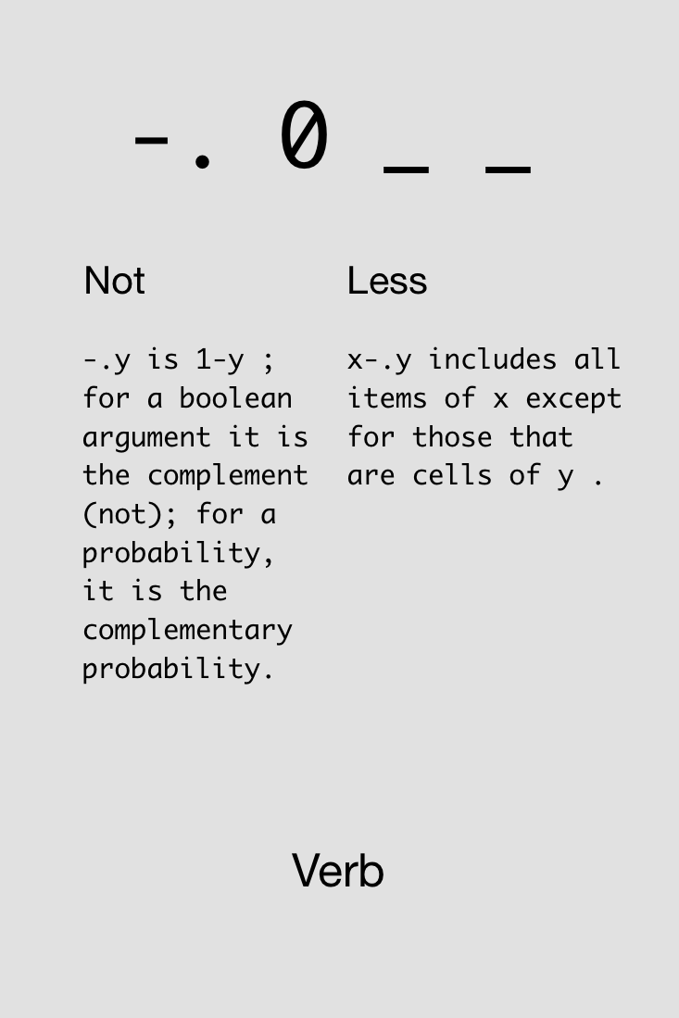

Slide 27


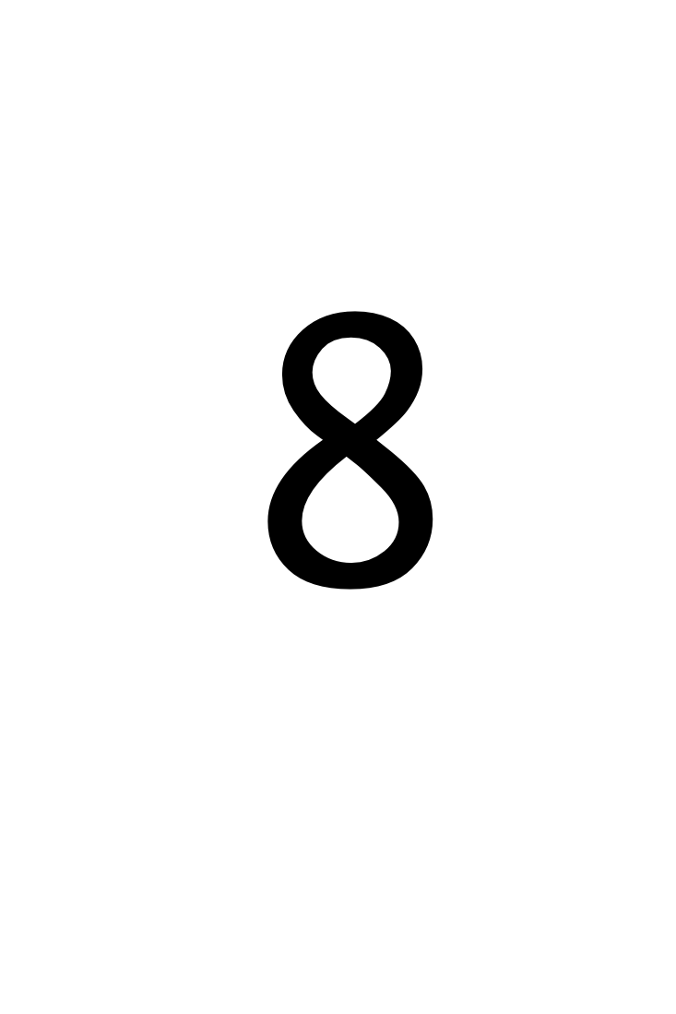
Challenge!
Compute whether a number, say 8, is even (gives 1 if even, 0 otherwise).
Find four solutions using all of these cards simultaneously:
1x
2x
4x
1x
4x
4x
1x
1x
1x

Slide 28
Solutions!
Compute whether a number, say 8, is even (gives 1 if even, 0 otherwise).

Slide 30
Try not to reinvent the rut

Slide 31
Arrays

Slide 32
Any variable can be an array. As for what the type and dimensioning is: you assigned the variable, didn't you? It contains whatever you put into it, a number, a string, an array, a structure... J will remember. If your program logic requires you to find out the current attributes of a variable, J can tell you.
J for C Programmers

Slide 33
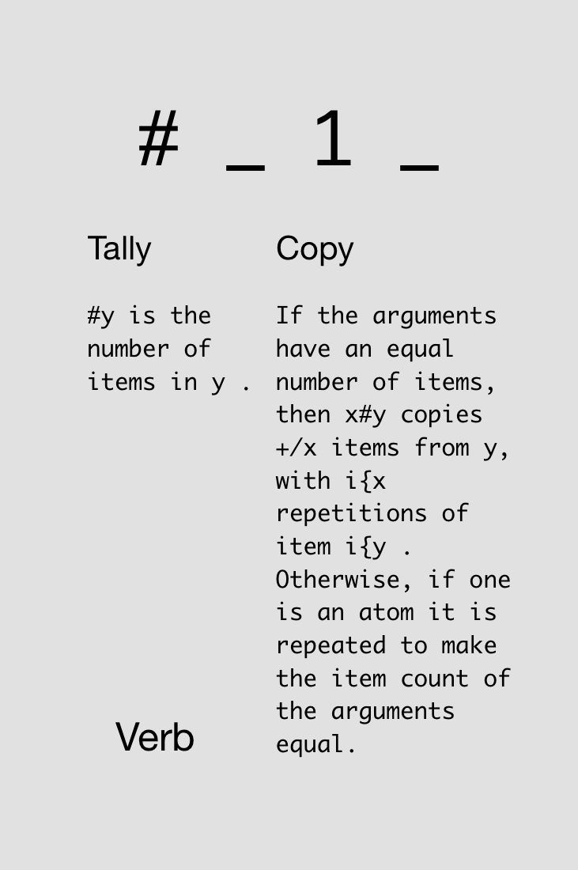

Notes:
Just monadic form

Slide 34
Variable assignment and array size:
a =: 5 3 7 9
a
5 3 7 9
#a
4
s =: 'hello'
#s
5
Notes:
No precedence rules except parentheses ()

Slide 35
In J, every operator has a loop built in.
J for C Programmers

Slide 36
Automatic element-by-element operations:
1 2 3 + 4 5 6
5 7 9
1 + 4 5 6
5 6 7
1 2 + 4 5 6
|length error
| 1 2 +4 5 6
Notes:
No precedence rules except parentheses ()

Slide 37
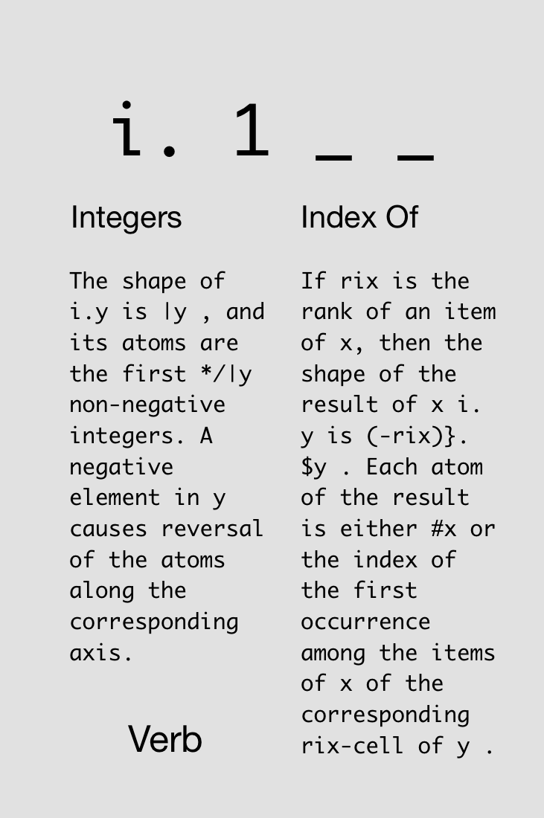
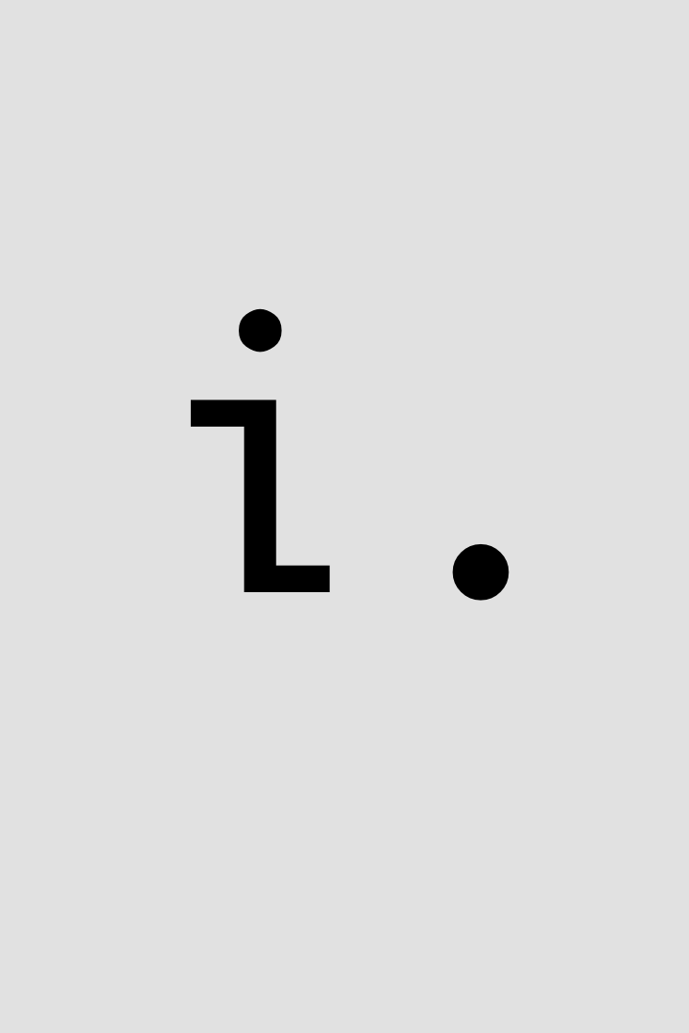

Slide 38
Notes:
Now dyadic form

Slide 39
i.4
0 1 2 3
3+i.4
3 4 5 6
3#i.4
0 0 0 1 1 1 2 2 2 3 3 3
#3#i.4
12
3##i.4
4 4 4
Notes:
No precedence rules except parentheses ()

Slide 40
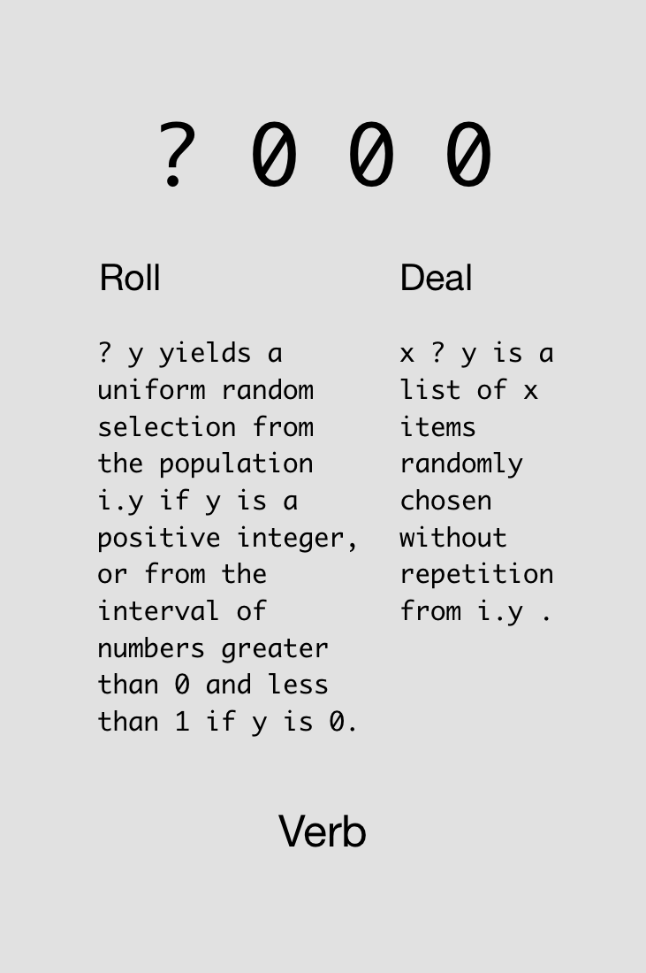
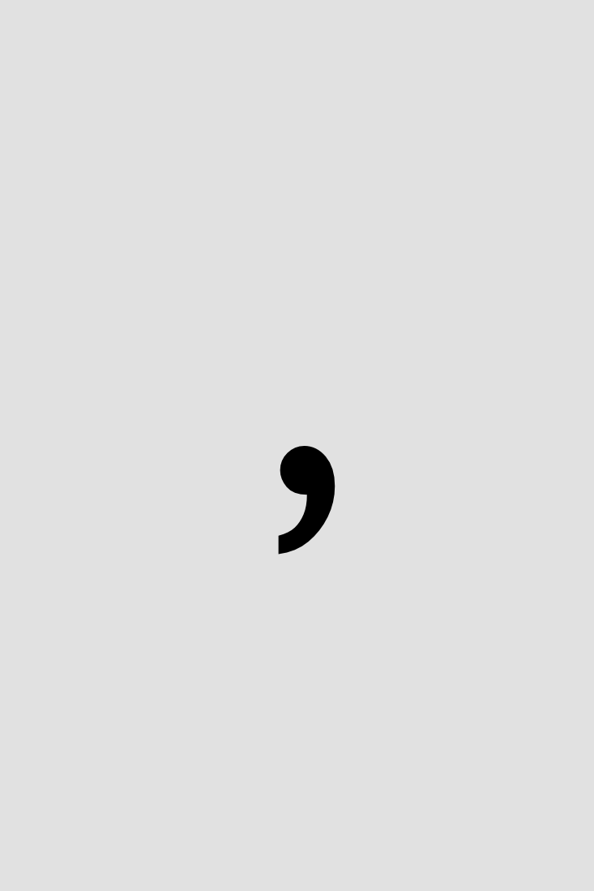


Slide 41
?5
1
?5
4
?0
0.654682
?5 2 3 6
3 1 0 4
3?7
1 4 2
Notes:
No precedence rules except parentheses ()

Slide 42
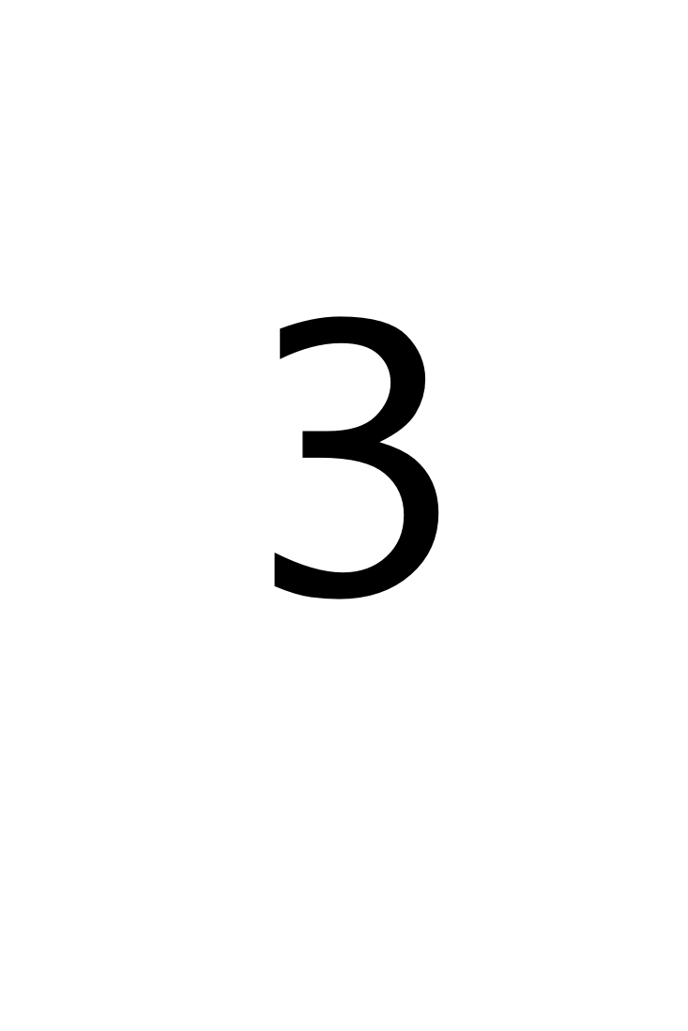
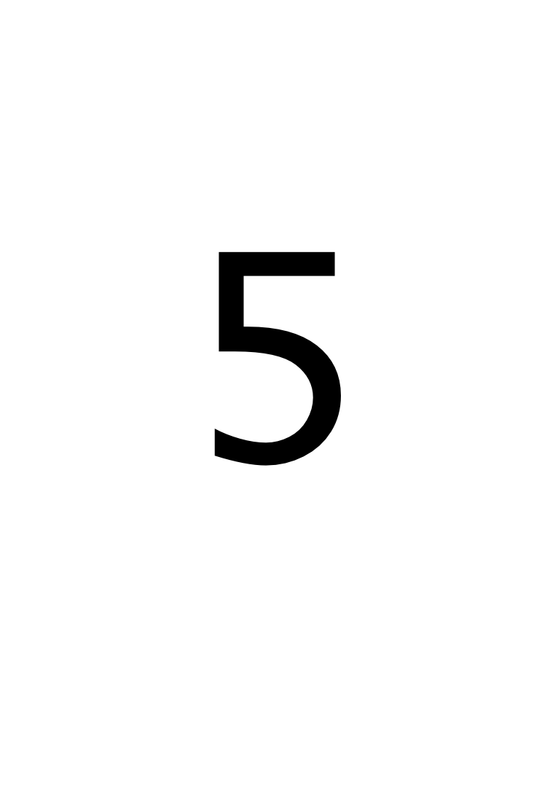
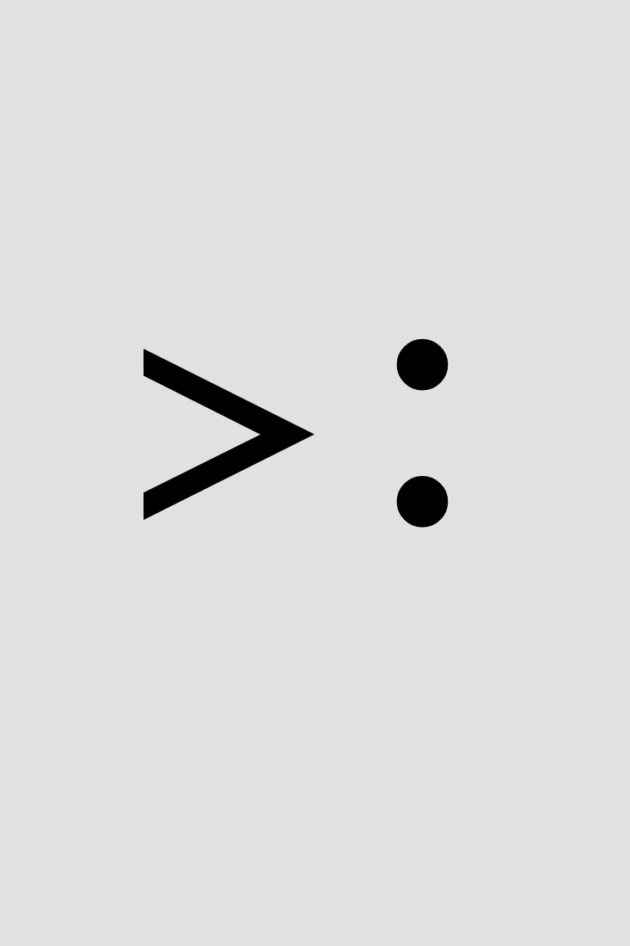
Challenge!
Roll five d20 dice with +3 modifiers on all rolls.
Find four solutions using all of these cards simultaneously:
4x
4x
4x
4x
4x
4x
4x
2x
Notes:
>: intentionally not described ahead of time

Slide 43
Solutions!
Roll five d20 dice with +3 modifiers on all rolls.

Slide 44
Solutions!
Roll five d20 dice with +3 modifiers on all rolls.

Slide 45
Adverbs
Notes:
Loopless coding

Slide 46
A noun holds data; a verb operates on one or two nouns to produce a result which is a noun; an adverb operates on one noun or verb to produce a derived entity.
J for C Programmers

Slide 47
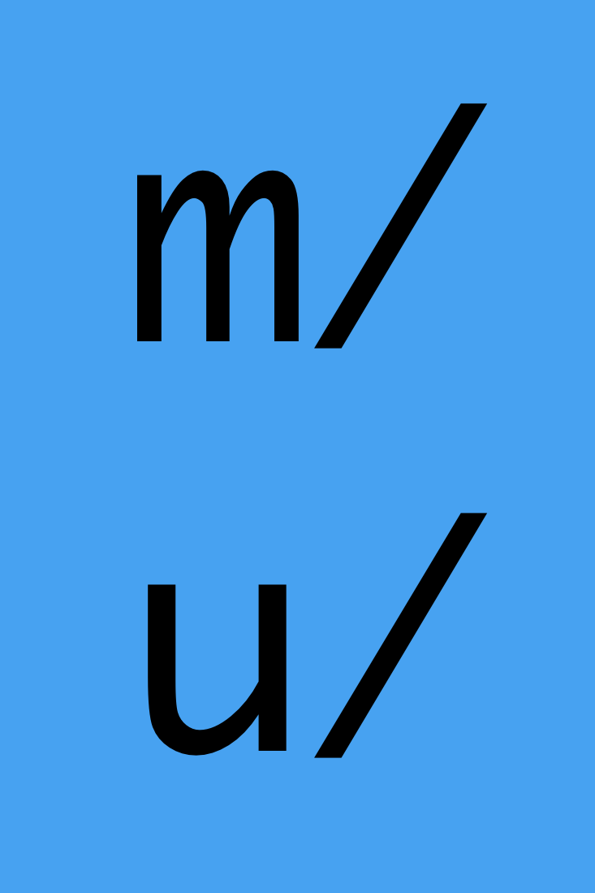
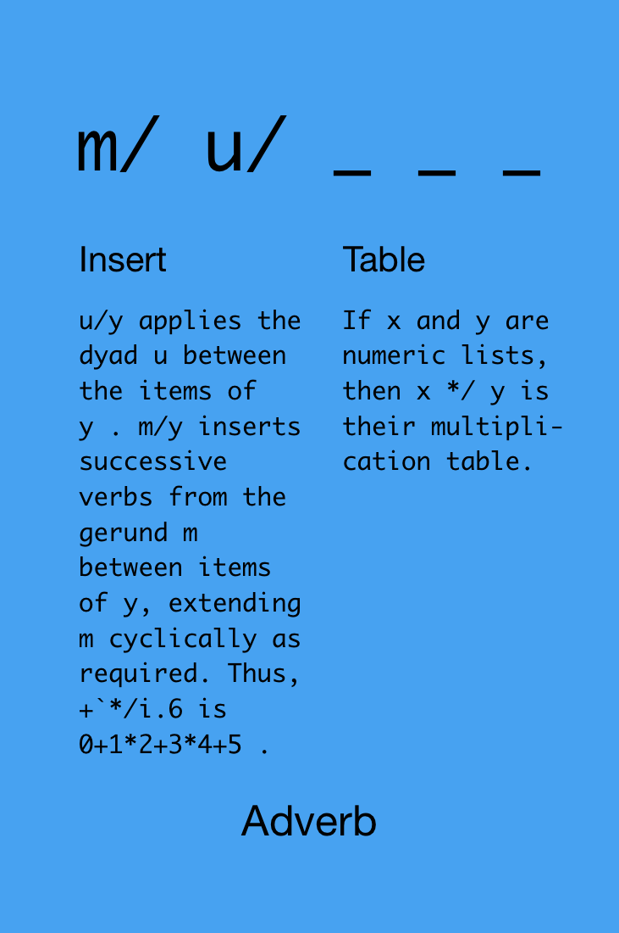

Slide 48
1+2+3+4+5
15
+/1 2 3 4 5
15
*/1 2 3 4 5
120
Notes:
No precedence rules except parentheses ()

Slide 49
New version of “arithmetic mean”:
vals=:3 _4 7 9 _2 3
+/vals
16
#vals
6
(+/vals)%(#vals)
2.66667
+/vals%#vals
2.66667
Notes:
No precedence rules except parentheses ()

Slide 50
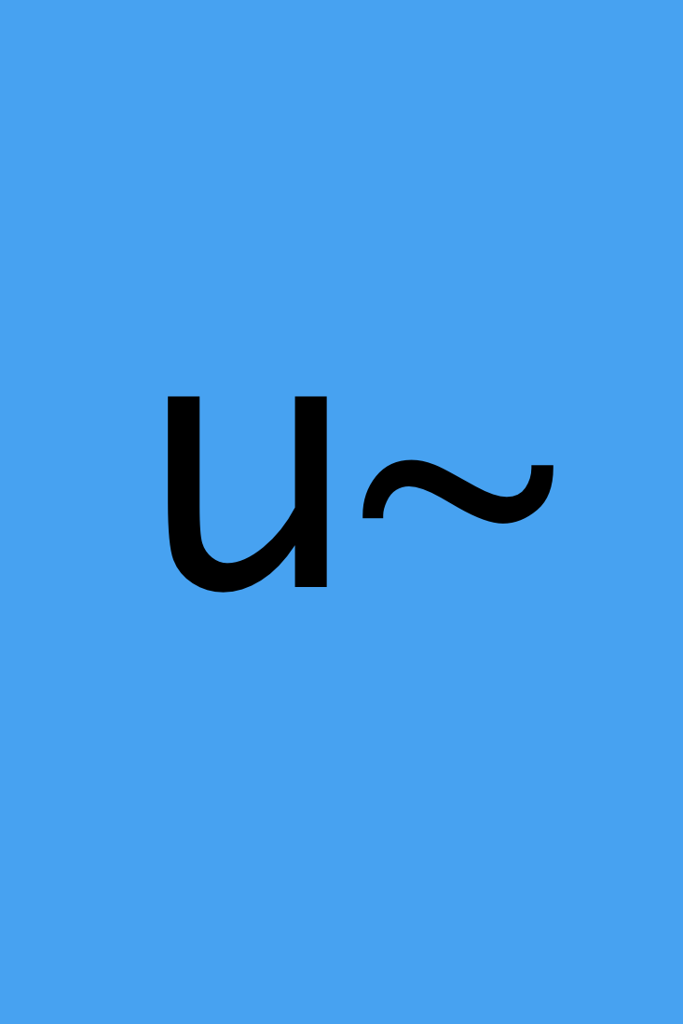
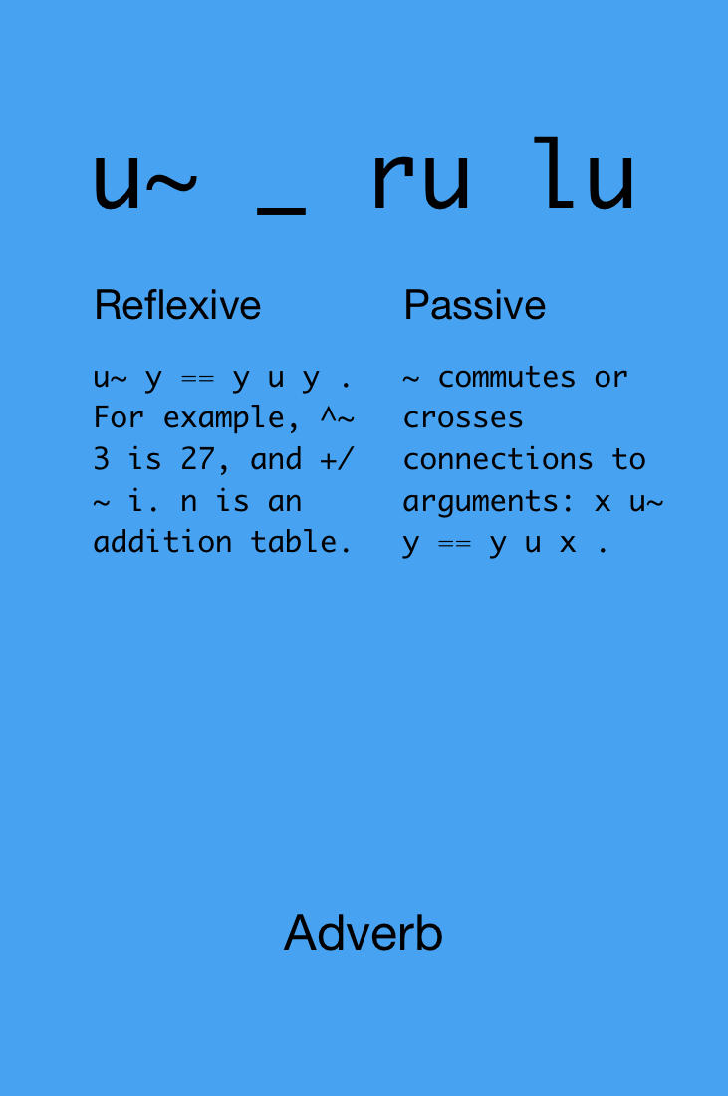

Slide 51

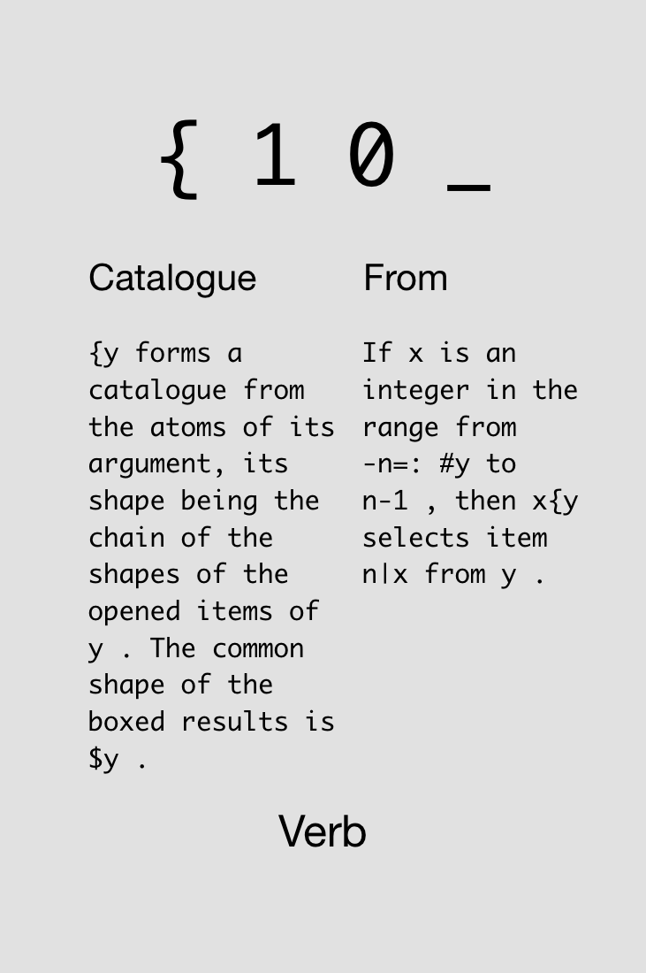
Notes:
“-n=: #y to n-1” means: from (first let n=4) -4 to 3

Slide 52


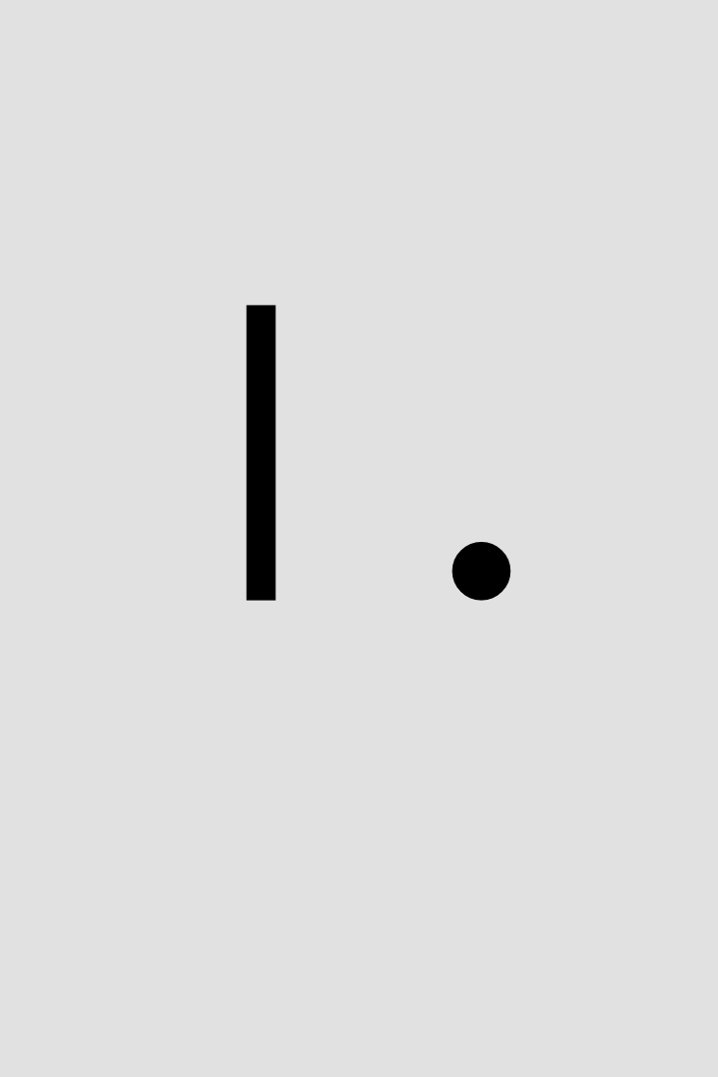
Challenge!
Given a string (or any array) s, determine if it’s a palindrome.
Find two solutions using all of these cards simultaneously:
5x
s
1x
1x
1x
2x
1x
1x
1x
1x
1x
2x
Notes:
|. intentionally not described ahead of time

Slide 53
Solutions!
Given a string (or any array) s, determine if it’s a palindrome.
s
s
s
s

Slide 54
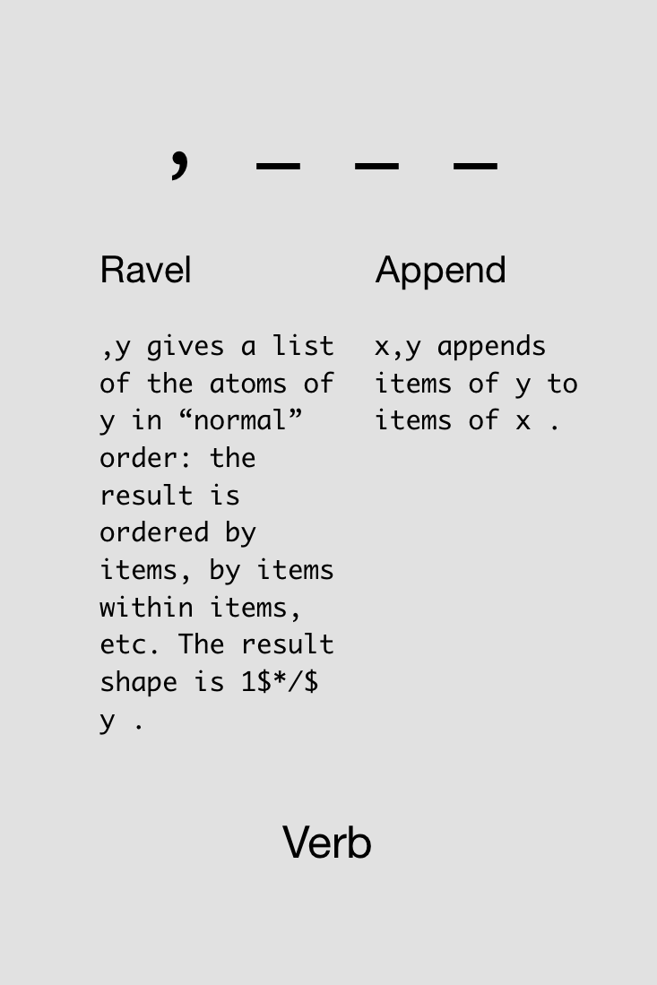

Slide 55
(i.3) (i.5)
|syntax error
| (i.3)(i.5)
(i.3),(i.5)
0 1 2 0 1 2 3 4
Notes:
No precedence rules except parentheses ()

Slide 57
Never put a seat belt around your intuition

Slide 58
Atoms, Lists,
Tables, et al.

Slide 59
Rank

Slide 60
The rank of a noun is the count of its axes. An atom has rank 0, a list rank 1, a table rank 2, and an array with 5 axes has rank 5.
J Primer

Slide 62
If you’re lucky enough to experience a miracle,
try not to micro manage it

Slide 63
Recursion

Slide 65
Devalue having

Slide 66
Hooks, Forks,
Tacit Functions

Slide 67
J uses the names x, y, u, v, m, and n to represent arguments to verbs and other entities. You should avoid using these names for other purposes.
J for C Programmers

Slide 69
Avoid both picking at minutia and sideswiping mountains

Slide 70
Big Data

Slide 71
This is one of the things that makes programming in J so pleasant: you don’t have to worry about allocating storage, or freeing it, or wondering how long is long enough for a character-string variable, or how big to make an array.
J for C Programmers

Slide 72
You may at first worry that you're using too much memory, or that you might misuse the processor's caches; get over it. Apply verbs to large operands.
J for C Programmers

Slide 74
Live for the destiny that aches for you

