Slide 1
Springboard Capstone Project One Predicting MY Next Craft Beer
Author: Josh Mayer
Date: September 14, 2017

Slide 2
Outline
Introduction & Problem Statement
The Untappd Application
Dataset
Analysis & Findings
Statistical Inference
Machine Learning
Conclusions

Slide 3
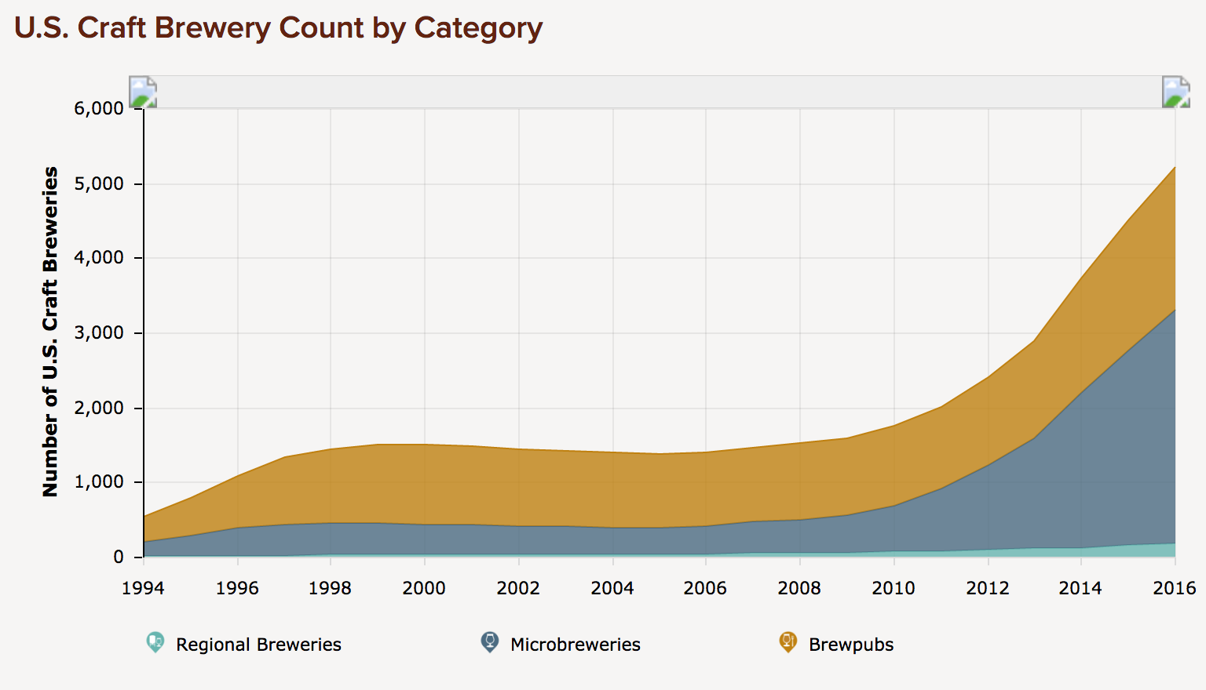
Introduction & PROBLEM STATEMENT
With almost 200% new craft breweries since 2010 and over 5,000 unique craft breweries in the U.S. today, beer is one of the fastest growing products in America.
THE PROBLEM
Given the substantial rise in the number of craft breweries deciding which beer to try next can be a confusing decision.
Source: https://www.brewersassociation.org/statistics/number-of-breweries/

Slide 4
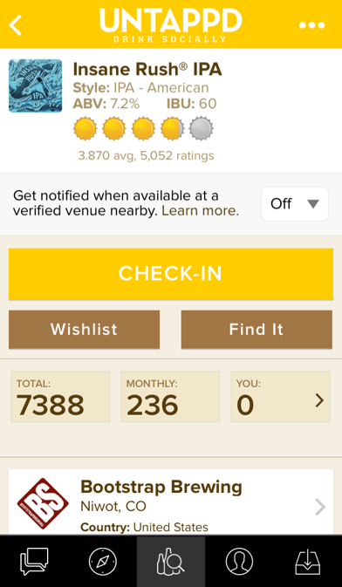
The Untappd Application
Untappd is an existing application that allows its users to rate and track each beer sampled. This data should be leveraged to help its users determine which beer to try next.
1) In this example I tried the beer named “Insane Rush IPA”.
3) Each beer shows you the average user rating as well as the number of unique ratings.
2) Upon check-in users may elect to rate the beer based on a 1 (worst) to 5 (best) scale.
Screenshot of the Untappd iPhone Application

Slide 5
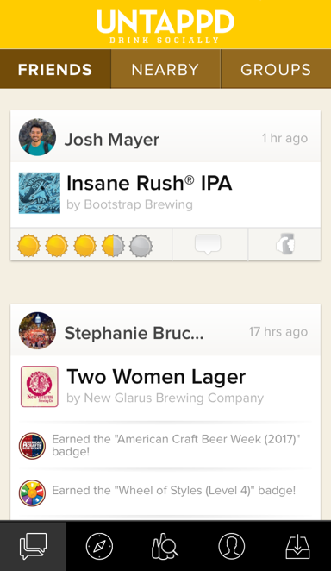
THE GOAL
The Untappd application should leverage its user ratings and provide tailored recommendations based on an individual users preferences.
PRIMARY OBJECTIVE
Based on a user’s historical ratings create predictions for untasted beers and create a personalized recommendation on which beer to sample next.
Screenshot of the Untappd iPhone Application

Slide 6
DATA ACQUISITION & WRANGLING
Data was acquired via calling the Untappd API. In total, almost 30,000 API calls were required to compile all of the necessary data for the project.
 | Primary Dataset (My personal ratings) Test/Train Set | Secondary Dataset (Untasted beer) Prediction Set
Results Returned per API Call | 50 | 1
Total Unique Records (Beers) Acquired | 181 | 19,838
API Calls Required | 4 | 29,146
Features Returned per Beer | 35 | 53
DATA WRANGLING
Duplicate Records - 9,308 records (32% of the acquired records) were dropped since they were duplicates. Driven by users creating duplicate records of the same beer (identified via unique beer ID).
Null Values – some of the records had features with null values (e.g. beer description, brewery city).
Outliers – records (beers) with a rating of 0.0 (meaning that I forgot to rate the beer upon check-in).

Slide 7
CHALLENGES WITH DATA ACQUISITION
Many challenges were encountered and overcome during the data acquisition phase.
PRIMARY CHALLENGES
The Untappd applications limits the number of API calls allowed to 100 per hour (required 300 hours to gather all of the data).
Built scripts to acquire and load the data into CSV files hourly.
A significant number of duplicate records returned from API calls had to be removed.
Believe the cause to be the fact that any user may create a new beer entry (record) even though it may already exist.
THE HOURLY PROCESS
The launch control app (1) hourly triggered a Python script to request 100 API calls, return the JSON data (2), and export the returned results to a CSV file (3).
Launch Control
App
1
Python Script
2
Untappd API
3
CSV File

Slide 8
INITIAL Hypothesis
The initial hypothesis was to determine if there was a statistical difference between my personal ratings and the ratings of the average Untappd user.
TWO-SIDED T-TEST RESULTS
Null hypothesis: mean of my beer ratings is the same as the mean of average user beer ratings.
P-value result of 0.40, meaning I cannot reject the null hypothesis.
The result meant that my ratings did not differ significantly from the average user, which was a surprising result.
COMPARING MY RATINGS TO THE AVERAGE USER RATINGS*
 | My Rating | Average User Rating
Unique Beer Count | 181.00 | 181.00
Average Rating | 3.39 | 3.43
Standard Deviation | 0.64 | 0.39
Lowest Rating | 1.50 | 2.31
25th Percentile | 3.00 | 3.16
50th Percentile | 3.50 | 3.53
75th Percentile | 3.75 | 3.73
Highest Rating | 5.00 | 4.56
*Rating scale is 1-5 with 5 being the highest score

Slide 9
FURTHER ANALYSIS
In addition to researching the initial hypothesis it was important to understand the potential impacts of other features in the primary dataset.
FEATURE ANALYSIS – R-SQUARED RESULTS
Style of Beer: 0.69
Alcohol by volume (ABV): 0.40
Individual bitterness unit (IBU): 0.24
Unique Brewery: 0.14
“Style of beer” was the feature with the highest correlation to beer rating with an R-Squared result of 0.69. This makes sense given that I prefer certain types of beer over others.
EXAMPLE: MY RATINGS VS BREWERY

Slide 10
MACHINE LEARNING
After analyzing the various features the goal was to determine the best algorithm to use to predict a user’s rating for a particular beer.
MACHINE LEARNING APPROACH
Test supervised learning algorithms with the key features: Linear Regression, Random Forest, and Gradient Boosting.
Leverage some of the feature analysis capabilities in the Random Forest algorithm to better understand the key features.
Understand model results and identify the best model.
Leverage the best model to create prediction ratings for the dataset of untasted beer.
FOCUS ON SUPERVISED LEARNING
Given the goal was to predict a specific numerical rating the focus was on supervised learning and regression algorithms.

Slide 11
MACHINE LEARNING – MODEL RESULTS
Evaluating different regression algorithms proved that Random Forest Regression produced the best results.
 | Train/Test Split | Cross-Validation (CV) | Model Score (1.0 is best)
Random Forest Regression | Yes | No | 0.61
Gradient Boosting Regression | Yes | No | 0.60
Linear Regression | Yes | Yes | 0.48 CV Score: 0.52
Overall the Random Forest Regression produced the best results although Gradient Boosting Regression was a close second. Linear Regression was a distant third even with leveraging cross-validation.

Slide 12
MACHINE LEARNING – FEATURE ANALYSIS
Leveraging some of the feature analysis capabilities of the Random Forest algorithm we see that average user rating is by far the best predictor of my individual rating.
FEATURES BY ORDER OF IMPORTANCE
Average User Rating
Country of Production
Beer Style
Brewery
Beer ID
City of Production
Number of Ratings
Alcohol by Volume (ABV)
Bitterness (IBU)

Slide 13
MACHINE LEARNING - PREDICTION
Implementing the newly built rating prediction model on the secondary dataset of almost 20,000 untasted beers shows that my top rated beer would be the Citra Single Hop Pale Ale from Hill Farmstead Brewery.
#1
Citra Single Hop Pale Ale
#2
Sucaba Barley Wine
#3
Angel's Share Bourbon Stout
#4
Rouge Sour Red Ale
#5
Parabola Russian Stout
Brewery: Hill Farmstead
Location: Greensboro, NC
My Predicted Rating: 4.60
Average User Rating: 4.30
Brewery: Firestone Walker
Location: Paso Robles, CA
My Predicted Rating: 4.50
Average User Rating: 4.36
Brewery: Hill Farmstead
Location: San Marcos, TX
My Predicted Rating: 4.48
Average User Rating: 4.29
Brewery: Brouwerij Omer Vander Ghinste
Location: Bellegem, Belgium
My Predicted Rating: 4.43
Average User Rating: 4.02
Brewery: Firestone Walker
Location: Paso Robles, CA
My Predicted Rating: 4.43
Average User Rating: 4.53

Slide 14
RESULTS SUMMARY
KEY FINDINGS
As users taste and rate more beer the impact of regression towards the mean is real. In this project this allowed the use of “average user rating” as a feature for model creation and prediction.
Along with producing the best overall model results, Random Forest Regression was the simplest algorithm to practically use and understand.
Given that the best model had a coefficient of determination (r-squared) of 0.61 there is still considerable room for improvement.
Leveraging the best model to predict future beer ratings provided some surprising results: two of the top five beers suggested are from the same brewery and I am excited to seek out and try their beer!

Slide 15
RECOMMENDATIONS & FUTURE IMPROVEMENTS
Key results show that the Untappd team could implement a prediction model to help users select their next beer.
PRIMARY RECOMMENDATIONS
Implement a prediction model to help users select their next craft beer.
OK to use “average user rating” as a feature.
Make the beer creation (record entry) process a bit more cumbersome for the user (e.g. require certain fields to have values).
Scrub the production environment on a regular basis to remove duplicate records (beers).
FUTURE IMPROVEMENTS
Leverage real-time, location-based data to help identify beers that may be immediately available to the user.
Provide real-time access to API data.
Run test/train model on a larger dataset to make a more robust prediction model.

