Slide 1
Springboard Capstone Project One Predicting Your Next Craft Beer
Author: Josh Mayer
Date: May XX, 2017

Slide 2
Outline
Introduction & Objective
The Untappd Application
The Dataset
Initial Analysis & Findings
Statistical Inference
Conclusions

Slide 3
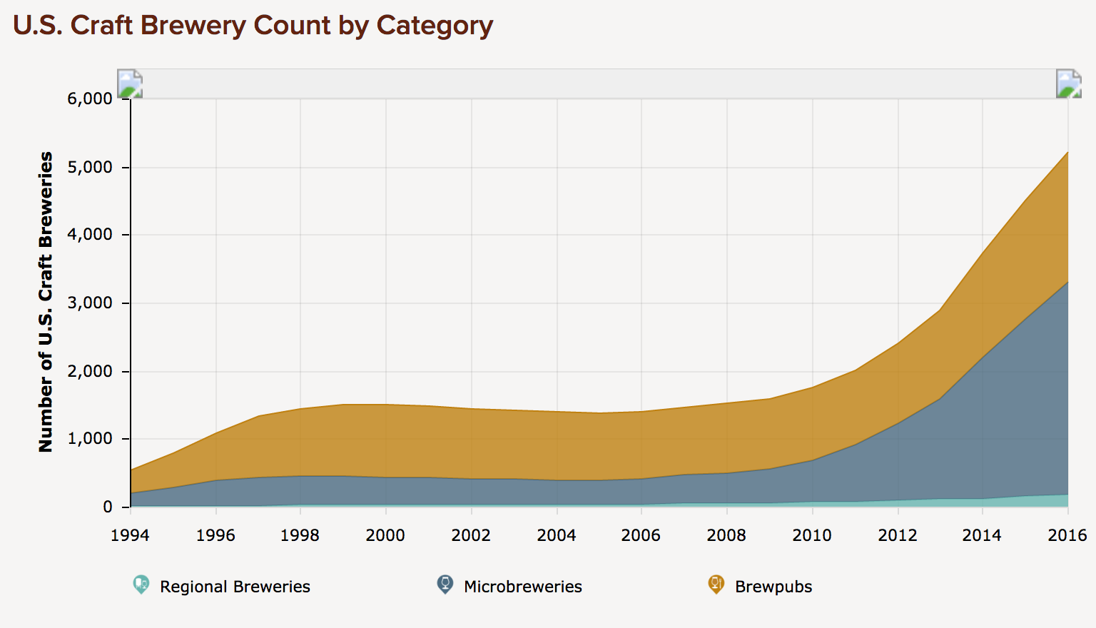
Introduction & Objective
With almost 200% new craft breweries since 2010 and over 5,000 unique craft breweries in the U.S. today, beer is one of the fastest growing industries in America.
Given the substantial rise in the number of craft breweries, deciding which beer to try next can be a confusing decision.
Source: https://www.brewersassociation.org/statistics/number-of-breweries/

Slide 4
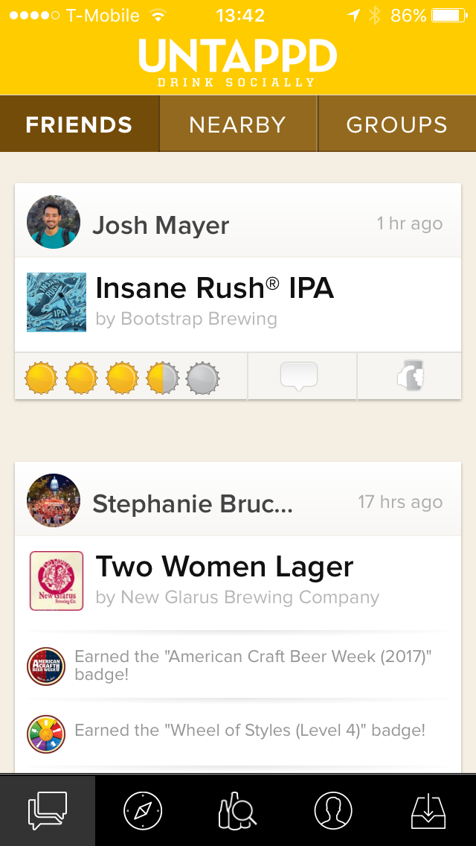
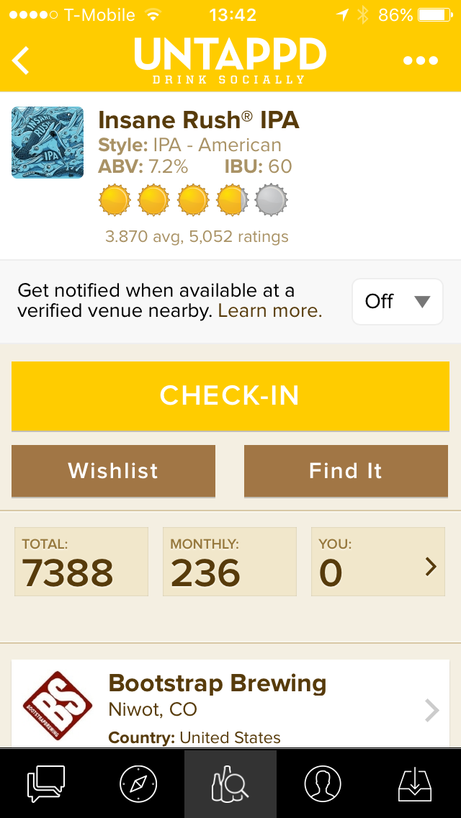
The Untappd Application

Slide 5
The Dataset

