Slide 1


Conditional Access Policy Documentation
Tenant ID
<TenantID>
Tenant Name
<TenantName>
Generated by
<GeneratedBy>
Generated on
<GenerationDate>
idPowerToys.com

Slide 2
Table of contents
# | Policy | State

Slide 3




















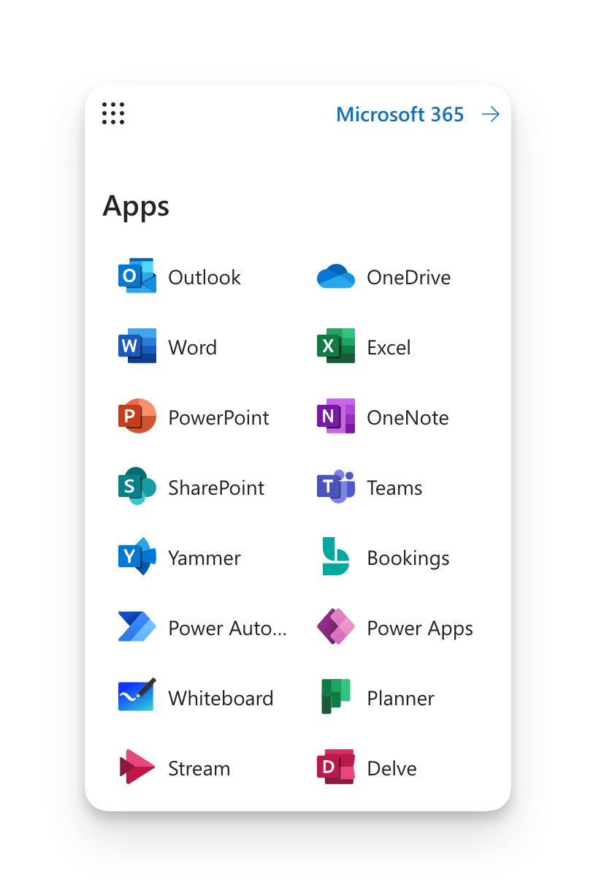

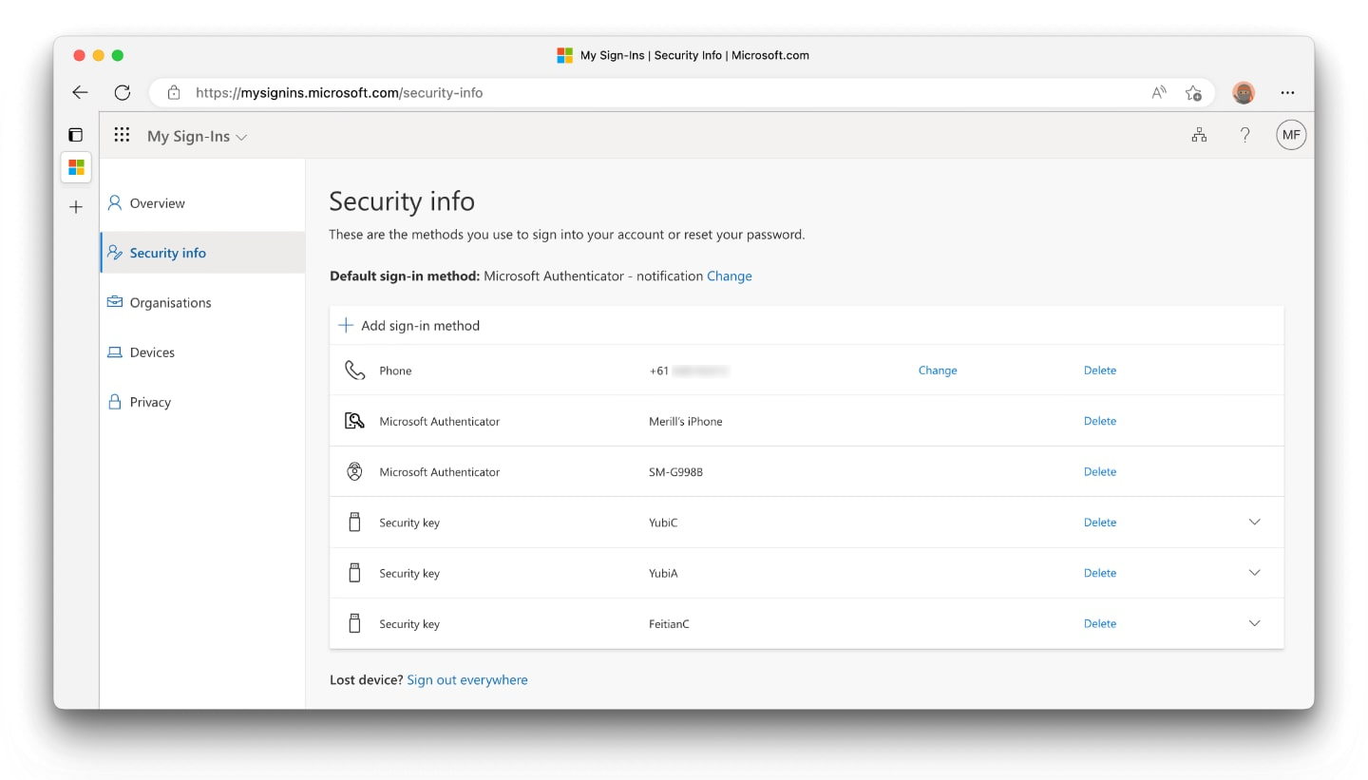
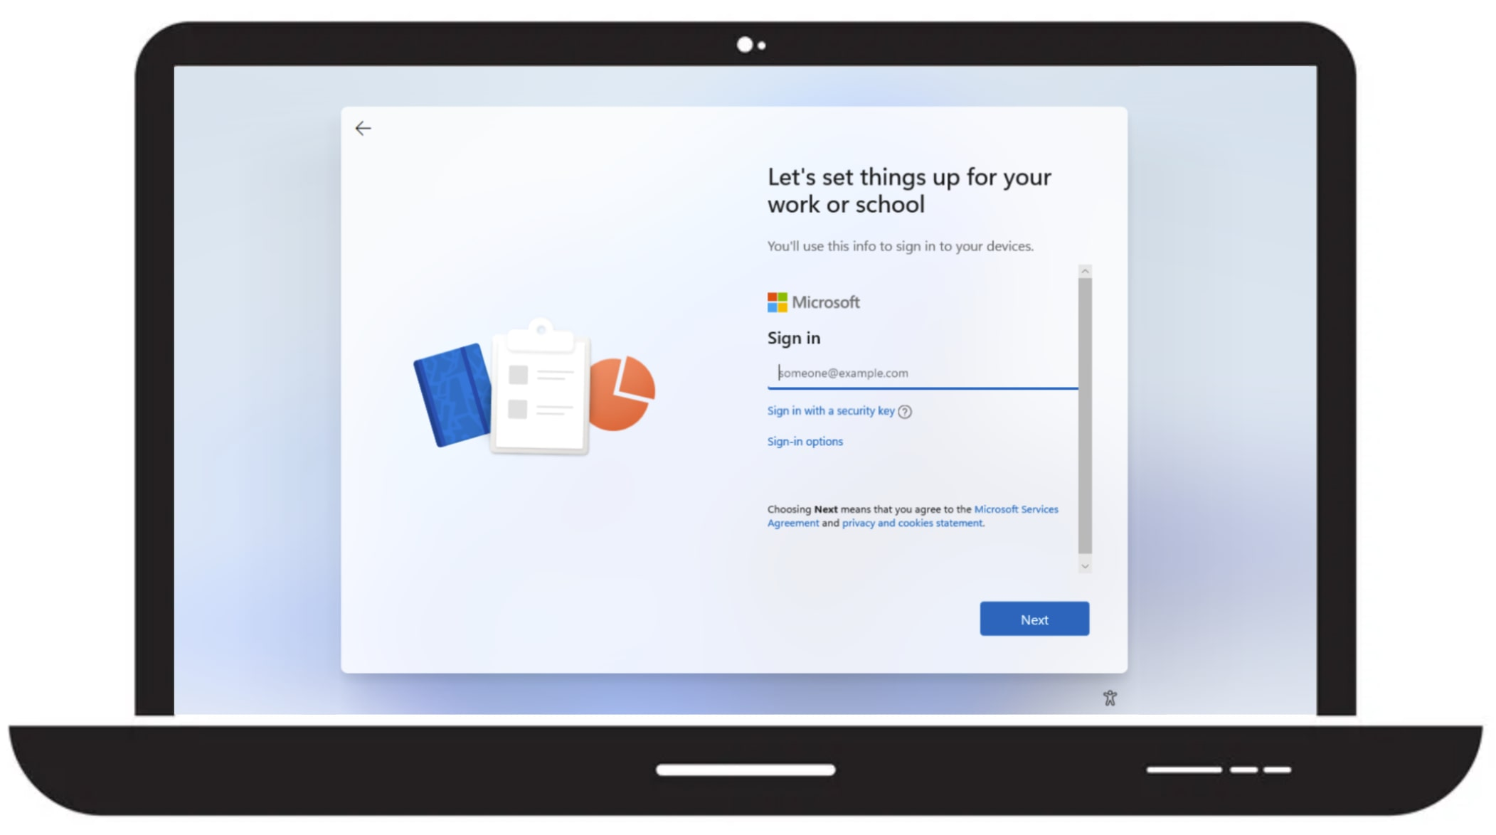














Conditional Access Policy Name
Policy Disabled
Policy Enabled
Policy Report-only
Last modified: 2022-00-00
Risk
Device platforms
Client apps
Filter for devices
Locations
Not configured
Not configured
Not configured
Not configured
Not configured
Conditions
Identity
Grant access
Microsoft Admin Portals
Block access
[Require one]
Session Controls
Grant Controls
<UserWorkloadIncExc>
Multifactor authentication
<CloudAppActionIncExc>
App enforced restrictions
Authentication strength
Conditional Access App Control
App Control Policy
Compliant device
Sign-in frequency
Hybrid Azure AD joined device
Periodic reauthentication
Approved client app
Persistent browser session
Always persistent
App protection policy
Continuous access evaluation
Strictly enforce location policies
Change password
Disable resilience defaults
Custom authentication factor
Token protection for session
Terms of use

