Slide 1

Master of Science
Applied Data Science
Portfolio Milestone
Joshua A. Gaze
SUID: 411546359

Slide 2
Introduction
The masters of science in Applied Data Science program offered by the School of Information Studies at Syracuse University provides students the opportunity to apply the concepts of data science to enterprise operations and processes, particularly in the areas of data capture, management, analysis and communication for decision making.
Projects were conducted throughout the program which demonstrate the skills developed in the course(s) which include, but not limited to:
IST 659: Data Administration Concepts & Database Management
IST 719: Information Visualization
IST 707: Data Analytics

Slide 3
Program Learning Outcomes
Collect, store, and access data by identifying and leveraging applicable technologies
Create actionable insight across a range of contexts (e.g., societal, business, political), using data and the full data science life cycle
Apply visualization and predictive models to help generate actionable insight
Use programming languages such as R and Python to support the generation of actionable insight
Communicate insights gained via visualization and analytics to a broad range of audiences (including project sponsors and technical team leads)
Apply ethics in the development, use and evaluation of data and predictive models (e.g., fairness, bias, transparency, privacy)

Slide 4

IST 659 – Database Management

Slide 5

IST 659 – Database Management
Background
This course in Data Administration Concepts & Database Management was taken under the direction of Dr. Gregory Block.
A loyalty rewards database interfacing with the credit card transactions of several issuing banking institutions.
This database will take cardholders transactions from their day-to-day commerce and convert this activity into points which cardholders can then redeem for items/concepts such as cashback cards, statement credits, airmiles, vacation packages, etc.

Slide 6
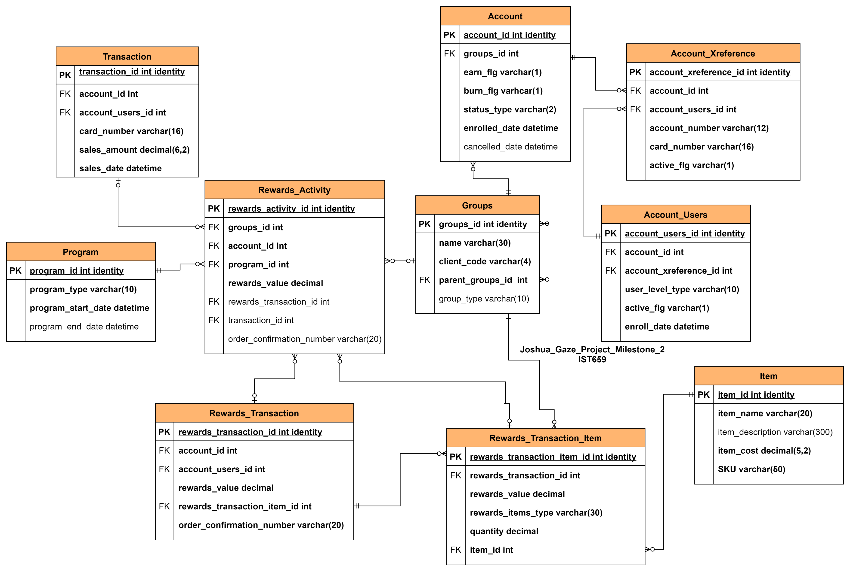
IST 659 – Database Management

Slide 7
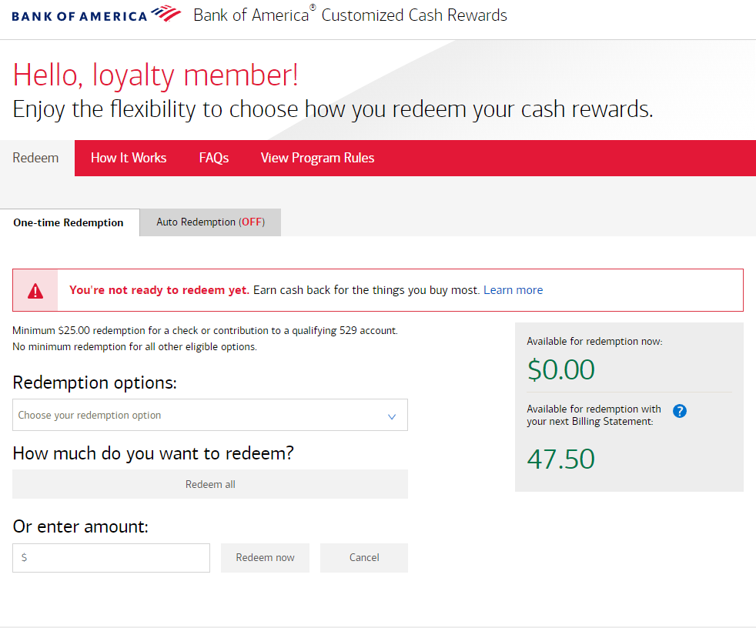
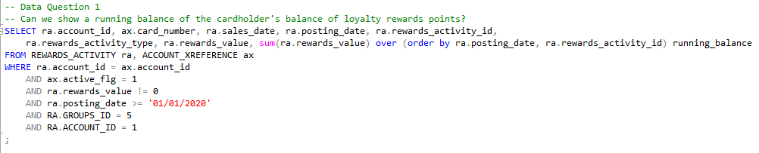
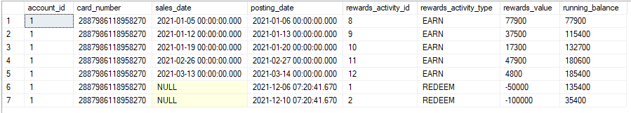
IST 659 – Database Management

Slide 8
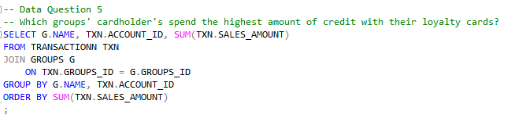
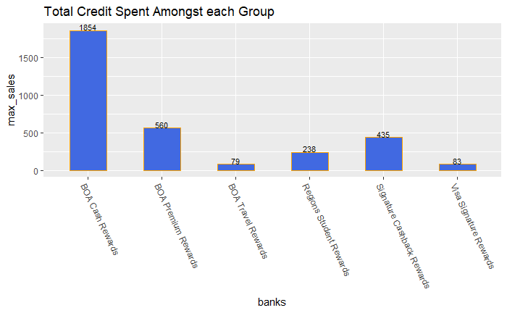
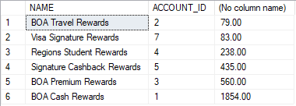
IST 659 – Database Management

Slide 9
IST 659 – Database Management
Reflection
One of my favorite takeaways from this project was the interaction of how data flows through a system. How it is ingested, processed, fed into pipelines, consumed, and everything else.
Regardless of where I end up in my data science career, the likelihood that I do not encounter a relational database management system are about slim to none. Meaning that it was a fantastic opportunity to learn foundational material of how databases work and using SQL to interact with them to meet my data needs.
Realized the importance of data integration in a database system. As a major source of dirty data can stem from it not being properly formatted when it was ingested in the database.

Slide 10

IST 719 – Information Visualization

Slide 11
IST 719 – Information Visualization
Background
This course in Information Visualization was taken under the direction of Professor Gary Krudys.
Tasked with identifying a “data story” through a visual lens.
This data story pertains to the Netflix catalogue, looking for unique insights that are best expressed through data visualizations.
RStudio was used for exploratory data analysis, ggplot and Python for generating the data visualizations, and Adobe Illustrator for constructing the layout and presentation of all the visuals to tell the data story.

Slide 12
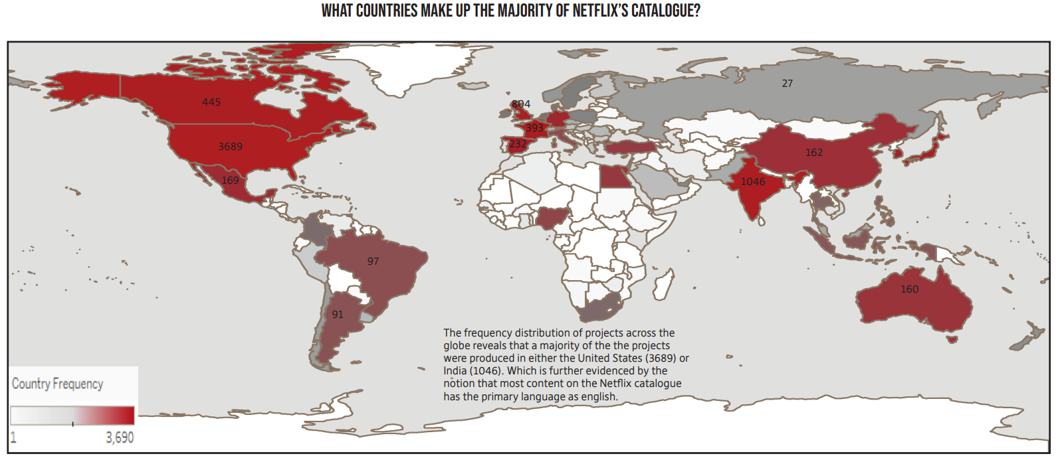
IST 719 – Information Visualization

Slide 13
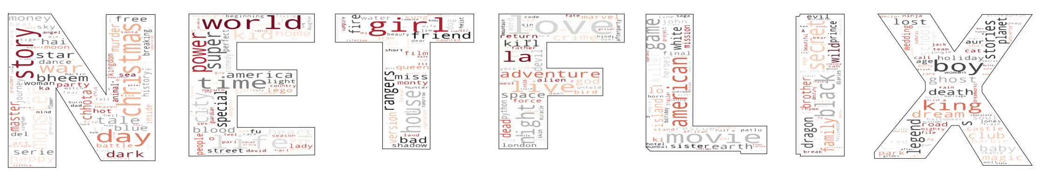
IST 719 – Information Visualization

Slide 14
IST 719 – Information Visualization
Reflection
I found that this course showcases the importance a tool like data visualization is for data scientists. Allowing us to simplify complex information and presenting it visually enables stakeholders to make informed and effective decisions quickly and accurately.
The smallest of things can make the impact of delivery that much greater. My original idea for a data visual on the descriptions of tv/movies was a simple word cloud. But I had the thought of instead creating a word cloud and embedding it into the outline of the Netflix logo. The amount of debugging and research of possible ways to implement this code was exhaustive. Knowing how much of an impact this could have, I strived forward until I was finally successful. I found a solution to make my visual

Slide 15

IST 707 – Data Analytics

Slide 16
IST 707 – Data Analytics
Background
This Data Analytics course was taken under the direction of Professor Ying Lin. Where the principles of data mining methods were discussed to aid in the understanding of data and how to formulate data mining tasks in order to solve problems using data.
Data was sourced from Kaggle and covers the credit usage of a bank’s cardholders. We were interested in clustering the cardholders into buckets such that the bank can tailor resources to best serve each cluster of accounts in the aim to improve their overall satisfaction with the financial services of this bank.
Using R and Python, used k-means clustering as our primary method to solve our data science task.

Slide 17
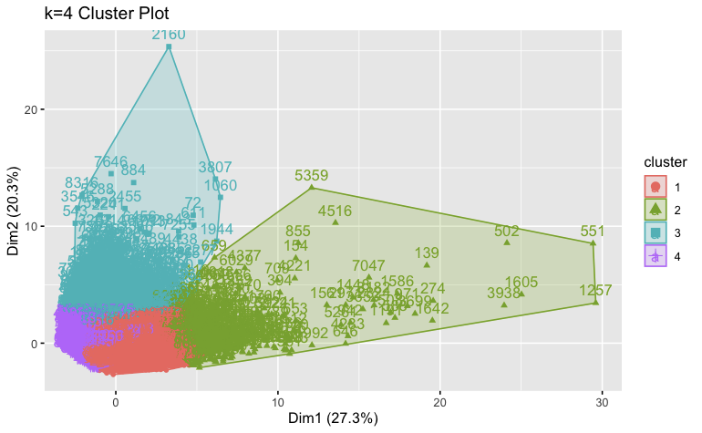
IST 707 – Data Analytics

Slide 18
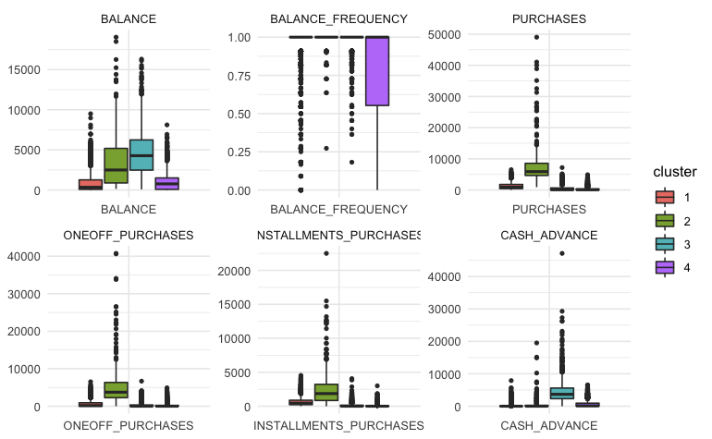
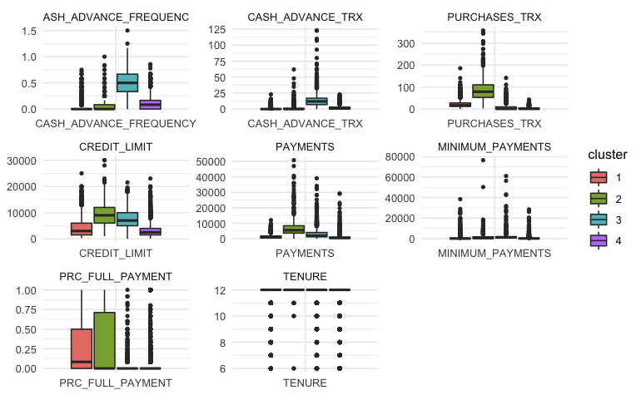
IST 707 – Data Analytics

Slide 19
IST 707 – Data Analytics
Reflection
This project was an extensive overview of the technical complexity that can arise in data science. It required thorough research in order to ensure the proper application of techniques were being utilized.
Another aspect which was a primary goal in the development of this project was the prioritization of privacy. Since this is classifying individuals based on their banking data, the last thing we would want is to have outcomes were our work was applied in an unethical manner.

Slide 20


Achievement of Learning Outcomes

Slide 21
1. Collect, store, and access data by identifying and leveraging applicable technologies
IST 659
Data was collected, stored, and managed in a relational database management system ingesting credit card transactions and acting as a ledger of points for the loyalty rewards system that banking partners have their cardholders use.
IST 707
Used the credit usage data of a banking institution’s cardholders and utilized machine learning models to segment such that each grouping has similar kinds of activity.

Slide 22
2. Create actionable insight across a range of contexts
IST 719
Showcasing a geographic distribution of Netflix titles to showcase not only the most popular countries, but to also showcase that the most utilized countries for producing titles are clustered tightly together. Which wouldn’t be easily discernable when examining this same data on a frequency table.
IST 707
Using k-means clustering, deciding the optimal number of clusters in which to separate the cardholders into. An optimal number that both minimizes the total variation within the sum of squares, while also keeping the count low in order to best communicate these results to the relevant stakeholders.
IST 659
Created stored procedures to produce stored reporting metrics that can be beneficial to all the relevant stakeholders. From the company behind this operation, to the banking clients, to the individual account holders.

Slide 23
3. Apply visualization and predictive models to help generate actionable insight
IST 719
Using textual analysis with interactive visuals to display the typical word choice used in describing movies or TV shows.
IST 707
Using k-means clustering, was able to generate 4 partitions of the bank’s cardholders where they had the following behaviors:
Frequent users of credit card with moderate tier of income, spending credit on lower priced goods, paying off majority of balance.
Frequent users of credit card with higher tier of income, spending credit on higher priced goods, paying off large majority of balance.
Infrequent users of credit card, take out multiple items on their line of credit. Should be closely examined to ensure no-default.
Infrequent users of credit card with a lower tier of income, spending their credit on lower priced consumer products.

Slide 24




4. Use programming languages such as R and Python to support the generation of actionable insight
IST 659
Microsoft Access
Microsoft SQL Server
IST 719
R
Python
Plotly
Adobe Illustrator
IST 707
R
Python

Slide 25
5. Communicate insights gained via visualization and analytics to a broad range of audiences
IST 659
Demonstrating the record activity visually as it was aggregated across the banking institutions.
IST 719
Showcasing complex data relationships through a geographic heat map and a word cloud to showcase the relative frequency of diction in media descriptions.
IST 707
After explaining the method behind segmenting the bank’s cardholders, we visualized the clustering with a plot to solidify why they were segmented in the way they ended up. This allowed us to also discern the kind of behaviors that represent a cluster of account holders.

Slide 26
6. Apply ethics in the development, use and evaluation of data and predictive models
IST 659
During SQL repeatable script that generates and ingests data sources, I incorporated into my SQL code to safeguard against SQL injection attacks. Additionally, ensuring that accounts are only able to access their own data and not that of other individuals.
IST 707
Since the context of our project was in financial banking data, we designed our project to not breach or encroach across ethical boundaries such as identifying specific individuals, asserting negative characteristics that may or may not impact their financial stability.

Slide 27
Conclusion
This Applied Data Science program has provided me a great opportunity to develop and refine my skills in all areas of the data science life cycle to best prepare me in my profession.
Through this program, I’ve discovered that we can always learn something that was previously unclear or unknown, and that we can always learn more about any situation or outcome.
Skills developed has developed a robust outline to asking the right questions about data and then executing the most proper solution plan for that context.
The concepts and methods learned through this Applied Data Science program equips myself, as a data scientist, the ability to break down and resolve various data questions and the contextual knowledge to communicate insights to stakeholders and technical analysts.

