Slide 1
Self-organization of orientation sensitive cells in the striate cortex.
von der Malsburg
presented by Eric Taylor

Slide 2
Functions of retina and cortex
Retina interprets images in a photographic way.
Cortex turns this geometrical image into a “space of concepts.”

Slide 3
Questions
Q: How does cortex process visual input?
A: Columns of neurons develop sensitivity
to specific orientations of light edges
Hubel and Wiesel (1962, 1963, 1968)
Q: How is this solution implemented?
Nature or nurture?
A: Nurture.

Slide 4
Findings from Hubel and Wiesel
  Neurons are selectively sensitive to light edges of certain orientation.
  Neurons are organized in “functional columns.”
  Neighboring columns respond to similar orientations.

Slide 5
Why tune to orientation?
Retinal fibers are most sensitive to changes in light intensity.
Greatest changes are the result of eye movements.

Slide 6
Goals for the model
Reproduce the results from work by Hubel and Wiesel
Accomplish this via learning
  Note: the model receives no corrective feedback.

Slide 7
Elements of the model
Two regions of cells:
  19 retinal cells (called “afferent fibers”)
  169 x 2 cortical cells
    169 excitatory cells
    169 inhibitory cells
Cells are connected via weights
  Weights could mean any of several things …

Slide 8
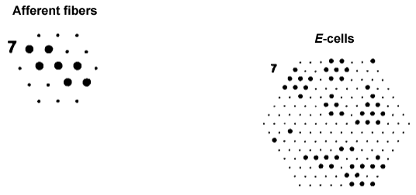
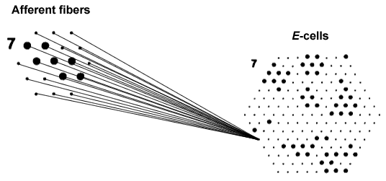
Wiring of the model

Slide 9
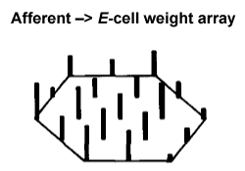
Wiring of the model

Slide 10
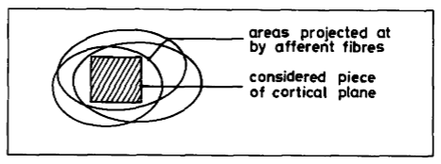
Wiring of the model

Slide 11
Wiring of the model
Initial weights set randomly
Sum of weights is constant
x
=
weight connecting afferent i and cortical k

Slide 12
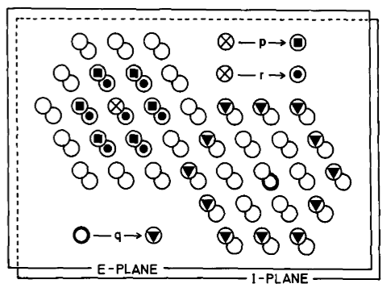
Wiring of the model
E –> E
immediate neighbors
E –> I
immediate neighbors
I –> E
next-to-immediate neighbors
I –> I
none
E = excitatory cortical cell
I = inhibitory cortical cell

Slide 13
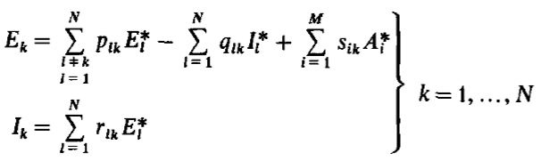
Signals and activation equations in a steady state
if
Signals:
otherwise
same but with I

Slide 14
Summary of the model
19 afferent fibers (retina)
169 E-cells, 169 I-cells (cortex)
Afferent fibers project to all E-cells
E-cells project to E-cells and I-cells
I-cells project to E-cells only
E-cells activation based on afferent, E-cells, and I-cells
I-cells activation based only on E-cells
Signal is activation exceeding threshold

Slide 15
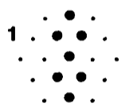
Simulation without learning
Clamp afferent cells for stimulus S at A_{i}* = 1
Solve for E_{k} , I_{k} at time t
repeat 20 times
for each S in fixed sequence
Solution from 20th step displayed in results

Slide 16
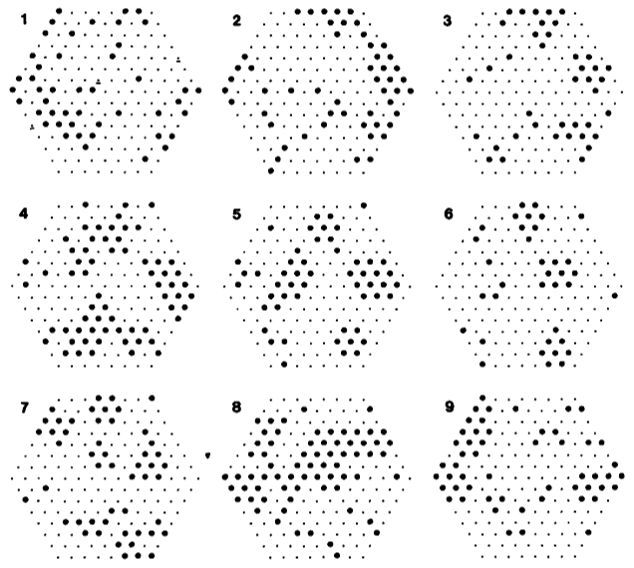
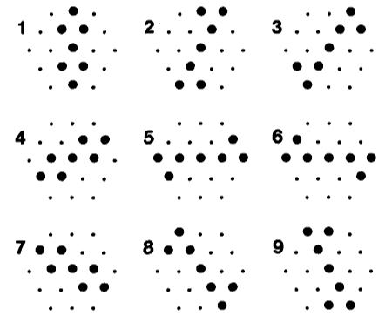
Results without learning
don’t show them yet
cortex
stimuli

Slide 17
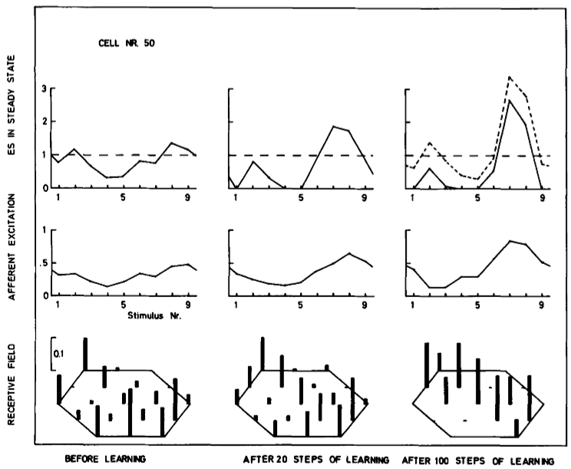
Results without learning

Slide 18
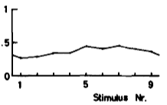
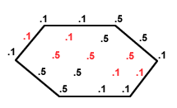
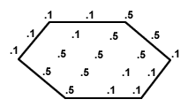
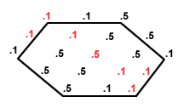
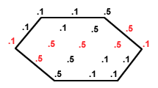
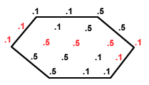
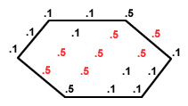
Continuous afferent excitation function
4
.
afferent to cortical weights s_{ik}
.
.
.
2I
.

Slide 19
Simulations with learning
Clamp afferent cells for stimulus S at A_{i}* = 1
Solve for E_{k} , I_{k} at time t
repeat 20 times
Update afferent to cortical cell weights s_{ik}
for each S in fixed sequence

Slide 20
Simulations with learning
Clamp afferent cells for stimulus S at A_{i}* = 1
Solve for E_{k} , I_{k} at time t
repeat 20 times
Update afferent to cortical cell weights s_{ik}
for each S in fixed sequence
Solution from 20th step displayed in results
This procedure repeated for a total of:
20 times
100 times
(two sets of results)

Slide 21
Learning algorithm
1.
= old weight
= updated weight
h = learning rate
2.
Normalize all

Slide 22
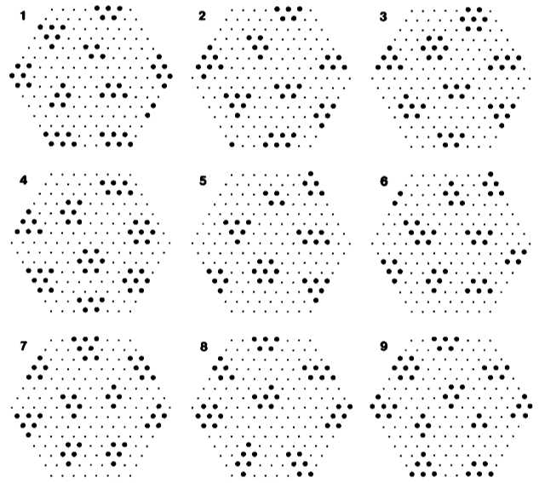
Results with 100 trials of learning
cortex
stimuli

Slide 23
Results with 100 trials of learning

Slide 24
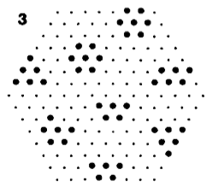
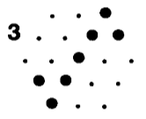
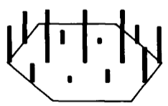
Cell NR. 120 stimulus 3
cortex
stimulus to cortex
stimulus
weights

Slide 25
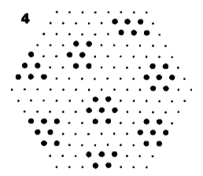
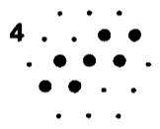
Cell NR. 120 stimulus 4
cortex
stimulus to cortex
stimulus
weights

Slide 26
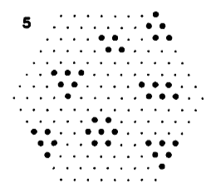
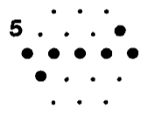
Cell NR. 120 stimulus 5
cortex
stimulus to cortex
stimulus
weights

Slide 27
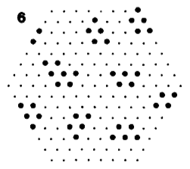
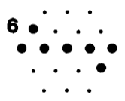
Cell NR. 120 stimulus 6
cortex
stimulus to cortex
stimulus
weights

Slide 28
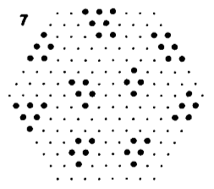
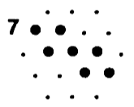
Cell NR. 120 stimulus 7
cortex
stimulus to cortex
stimulus
weights

Slide 29
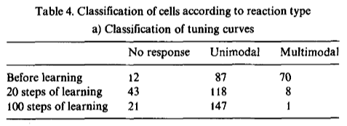
Tuning curves

Slide 30
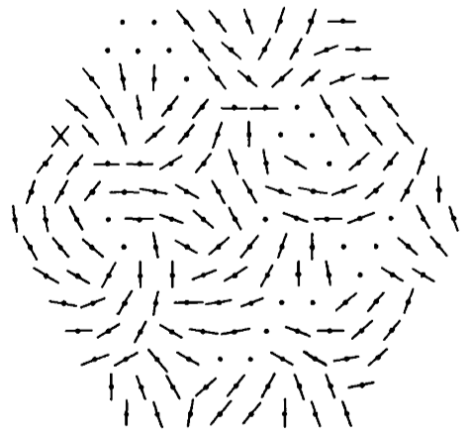
Optimal orientation per cell

Slide 31
Summary of modeling results
Cortical activation organized by clusters
Orientation specific units brought about via learning (not genetic determination)
Neighboring cells tuned to similar stimuli

Slide 32
Experimental simulations
Non-standard stimuli
  An experienced model shows graded activation to similar but untrained stimuli
Non-specific input
  Model is robust to noisy stimuli
Redundancy of information
  Model recovers from local disruptions

Slide 33
Conclusions
Nurture is a plausible explanation for cortical clustering
Model also demonstrates graded activation and is robust to noisy stimuli and local disruptions
Good job, von der Malsburg!
  Now get back to work.

