Slide 1
Reducing the Process of Counting Quantities in Images Using AI
#AH015
ELITE CODERS:
ARJUN SINGH
ANSHIKA SHUKLA
JOSHUA HANIEL

Slide 2
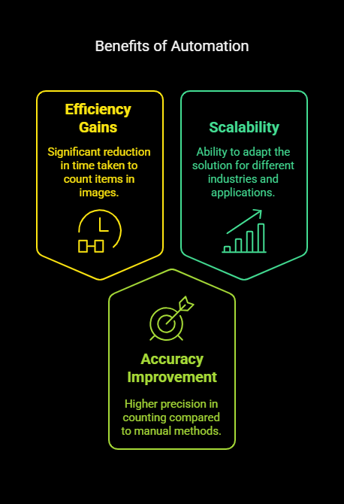
Object Detection Overview
Object detection is a computer vision technique used to identify and classify multiple objects within an image or video. The technology has applications in fields such as security, autonomous driving, and more.
Importance of YOLO Models: The "You Only Look Once" (YOLO) family of models is renowned for its high speed and accuracy in real-time object detection. YOLO models process entire images in one pass, making them extremely efficient.
Why YOLOv8? YOLOv8 is the latest and most advanced version, offering:
Better performance compared to earlier models.
More flexibility for various input sizes and types.
Optimized for both images and video streams.

Slide 3
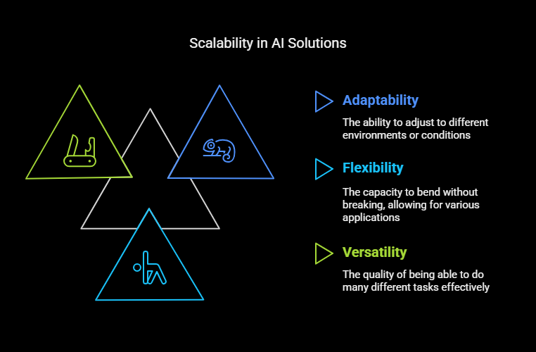
Proposed Solutions
Model Optimization:
Use of lighter models (e.g., MobileNet, YOLOv5) for faster inference.
Quantization and pruning techniques to reduce model size.
Batch Processing:
Process multiple images simultaneously to optimize the pipeline.
Region of Interest (ROI) Selection:
Focus only on relevant areas of the image to reduce unnecessary computations.

Slide 4
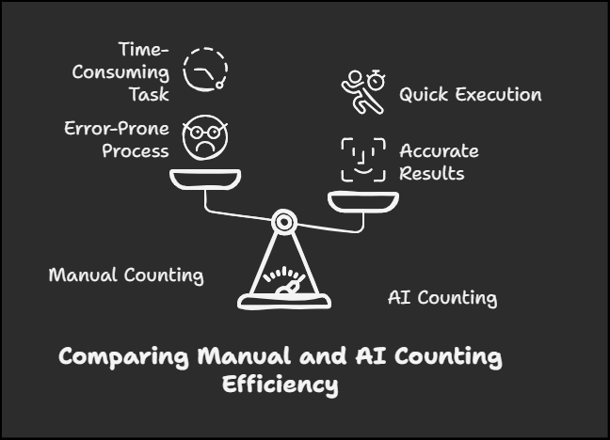
TECHNIQUES FOR SPEEDING UP
Model Compression: Reduce model size using quantization and pruning.
Parallel Processing: Utilize multi-threading and GPU acceleration.
Cloud-based APIs: Leverage services like Google Cloud Vision API for fast, scalable processing.

Slide 5
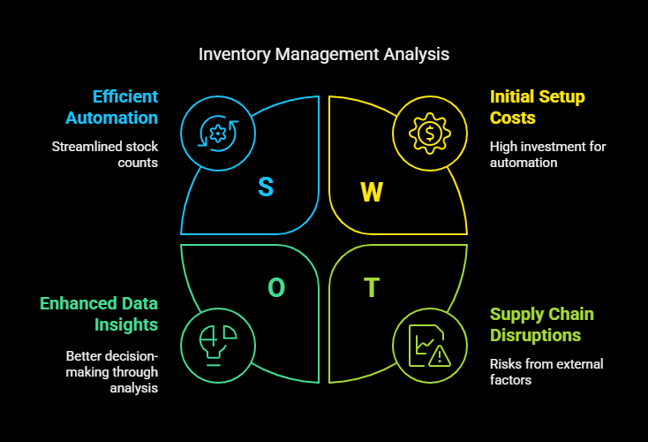
Use Cases
Retail Inventory Management: Automating stock counts for better inventory control.
Manufacturing Quality Control: Ensuring product counts meet production standards.
Research and Analysis: Streamlining data collection for studies requiring item counts.

Slide 6
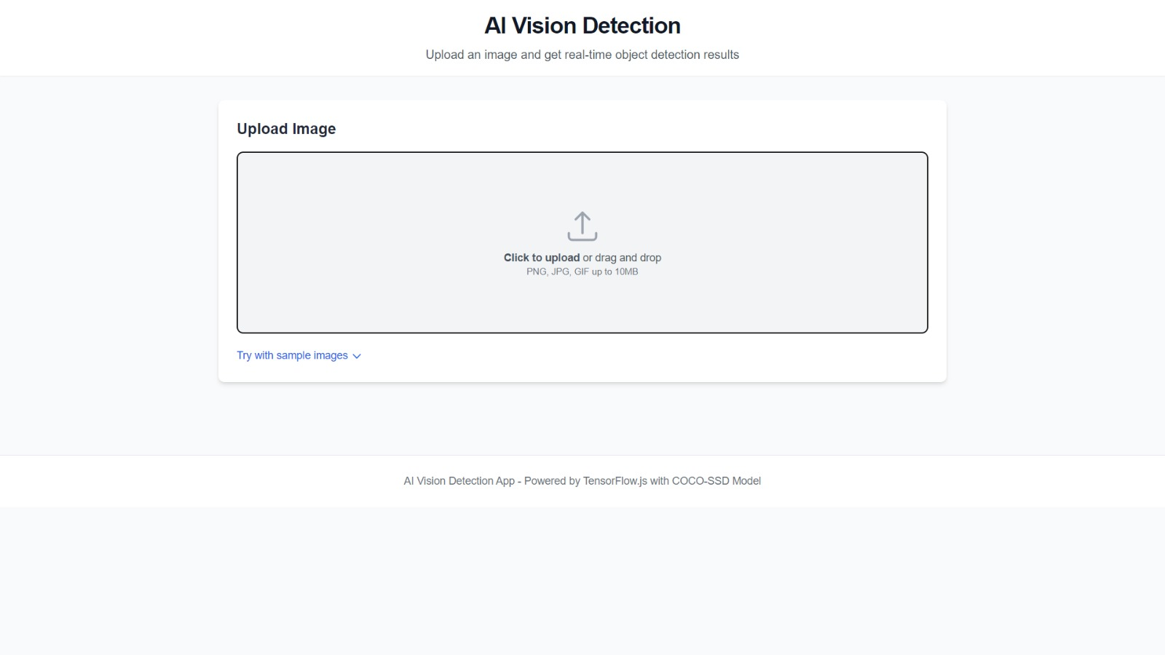
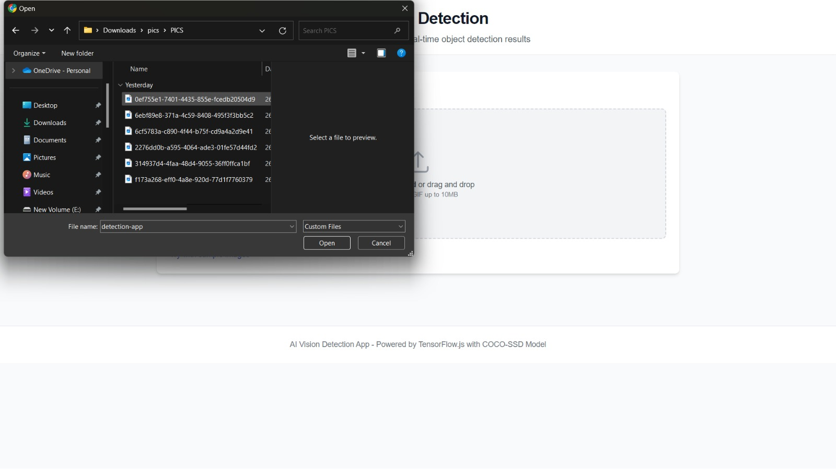
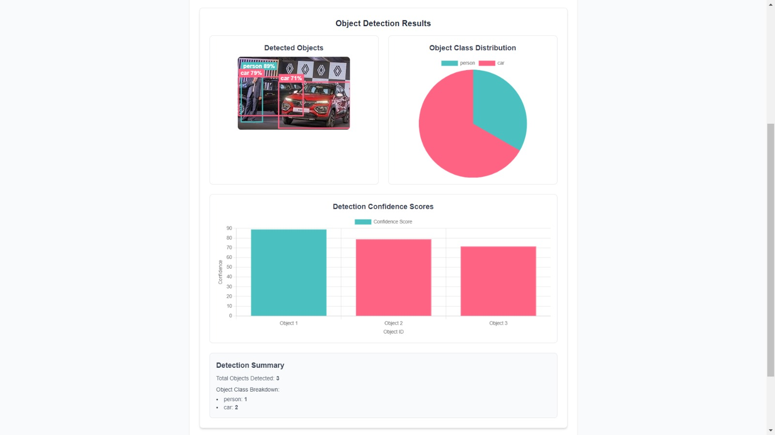
Work Flow

