Slide 1


Slide 2
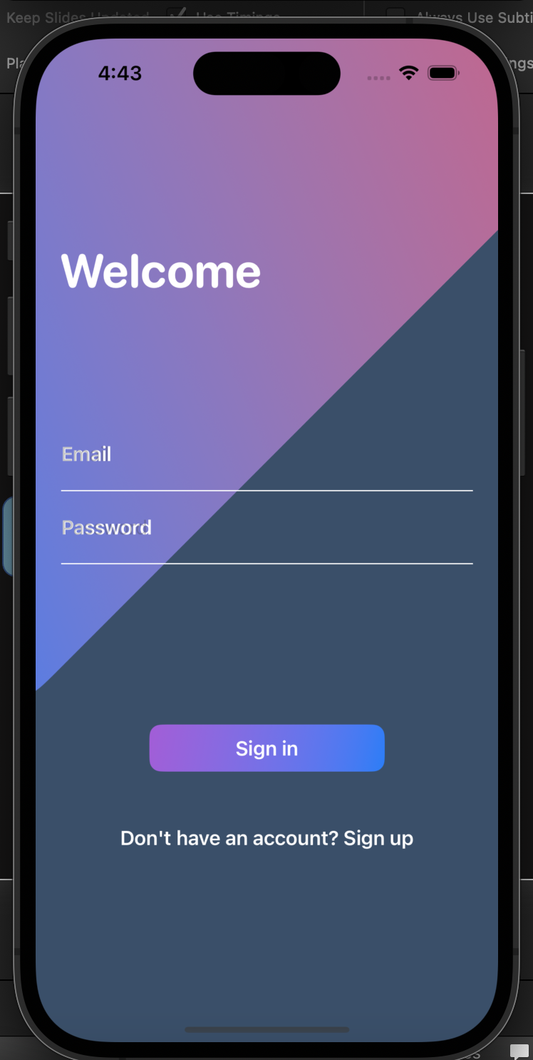

Slide 4
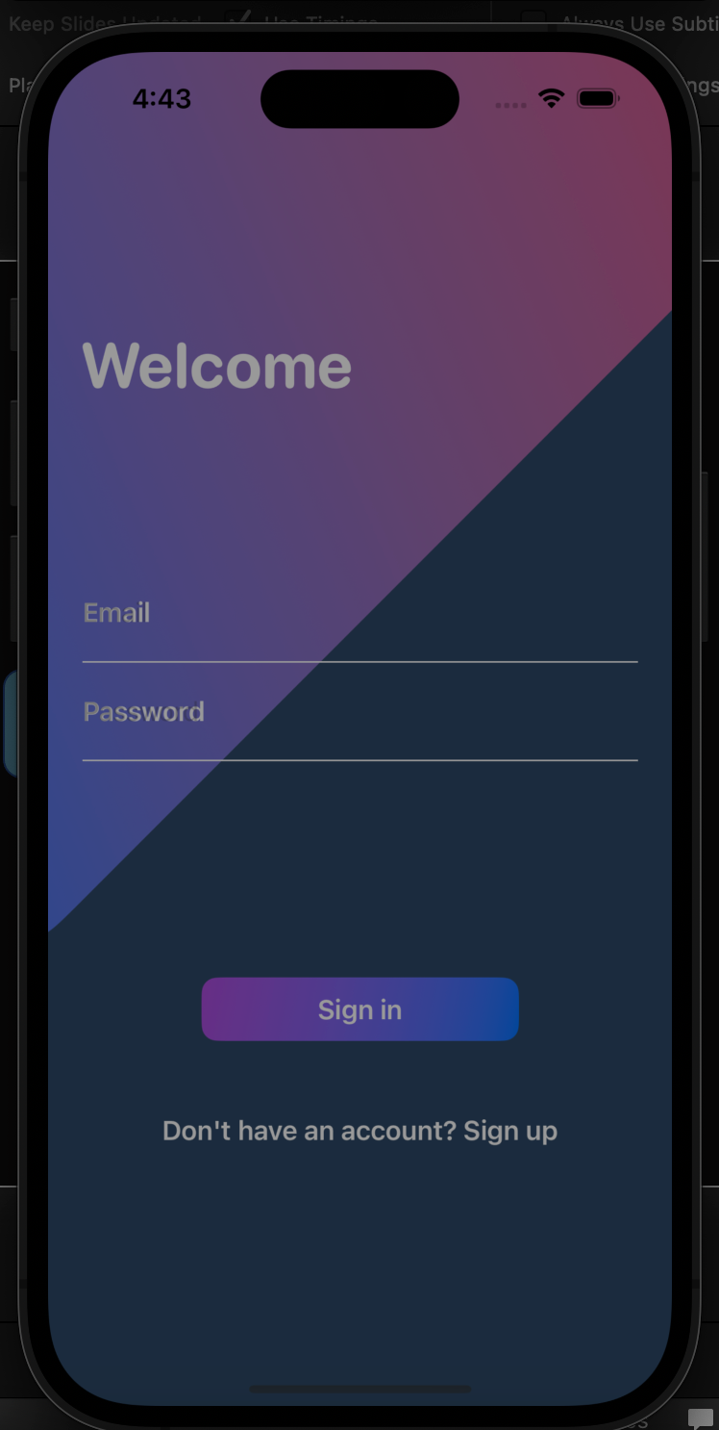
Functionality
• Point one
• Point two
• Point three

Slide 5
Functionality
• Point one
• Point two
• Point three

Slide 6
Functionality
• Point one
• Point two
• Point three

Slide 7
Functionality
• Point one
• Point two
• Point three

Slide 8

Functionality
Practicality
• Point one
• Point two
• Point three
• Point one
• Point two
• Point three

Slide 9
Functionality
Practicality
• Point one
• Point two
• Point three
• Point one
• Point two
• Point three

Slide 10
Functionality
Practicality
• Point one
• Point two
• Point three
• Point one
• Point two
• Point three

Slide 11
Functionality
Practicality
• Point one
• Point two
• Point three
• Point one
• Point two
• Point three

Slide 12


Slide 13
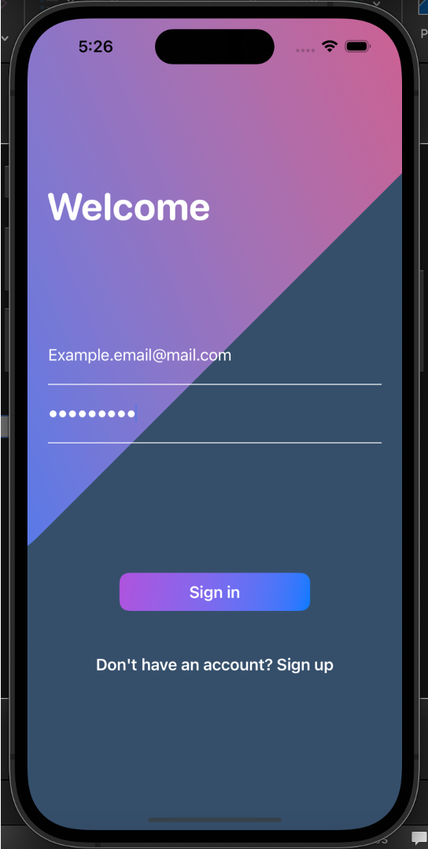

Slide 14
