Slide 1

Digital portfolio
DIGITAL PORTFOLIO STUDENT NAME: Joshua prem kumar.j REGISTER NO AND NMID: 32324090728 & astvu3233232409028 DEPARTMENT: BCA COLLEGE: Voorhees College/Thiruvalluvar University

Slide 2
Agenda
AGENDA: 1. Problem Statement 2. Project Overview 3. End Users 4. Tools and Technologies 5. Portfolio design and Layout6 6. Features and Functionality 7. Results and Screenshots 8. Conclusion 9. Github Link

Slide 3
Problem statement
1. Problem Statement Students often lack a professional medium to present their projects. Resumes alone are not interactive or visually appealing. A digital portfolio bridges this gap by allowing projects, skills, and achievements to be showcased online. It solves the problem of limited visibility for recruiters and potential collaborators.

Slide 4
Project Overview
2. Project Overview Developed a responsive personal portfolio using HTML, CSS, and JavaScript. Provides sections like Home, About, Projects, and Contact. Designed to adapt to different devices (desktop, tablet, mobile). Focuses equally on visual design and user-friendly functionality.

Slide 5
End users
3. End Users Students – to highlight academic and personal projects. Recruiters/Employers – quick access to candidate’s skills and contact details. Peers/General audience – learn about the Developer’s journey and technical growth

Slide 6
Tools and techniques
4. Tools and Technologies HTML5 ← Content structuring (headings, paragraphs, forms). CSS3 Styling (colors, layouts, media queries for responsiveness). JavaScript (ES6)→ Dynamic behavior (menu toggle, smooth scroll, interactivity). GitHub → Version control, project backup, and live hosting with GitHub Pages.

Slide 7
Portfolio design and layout
5. Portfolio Design and Layout Header & Navbar – sticky navigation with a collapsible mobile menu. Hero Section professional intro with name, tagline, and background image. About Section – personal profile, education, and background details. Projects Section grid layout with hover effects showcasing different works. Contact Section – clickable email and phone for instant communication.

Slide 8
Featured and functionality
6. Features and Functionality Fully responsive design adapts to desktop, tablet, and mobile. Interactive navigation menu smooth scrolling and menu toggle. Project showcase with hover effects improves Ul experience. Clickable contact links – direct call or email with a single click. Lightweight and fast-loading website ensures better user engagement.

Slide 9
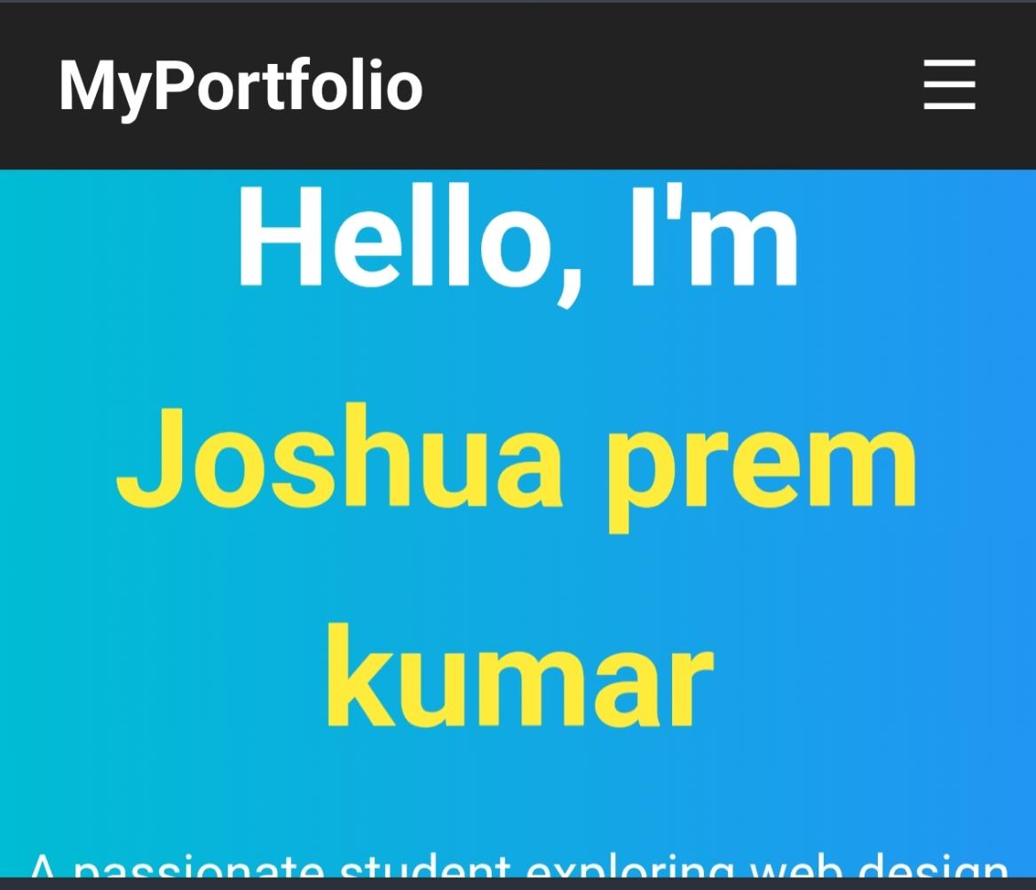
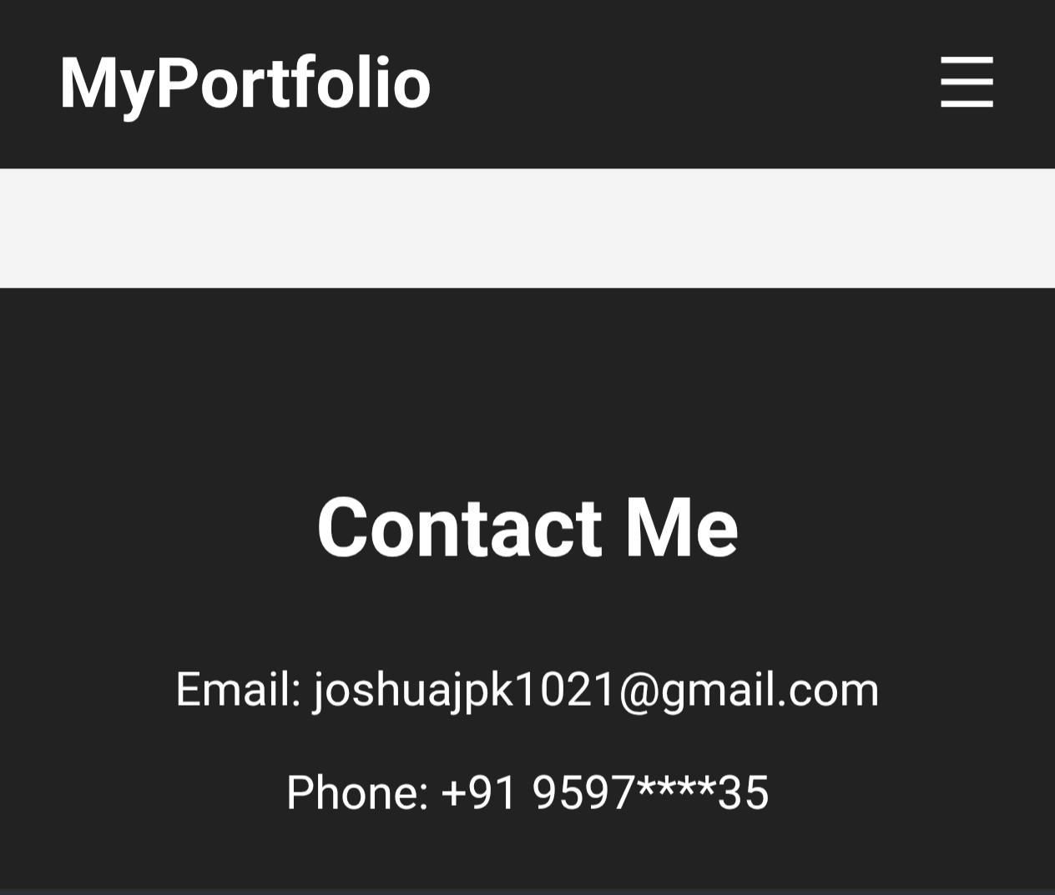
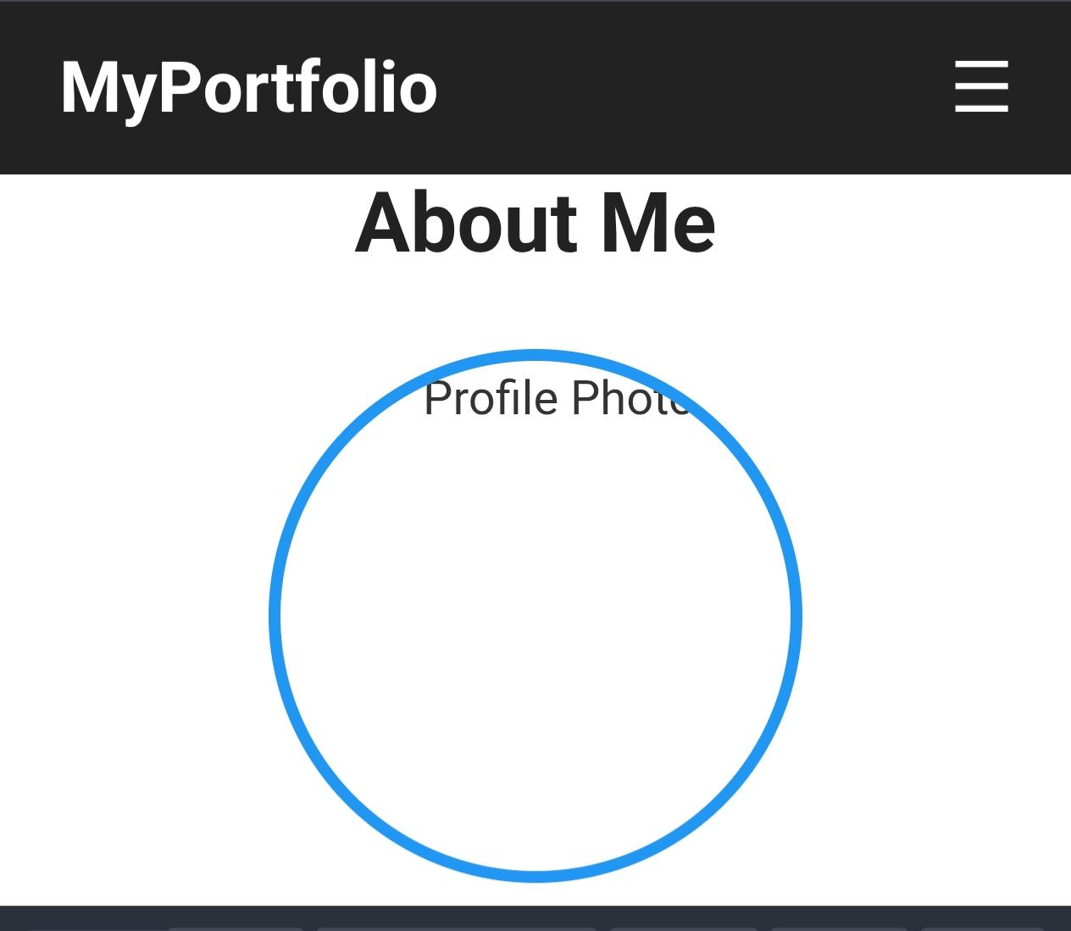
Sample screen shot

Slide 10
Conclusion
CONCLUSION My profile The portfolio website provides a professional platform to highlight skills and projects. It demonstrates the use of fundamental web technologies and serves as a foundation for more advanced web development.

