Slide 1
Normalizing ‘Jejemon’ text using a modified mapping
of the Soundex Algorithm
A Special Problem
Presented to the Faculty of the
Institute of Computer Science
University of the Philippines Los Baños
Joshua Karl T. Madronio
Prof. Vladimir Y. Mariano
April 2013

Slide 2
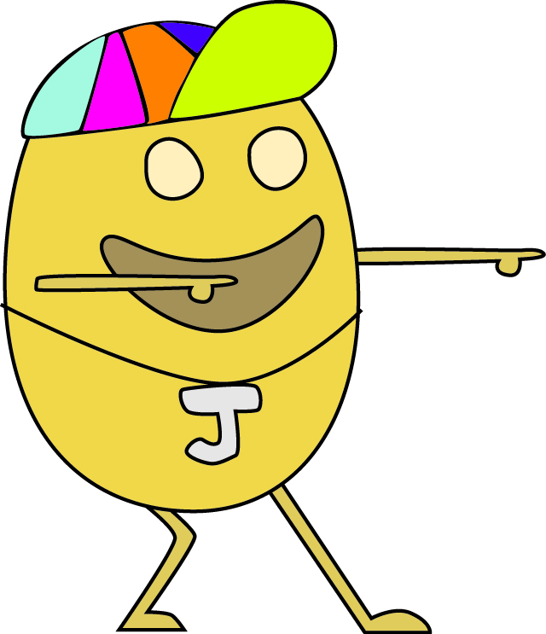
Aa -> 4a
Bb -> bb
Cc -> cc
Dd -> DD
Ee -> 3e
Ff -> ff
Gg -> 6g
...
Jejemon, Jejenese, & Jejebeth
Ha1xT! Nk2InisH m6A p3ePz dT0 s SKooL! 1NaZ4R
N!LaH qoH, J3J3m0N dEw kx3 qoH! ;(
SMS texts (categorized as mild) : i2 ay 1 txt msg.subrang onti lng dpat ng chars q.

Slide 3
SMS texts
Twitter (Guillermo, 2010)
Spread to forums, blogs, instant messages,
comments, and so on.

Slide 4
What will happen to:
Data miners
Website indexers
Translation machines
Topic generators
Keyword searchers (Internet ads)
Filters
and other automated systems
when they encounter, for example, the input
“Hl0w pHuwZ! kMuXt4H naH?”
or “Bkt b kc klngaan png mgxmple?”

Slide 5
General objective: To develop an effective way of normalizing Jejemon text using a modified Soundex mapping.
Specific objectives:
1. To define rules for getting the phoneme sequence of a Jejemon text;
2. To develop a pronunciation dictionary, and modify the Soundex mapping; and
3. To assess the efficacy of the developed approach by computing the
distance of the input with the output using word error rates (WER).

Slide 6
Limitations
1. Focuses only on Filipino
2. Normalization of syntax only (no grammar, context, out-of-vocabulary words)
3. Hopes to effectively normalize Jejenese up to the moderate degree (including SMS texts)

Slide 7
Methodology
1. Accumulation and definition of grapheme-to-phoneme rules.
2. Building of a Filipino phonetic dictionary with a modified Soundex code.
3. Normalization.

Slide 8
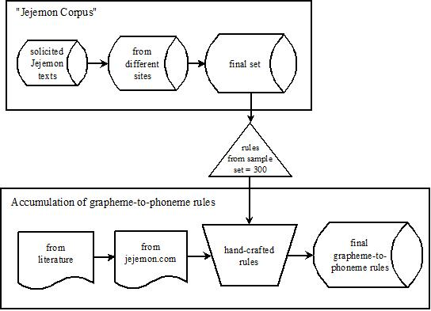
Methodology: Accumulation of grapheme-to-phoneme rules

Slide 9
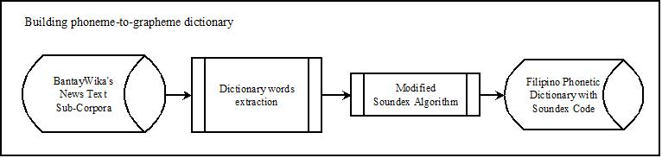
Methodology: Building of a Filipino phonetic dictionary with modified Soundex code

Slide 10
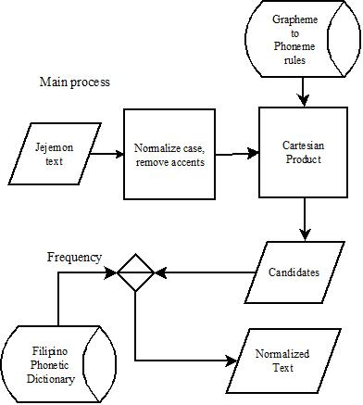
Methodology: Normalization

Slide 11
Results
143, 269 entries to the Filipino Phonetic Dictionary
From 206, 705 sentences in the BantayWika Text News Sub-Corpora
251 Jejemon sentences from the Internet

Slide 12
Problems encountered by the approach
Problem | Example
‘Jejenized’ English words* | gud nYtz!
Syllable truncation | wa for wala
Letter truncation | ndi for hindi
OOV words* | IV-A
Proper nouns* | Batong Malake St.
Word concatenation | palng for pa lang
Dictionary noise | Entries like mu
*limitation of the study

Slide 13
Fin.
Thank you

