Slide 1
Worthy DRAFT pick or bust? (WR edition)
JOSHUA KONG – DATA SCIENTIST
DATE: TODAY

Slide 2
agenda
CONTEXT
DATA
INTERPRETING COEFFICIENTS
DIFFERENT MODELS
LIMITATIONS & NEXT STEPS
CONCLUSION

Slide 3
I. CONTEXT
DRAFT PICK
WORTHY OR BUST DESIGNATION
COMBINE
FEATURES

Slide 4
FEATURES
games_played
rec_col’
rec_yds_col
ypr_col
rec_td_col
rush_attempts
rush_yds
ypc
rush_td
worth
age_x
taller_six
weight
drafted
invited
power_five

Slide 5
II. DATA
WEBSCRAPE
COLLEGE STATS, NFL STATS, COMBINE STATS
PLAYERS WITH ALL THREE & WR
WHITTLED ~450 PLAYERS DOWN TO ~20 PER YEAR
ISSUES
MISSING DATA, INCONSISTENT PLAYER NAMES

Slide 6
WR1 VS. WR2
FEATURES | WR1 | WR2
HEIGHT | 5’11” | 6’3”
WEIGHT | 198 | 215
FORTY | 4.38 | 4.35
GAMES | 13 | 13
REC | 59 | 109
REC YARDS | 1152 | 1447
REC TD | 8 | 10

Slide 7
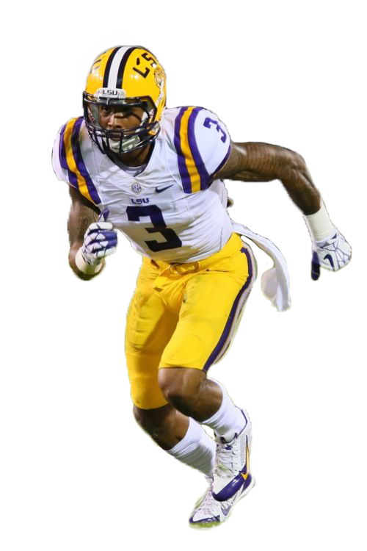
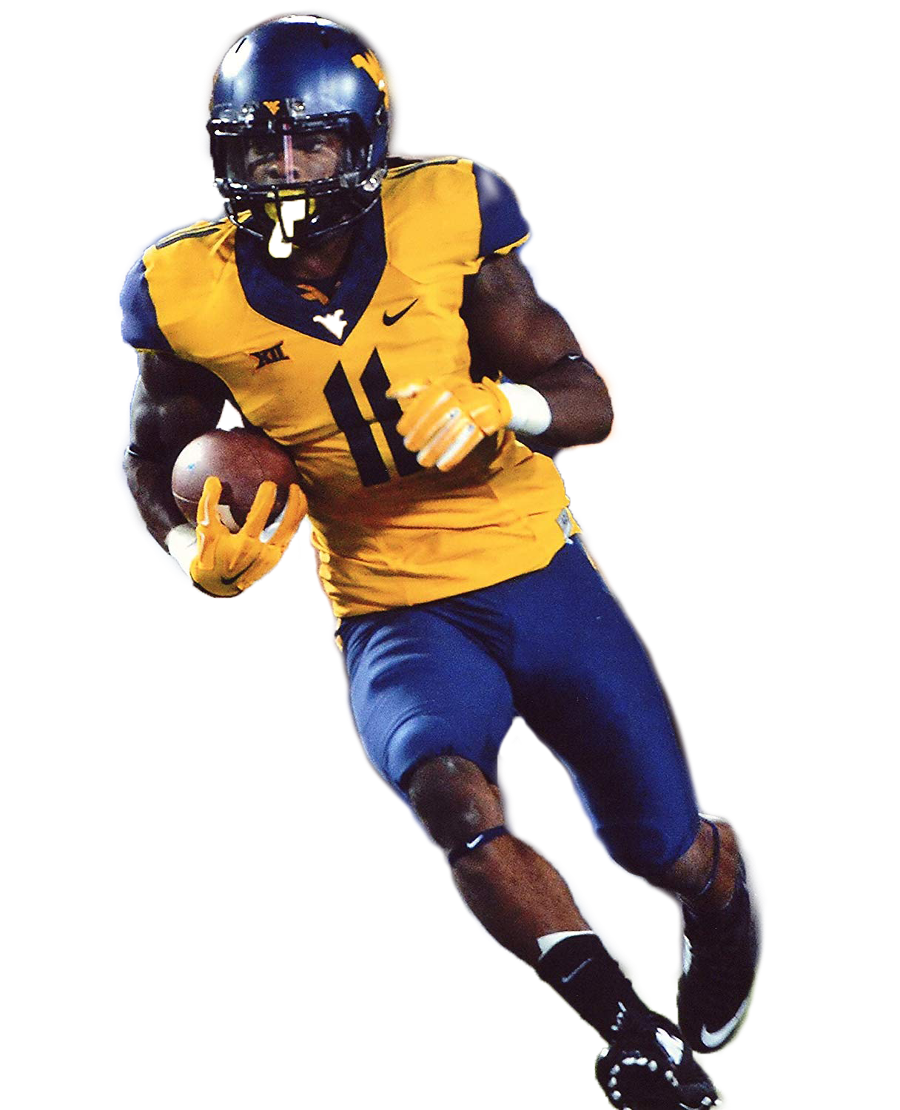
WR1 VS. WR2
PHOTO EDITS BY VIVIAN PENG (https://www.vivianpeng.com/)

Slide 8
WR3 VS. WR4
FEATURES | WR3 | WR4
HEIGHT | 5’11” | 6’3”
WEIGHT | 194 | 212
FORTY | 4.42 | 4.57
GAMES | 12 | 13
REC | 74 | 56
REC YARDS | 1363 | 781
REC TD | 20 | 9

Slide 9
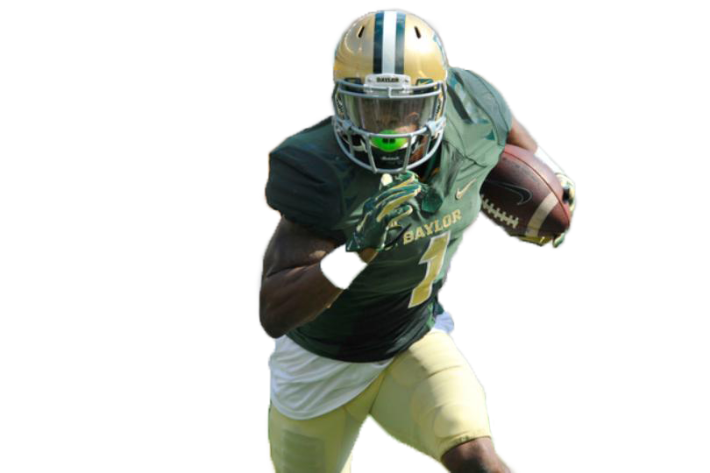

WR3 VS. WR4
PHOTO EDITS BY VIVIAN PENG (https://www.vivianpeng.com/)

Slide 10
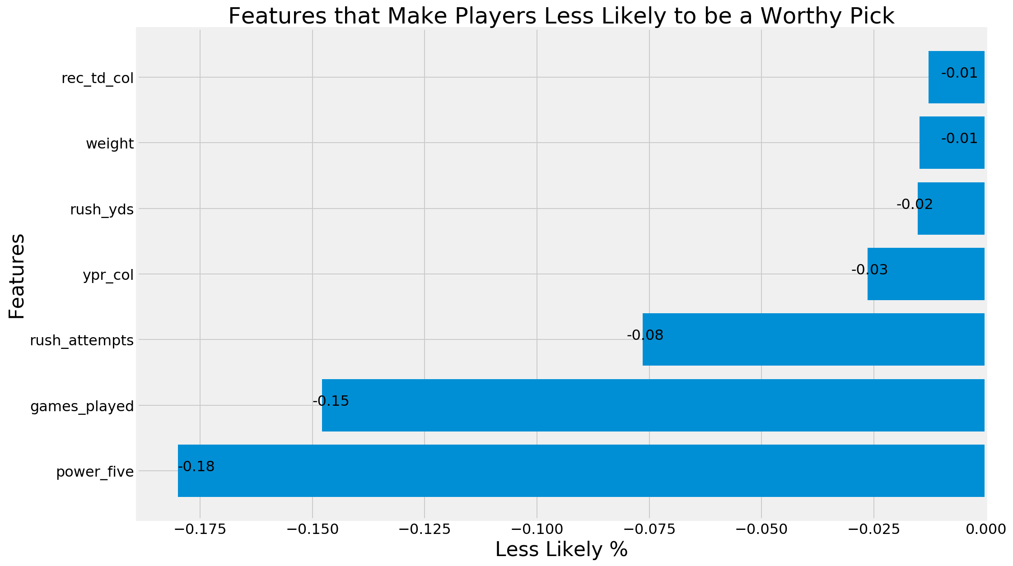
III. Interpreting coefficients

Slide 11
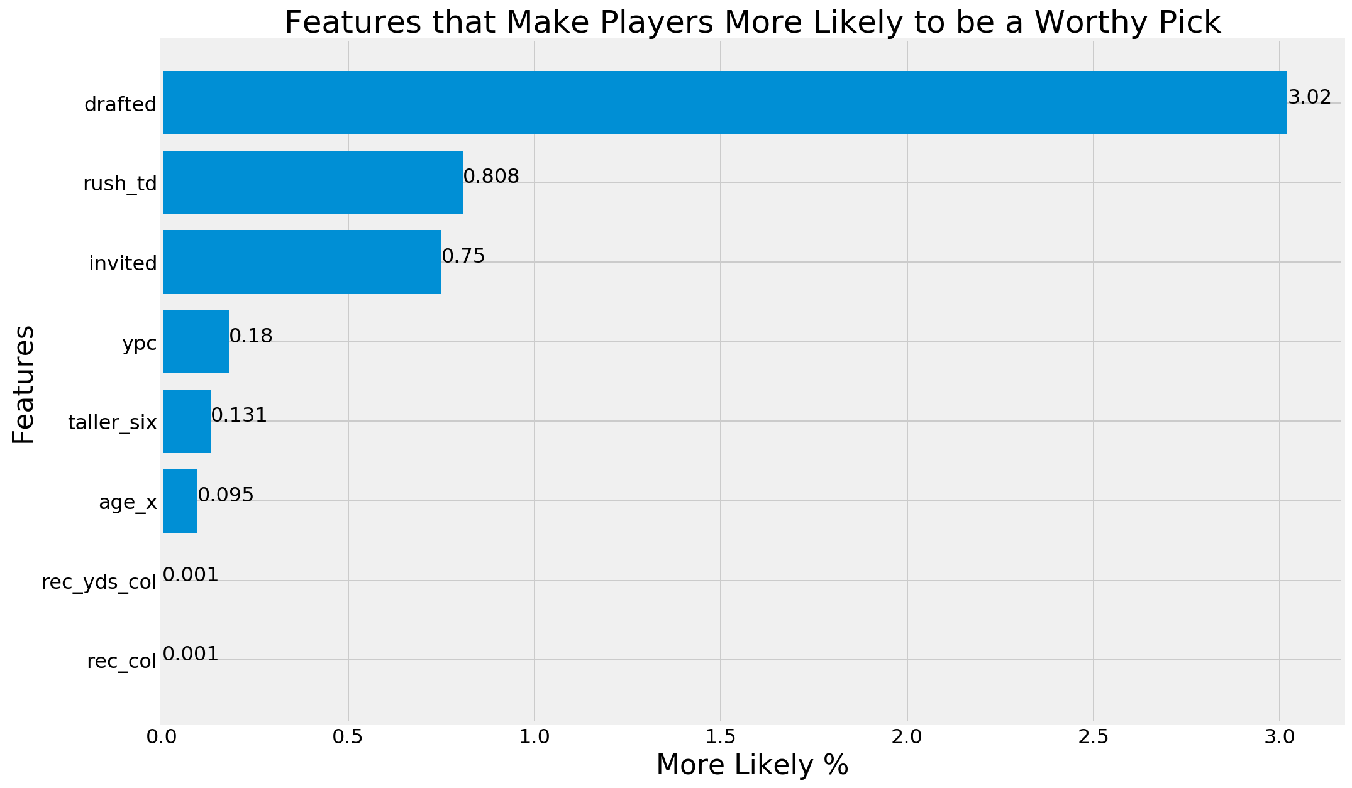
III. Interpreting coefficients

Slide 12
IV. Different models
FEATURES | TRAIN ACC. SCORE | TEST ACC. SCORE | TRUE POSITIVES
LOG. REG. | 76% | 68% | 1
KNN | 69% | 79% | 2
BDT | 98% | 53% | 0
SVC | 69% | 74% | 0
Interpretability extremely important
Baseline: 70% IF EVERYONE PREDICTED AS BUST
DIFFERENT ITERATIONS OF BDT PRODUCED GREAT SCORES

Slide 13
V. Limitations & NEXT STEPS
NOT ALL PLAYERS INVITED TO COMBINE
LIMITED ACCESS TO ADVANCED STATS
LIMITED TRAINING
ORDINAL INJURY FEATURE
INTERACTION TERMS
NOT ALL CONFERENCES TRACKED
GRIDSEARCHING HYPERPARAMETERS
Replace Drafted with projected draft round
nlp model where scouts' analyses on players become features
Notes:
(can use that information to determine whether a player will be drafted or not)

Slide 14
VI. CONCLUSION
DRAFTING PROCESS STILL VERY MUCH A CRAPSHOOT
IDENTIFIED A FEW HELPFUL COEFFICIENTS CONTRIBUTING TO BEING A WORTHY PICK
ADVANCED ANALYTICS CAN GIVE EDGE IN DRAFTING PROCESS

