Slide 1
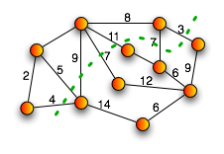

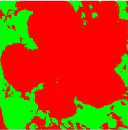
Parallel Max-Flow Min-Cut
Joshua Lee and Mona Huang

Slide 2
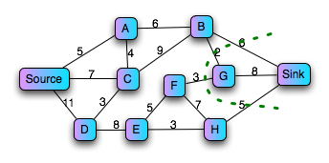
What is Max-Flow Min-Cut?
The maximum flow is the maximum amount of capacity that can pass from the source to the sink
The minimum cut is the set of edges with the smallest aggregate weight that can be removed from the graph so that no path exists from the source to the sink
Max Flow: 16
Max Flow = Min Cut

Slide 3
Motivation
Image Processing
Graph models can get very large
Standard DSLR: 18 mega pixels
Simple Graph Model:
~18 million vertices
~150 million edges
~2 GB file
Parallelizing can lead to speed ups and MFMC solutions for large graphs that do not fit in memory

Slide 4

Challenges
Major Challenges of Parallelization:
Distributing graph between processes
Avoiding capacity constraint violation from multiple updates
Finding augmenting paths from the source to the sink without giving each processor a complete view of the graph
Maintaining a high level of parallelizable computation

Slide 5


Parallelizing Max-Flow Min-Cut
Map Reduce
Each process responsible for single vertex and its neighbors
Master reducer responsible for accepting full paths
Accumulator data structure
Delayed updates to edges
MPI
Master/Slave
Each slave responsible for finding a path from s to t
Master responsible for validating paths

Slide 6
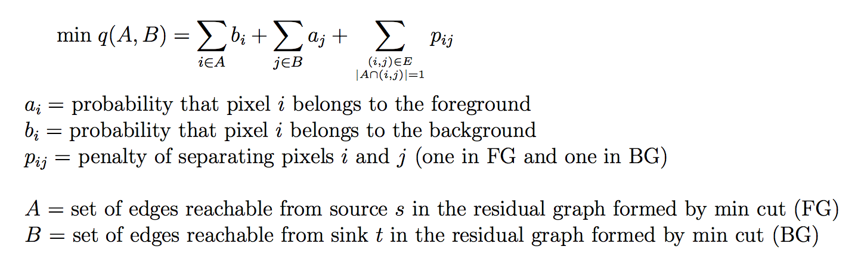


Image Segmentation
Image Converter
M/R
Max-Flow

Slide 7
Thanks for Watching!
Website: http://people.seas.harvard.edu/~joshlee/

