Slide 1
NBA Stats
Yiannis Karydis | Nicola Cisbani | Joshua Lee

Slide 2
Use Case
Read Action:
As a user, I want to view information based on a specific action (like a specific player stat, the list of last year awards, ...).
Given the input action, the Application accesses the DB tables and returns the information.

Slide 3
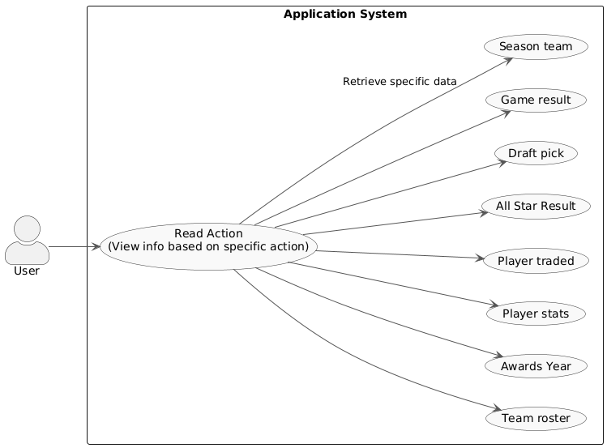
UML Diagram

Slide 4
Use Case
Write Action:
Update Player Roster Mid-Season: As administrator, I want to update a player's team in the database so I can accurately track their tenure and stats following a trade.
Given the Admin initiates a roster change (an INSERT into DB), if the admin is not logged in, the System prompts for a password to grant write privileges.

Slide 5
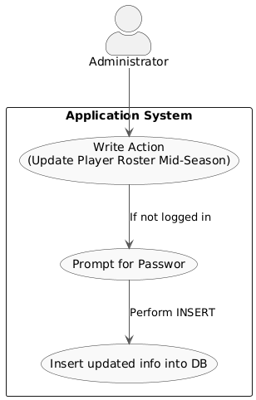
UML Diagram

Slide 6
Entities
Player: This table would contain basic information about players, such as their height, weight, college, and birth date. Data for this table would come from files like Player Career Info.csv.
Team: This table would hold information about each team, including full names, abbreviations, city, and home arena. Information would be derived from files like Team Abbrev.csv or Team Summaries.csv.
Season: This table would list all league seasons with their start and end years. It would serve as a support table to link player and team stats to a specific season with Player Season Info.csv.
Game: This table would include details about each individual game, such as the date, final scores, and the teams that played. Data could be obtained from Game.csv or game summary files.

Slide 7
Entities
Draft Pick: This table would record a player's draft history, including the draft year and their selection number. The data would come from the Draft Pick History.csv file.
All-Star Selection: This table would record every instance a player was selected for the All-Star Game, specifying the year. Information would be derived from the All-Star Selections.csv file.
Award: This table would list the different league awards (e.g., MVP, Rookie of the Year). Data could be extracted from the Player Award Shares.csv file.
Player Stats: This is an associative table that links Players to Seasons. It would contain a player's detailed statistics for a given season, such as points, rebounds, and assists. Information would come from files like Player Per Game.csv or Player Totals.csv.

Slide 8
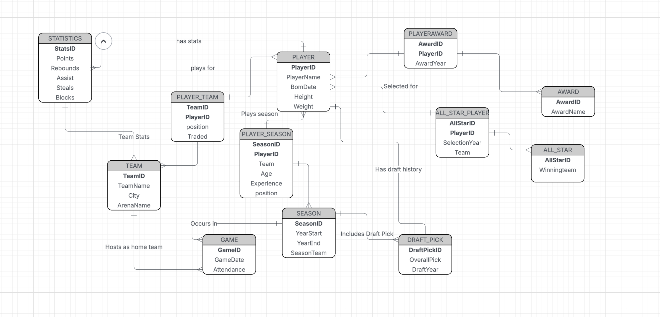
E/R diagram

Slide 9
E/R -> relations
Player(PlayerID, PlayerName, BornDate, Height, Weight)
Team(TeamID, TeamName, City, ArenaName)
Season(SeasonID, YearStart, YearEnd)
Game(GameID, GameDate, Attendance, SeasonID→Season, HomeTeamID→Team)
PlayerTeamSeason(PlayerID→Player, TeamID→Team, SeasonID→Season, StartDate, EndDate) PK = (PlayerID, TeamID, SeasonID)
Draft_Pick(DraftPickID, OverallPick, DraftYear, PlayerID→Player, SeasonID→Season)

Slide 10
E/R -> relations
All_Star(AllStarID, SelectionYear, SelectionType, PlayerID→Player)
Award(AwardID, AwardName)
Player_Award(PlayerID→Player, AwardID→Award, AwardYear) PK = (PlayerID, AwardID, AwardYear)
PlayerGameStats(StatsID, Points, Rebounds, Assists, Steals, Blocks, GameID→Game, PlayerID→Player) UNIQUE(GameID, PlayerID)
TeamGameStats(StatsID, Points, Rebounds, Assists, Steals, Blocks, GameID→Game, TeamID→Team) UNIQUE(GameID, TeamID)

